Slide 1
Academic Life & Skills
Lecture 2
November 2019

Slide 2
Begin with the end in mind – have a plan
I plan ahead and set goals.
I do things that have meaning and make a difference.
I am an important part of my classroom and contribute to my school’s mission and vision.
I look for ways to be a good citizen.
I plan now what I want to do and be later in life.
I am a go-getter instead of a daydreamer.
I am in control of my future, not someone else.
I say “no” to things that may get in the way of my long-term goals.
I do the things I need to do now to help me get to where I want to go later.

Slide 3
Don’t let failure get in your way of success
Albert Einstein was not able to speak until he was almost 4 years old. His teachers said he would “never amount to much”. | The Beatles were rejected by a record company who said “we don’t like their sound. They have no future in show business.”
Walt Disney was fired from a newspaper for “lacking imagination” and “having no original ideas”. | Oprah Winfrey was demoted from her job as a news anchor because “she wasn’t fit for television”.
Michael Jordan was cut from his high school basketball team. | Beethoven’s music teacher once told him that he was a hopeless composer.

Slide 4
You can do anything- just try
https://www.youtube.com/watch?v=JC82Il2cjqA

Slide 5
Discussion
What is “the end” for you?
What do you hope to be doing in 5 years?
10 years?
20 years?
ACTIVITY
Make a list of things you want to do in your life.

Slide 6
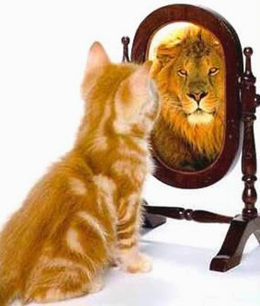
Before you figure out the “end”, you have to take a look at who you are and where you are now!
Activity
Draw a picture of something that represents you. It could be an animal, plant, machine, a food, etc. Explain why you chose what you did.

Slide 7
discussion
In 10 years, a newspaper decides to do a story about YOU! They interview 4 people who know you. These could be friends or family. What would you want them to say about you?

Slide 8
Mission statement, part 1:
Write your name in a circle. Out from the circle, write words that describe you.
Compassionate
Musical/artistic
Azad
Hard working
Passionate
Cares for the environment

Slide 9
Mission statement, part 2:
Now think about what kind of person you WANT to be.
Make a list.
I want to be a (an):
Kind person.
Giver to the community.
Outstanding leader and role model.
Inspiration to others.
More patient person.

Slide 10
Mission statement, part 3:
Use the two lists to write a mission statement. This is a sentence or paragraph about the person you want to be. Here is an example:
My mission is to:
Spend more time volunteering to help the poor, refugees and the needy.
Use my gifts of music, art, and creativity to teach and inspire others.
Always see the good in others and bring out the good in others.
Never give up on myself and my goals.
Never give up on my surroundings.
Always make decisions based on what is best for surrounding.

Slide 11
How good are you at beginning with the end in mind?
1 2 3 4 5 6 7 8 9 10
I think only I always keep the
about today. end in mind.
Why did you rate yourself this way?

Slide 12
discussion
The importance of saying “NO”!
How does saying “no” sometimes help you with “beginning with the end in mind”?

