Slide 1
Academic Life and Skills I
IRD
2nd year
2019-2020

Slide 2
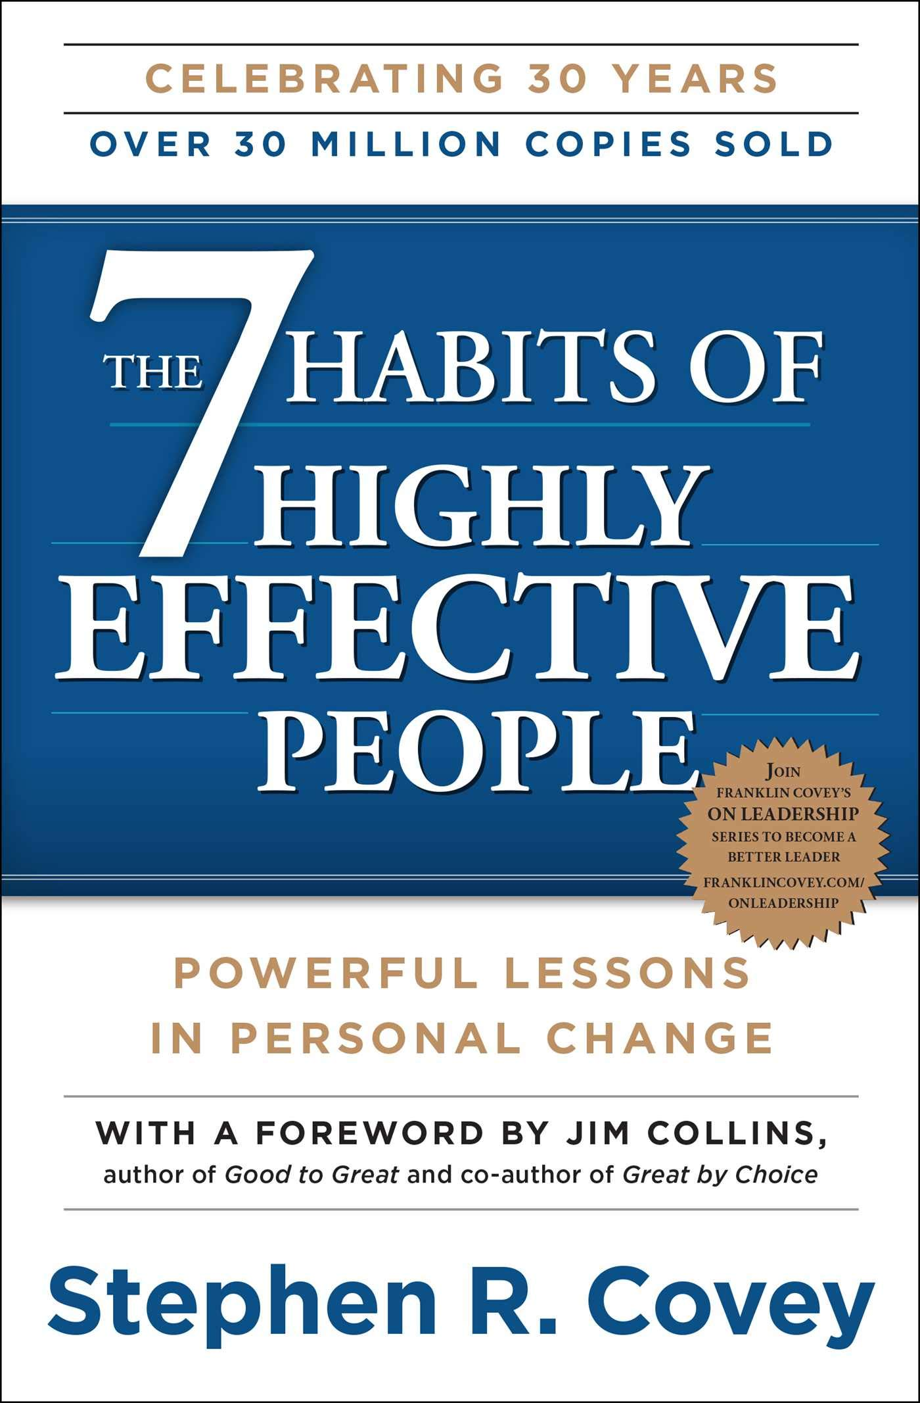

Slide 3
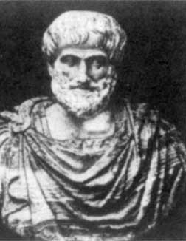
Why Should a “Center of Excellence” Focus on Habits?
“We are what we repeatedly do. Excellence, then, is not an act, but a habit.” - Aristotle
(emphasis mine)

Slide 4
7 Habits of Highly Effective People
Habit #1: Be Proactive
Habit #2: Begin with the End in Mind
Habit #3: Put First Things First
Habit #4: Think Win/Win
Habit #5: Seek First to Understand, Then to Be Understood
Habit #6: Synergize
Habit #7: Sharpen the Saw
Notes:
Before launching into 1st habit, recommend taking the “Inside-Out” approach and read the book with the purpose in mind of sharing or discussing what you learn with someone else within 48 hours after you learn it.
Habit #1: Be Proactive
“Change starts from within and highly effective people make the decision to improve their lives through the things that they can influence rather than simply reacting to external forces.”
Habit #2: Begin with the End in Mind
“Develop a principle-centered personal mission statement. Extend the mission statement into long-term goals based on personal principles.”
Habit #3: Put First Things First
“Spend time doing what fits into your personal mission, observing the proper balance between production and building production capacity. Identify the key roles that you take on in life, and make time for each of them.”
Habit #4: Think Win/Win
“Win‐Win is a frame of mind that constantly seeks mutual benefit in all human interactions. Win‐Win means that agreements or solutions are mutually beneficial and satisfying.”
Habit #5: Seek First to Understand, Then to Be Understood
“Seek First to Understand’ involves a very deep shift in paradigm. We typically seek first to be understood. Most people do not listen with the intent to understand; they listen with the intent to reply. They’re either speaking or preparing to speak. They’re filtering everything through their own paradigms, reading their autobiography into other people’s lives.”
Habit #6: Synergize
“Synergy works; it’s a correct principle. It is the crowning achievement of all the previous habits. It is effectiveness in an interdependent reality‐‐ it is teamwork, team building, the development of unity and creativity with other human beings.”
Habit #7: Sharpen the Saw
“This is the habit of renewal it circles and embodies all the other habits. It is the habit of continuous improvement that lifts you to new levels of understanding and living each of the habits”

Slide 5
The structure

Slide 6
The three fundamental paradigms
Dependence: the paradigm under which we are
born, relying upon others to take care of us.
Independence: the paradigm under which we
make our decisions and take care of ourselves.
Interdependence: the paradigm under which we
cooperate to achieve something that cannot be
achieved independently.

Slide 7
Be Proactive
The word proactive means that we are responsible for our own lives.
Our behavior is a function of our decisions, not our conditions.
We can subordinate feelings to values.
We have the initiative and the responsibility to make things happen.
Proactive people do not blame circumstances, conditions, or social conditioning for their behavior. Their behavior is a product of their own conscious choice, based on values, rather than a product of their conditions, based on feeling.
However
Proactive people are still influenced by external stimuli but their response, conscious or unconscious, is a value based choice or response.

Slide 8
Be proactive
“Use your R and I!” (Resourcefulness and Initiative)
Act or Be Acted Upon
Listening to Our Language

Slide 9
Reactive Vs. Proactive language
Reactive Language | Proactive Language
There’s nothing I can do | Let’s look at our alternatives
That’s just the way I am. | I can choose a different approach.
He makes me so mad. | I can control my own feelings.
They won’t allow that. | I can create an effective presentation.
I have to do that. | I will choose an appropriate response.
I can’t | I choose.
I must. | I prefer.
If only. | I will.
Notes:
What is the common thread?
The reactive is a response to things out of the person’s control.
The proactive looks at what the person can control.
Reactive are the “Have” – I have to do this.
Proactive are the “Be” – How can I be better?

Slide 10
Circle of Influence/Circle of Concern
CIRCLE OF CONCERN
CIRCLE OF CONCERN
CIRCLE OF INFLUENCE
CIRCLE OF INFLUENCE
Proactive Focus: Positive Energy Enlarges the Circle of Influence
Reactive Focus: Negative Energy Reduces the Circle of Influence
Notes:
Proactive Focus vs Reactive Focus
When we focus on our circle of concern, we empower things within it to control us. When we focus on our circle of influence (the things we can control), we create a positive energy that changes ourselves.
I cannot control the things around me, only my reaction to those things….focus on what you can manage, control, and influence.

