Slide 1
Research Methods Introduction: Theory, knowledge and Research
4th year IRD
Ishik University
Dilshad Hamad (PhD)
Fall 2019-2020

Slide 2
We do research to improve our knowledge on the social world
Social World
The setting or cultural surroundings in which social research takes place.
Knowledge
(1) information about or awareness of something, an issue, a fact;
(2) an understanding of a matter, a fact, an issue.

Slide 3
Ontology & Epistemology
Ontology
The ‘science or study of being’; in social research, ontology refers to the way the social world is seen to be and what can be assumed about the nature and reality of the social phenomena that make
Epistemology
The theory of knowledge and how we know things.

Slide 4
Natural sciences vs. social sciences
natural sciences
social sciences
we study the natural/physical world which is separate from us
, we study something which we are part of it ’social world’

Slide 5
Social phenomena
social phenomenon Anything that influences or is influenced by human beings who interact with and are responsive to each other.

Slide 6
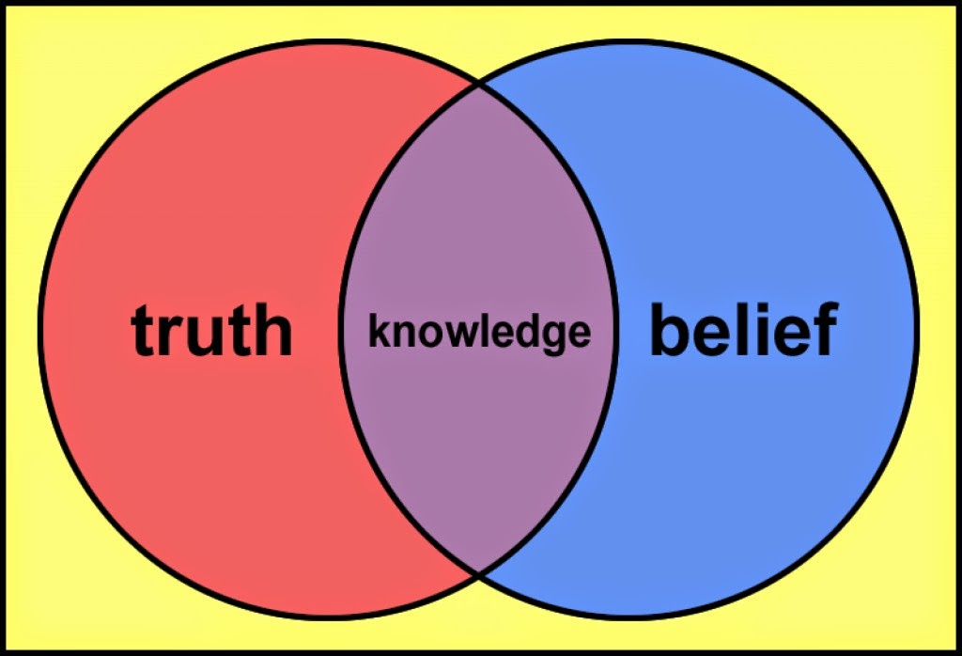
knowledge
(1) information about or awareness of something, an issue, a fact;
(2) an understanding of a matter, a fact, an issue.

Slide 7
Where our knowledge comes from?

Slide 8
Five ways of knowing
Belief
I belief the number of cars should be reduced to save the environment
Not may need to challenge our believes
Authoritative knowledge
Religious, political or social authorities make sources of our knowledge
We may ask the authority of such sources
experiential knowledge
We gain knowledge through our daily and life experience
As social researchers we may need to reflect on the knowledge and skills we have gained from our experience and how this influences what we are interested in and what we do.

Slide 9
Ways of knowing…
theoretical knowledge
Our knowledge may partly come from theories we accept them
As social researchers we can begin to identify the theories we use in everyday life and the theories that are used by others studying the same aspects of the social world.
Empirical knowledge
Based on available research evidence or hypothesis that can be tested
As social researchers we need to develop the skills to enable us to gather data to answer research questions or test hypotheses, to develop knowledge-based theories.

Slide 10
Three approaches to Truth (Blaikie, 1993: 6)
there are truths to be known about
the way the natural and social worlds work. The truth can be observed
all knowledge of these worlds is
tentative; reality can not be observed directly but through concepts and theories
all knowledge
of the world, but particularly of the social world, is relative in time and space; there
are no absolute truths.

Slide 11
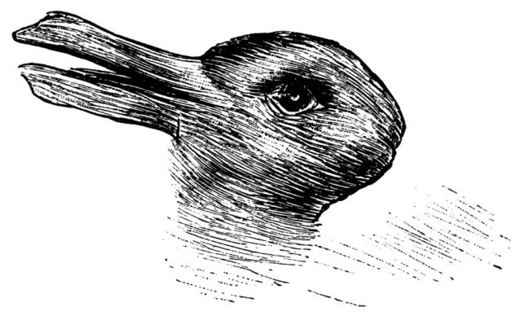
How people see the world around them?

Slide 12
Main ontological perspectives
Objectivism
An ontological position which asserts that the social phenomena that make up our social world have an existence of their own, apart from and independent of the social actors (humans) who are involved.

Slide 13
Constructivism
An ontological position which asserts that the social phenomena making up our social world are only real in the sense that they are constructed ideas which are continually being reviewed and reworked by those involved in them through social interaction and reflection.

Slide 14
Realism
An ontological position which asserts that the social world has a reality that is separate from the social actors involved in it, that can be known through the senses as well as the effects of ‘hidden’ structures and mechanisms.

Slide 15
Main epistemological perspectives
Epistemology
An epistemology is a theory of knowledge; it presents a view and a justification for what can be regarded as knowledge – what can be known and what criteria such knowledge must satisfy in order to be called knowledge rather than beliefs (Blaikie, 1993: 6–7).

Slide 16
Positivism
An epistemological position which asserts that knowledge of a social phenomenon is based on what can be observed and recorded rather than subjective understandings.
Augustus Comte (1798–1857) proposed that the social world can be studied using the same approaches as the natural world, in particular that there are general discernible ‘laws’ about the way the social world works which do not vary.

Slide 17
Main feature of positivism
Knowledge is defined as that which can be observed by the senses.
Knowledge of the social phenomenon is based on what can be observed and recorded rather than subjective understandings.
Usually data are gathered to test a hypothesis which has been generated from existing theory.
The researcher is independent of and has no impact on the data – the researcher is objective.

Slide 18
A positivist study will include
quantitative data are collected;
aspects of the social world, social phenomena, are measured;
causal relationships between different aspects of the social world are sought;
large data sets and statistical analysis are often used.

Slide 19
Hypothesis
A proposal or statement that is intended to explain observations or facts; it can be thought of as an ‘informed guess’ about the social world that, if true, would explain the phenomenon being researched.

Slide 20
Interpretivism
Main features
Knowledge gathered includes people’s interpretations and understandings.
The main focus is on how people interpret the social world and social phenomena,
enabling different perspectives to be explored.
The researcher is interpreting other people’s interpretations in terms of the theories and
concepts of the social researcher’s discipline – studying the social phenomenon as if
through the eyes of the people being researched.
The researcher works with the data gathered to generate theory.
An epistemological position that prioritizes people’s subjective interpretations and understandings of social phenomena and their own actions.

Slide 21
Interpretivist study will include
qualitative (rich in detail and description) data is collected;
uncovering and working with subjective meanings;
interpretation of meaning within a specific context;
empathetic understanding, ‘standing in the other’s shoes’.

Slide 23
Realism
Realism
Critical Realism
An epistemological approach that asserts that knowledge of a social phenomenon is based on both what can be observed and recorded and ‘hidden’ structures and mechanisms whose effects can be observed.
prioritizes identifying structures or mechanisms that result in inequality or injustice and thus offers the opportunity for social change by changing or negating the structural mechanisms that are identified as having these impacts.

Slide 24
Main features of Critical Realist approach
revealing hidden structures and mechanisms;
uncovering power relations and dominant ideologies;
research that leads to action;
collecting qualitative and/or quantitative data.

Slide 25
What is social research is about?
Social researchers try to:
(a) to describe and explore a social phenomenon (or social phenomena);
(b) and, usually, to understand and explain how and why the phenomenon is – or is understood – as it is.
Social research is about ‘exploring, describing, understanding, explaining, predicting, changing or evaluating some aspect of the social world . . . ‘what’, ‘why’ and ‘how’ questions. (Blaikie, 1993: 4)

Slide 26
Four types of research
Descriptive research | Exploratory research | Explanatory research | Evaluation research
Who are the young men who are involved in gun crime? | What is it like to be a member of a gang? | Why do young men join gangs that participate in gun-related crime? | What changes in policy and practice would best help young men not to join such gangs?

Slide 27
Research concepts
Variable
Causal relationship
An attribute or characteristic of cases (for example, individuals, organisations, objects or situations) which can vary from case to case.
The assertion that a change in ‘A’ causes a change in ‘B’.

Slide 28
Theory & Concepts
Theory
Concepts
A set of ideas or related concepts which can be used to explain and understand an event, situation, social phenomena.
An abstract idea which encapsulates a way of describing or thinking about a social phenomenon, for example, family, poverty, power, health. (See A4 for more about working with concepts.)

Slide 29
Types of theories
macro theories | meso theories | micro theories
Theories that attempt to cover all aspects of the social world in general terms (also known as grand theories). | Middle-level theories relating to social phenomena usually found, such as organisations, institutions, | Local theory relating to a specific area, group of people or aspect of the social world.

Slide 30
Paradigms
(1) The entire constellation of beliefs, values, techniques and so on shared by members of a given (scientific) community (Kuhn, 1970: 175).
(2) A cluster of beliefs and dictates which for scientists in a particular discipline influence what should be studied, how research should be done, how results should be interpreted and so on (Bryman, 1988: 4).

Slide 31
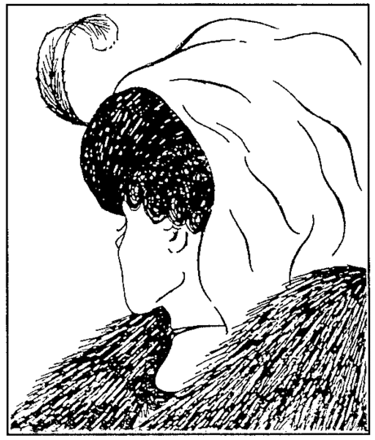
Paradigms as maps
‘directing us to the problems that are important to address, the theories that are acceptable, and the procedures needed to solve the problems’ (Marlow, 2001: 7).

Slide 32
Theoretical framework
The ideas and approaches to viewing and gathering knowledge, and which provide the basic ways of addressing a topic.

Slide 33
Using theories in social research
Using existing theories of your own and of others
Using theories of social research and knowledge
Working with theory
Developing research questions or hypotheses
Explaining your data

Slide 34
Deductive Vs. Inductive

