Slide 1

Gender and Electronic Media

Slide 2


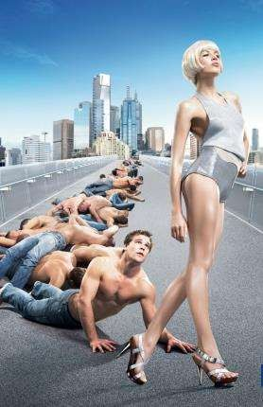
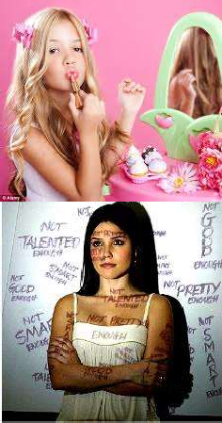

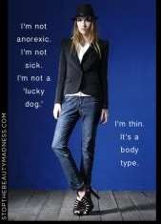
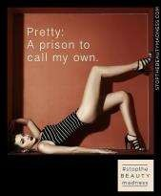
MEDIA: prints, paintings, television, movies, radio, newspapers, comics, comix, novels, zines, magazines, CDs, MP3s,podcasts, video games, blogs, videos, and Tweets and more.

Slide 3
Introduction
Men and Women are constantly being sexualized on television, movies, book covers, advertisements and other forms of media. Women are objectified and degraded to sell products and onlookers are lead to believe it is normal behavior and given unrealistic expectations to attempt to achieve. How gender is depicted in media is a problem that seems to only be getting worse, not better. More attention needs to be put on how wrong gender is being portrayed in media, which is why I chose to research this topic and present it. Knowledge about this furthers understanding about gender in communication because we are surrounded by media, which communicated all of these things to us constantly. Gaining understanding, knowledge, and having our eyes open to what media is exposing us to will help us be able to dismiss and make our own decisions and choices regarding gender. It will also help us communicate about gender and avoid falling into the many oppressive boxes media puts gender in.

Slide 4
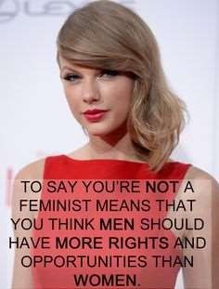
Gender is when women and men are socialized for their roles that their cultures have prescribed them. Gender focuses on the socio-cultural elements of male and female role expectations. Gender roles refer to sets of culturally defined character traits labeled as “masculine” and “feminine”. Gender refers to socially learned behavior and expectations that distinguish masculinity and femininity.
Gender Equality is when women and men have equal conditions for realizing their full human rights and potential to contribute to national, political, economic, social and cultural development and benefit equally from the result. Attaining gender equality requires recognition that current social, economic, cultural and political systems are gendered.
Femininity is “acquired and reproduced through socialization and the development of self concept” Women are expected to be emotionally expressive, dependent, passive, cooperative, warm and accepting a subordinate status in marriage and employment. Competitiveness, violence and anger are attributes which are largely regarded as being unfeminine and not tolerated as female behavior(Tapfumaneyi & Rupande , 2013).

Slide 5
MEDIA
media influence how people dress, what they eat, what they look like, the games they play, the music they listen to, and the entertainment they watch. Media convey these messages in two ways:
In the message content of the television shows, magazine articles, news items, music, and movies
In the advertising that surrounds these messages.
Media create false consciousness, making people believe they exert control over what they view (and what they think about what they view) when in reality they have little or no control (DeFrancisco, 2014).

Slide 6
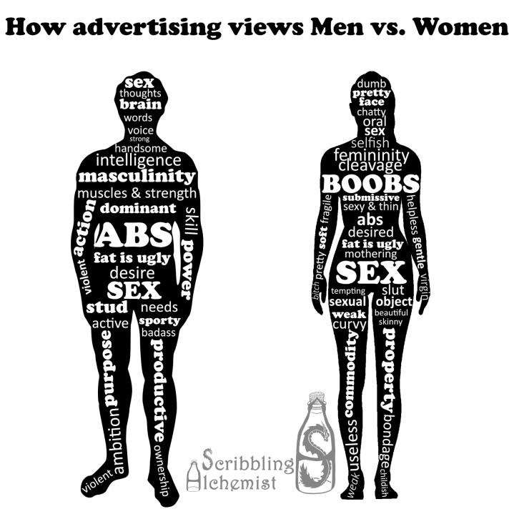

Slide 7
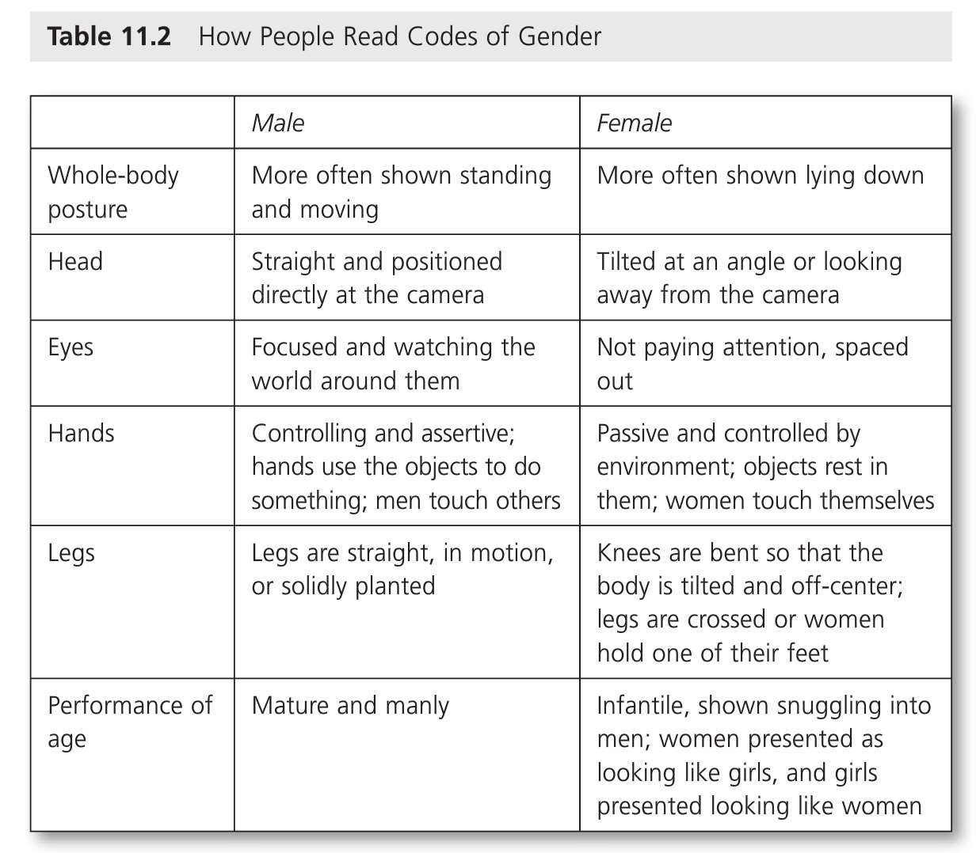

Slide 8
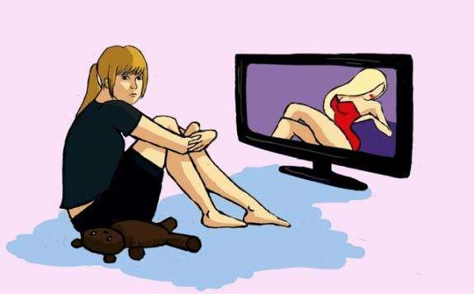
Media has defined how females and males should look and act. Stereotypes play a huge role in this. Though advertisements, performers, actors and actresses, the standard male should be masculine, dominant, physically fit, has abs, handsome and so on like depicted in the image on the previous slide. The standard women is feminine, soft, pretty, treated as property, objectified, should be submissive, thin, have large breasts and so on, again as described in the image on the previous slide. Because of the heavy usage of these types of individuals in media, what is actually a normal body type for either gender is not acceptable, so everyone who doesn’t process the unattainable image/ especially for women, doesn’t measure up and is deemed unworthy. Women are often represented negatively thereby promoting negative stereotypes about them (Tapfumaneyi & Rupande , 2013).

Slide 9
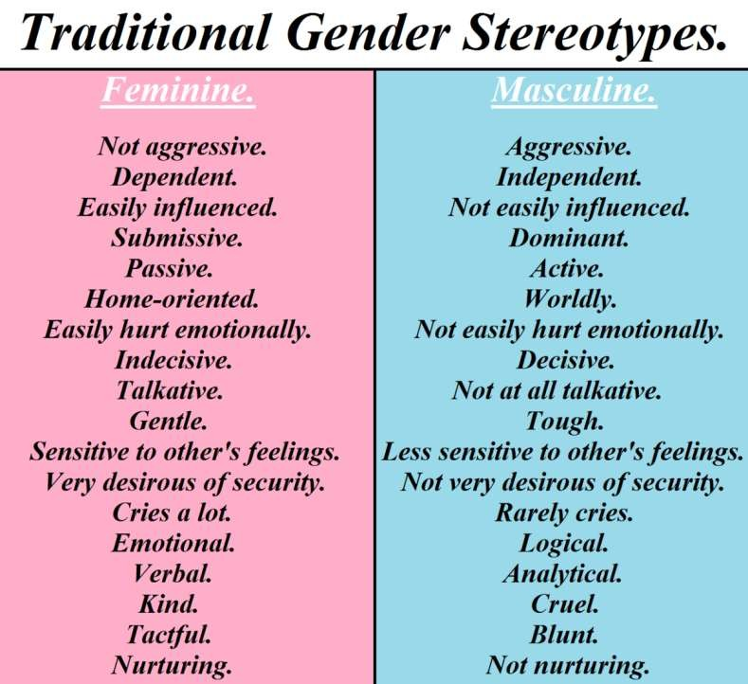

Slide 10
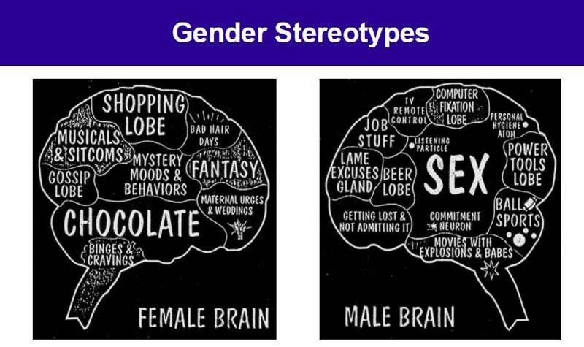

Slide 11
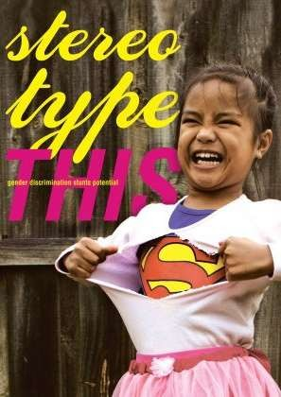
Stereotypes
A stereotype is an oversimplified image or idea of a specific type of person or thing.
A Stereotype threat occurs when a group is informed of a stereotype and then the group’s performance is affected by the stereotype. Stereotypes are everywhere, and all of us will come up against them more than once (DeFrancisco, 2014) .
Gender stereotypes
vary
on four
dimensions: physical occupations
traits, role behaviors,
characteristics, (Tapfumaneyi
and
&
Rupande , 2013).

Slide 12
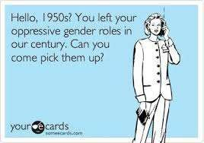
Mass mediated images construct an understanding of gender in which feminine women are physically passive and ineffective and masculine men are physically active and capable (DeFrancisco, 2014).

Slide 13
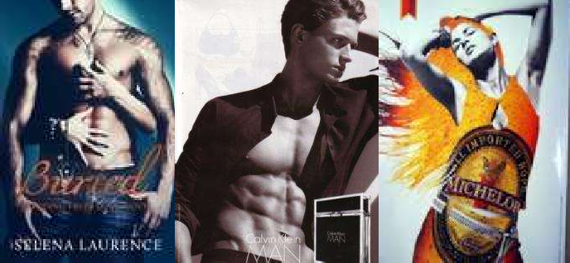
Objectification occurs when people are viewed as objects existing solely for the pleasure of the viewer, rather than as agents capable of action. The person being objectified often is reduced to body parts: breasts, genitalia, muscles, curves, buttocks, and hair. The person is no longer human but commodified—turned into a market commodity like other inanimate products, free to be bought and fondled (even if only by others’ eyes).
Self-objectification occurs when people internalize the objectifier’s view of their body and “participate in their own objectification” by seeking to exert a limited power linked to their ability to attract the gaze of others. This happens all of the time; girls or women wear low cut shirts to show off cleavage to catch attention, or wear short shorts that show their butt cheeks. Stars dress this way, as well as actresses (DeFrancisco, 2014) .

Slide 14
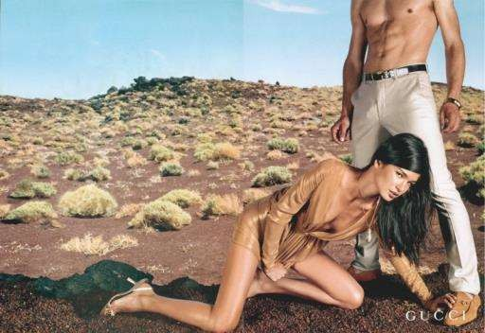
Commodification is the selling of cultural, sexual, or gender difference in a way that supports institutionalized discrimination. Women's bodies are constantly used in ads to sell things. They are turned into things and objectified. This doesn't tend to happy to men as much. When men appear in ads they are centered, and in a strong pose, while woman are generally appearing seductive and/or lower than the man (DeFrancisco, 2014).

Slide 15
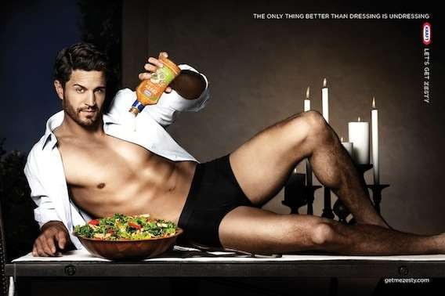

Slide 16
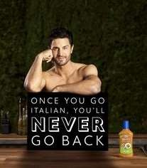
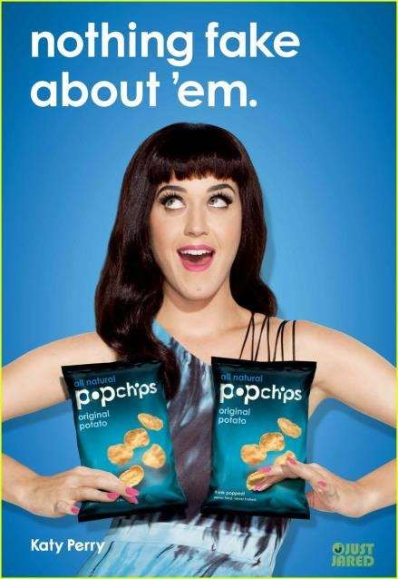

Slide 17
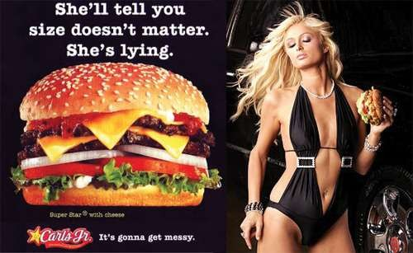

Slide 18

A fine example of a woman’s worth in advertisement. Sexual innuendoes, super appropriate, don’t you think?

Slide 19
A lot of advertisements don’t even show a women’s whole body; they just focus on the most important parts of her.

Slide 20
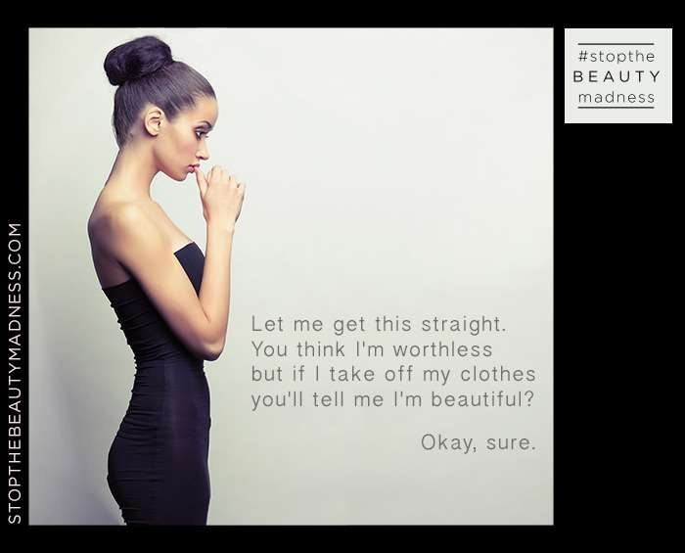

Slide 21
Women are posed lower to the ground than men showing men are dominant and women are submissive.

Slide 22
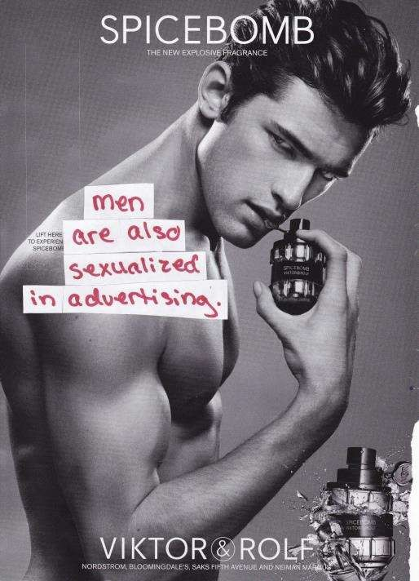

I talk a lot about how badly
women are represented in
are
advertising, but men
sexualized as well, whether it is in an advertisement, on a book cover, or other mediums.

Slide 23
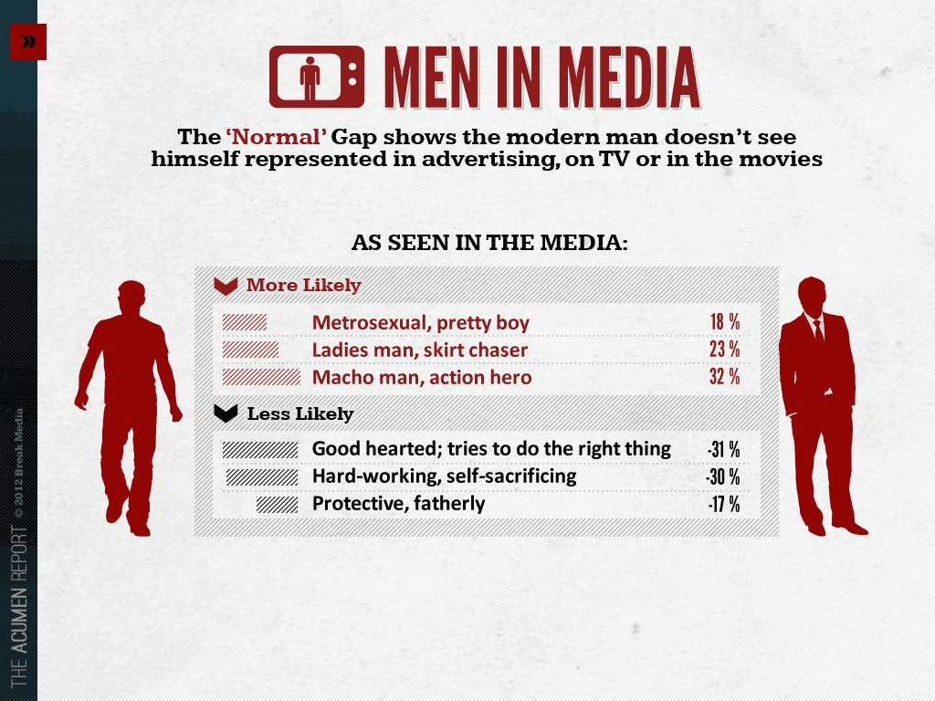

Slide 24
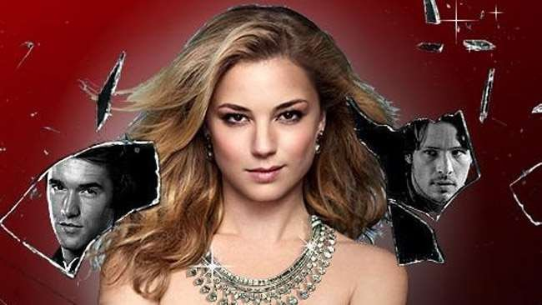
A lot of television and movies exploit sexuality and sexualize characters, especially women, but not all of them rely heavily on that. Revenge is an example of a female lead who doesn’t fall into stereotypes, but is a strong woman, who doesn’t need a man to handle things for her.

Slide 25
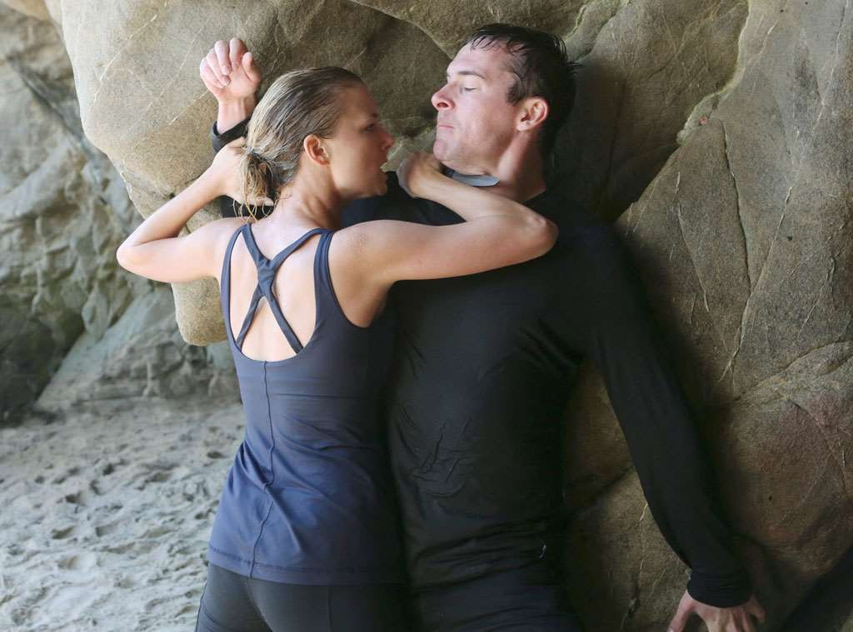

Slide 26
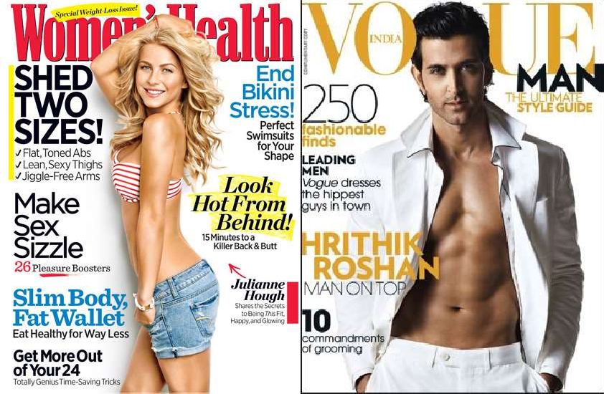
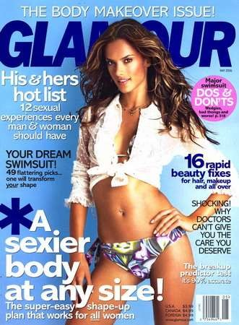
A lot of magazines have sexualized images on the cover of women. Images of woman with little clothing, or that focus on clothing you must wear, or things you need as well as articles about best dressed stars and who wore it better because it is the end of the world if two individuals in the public eye wear the same outfit, especially to the same event. Media and magazine are teaching people and children that these things are what is important instead of actual important things going on in the world. Look at the covers. Being healthy is looking “HOT” from behind? Really? A sexier body at any size… why do we need to be sexy? And any size, but the girl on the cover is toned and thin… It measure people’s worth only in terms of their appearance (DeFrancisco, 2014).

Slide 27
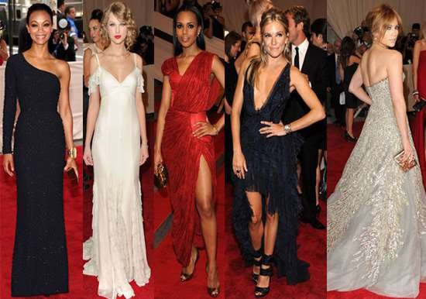
Why is it important who is best dressed?
“Is your decision about what to wear really a personal choice, or is it a response to the larger cultural context that determines some fashion choices are acceptable and others are not” (DeFrancisco, 2014)?

Slide 28
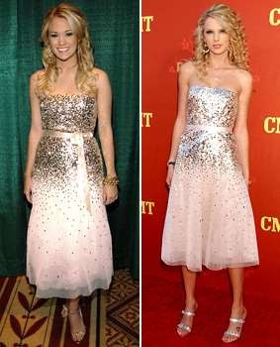
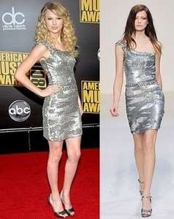
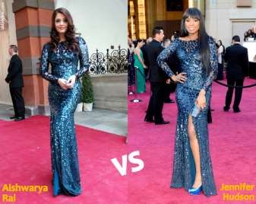
You don’t see men being scrutinized like this, most suits are pretty similar…

Slide 29
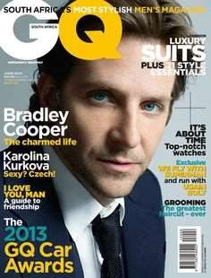
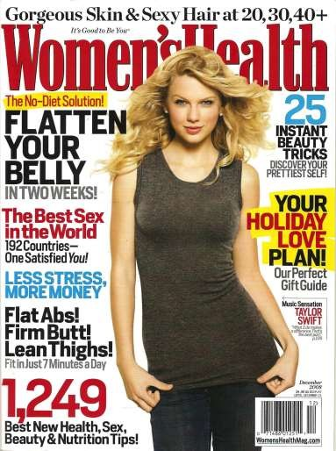
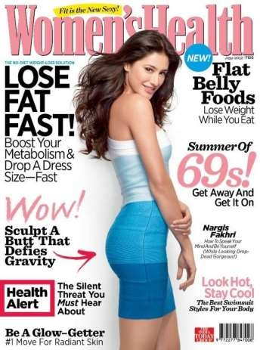
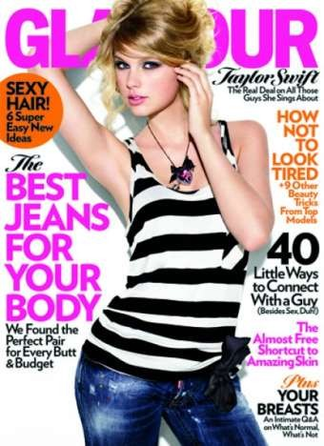
Some covers are better-- Taylor seems to keep it classy.

Slide 30
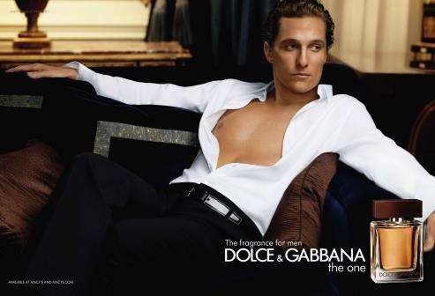
Rapaille believed that advertisements worked best when they spoke to the
consumer’s inner desires and fantasies. Using sexuality in advertisements can trigger a range of desires, from arousal to unrealistic desires of wanting to look like the person in the ad, or even fantasies that you are the person in the ad.
The sexuality based advertisements generally feature the ‘perfect’ woman or the ‘perfect’ man, or in some cases both. Consumers connect this image with the product being sold, so in some cases the thought process is, the consumer needs the product so they can look or be like the person in the ad. The text by Sterin states, “We all have a strong tendency to copy what we see others do, especially if they appear powerful, rich, and attractive.” Insane amounts of time, money and effort will go into trying to look like that person when in reality it is doing more harm than good (Sterin, 2014, 2012).

Slide 31
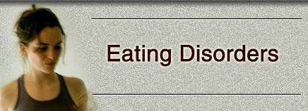
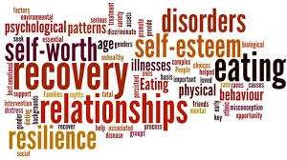

Slide 32
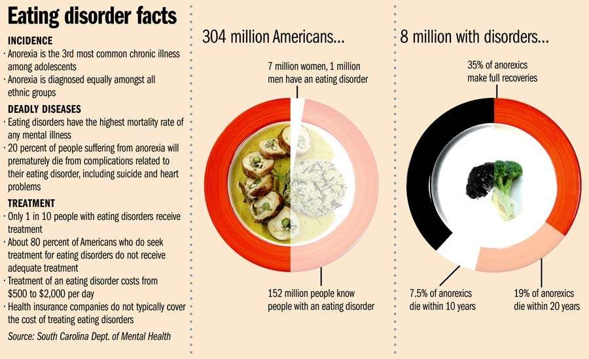

Slide 33
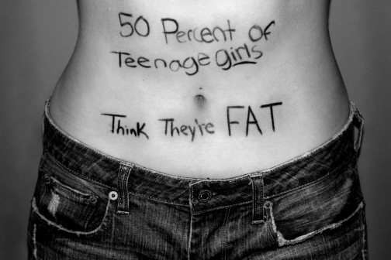
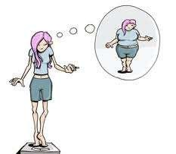
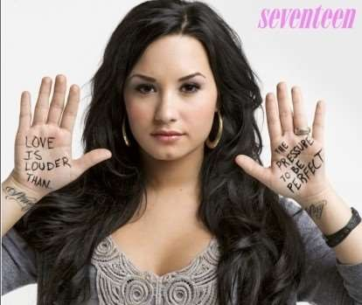
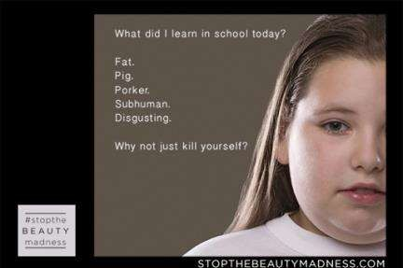

Slide 34
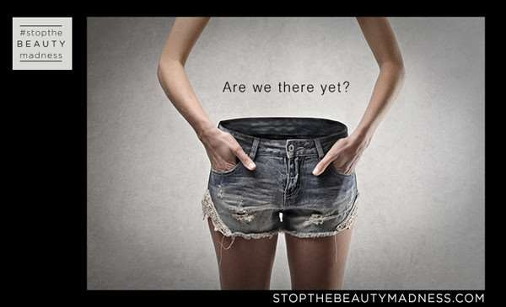

Slide 35
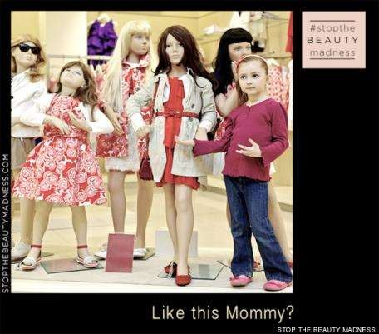
These problems don’t just affect adults; they also affect children and young adults. It is already difficult for children and young adults to figure out who they are and their place in this world, but with the pressure of media, it makes it impossible. That is why a large portion of young adults suffer from an eating disorder, when a lot of them are probably normal and healthy to begin with. Most ads don’t promote healthy women, and they should. The textbook by Sterlin says, “It’s well established that seeing images of underweight women make normal or overweight women feel bad about themselves,” which s h o u l d n ’ t be a c c e p t a b l e ( J h a l l y , 2 0 1 0 ) ( S t e r i n , 2 0 1 4 , 2 0 1 2 ) .

Slide 36
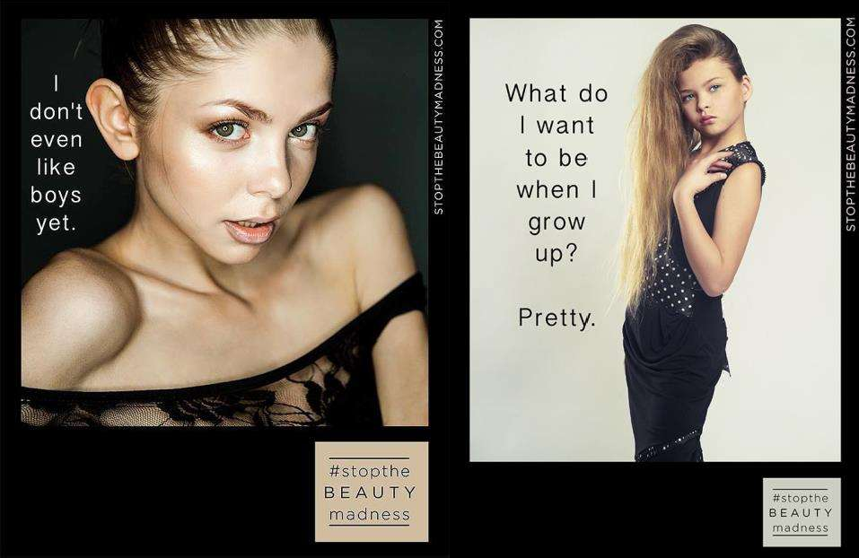
“Although media images are not real, they have real effects on how people perceive sex and
gender” (DeFrancisco, 2014)
.

Slide 37
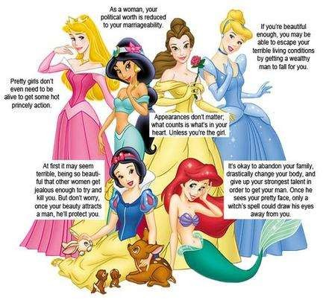
I found this image on Google as I was looking for examples of gender in media. I’m a huge Disney fan and grew up on all of these movies, but this image makes a good point about how gender is depicted in media that is even geared toward young children.

Slide 38
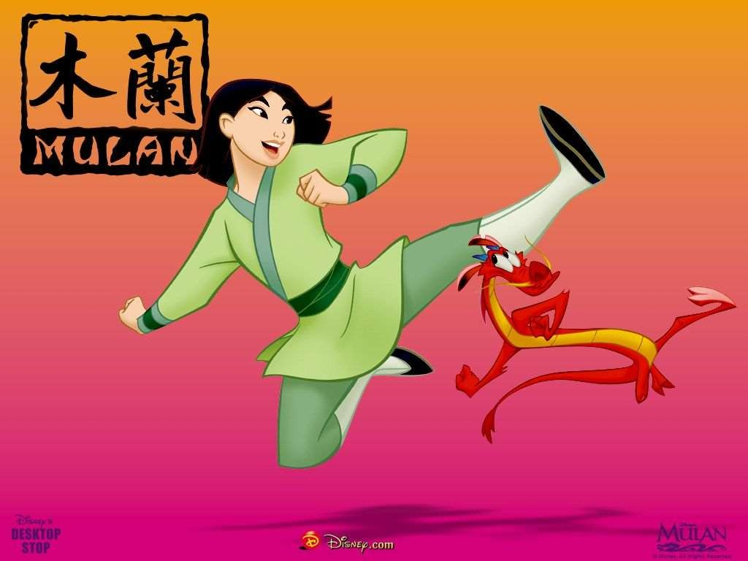
While Disney has some bad gender messages, one of my favorite Disney movies does have a strong female character who goes against gender expectations to save her father, though she has
to pretend to be a man in order to do it… In the end she gains respect as a women.

Slide 39
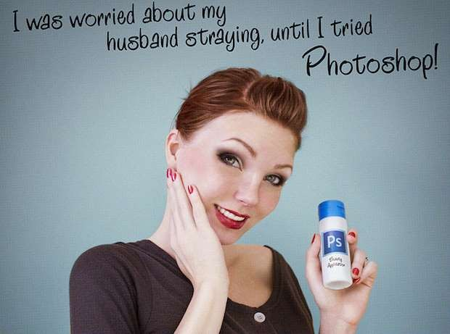
Photoshop is a huge part of the problem, since it is rare that an untouched photo is published; first it is edited, so there are no blemishes or pores, and so the person is even thinner than they really are, as well as many other altercations. The people in the pictures are no longer real once the process is complete.

Slide 40
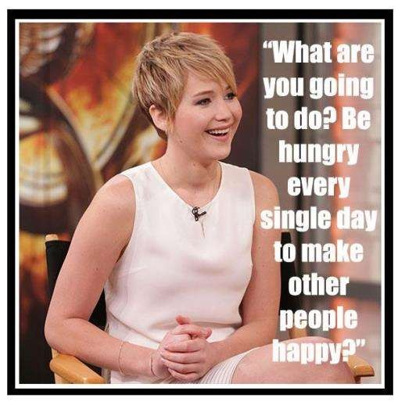
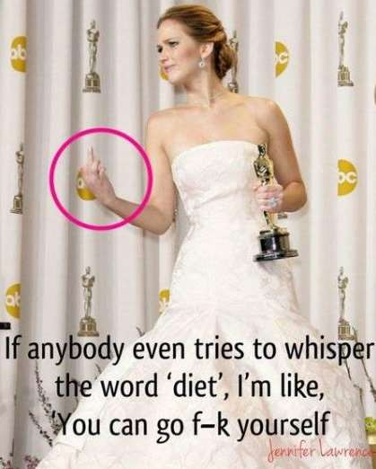
There are a handful of people in the public eye, like Jennifer Lawrence, who speak out against what is being depicted in the media, but more need to. The structure of media needs to change so the culture is exposed to ‘real women.’

Slide 41
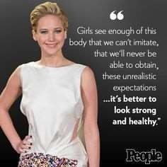

Jennifer Lawrence has spoken out about the media and the pressure of dieting on multiple occasions like this quote, “But I think when it comes to the media, the media needs to take responsibility for the effect that it has on our younger generation, on these girls who are watching these television shows, and picking up how to talk and how to be cool, so then all of a sudden being funny is making fun of the girl who's wearing an ugly dress." She doesn’t hold back and says what she is thinking and media and the world needs more of that. This is the type of person that people should be idolizing; she is smart, talented, f u n n y , a n d m o s t i m p o r t a n t l y , H E A L T H Y .

Slide 42


Slide 43


Slide 44


Slide 45

I’m sure by now, you’re getting the picture. Jennifer Lawrence is flawed like everyone else and has made mistakes, but I think she is an amazing woman. I hope that her and others like her, will
help open people’s eyes to the negative, life altering effects the media has on it’s viewers.

Slide 46

Lorde previously took to social media and posted a comparison of an untouched photograph next to the edited picture of herself with the words, “i find this curious - two photos from today, one edited so my skin is perfect and one real. remember flaws are ok :-).” Those are some powerful words which should be advertised instead of things like, “If your hair isn’t beautiful, the rest hardly matters,” which is from an ad for Pantene shown in the documentary, Killing Us Softly 4. Kilborne stated, “our popular culture seems to have the ability to make women anywhere and everywhere feel absolutely terrible about themselves.” Media is clearly horrible for our culture, slaughtering self-esteem and in turn encouraging eating disorders and various health conditions. That isn’t even counting the products that are being sold to our culture with these advertisements, which some are also causing health problems (Lorde, 2014) (Toomey, 2013) (Jhally, 2010) (Sterin, 2014, 2012).

Slide 47

Women are sold countless products to make them beautiful, such as Revlon Colorstay Mineral Blush, which has ingredients that are linked to causing cancer according to Environmental Workers Group rating for the product. The organization assesses the ingredients in beauty products and gives a rating for each one and what affects using the product can have on one’s health. Not only does our culture have immense pressure to use these products to be beautiful, but some have to use them for their career like Troian Bellisario from the show Pretty Little Liars, displayed to the right, who also made a powerful comment about media and beauty. In a world where plastic surgery in continuously increasing, it is refreshing to see people like Troian, Jennifer, and Lorde speaking out in hopes to make a difference. If more people become aware of this major flaw and speak out, maybe the vicious cycle can be broken (Group, 2007-2014) (Community, 2014)
(Sterin, 2014, 2012).

Slide 48

Text blown up that accompanied the image Troian Bellisario posted on Instagram from the previous slide.

Slide 49

I mentioned on the first slide about Troian the Environmental Workers Group. The company created a website called EWG’s Skin Deep. Here is the description about what they do: It's our mission at Environmental Working Group to use the power of information to protect human health and the environment. EWG's Skin Deep database gives you practical solutions to protect yourself and your family from everyday exposures to chemicals. We launched Skin Deep in 2004 to create online safety profiles for cosmetics and personal care products. Our aim is to fill in where industry and government leave off. Companies are allowed to use almost any ingredient they wish. The U.S. government doesn't review the safety of products before they're sold. Our staff scientists compare the ingredients on personal care product labels and websites to information in nearly 60 toxicity and regulatory databases. Now in its eighth year, EWG's Skin Deep database provides you with easy-to- navigate safety ratings for a wide range of products and ingredients on the market.
Explore the site and find out more at: http://www.ewg.org/skindeep/.

Slide 50

This is a really great resource and it makes you think twice
about the products we are being told we need to use
according to our gender. Women’s worth is determined by their beauty, so they need to buy makeup products to fulfill that requirement and a lot of the products are harmful.

Slide 51


I was shocked by some of the ratings of the items I use on a daily bases. I had a natural shampoo and conditioner that I expected to have a low rating because it was natural, and it ended up being very high. That is when I learned that there is a difference between natural and organic.

Slide 52
STOP THE BEAUTY MADNESS

Slide 53
Beauty Defined
I live in a world
Where beauty is defined by words like TALL, SKINNY, THIN, FLAWLESS…
Where beauty is not being NORMAL
For MY OWN body type.
But now I know it is far better to STAND OUT.
Ads depict the PERFECT WOMAN; who has been Photo shopped so she isn’t even REAL,
But I’m made to BELIEVE I should look like that,
Instead of all five-feet one hundred and twenty pounds of myself.
I must fit into a body type that only a very small percentage of the population possesses.
In middle school I was asked if I was anorexic because I was THIN.
The shocking words coming from people so young,
Because that had become a NORM in our world. Now I’m twenty-five and am no longer super thin,
I’ve gained weight and have meat and curves on my BODY, Which makes me feel self-conscious in my own SKIN.
I’m surrounded by ads telling me what I NEED to be
BEAUTIFUL.
SHINY HAIR, Makeup to cover my FLAWS, acne treatment to get rid of my BLEMISHES, and WEIGHT LOSS pills.
They LEAVE OUT how these products will affect my HEALTH long-term,
Or even my SELF-ESTEEM.
I remember being embarrassed growing up,
Because I didn’t have the COOL name brand clothing others had.
All I wanted to do was fit in,
I have been taught by the media, That it is not okay to look like I do. It is not beautiful to have PORES, Or scars that tell stories.
The media has created a SICKNESS. A DISEASE,
That has turned into a WIDE-SPREAD epidemic. We need to STOP THE BEAUTY MADNESS,
Before it is TOO LATE.
Stop labeling people,
Because being DIFFERENT is what makes each of us beautiful. My appearance doesn’t make me who I am,
My CHARACTER, PASSIONS and INTERESTS do.
Don’t DEFINE me by what I look like, But instead by what I do.
I’m a WRITER, ARTIST, WIFE, POET, FRIEND, ARCHER, SOCCER-PLAYER, MUSIC LOVER…

Slide 54
It is time to TEACH our children to be comfortable in their own skin, Encourage being HEALTHY,
instead of setting unrealistic standards,
So people resort to becoming ANOREXIC or BULIMIC,
Just to be SKINNY.
Revel in the beauty of FLAWS,
Instead of getting plastic surgery for SOMEONE ELSE’S idea of beauty.
When we give into these ideals we are losing pieces of ourselves,
And eventually there won’t be anything Left.
I don’t know about you,
But I don’t want to be a BARBIE,
I just want to be MYSELF.
© Christie (Cote) Omodeo July 15, 2014

Slide 55

My Slam Poem performance that I entered into the #StopTheBeautyMadness contest.
If you have trouble playing the video, it can be found here: https://youtu.be/40Vaqx5IqpY

Slide 56


Slide 57


Slide 58

Stop being passive
oppositional gaze is to be an active participant in media discourse about gender, instead of a passive recipient of it, one must possess a vocabulary with which to critically discuss the content and the gaze. One cannot engage in creative readings of media unless one knows such readings are necessary and possible.
Don’t just accept things because that is how they are, become aware and challenge them. Make sure you are doing/buying something, dressing or whatever for you, not because influences are telling you to.

Slide 59
Conclusion
Kilbourne said the media and its impact has only gotten worse since she began her career, spreading awareness and wanting to make a difference. For the good of our culture, health, and self-esteem the media needs to change. It has created a toxic environment for our culture. Sexuality isn’t a bad thing, but when it is being used in advertisements it has a significant negative widespread cultural impact on the nation’s health and self-esteem.
It is important to be aware of how gender is portrayed in media, especially as consumers, so we can stop being passive consumers and be active about what is important instead of feeding into the unhealthy trap that is gender in media.
Using the media in promoting gender sensitive media productions is crucial in improving social gender relations. If media is to change the portrayal of women by projecting positive images of them in media productions, it will lead to improved gender relations in society (Tapfumaneyi & Rupande , 2013).
Through examining gender in media I found endless examples of how both genders are overly sexualized, and media heavily influences what it means to be a man or women. There are also heavy ramifications because of the intense media influence on gender. This subject is huge with a seemingly endless amount of information, but limited awareness.

