Slide 1
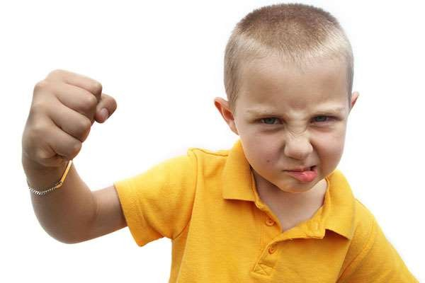
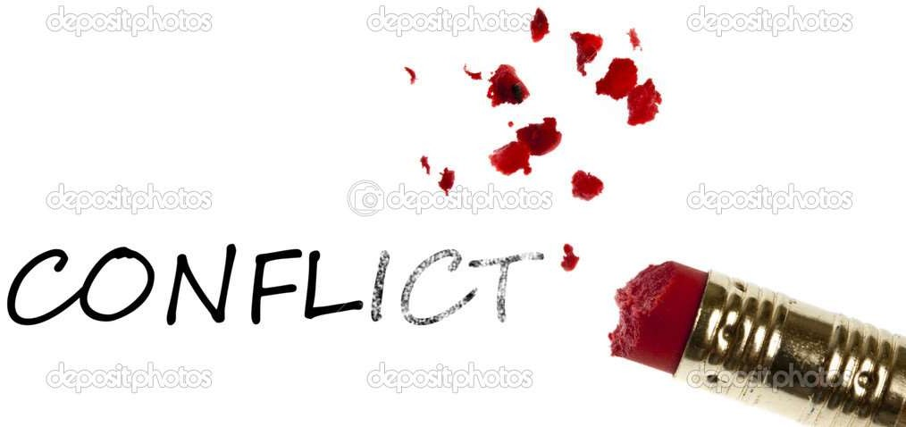
Mohsin Uddin
Assistant Professor
Tishik International
University, Erbil

Slide 2
Defining and Classifying Groups
Group(s)
Two or more individuals interacting, who have come together to achieve particular objectives.
Formal Group
A chosen work group defined by the organization’s structure.
Informal Group
A group that is neither formally structured now organizationally determined; appears in response to the need for social contact.

Slide 3
Defining and Classifying Groups (cont’d)
Command Group
A group composed of the individuals who report directly to a given manager.
Task Group
Those working together to complete a job or task.
Interest Group
Those working together to attain a specific objective with which each is concerned.
Friendship Group
Those brought together because they share one or more common characteristics.

Slide 4
Why People Join Groups
Security
Status
Self-esteem
Affiliation
Power
Goal Achievement
E X H I B I T 8–1

Slide 5
Group Structure - Status
Status
A socially defined position or rank given to groups or group members by others.
Power
Contribution to the group’s goals
Group Member
Status
Personal characteristics

Slide 6
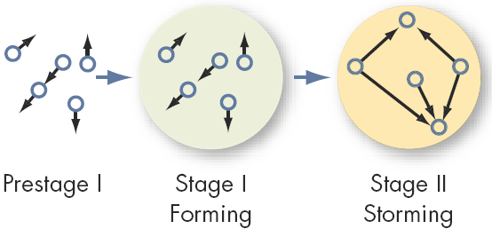
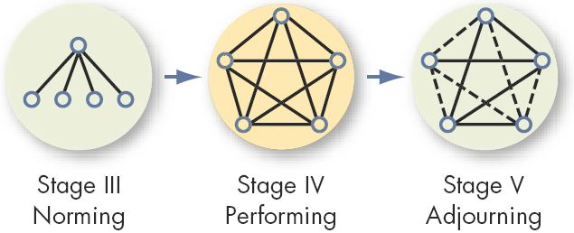
Stages of Group Development

Slide 7
The Five-Stage Model of Group Development
1
Forming:
Uncertainty about purpose, structure, and leadership
2
Storming:
Intragroup conflict as members resist constraints
3
Norming:
Group is cohesive with strong group identity
4
5
Performing:
Adjourning:
Group fully functional and working toward goals
For temporary groups: breaking up

Slide 8
The Five-Stage Model of Group Development
1. Forming Stage
The first stage in group development, characterized by much uncertainty.
2. Storming Stage
The second stage in group development, characterized by intragroup conflict.
3. Norming(rule) Stage
The third stage in group development, characterized by close relationships and cohesiveness.

Slide 9
…Group Development (cont’d)
4. Performing Stage
The fourth stage in group development, when the group is fully functional.
5. Adjourning Stage
The final stage in group development for temporary groups, characterized by concern with wrapping up activities rather than performance.

Slide 10
Group Structure
Roles
Norms
Status
Size
Cohesiveness

Slide 11
Social Loafing
social loafing is the phenomenon of a person exerting less effort to achieve a goal when he or she works in a group than when working alone.

Slide 12
Ways to Prevent Social Loafing:
Set group goals so that the group has a common purpose.
Increase intergroup competition which again focuses on the group outcomes
Engage in peer evaluation
Distribute rewards

Slide 13
Group Structure - Cohesiveness
Cohesiveness
Degree to which group members are attracted to each other and are motivated to stay in the group.

Slide 14
How to Increase Group Cohesiveness
Increasing group cohesiveness:
Make the group smaller.
Encourage agreement with group goals.
Increase time members spend together.
Increase group status and admission difficultly.
Stimulate competition with other groups.
Give rewards to the group, not individuals.
Physically isolate the group.

Slide 15
Group Decision Making
  Large groups facilitate the pooling of information about complex tasks.
  Smaller groups are better suited to coordinating and facilitating the implementation of complex tasks.
  Simple, routine standardized tasks reduce the requirement that group processes be effective in order for the group to perform well.

Slide 16
Group Decision Making
Strengths
  More complete information
  Increased diversity of views
  Higher quality of decisions (more accuracy)
  Increased acceptance of solutions
Weaknesses
  More time consuming (slower)
  Increased pressure to conform
  Domination by one or a few members
  More conflicts
  Ambiguous responsibility

Slide 17
Learning objectives
Define the term Conflict
Understanding the causes of Conflict
Types of Conflict

Slide 18
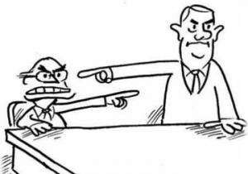
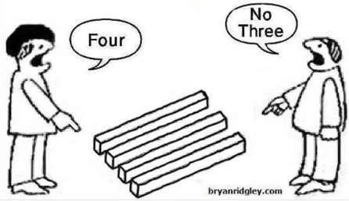
A CONFLICT is serious disagreement or argument between two or more persons

Slide 19
Why conflict Arise
Needs
Pressures
Policies
Perception

Slide 20
General causes of conflicts
Poorly defined goals
Different personal idea/thought
Lack of cooperation/trust
Unclear roles/lack of job description

Slide 21
Effects of conflict in organizations
Stress
Absenteeism
De-motivation
Non-productivity

Slide 22
Word Which Initiate a Conflict
Negative Words
You never
I told you
I never
Whatever
Good for you

Slide 23
Word Which Resolve a Conflict
If you can
One option is
We understand that
Let me explain
We can help you to

Slide 24
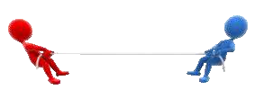
WHAT IS CONFLICT
Conflict can be defined in many ways and can be considered as an expression of opposition , negative attitudes and misunderstanding .
Conflict may arise between different organisations or within organisations , or between organisations and their social and political environments .

Slide 25
Definitions Of Conflict
According to Joe Kelly , “ Conflict is defined as opposition or dispute between persons,
groups or ideas ”.
According to Follett, “ Conflict is the presence of difference , difference of opinions, of interests ” .

Slide 26
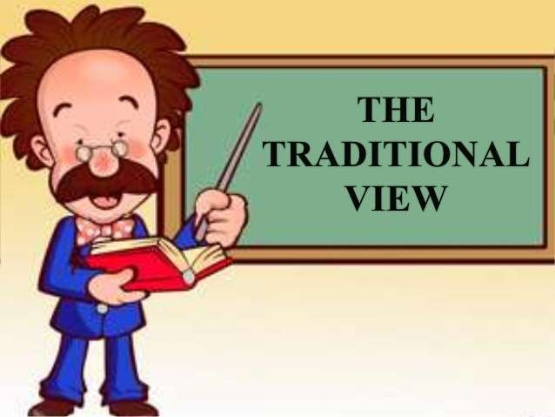
Views on conflict
(1930-1940)
Traditional view:
The early approach to conflict assumed that all conflict was bad.
Conflict was viewed negatively, and it was used with such terms as violence, destruction.

Slide 27
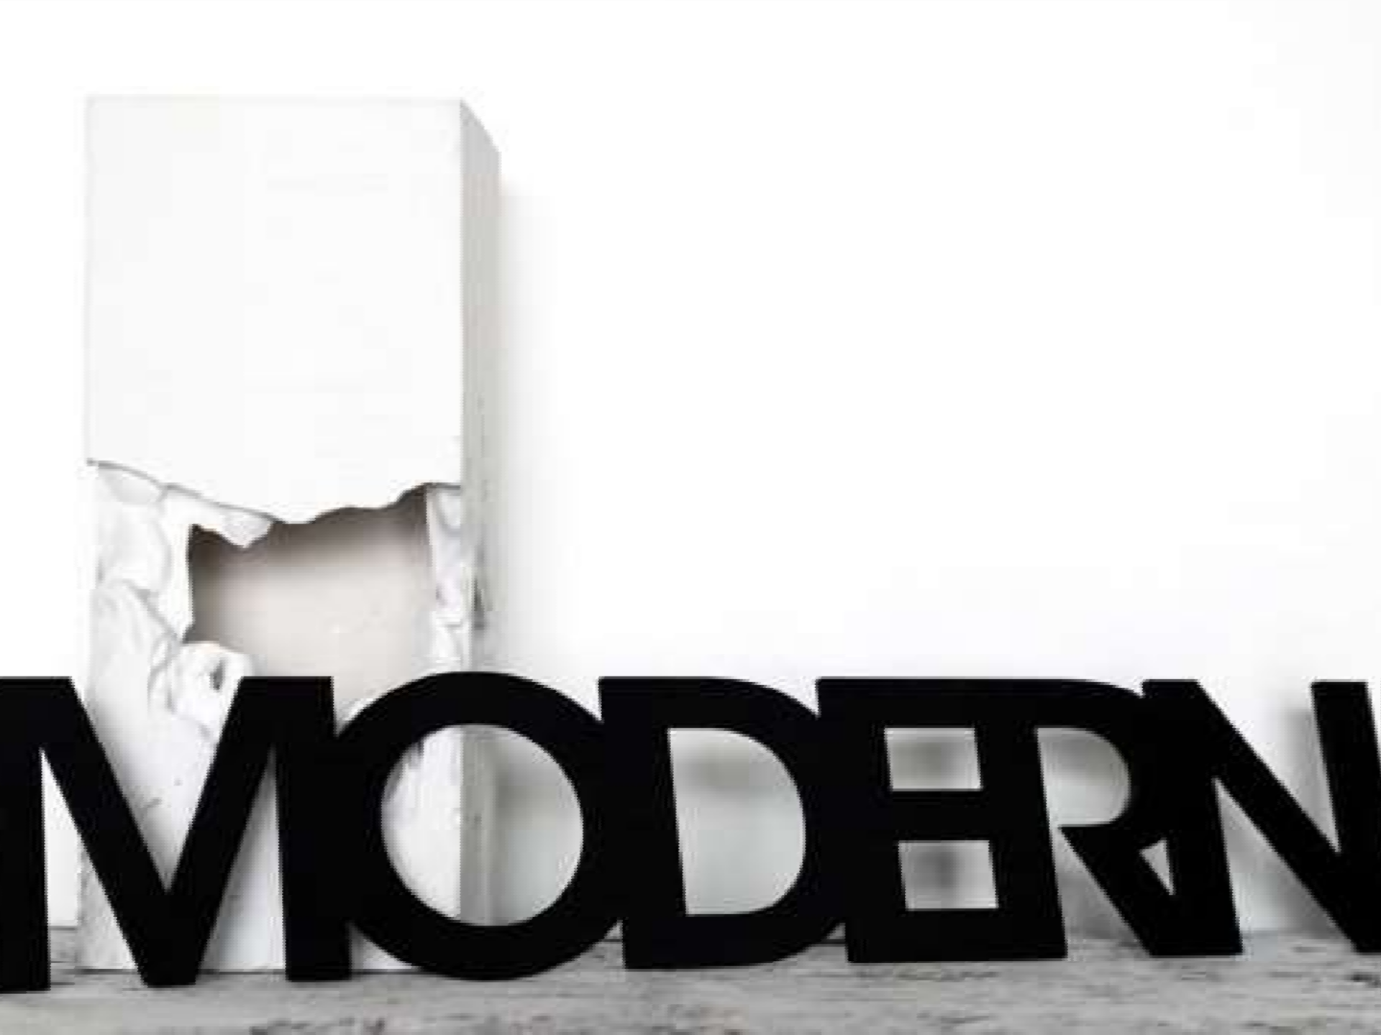
Conti…
Modern View: This view is based on the belief that conflict is not only a positive force in a group but is also necessary for a group to perform effectively. This approach encourages group leaders to maintain an ongoing minimum level of conflict – enough to keep the group viable and creative.

Slide 28
Types of Conflict
Conflict is good or bad depends on the type of conflict.
There are four types of conflict

Slide 29
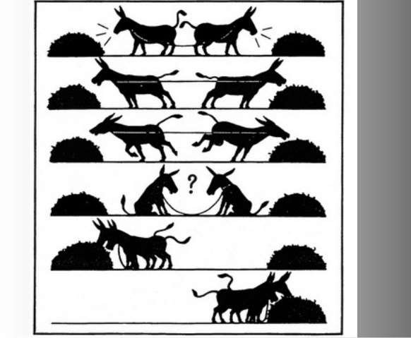
Constructive Conflict: works toward the goals of an organization or group
Constructive/Positive
Increase information & ideas
Encourages innovative thinking

Slide 30
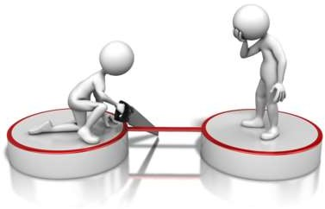
Destructive Conflict: blocks an organization or group from reaching its goals
Tension, anxiety, stress
Reduce trust
Reduce information

Slide 31
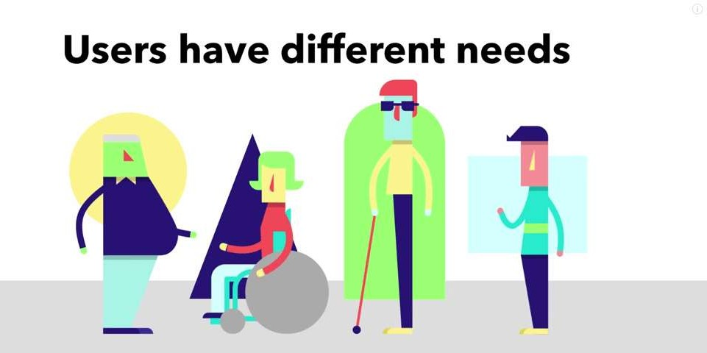
Task conflict - task conflict arises when two parties are unable to move forward on a task due to different needs, behaviors or attitudes. It can be conflict over organizational
policies resources
and procedures, distribution of or the method or means of
completing a task

Slide 32
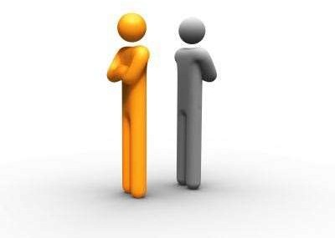
Relationship conflict - Relationship conflict is a conflict resulting from either personality clashes or negative emotional interactions between two or more people.

Slide 33
Stages of Conflicts
There is general agreement on four basic stages of conflict.

Slide 34
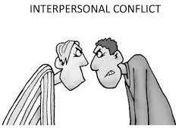
Interpersonal
Interpersonal: conflict among two or more individuals (for example, an argument between a boyfriend and girlfriend, or between a student and her/his teacher, or child and parent, or between friends/colleagues).

Slide 35
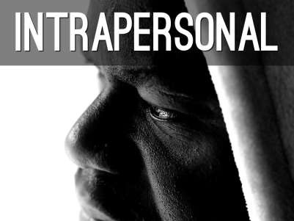
Intrapersonal
Intrapersonal: conflict within the individual (for example, a person
who cannot make decisions).

Slide 36
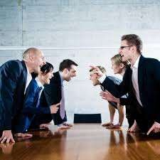
Intragroup
Intragroup: conflict within a group (for example, between members of the same work or football team).

Slide 37
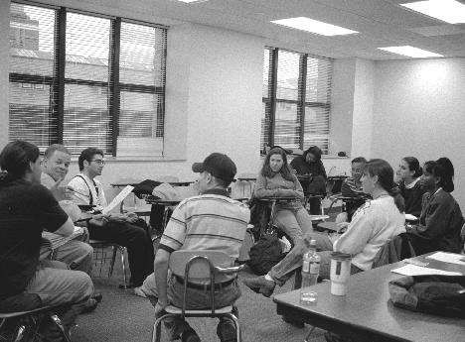
Intergroup
Intergroup: conflict between two or more groups (for example, between two different youth gangs, or between students and the school faculty).

Slide 38
Now……….
Individual Exercise

Slide 39
Conflict Table
I win
I lose
Win-Win | Lose-Win
Win-Lose | Lose-Lose
You win
You lose

Slide 40
Methods to deal with conflicts
Competition (win-lose situation)
Avoidance (lose-lose situation)
Compromise (lose-lose situation)
Collaboration (win-win situation)

Slide 41
Steps to resolve conflicts
Listen actively
Maintain equity
Focus on issue, not on personality
Encourage feedback
Identify alternate solutions
Give your positive feedback
Agree on an action plan

Slide 42
Conflict resolution techniques
Problem solving
Expansion of resources
Avoidance
Smoothing
Compromise

