Slide 1
Chapter -4 Gender and Research Mohsin Uddin

Slide 2
Home work-1 Marks-5
Prepare a Chart paper(A2 size) to depict the status of women in our society by taking/ pasting pictures and headlines that appear in Newspapers and magazines.

Slide 3
Home work-2 Marks-5
Collect slogans and quotations that question gender discrimination and promote gender equality.

Slide 4
Group/Individual Presentation
2-3 Students
15 slides
10 Marks
Topics
Gender, Personal Experience on Gender, violation of rights of girls and women, Dowry, Girls Education,
DATE: 22 APRIL 2019

Slide 5
Learning Objectives
After going through this unit, you will be able to:
Issues Related to Gender
Discuss the research methods

Slide 6
Opening Discussion
Identify the same and correct the statement to make it bias-free.
The chairman of the School Develop and Monitoring Committee addressed the parents.
A scientist is interested in the study of nature. He tries to find the laws that govern the natural phenomenon.
Plastic and cement are examples of man-made materials.
Men work in fields and the women do cooking and take care of childeren

Slide 7
Solution
(a) The chairperson of the School Develop and Monitoring Committee addressed the parents.
(b) A scientist is interested in the study of nature. He/she tries to find the laws that govern the natural phenomenon.
(c) Plastic and cement are examples of materials made by men and women.
(d) The men and women in the family work in the fields and together they do cooking and take care of children.

Slide 8
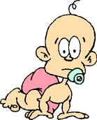
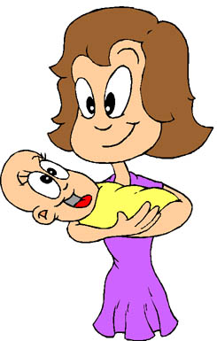
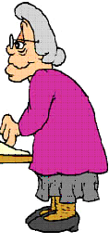
Neglect
Cannot benefit from the services
Violence
Social pressure
ADOLESENT/ADULT
Unwanted pregnancies,
Sexuel harassment/abuse
Smoking and
OLDERS
/problems on quality of life
CHILDHOOD
Nutrition problems

Slide 9
Understanding Gender-Based Violence-Issues
Discussion - Think of violence against women and violence against men.

Slide 10
Violence against Men | Violence against Women
Murder | Part of a woman's daily life
Planned | Dowry
For a reason- example over property, land, money, women | Sexual harassment
Men perpetrating violence against men | War crimes against women
Beaten up by a brother for teasing his | Rape as a weapon of revenge
Harassed by police | Child sexual abuse
Politics

Slide 11
ISSUES RELATED TO GENDER IN SCHOOL
The socialization of gender within our schools assures that girls are made aware that they are unequal to boys.
When different behaviors are tolerated for boys than for girls because 'boys will be boys', schools are continuing the oppression/domination of females.
There is some evidence that girls are becoming more academically successful than boys,
Girls are praised for being neat, quiet, and calm, whereas boys are encouraged to think independently, be active and speak up.

Slide 12
Difference between Patriarchy and Matriarchy
Characters | Patriarchy | Matriarchy
House Hold | Father is the head of the household | Mother is the head of the household
Power | The father has more power and control over others | The mother has more power and control over others
Property | The ownership of property goes to males. | The ownership of property goes to females
Governance | The society is governed by Males | The society is governed by females

Slide 13
Social Attitudes towards Girl’s Education
The social barriers and social attitudes standing in the way of girls attending schools - poverty, compulsions of older girls in families having to look after the home and siblings,
the conception or misconception that girls do not need education and/or that what is taught in schools is irrelevant to them, parents seeing limited (economic) benefits in educating daughters,
lack of women teachers and separate schools for girls, supportive facilities (like adequate and clean toilets in schools) and transport facilities to travel to school and back, all these inhibit parents from getting their girls enrolled.

Slide 14
Gender attribute
Males are more intelligent than females
Males are more self-confidence than females
Certain types of social activities are not suitable for women.
Males have greater tolerance to pain than females
Some jobs are more suitable to females than to males.
Household work is the duty of all women and girls

Slide 15
Biological attribute
Women may tolerate children.
Female voice is generally harsher than that of males.
For a women, the looks and character are more important than anything else

Slide 16
What is Research?
Search for an answer to a question /solution to a problem
to extend knowledge, unravel mysteries, build theories
To verify & test facts, predict events & derive causal explanations
To solve problems & achieve national development
Based on scientific method

Slide 17
Research Cycle
Problem
Findings
Objectives
Research
Strategy
Interpret
Gather
Data
Research Design
Literature Review

Slide 18
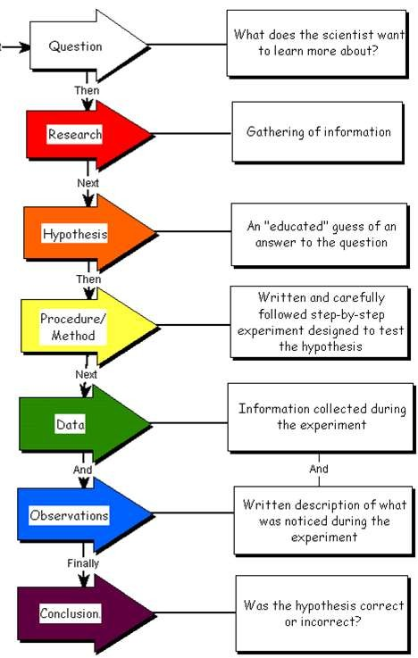
Scientific Methods

Slide 19
Approaches in Gender Research
Positivism : to establish the scientific laws of society –the causal relationship – which are arrived by testing hypothesis as in science
Intrepretivism : to build an understanding of the motives and intentions that support social behaviour
Critical Social Research : to ask critical questions with a view to changing society or to transform unequal power relationship

Slide 20
Hypothesis
A tentative proposition as to possible answers to a question
Guides the direction, suggests type of research

Slide 21
Steps in Scientific Methods
Systematic step by step procedure –
Observation,
Hypothesis,
Definition,
Data collection,
Analysis of data,
Conclusion

Slide 22
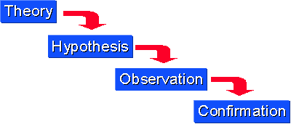
Deductive Reasoning
Applying a general principle to a specific case
All apples are fruits ( Major premises)
All fruits grow on trees ( Minor premise)
Therefore all apples grow on trees(conclusion)
False premise can lead to fake results
All sincere employees are sincere
Mohan is a regular employee
Hence Mohan is sincere
Establishes a logical relationship

Slide 23
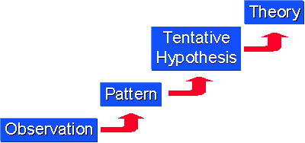
Inductive Reasoning
Studying several individual cases and drawing a generalization
Used when facts are studied, truths are un-covered
Induction involves observation and generalization

Slide 24
Types of Research
Pure Research : Basic, fundamental
Applied Research: Solution to a real life problem
Exploratory Research : Preliminary study of an unfamiliar problem
Diagnostic Study : Discovering what and why of happening
Descriptive Study : Fact finding investigation

Slide 25
Types of Research … Continued
Evaluation study: assess effectiveness
Action Research: Study to solve a problem
Experimental Research: assessing effect of a variable on a phenomenon
Analytical study: Analysis applied to data
Historical Research: Reconstructing origin & development
Survey Research : Fact finding

Slide 26
Types of Research … Continued
Case Study: study of a person, group or situation
Field Study: Community studies like survey
Quantitative Study: based on measurement of quantity
Qualitative Research : concerned with qualitative phenomenon
Empirical Research: trusts on experience or observation

Slide 27
What a Research Design is
Research Design is the structure of research
A systematic plan/outline/blue print
Without a plan research work will be unfocused, aimless
Research plan describes boundaries, help perceive problems

Slide 28
Method of Collection of Data
Data are facts or other materials for analysis/making testing of hypothesis possible
Observation : Gathering data by viewing
Interviewing: Involves face to face conversation
Mail Survey : Getting Questionnaire completed
Experimentation : Involves study of independent variables
Sociometry: Graphic representation of social relationship
Simulation : Involves creation of an artificial situation similar to the actual situation

Slide 29
Tools for Data Collection
Tool is an instrument used for research
Schedule for Interview
Observation schedule : Form for recording observation
Interview guide : Suggestive Reference
Check List : A list pertinent to an object
Rating Scale : Measuring attitude
Opinionnaire : List of questions to an issue
Document schedule
Schedule for Institutions : Used for survey of organizations

Slide 30
Life Skills a Researcher Needs to Develop
Reading : Books, news paper, magazines, manuals etc
Listening : to friends, radio, television
Watching : watch children, friends, social issues, tv
Choosing: choose deliberately
Questioning: Question the information we receive
Summarizing : summarize information. Organize it
Writing: to convey your mind to another mind

Slide 31
Why Qualitative Methods?
Positivist perspective: reality exists and can be studied
Common view: Qualitative methods help “to check, qualify, and enrich the findings from the more established analytical approaches.”
Qualitative approaches can provide insight into:
peoples’ perceptions and their observed practices: the why
and the how
process; change over time
“rich description” such as the multiple meanings associated with terms and behaviors
the individual’s point of view, a reminder that people are “active
participants in constructing their own future” (Booth et al. 2006)
the constraints of everyday life
5

Slide 32
Methods
Vision for Mixed
Initial qual interviews →
Quant pretest
Quant survey & analysis
Indepth qual interviews
Approach
A sequenced interactive approach of qualitative and quantitative methods and analysis
Ground truthing
6

Slide 33
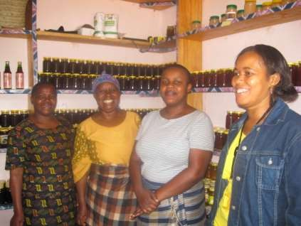
Why Qualitative Methods for Gender
Research?
Make visible women’s life experiences
Differentiate men’s and women’s views
multiple meanings
Allows for responses
7

Slide 34
Data Collection Methods: Interviews
Interview Principles
A conversation with a purpose
Use a questionnaire Express ignorance
One question at a time
Let the interviewee finish talking…
Key Informant Interviews
Group Interviews
Focus Group Discussions

Slide 35
Asking Questions
qualitative ≠ random
but can be Structured/Semistructured/Unstructured Discrete or Open-ended questions
Descriptive questions (broad, general) and allow people to describe their experiences and their daily activities, e.g., “Tell me about a typical day.”
Structural questions explore responses to descriptive questions. They are used to understand how the respondent organizes knowledge.
Avoid asking the informant questions that make him or her do the analytical work for you. Instead of asking, “What do you mean that it is “too hard” to find workers at planting time?” you might ask, “What efforts did you take to find workers at planting time?” or “Give me an example of what you did to find workers.”
9

Slide 36
Key Informant Interviews
sample bias
Dominant narratives
Too many men
Too many wealthier or higher status women (e.g., , lead farmers, married women only, etc.)
Who are Key Informants?
They have specialized knowledge
They represent larger group
They are influential
They are gatekeepers

Slide 37
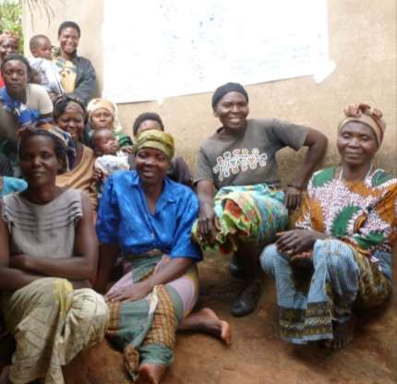
Group Interviews
All members are encouraged to participate; easiest with more homogeneous groups
Can be structured, semi- structured, or open-ended interview schedule
Can accommodate about
15 people

Slide 38
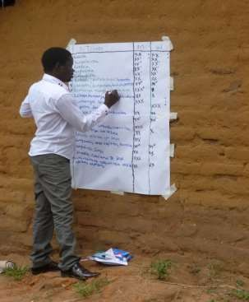
Value Chain Group Interview
Purpose: To understand the activities of men and women in the value chain
Task | Women | Men
Preparing the land | X | XXXX X**
Planting | XXXXX**
Input use | XX | XXXX
Weeding | XXXXX** | XX
Harvesting | XXX | XXX
Post-harvest activities (sorting, grading, shelling, packing) | XXXXXXX
12

Slide 39
A Special Type of Group Interview:
Focus Group Discussions
Historically, the FGD was used to test specific positions or findings with a defined group (think shampoo):
What are your experiences with [selected topic]?
What are the challenges to changing people attitudes about [selected topic]?
What actions can be taken to address [selected topic]?
Allows individuals to hear from other participants in the group in a way that creates new ideas and sometimes influences previously held opinions.
The goal of the focus group is to see which views are more widely held and to clarify their meaning.
13

Slide 40
Data Analysis Process The art of interpretation:
“From field notes to filed notes”
Data reduction
Compilation
Cleaning
Coding
Data display
Charts, tables, figures, maps
Verification and conclusions

Slide 41
LET US SUM UP

