Slide 1
International Economics II
Price level and the Exchange Rates 2
HE Educator : Dr. Waqar Ahmad

Slide 2
Learning Objectives
A model of real monetary assets and interest rates
A model of real monetary assets, interest rates, and exchange rates
Long run effects of changes in money on prices, interest rates, and exchange rates

Slide 3
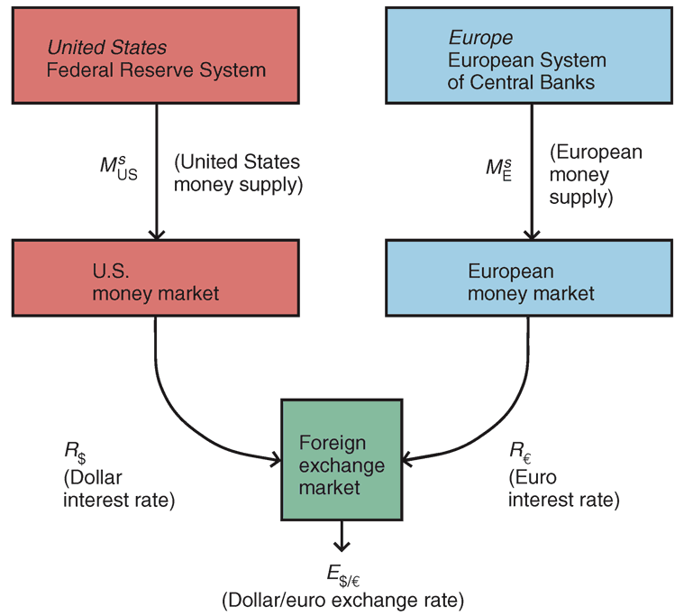
Fig 14-7: Money Market/Exchange Rate Linkages

Slide 4
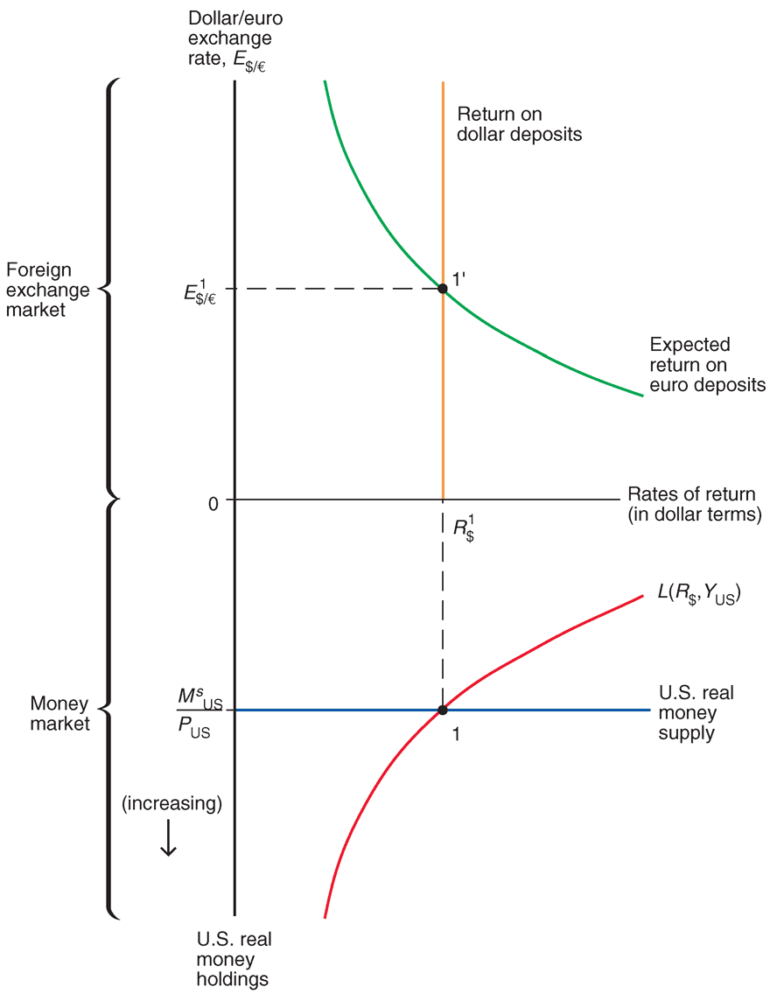
Simultaneous Equilibrium in the U.S. Money Market and the Foreign Exchange Market

Slide 5
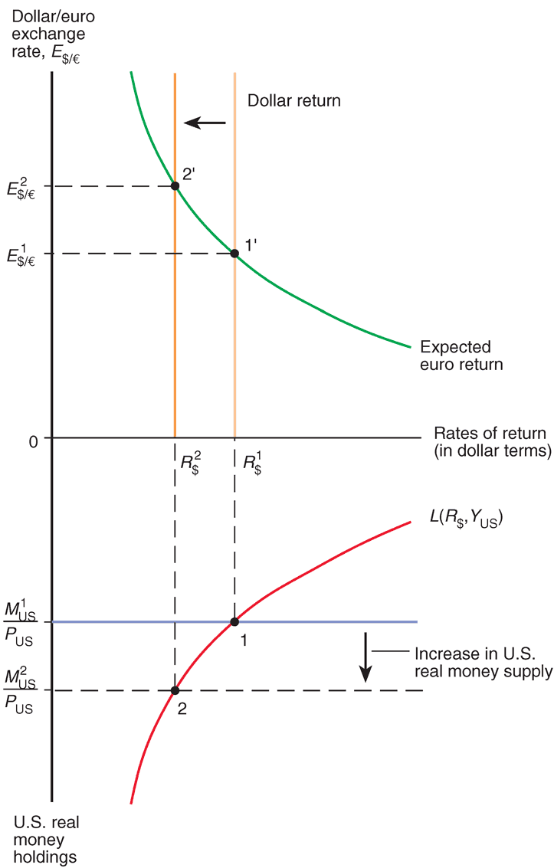
Effect on the Dollar/Euro Exchange Rate and Dollar Interest Rate of an Increase in the U.S. Money Supply

Slide 6
Changes in the Domestic Money Supply
An increase in a country’s money supply causes interest rates to fall, rates of return on domestic currency deposits to fall, and the domestic currency to depreciate.
A decrease in a country’s money supply causes interest rates to rise, rates of return on domestic currency deposits to rise, and the domestic currency to appreciate.

Slide 7
Changes in the Foreign Money Supply
How would a change in the supply of euros affect the U.S. money market and foreign exchange markets?
An increase in the supply of euros causes a depreciation of the euro (appreciation of the dollar).
A decrease in the supply of euros causes an appreciation of the euro (a depreciation of the dollar).

Slide 8
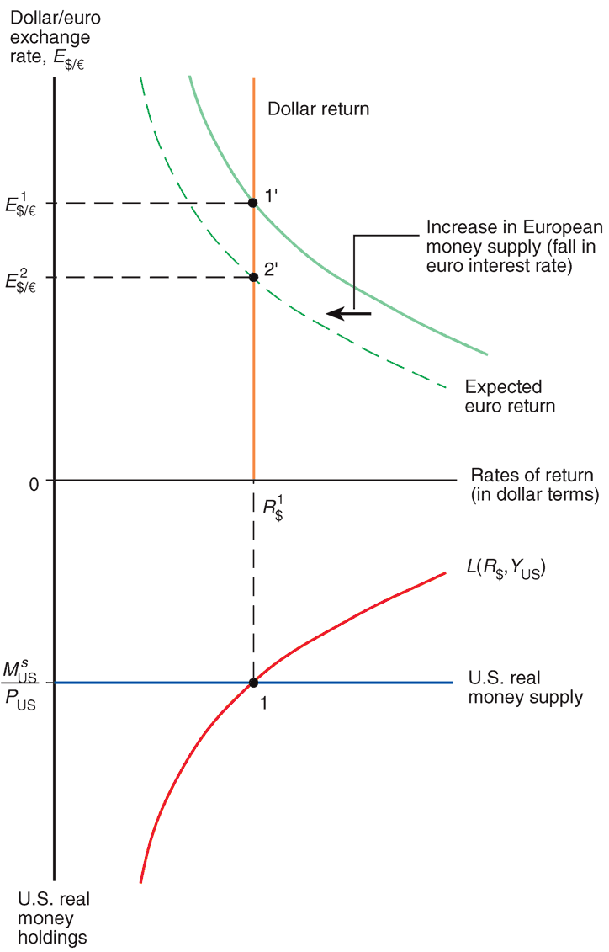
Effect of an Increase in the European Money Supply on the Dollar/Euro Exchange Rate

Slide 9
Changes in the Foreign Money Supply (cont.)
The increase in the supply of euros reduces interest rates in the EU, reducing the expected rate of return on euro deposits.
This reduction in the expected rate of return on euro deposits causes the euro to depreciate.
We predict no change in the U.S. money market due to the change in the supply of euros.

Slide 10
Long Run and Short Run
In the short run, prices do not have sufficient time to adjust to market conditions.
the analysis heretofore has been a short run analysis.
In the long run, prices of factors of production and of output have sufficient time to adjust to market conditions.
Wages adjust to the demand and supply of labor.
Real output and income are determined by the amount of workers and other factors of production—by the economy’s productive capacity—not by the quantity of money supplied.
(Real) interest rates depend on the supply of saved funds and the demand of saved funds.

Slide 11
Long Run and Short Run (cont.)
In the long run, the quantity of money supplied is predicted not to influence the amount of output, (real) interest rates, and the aggregate demand of real monetary assets L(R,Y).
However, the quantity of money supplied is predicted to make level of average prices adjust proportionally in the long run.
The equilibrium condition M^{s}/P = L(R,Y) shows that P is predicted to adjust proportionally when M^{s} adjusts because L(R,Y) does not change.

Slide 12
Long Run and Short Run (cont.)
In the long run, there is a direct relationship between the inflation rate and changes in the money supply.
M^{s} = P x L(R,Y)
P = M^{s}/L(R,Y)
ΔP/P = ΔM^{s}/M^{s} - ΔL/L
The inflation rate is predicted to equal the growth rate in money supply minus the growth rate in money demand.

Slide 13
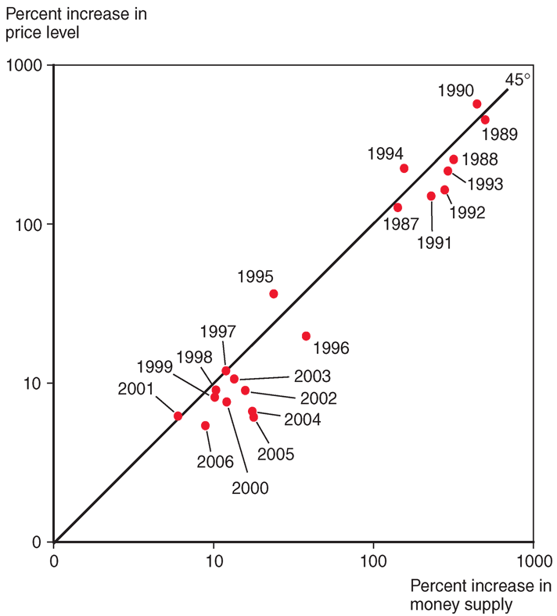
Average Money Growth and Inflation in Western Hemisphere Developing Countries, by Year, 1987–2006
Source: IMF, World Economic Outlook, various issues. Regional aggregates are weighted by shares of dollar GDP in total regional dollar GDP.

Slide 14
Money and Prices in the Long Run
How does a change in the money supply cause prices of output and inputs to change?
Excess demand of goods and services: a higher quantity of money supplied implies that people have more funds available to pay for goods and services.
To meet high demand, producers hire more workers, creating a strong demand of labor services, or make existing employees work harder.
Wages rise to attract more workers or to compensate workers for overtime.
Prices of output will eventually rise to compensate for higher costs.

Slide 15
Money and Prices in the Long Run (cont.)
Alternatively, for a fixed amount of output and inputs, producers can charge higher prices and still sell all of their output due to the high demand.
Inflationary expectations:
If workers expect future prices to rise due to an expected money supply increase, they will want to be compensated.
And if producers expect the same, they are more willing to raise wages.
Producers will be able to match higher costs if they expect to raise prices.
Result: expectations about inflation caused by an expected increase in the money supply causes actual inflation.

Slide 16
Money, Prices, Exchange Rates, and Expectations
When we consider price changes in the long run, inflationary expectations will have an effect in foreign exchange markets.
Suppose that expectations about inflation change as people change their minds, but actual adjustment of prices occurs afterwards.

Slide 17
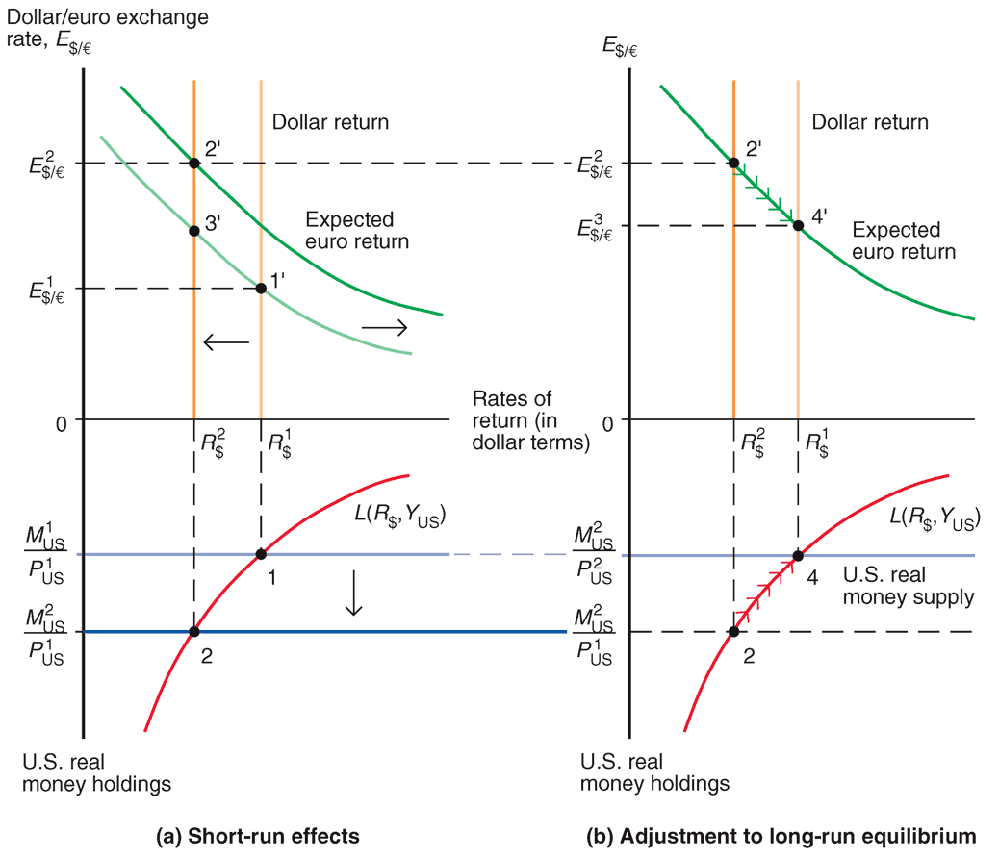
Short-Run and Long-Run Effects of an Increase in the U.S. Money Supply (Given Real Output, Y)
Change in expected
return on euro deposits
The expected return on euro deposits rises because of inflationary expectations:
The dollar is expected to be less valuable when buying goods and services and less valuable when buying euros.
The dollar is expected to depreciate, increasing the return on deposits in euros.

Slide 18
Short-Run and Long-Run Effects of an Increase in the U.S. Money Supply (Given Real Output, Y)
Original (long run) return
on dollar deposits
As prices increase,
the real money supply decreases and the domestic interest rate returns to its long run rate.

Slide 19
Money, Prices, and Exchange Rates in the Long Run (cont.)
A permanent increase in a country’s money supply causes a proportional long run depreciation of its currency.
However, the dynamics of the model predict a large depreciation first and a smaller subsequent appreciation.
A permanent decrease in a country’s money supply causes a proportional long run appreciation of its currency.
However, the dynamics of the model predict a large appreciation first and a smaller subsequent depreciation.

Slide 20
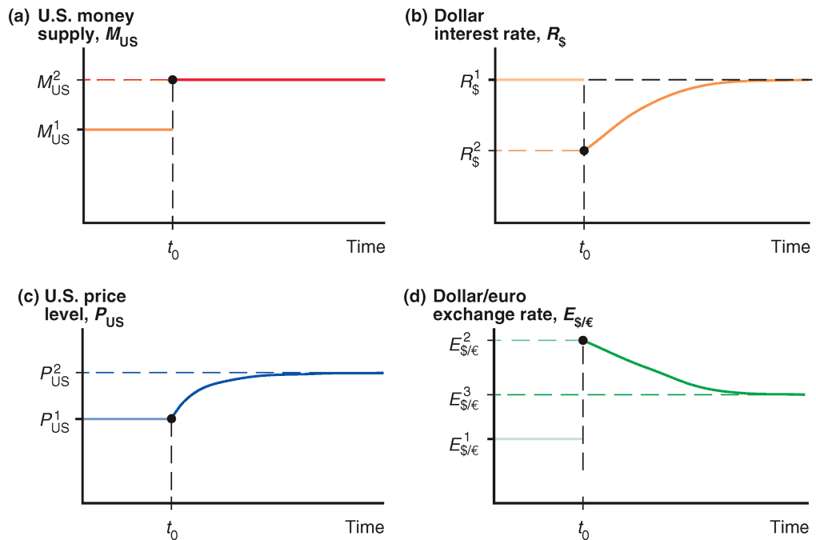
Time Paths of U.S. Economic Variables After a Permanent Increase in the U.S. Money Supply

Slide 21
Exchange Rate Overshooting
The exchange rate is said to overshoot when its immediate response to a change is greater than its long run response.
Overshooting is predicted to occur when monetary policy has an immediate effect on interest rates, but not on prices and (expected) inflation.
Overshooting helps explain why exchange rates are so volatile.

Slide 22
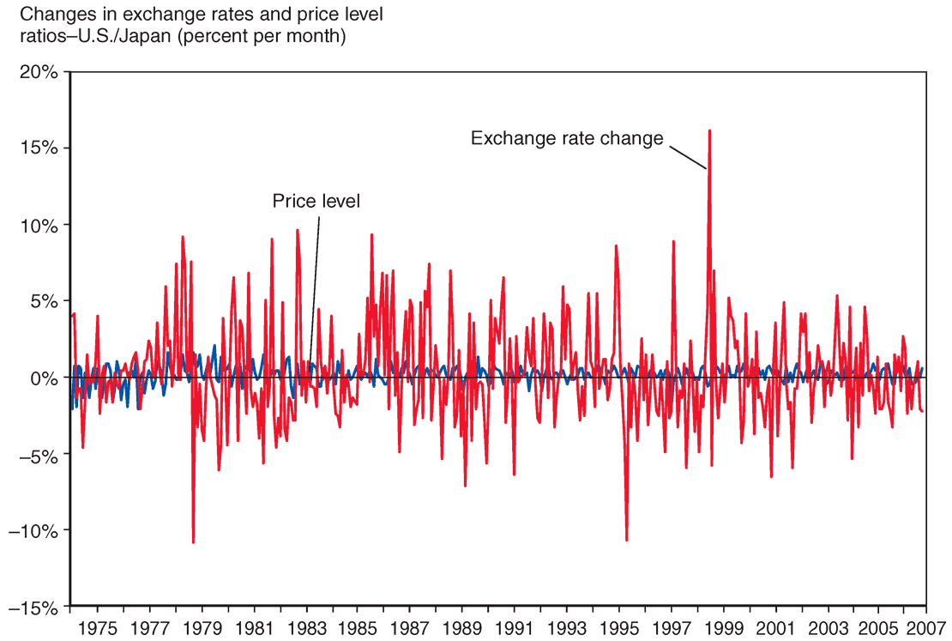
Month-to-Month Variability of the Dollar/Yen Exchange Rate and of the U.S./Japan Price Level Ratio, 1974–2007
Changes in price
levels are less
volatile, suggesting
that price levels
change slowly.
Exchange rates are influenced by interest rates and
expectations, which may change rapidly, making exchange rates volatile.
Source: International Monetary Fund, International Financial Statistics

Slide 23
Summary
Money demand for individuals and institutions is primarily determined by interest rates and the need for liquidity, the latter of which is influenced by prices and income.
Aggregate money demand is primarily determined by interest rates, the level of average prices, and national income.
Aggregate demand of real monetary assets depends negatively on the interest rate and positively on real national income.

Slide 24
Summary (cont.)
When the money market is in equilibrium, there are no surpluses or shortages of monetary assets: the quantity of real monetary assets supplied matches the quantity of real monetary assets demanded.
Short run scenario: changes in the money supply affect domestic interest rates, as well as the exchange rate.
An increase in the domestic money supply
lowers domestic interest rates,
lowering the rate of return on deposits of domestic currency,
causing the domestic currency to depreciate.

Slide 25
Summary (cont.)
Long run scenario: changes in the quantity of money supplied are matched by a proportional change in prices, and do not affect real income and real interest rates.
An increase in the money supply
causes expectations about inflation to adjust,
causing the domestic currency to depreciate further,
and causes prices to adjust proportionally in the long run,
causing interest rates return to their long run values,
and causes a proportional long run depreciation in the domestic currency.

Slide 26
Summary (cont.)
Interest rates adjust immediately to changes in monetary policy, but prices and (expected) inflation may adjust only in the long run, which results in overshooting of the exchange rate.
Overshooting occurs when the immediate response of the exchange rate due to a change is greater than its long run response.
Overshooting helps explain why exchange rates are so volatile.

