Slide 1

Production function, single variable-law of variable proportion, two variable- law of return to scale, cost and analysis, short – run and long run cost curve and its managerial use
Week -7
Prepared by: Dr Waqar Ahmad, Asstt. Prof.

Slide 2

Learning Objectives
What is Production
Factors of Production
Production function
Law of variable Proportions
Law of return to Scale
Product Optimisation
Economics & Diseconomies of Scale

Slide 3

What is Production ?
Making something material
Economics
Converts the recourses of nature to satisfy human wants.
Actively directed towards the satisfaction of wants of people by
converting.
Physical input into physical output.
Example:- making of cloth, service of doctors, lawyers, teachers, actors and dancers etc
Production of creation of utility – Raw material to finished goods
Place Utility- Extraction from earth to transforming goods
Time utility – making them available at the time when required
Personal utility- personal utility

Slide 4
Factors of Production
Factors or resources which makes
Production possible
Land
Labour
Capital
Entrepreneur

Slide 5

Land
Not limited to soil or earth surface but includes –all free gift
of nature , water, air, natural vegetation etc.
Characteristics
1. Nature Gifts
2. Supply is fixed
3. Indestructible power
4. Passive factors
5. Different uses

Slide 6
Labour
Intentions to economics, it is mental or physical excretion for
reward and not for pleasure /love
Ex- work of maid vs work of homemaker
Characteristics
1. Human effort
2. Perishable
3. Inseparable form labourer
4. Power differ to labourer to labour
5. All labourer not productive
6. Poor bargaining power
7. Choice hours of labour vs hours of leisure
8. Mobile

Slide 7
Capital
Part of wealth used for further production of wealth
Capital vs wealth
Capital stock vs income flow concept
Man made instrument of production
Help in production
Types of Capital
1. Fixed capital
2. Circulation capital
3. Real capital
4. Human capital
5. Tangible capital
6. Intangible capital
7. Individual capital
8. Social capital

Slide 8
Capital Formation
Increase in stock of real capital
Investment
Replacement, renovation & additional investment
Cut down current production & use for capital goods
Stages of capital formation
1. Saving
2. Mobilisation of saving
3. Investments

Slide 9
Entrepreneur
Organiser, risk taker, manager initiate production work &
bear risk
1. Function
2. Initiating business enterprise & resource
coordination
3. Risk bearing & uncertainty bearing
4. Innovations: Schumpeter introduce new
5. Innovations

Slide 10
Production Function
Prof. Koutsoyiannis:
‘’The production function is purely its inputs and output technical relation which connects factor’’
Prof. Watson
“The relation between a firm’s production and material factors of production”
Q=f(K,L, N)
Q= Quantity, f=Function, K= Capital, L=Labour, N=Land

Slide 11
Types of Production Function
Production Function
Short Run Production Long Run Production
Return to a factor Return to scale
One variable factor All factors are variable
and other are fixed
Low of variable Low of return

Slide 12
Features of Production Function
Sustainability
Complementary
Specificity

Slide 13
Assumption of Production Function
Particular Unit of time
Technical knowledge
Factors of production are divisible into most viable units
Producers using best technique available.

Slide 14
Cob-Douglas Production Function
Cob-Douglas Production function is based on the empirical study
by Paul H. Douglas and C.W. Dobb.
It is the linear homogenous production function of degree which
takes into consideration two inputs.
Labour
Capital
Cob-Douglas production function can be expressed as.
Q= KL C
Where Q is the output L and C are Labour and capital(input)
respectively.
K, a are positive constants where 0<a<1.
a
a-1

Slide 15
Properties of Cob-Douglas production function
1. Contribution
Labour ¾, Capital ¼
The Equation tells that output depend directly on L and K and that part of output which cannot be explained by L and K is explained by A which is residual often called technical change.
Its is homogeneous function and the degree of its homogeneity is given the sum of exponent.
Its is based on constant return to scale.

Slide 16
S
R
C3
300
P
Capital
C2
200
Q
C1
100
O
L1
L2
L3
Labour

Slide 17
Law of Variable proportions

Slide 18
Law of Production
Laws of Production
Laws of Variable Proportion Laws of Returns

Slide 19
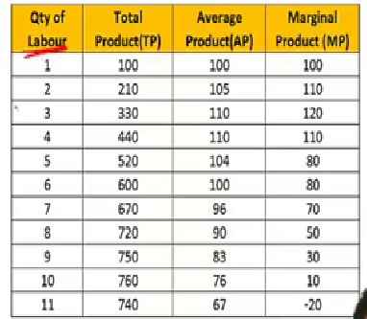
Meaning
Total Product (TP)
Sum of MP
Average Product (AP)
TQ/Q
(Quantity of Labour or quantity of factors of production eg. Labour)
Marginal Product (MP)
TPn -TP n-1

Slide 20
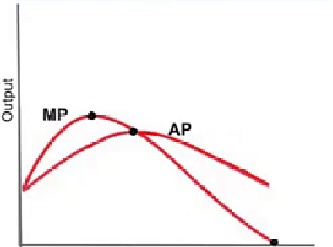
Relationship of AP & MP
  Amount of Variable factor
When AP rise : MP > AP
When AP is Max : MP = AP
When AP Falls : MP < AP
Ex.: Magnet

Slide 21
Law of variable Proportions
Input – Output relationship with by varying one factor of
production.
Law operate under short run
Short run is period where only one FOP is variable and other are fixed or constant.
Assumption of law of variables Proportion
State of technology remain unchanged
One factors is changed other are constant
Not when factors are to used in fixed proportions
Input & Output not profitability

Slide 22
Law of variable Proportions
According to Benham
As the proportion of the factor in a combination of factors is
increased after a point, first the marginal and then the average
product of that factor will diminish.
According to Stigler
As equal increment of one input are added, the input of
other productive services being held constant, beyond a certain
Point the resulting increment of product will decrease that the
marginal product will diminish.
It happens in 3 stages
Law of Increasing Return (Production increasing in increasing rate)
Law of Diminishing return (Production increasing at a diminishing rate)
Law of Negative return (Production starts to decrease)

Slide 23
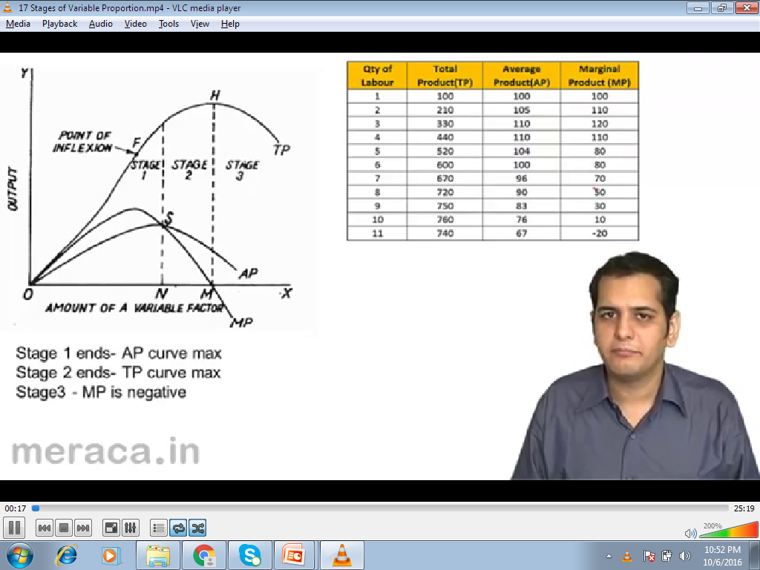
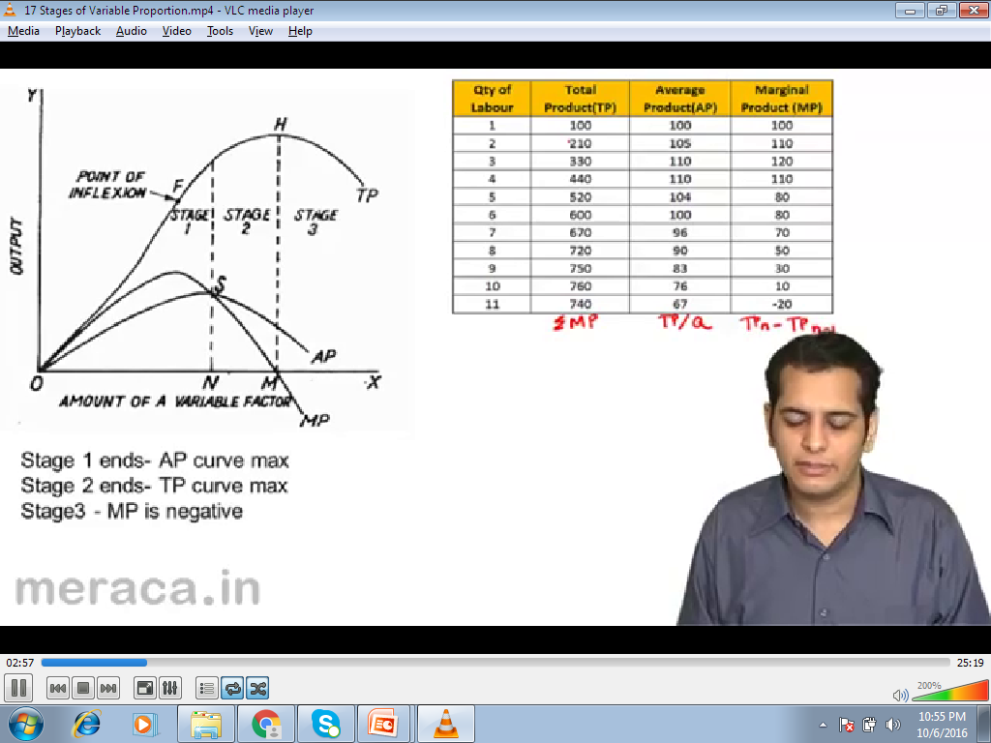
Law of variable Proportions

Slide 24
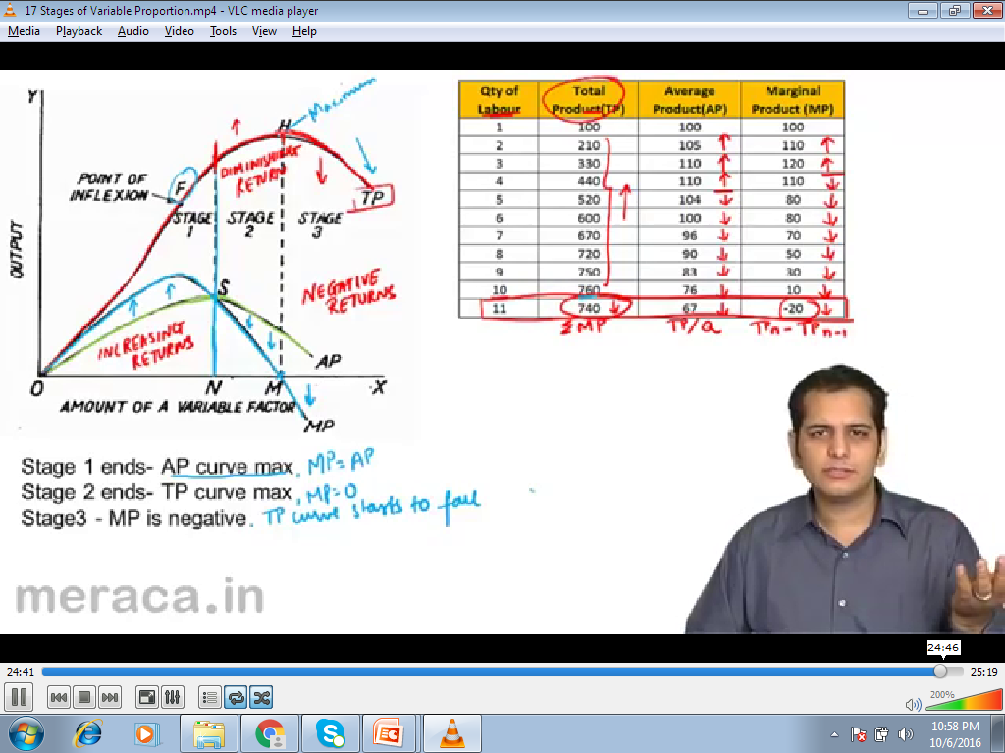
Law of variable Proportions

Slide 25
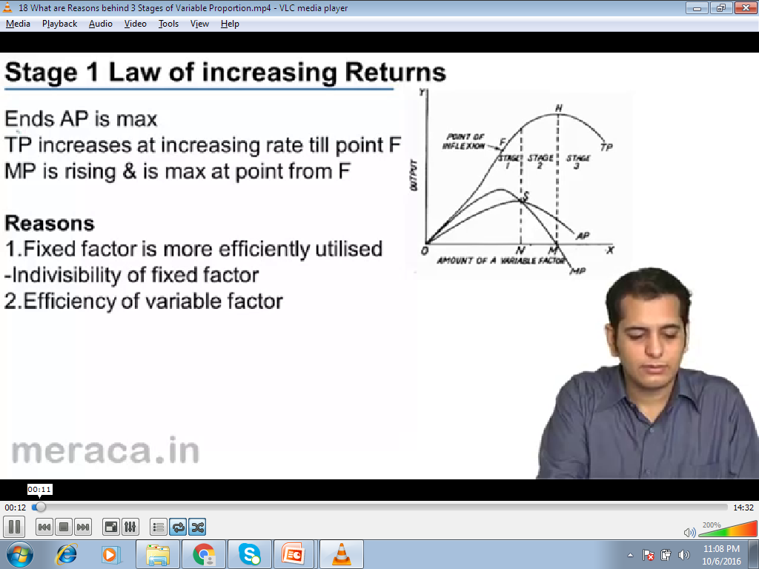
Stage 1. Law of Increasing return
1. Ends AP is MAX
2. TP increase at increasing rate till point F
3. MP is rising & is max. at point from F
Reasons
1. Fixed factors is more efficiently utilized Indivisibility of
fixed factor.
2. Efficiency of variable factor

Slide 26
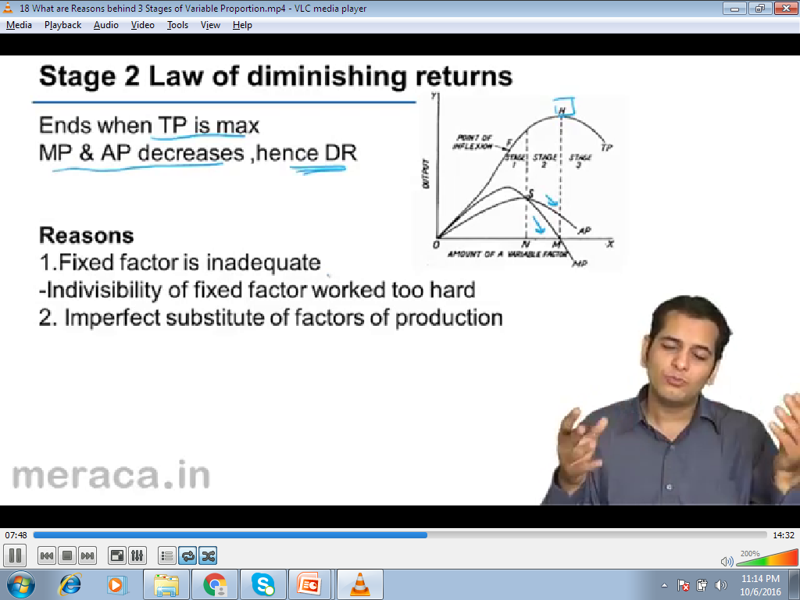
Stage 2. Law of Diminishing return
1. Ends when TP is MAX
2. MP & AP decrease, hence DR
Reasons
1. Fixed factors is inadequate.
- indivisibility of fixed factors worked too hard.
2. Imperfect substitute of factors of production.

Slide 27
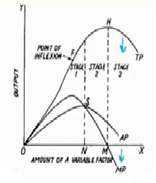
Stage 3. Law of Negative Return
1. MP is negative
Reasons
1. Quantity of variable factor too excessive for fixed
factor

Slide 28
Law of Return to Scale

Slide 29
Return to Scale
Study of production in long run
All the factors are increased together
Change in output due to change in scale
Change in scale vs change in variable proportion
1. Constant return to scale (a+b=1) 2acer+200 = 2000units
2. Increasing return to scale (a+b>1) 2acers+200 = 2500 units
3. Decreasing return to scale (a+b<1) 2acers+200= 1500 units

Slide 30
Comparison between
laws of Variable Proportion vs Return to scale
1. Short run vs Long Run
2. One factors of production vs all
factors of production change
3. Change in factors proportion vs
change in scale

Slide 31
Production Optimisation

Slide 32
Production Optimisation
What combination of factors of production.
Minimise production cost?
1. Isoquants
2. Isocost Lines

Slide 33
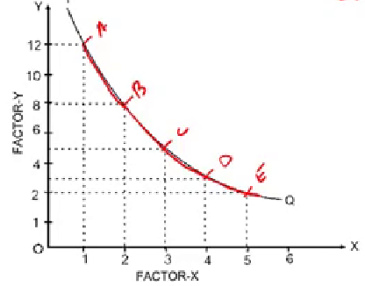
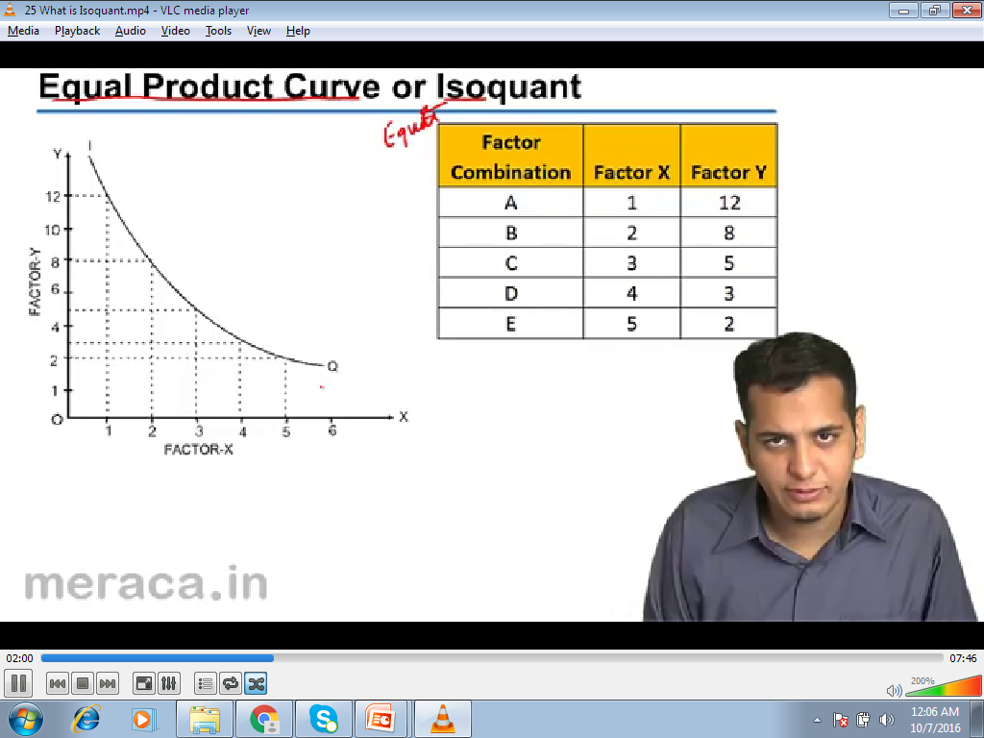
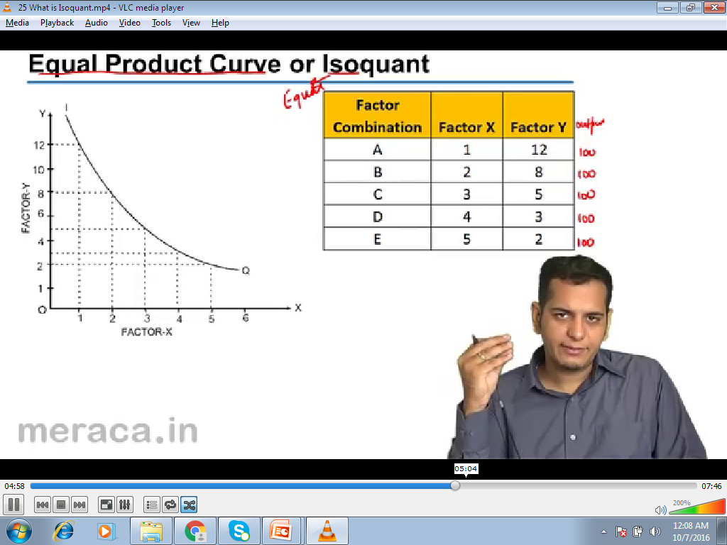
Isoquants
It is also known as Equal Product Curve or ISO Product Curve
or Production difference curve or Constant product curve
Isoquants is a curve which represents different combination of two factors which yield same level of output.

Slide 34
Properties of Isoquants Curve
Similar to indifference curve of theory of consumer behaviour
Combination of inputs giving same level output.
Equal Product or Equal product curve.
Producer is indifferent between them
Production – indifference curve
IC not possible to quantify the level of satisfaction.
IQ Level of production can be identified.

Slide 35
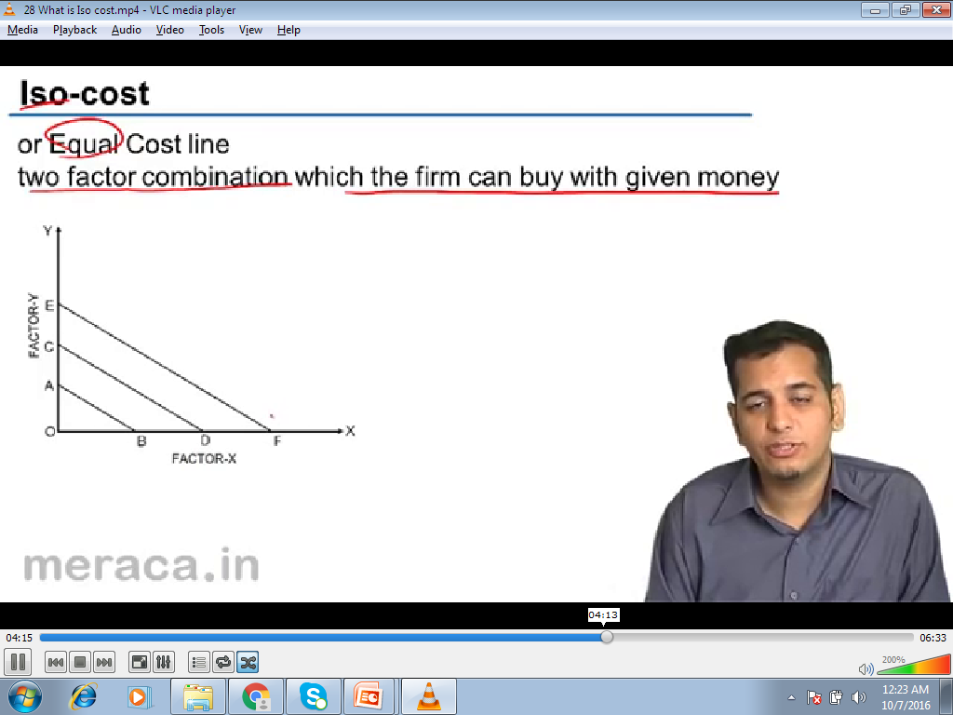
Iso-cost lines
Iso-Cost Line may be defined as the line which shows different possible combinations of two factors that the producer can afford to buy given his total expenditure to be incurred on these factors and price of the factors

Slide 36
Producers Equilibrium

Slide 37
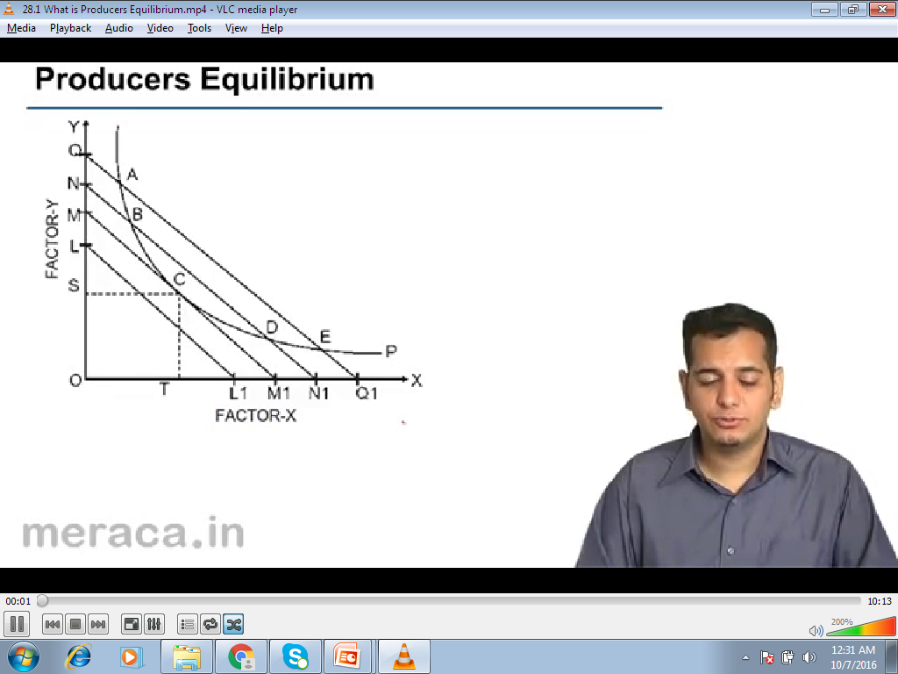
Producers Equilibrium

Slide 38
Producers Equilibrium
The object of the firm is to obtain the least cost
combination of the Factors production.
This can be drawn having the information of :
iso-product map
Iso- cost line
The Iso- product curve map curve shows a
given level of output that can be obtained by
different combination of factors, labour and
capital.

Slide 39
Properties of Producers
Equilibrium
1. Iso-Quants represents technical conditions of
production
2. Iso-Cost lines represent level of cost
3. Least cost = tangency point of the given Isoquant
with the Iso-cost.

Slide 40
Cost and analysis

Slide 41
The Nature of Costs
Explicit Costs
  Accounting Costs
  arise from transactions in which the firm purchases inputs or the services of inputs from other parties
Economic Costs
  Implicit Costs
  Explicit cost
  Alternative or Opportunity Costs

Slide 42
  Implicit Costs
  costs associated with the use of the firm’s own resources and reflect the fact that these resources could be employed elsewhere
  Sunk Costs

Slide 43
Short-Run Cost
Total fixed cost (TFC) – the cost incurred by the firm that does not depend on how much output it produces
Total variable cost (TVC) – the cost incurred by the firm that depends on how much output it produces

Slide 44
Total cost (TC) – the sum of total fixed and total variable cost at each output level
Marginal cost (MC) – the change in total cost that results from a one-unit change in output
Average fixed cost (AFC) – total fixed cost divided by the amount of output
Average variable cost (AVC) – total variable cost divided by the amount of output
Average total cost (ATC) – total cost divided by the output

Slide 45
Short-Run Cost Functions
Total Cost = TC = f(Q)
Total Fixed Cost = TFC
Total Variable Cost = TVC
TC = TFC + TVC

Slide 46
Short-Run Cost Functions
Average Total Cost = ATC = TC/Q
Average Fixed Cost = AFC = TFC/Q
Average Variable Cost = AVC = TVC/Q
ATC = AFC + AVC
Marginal Cost = ΔTC/ΔQ = ΔTVC/ΔQ

Slide 47
Short-Run Cost Functions

Slide 48
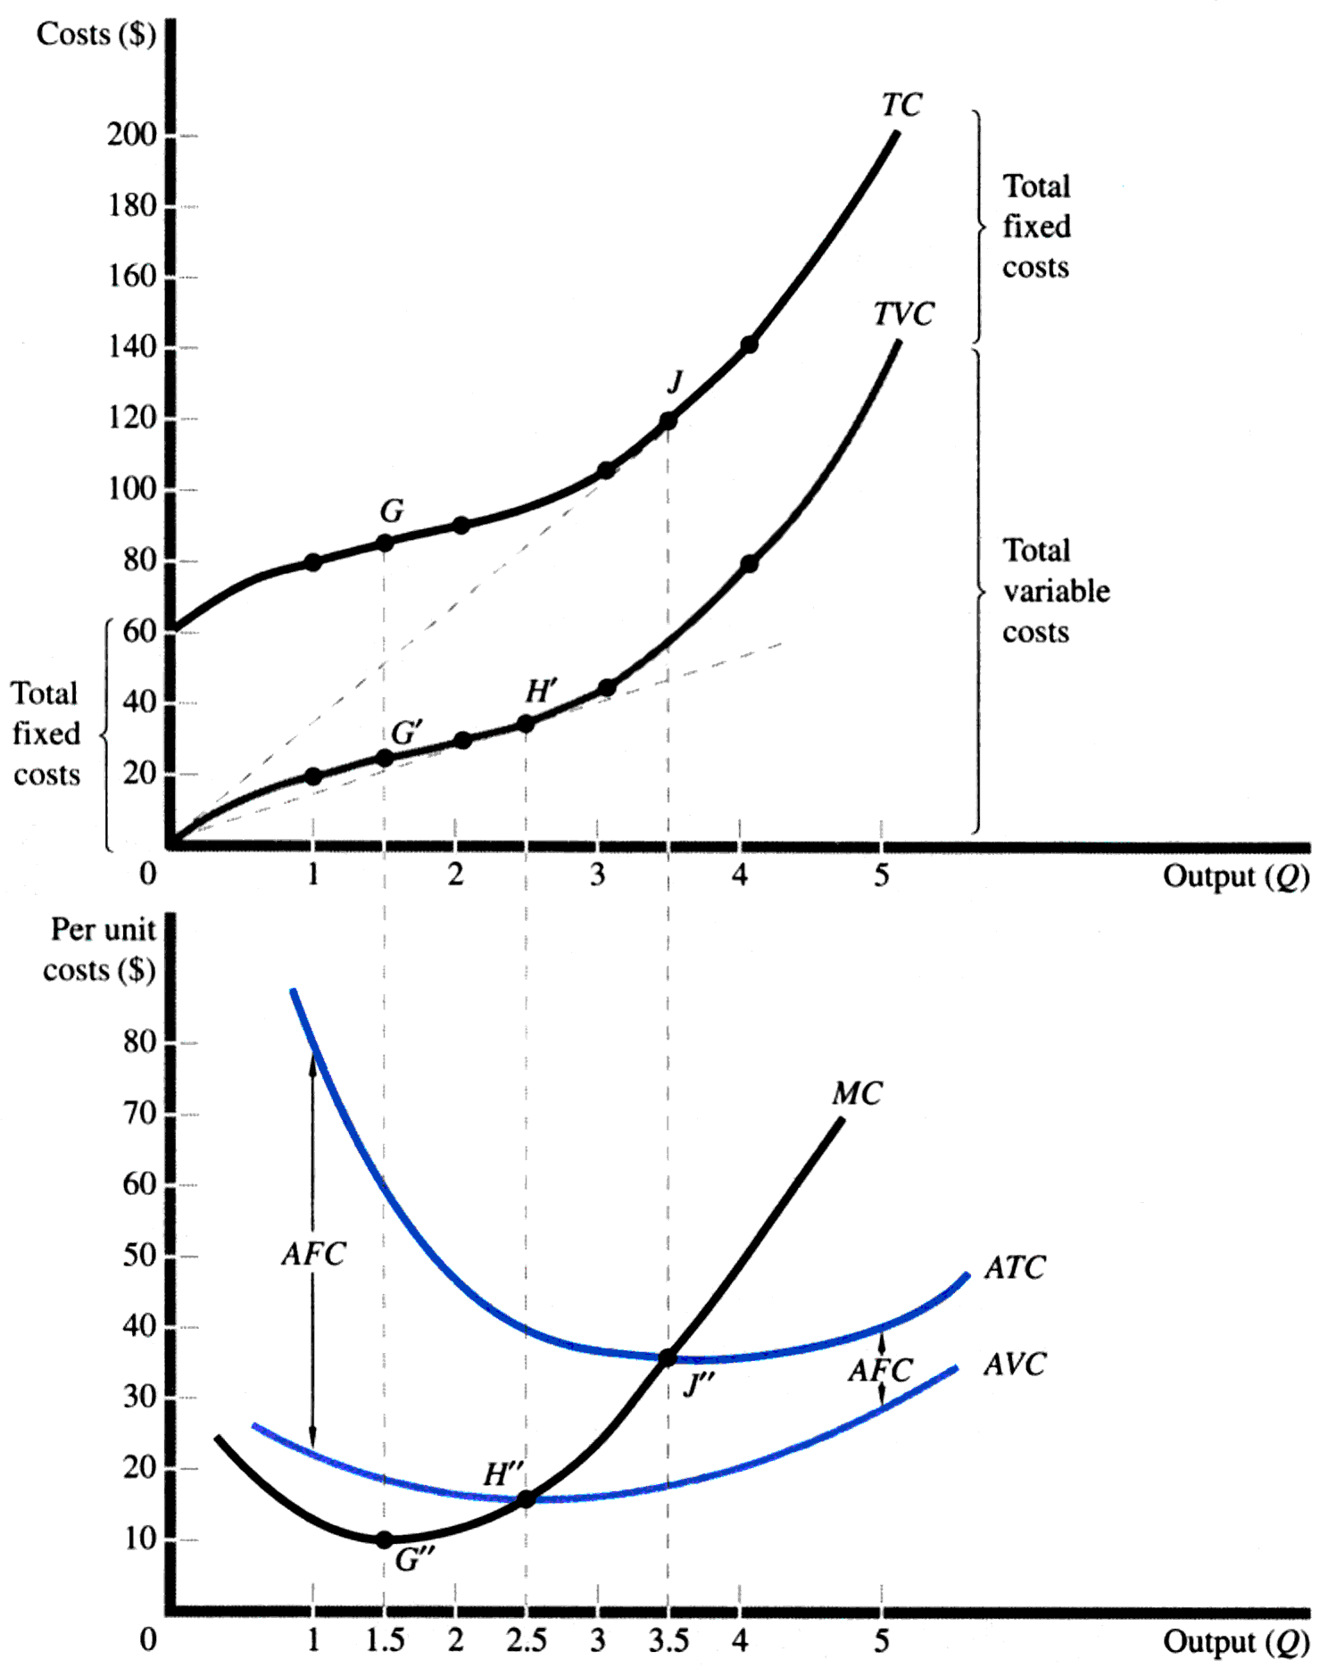

Slide 49
Behind Cost Relationships
The shape of the TVC curve is determined by the shape of the TP curve, which in turn reflects diminishing marginal returns.

Slide 50
Short-Run Cost Curves

Slide 51
Marginal Cost
The marginal product curve of the variable input generally rises and then falls, attributable to the law of diminishing marginal returns.
As a result, the MC curve will first fall and then rise

Slide 52
Average Cost
The average product curve rises, reaches a maximum, and then falls, due to the law of diminishing marginal productivity.
As a result, the AVC curve will fall and then rise.
The AFC curve declines over the entire range of output as the amount of total fixed cost is spread over ever-larger rates of output.
The ATC curve is the sum of AFC and AVC. It measures the average unit cost of all inputs, both fixed and variable, and must also be U-shaped.

Slide 53
Marginal-Average Relationships
When marginal cost is below average (total or variable) cost, average cost will decline.
When marginal cost is above average cost, average cost rises.
When average cost is at a minimum, marginal cost is equal to average cost.

Slide 54
Geometry of Cost Curves

Slide 55
Long-Run Cost Curves

Slide 56
Economies of Scale and Diseconomies of Scale
Economies of scale – a situation in which a firm can increase its output more than proportionally to its total input cost
Diseconomies of scale – a situation in which a firm’s output increases less than proportionally to its total input cost

Slide 57
Long-Run Cost Curves
Long-Run Total Cost = LTC = f(Q)
Long-Run Average Cost = LAC = LTC/Q
Long-Run Marginal Cost = LMC = ΔLTC/ΔQ

Slide 58
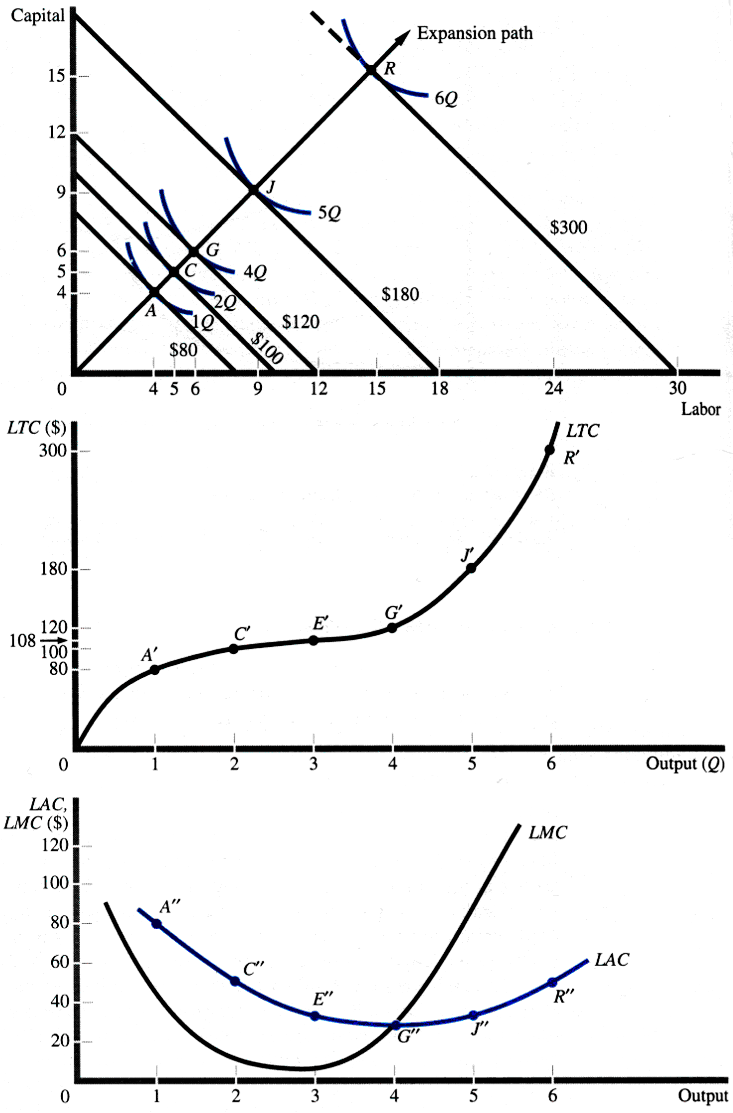
Derivation of Long-Run Cost Curves

Slide 59
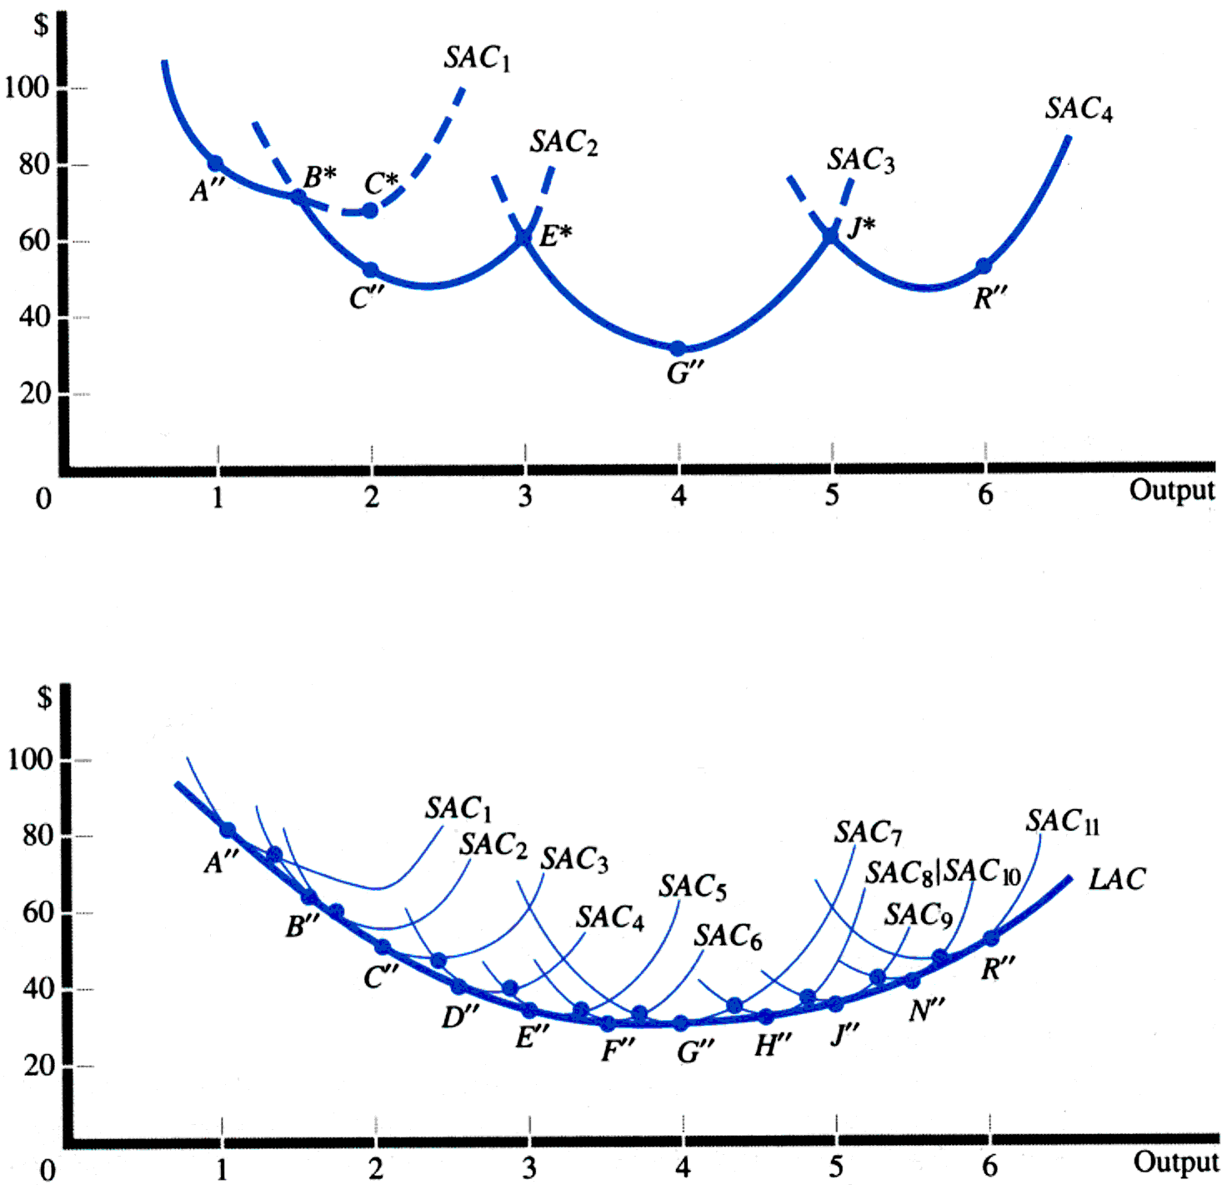
Relationship Between Long-Run and Short-Run Average Cost Curves

Slide 60
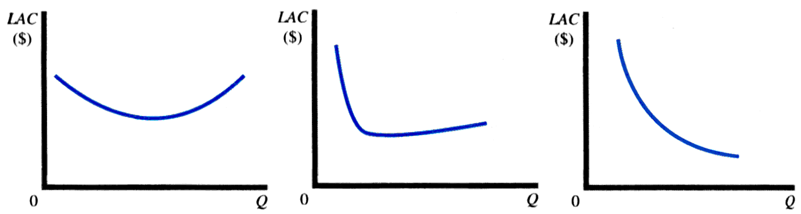
Possible Shapes of
the LAC Curve

Slide 61
Cost-Volume-Profit Analysis
Total Revenue = TR = (P)(Q)
Total Cost = TC = TFC + (AVC)(Q)
Breakeven Volume TR = TC
(P)(Q) = TFC + (AVC)(Q)
Q_{BE} = TFC/(P - AVC)

Slide 62
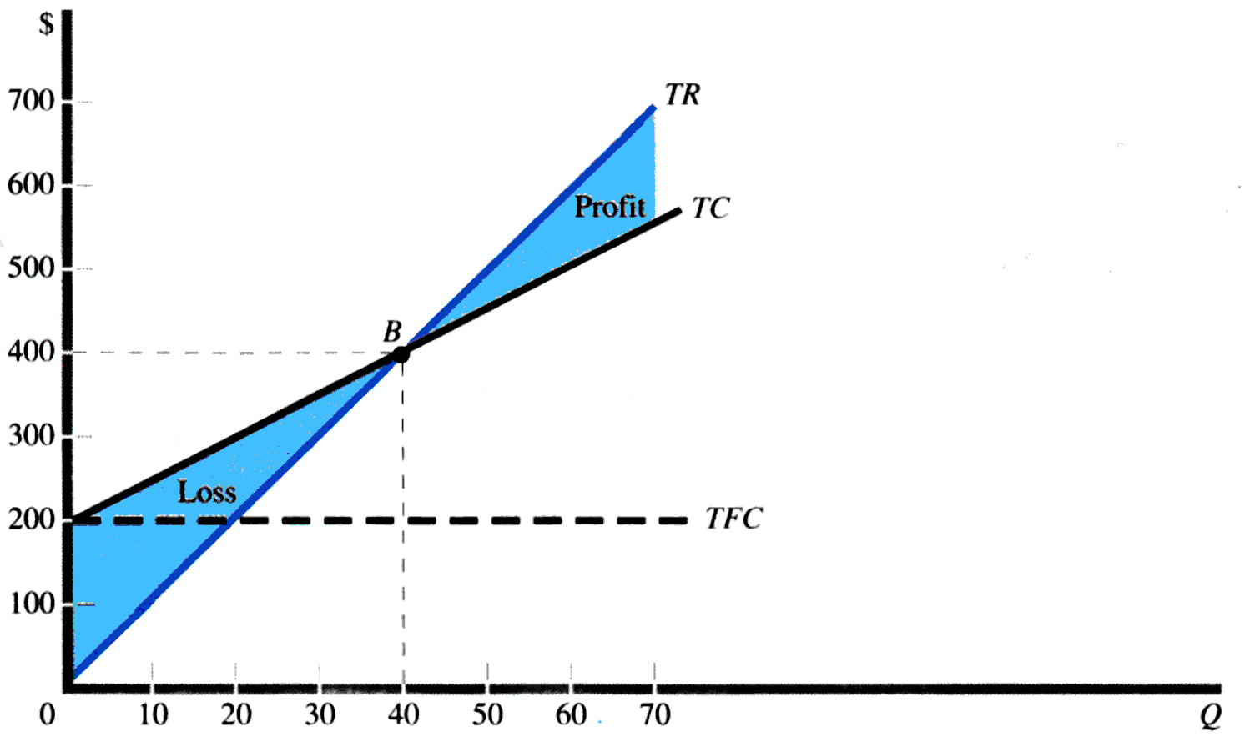
Cost-Volume-Profit Analysis
P = 400
TFC = 200
AVC = 5
Q_{BE} = 40

Slide 63
Empirical Estimation
Functional Form for Short-Run Cost Functions
Theoretical Form
Linear Approximation

Slide 64
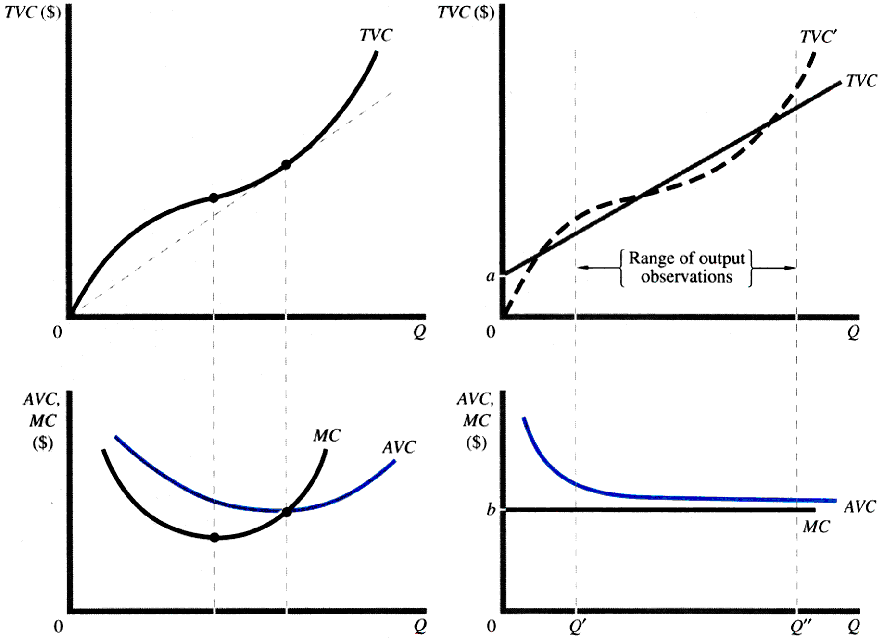
Empirical Estimation
Theoretical Form
Linear Approximation

Slide 65
Estimating Cost Functions
Techniques:
  Surveys
  Econometric specification
New entrant/survivor technique – method for determining the minimum efficient scale of production in an industry based on investigating the plant sizes either being built or used by firms in the industry

Slide 66
Minimizing Costs Internationally
Foreign Sourcing of Inputs
New International Economies of Scale
Immigration of Skilled Labor
Brain Drain

Slide 67
Importance of Production Functions in Managerial Decision Making
Production levels do not depend on how much a company wants to produce, but on how much its customers want to buy.
Capacity Planning: planning the amount of fixed inputs that will be used along with the variable inputs. Good capacity planning requires:
  Accurate forecasts of demand
  Effective communication between the production and marketing functions

Slide 68
Thank You

