Slide 1
Tishk International University
Faculty of Administrative Sciences and Economics
Accounting Department
Computerized Accounting III {ACC 410}
Tally.ERP 9
Part (III) Reporting
By
Dr. Samer H. Alssabagh
E-mail: Samer.alssabagh@ishik.edu.iq

Slide 2
From Previous Part:
Bookkeeping:
Journal Voucher
Purchases Voucher
Sales Voucher
Purchases Returns Voucher (Debit Note)
Sales Returns Voucher (Credit Note)
Receipt Voucher
Payment Voucher
Contra Voucher
Dr. Samer H. Alssabagh

Slide 3
The Contents of This Part:
Reporting:
Balance Sheet
Profit & Loss A/c
Stock Summary
Trial Balance (TB)
Ledger
Sales Register
Purchase Register
Dr. Samer H. Alssabagh

Slide 4
Reporting in Tally.ERP 9
Based on the voucher that you enter, Tally automatically prepares several kinds of administrative and financial reports.
Tally provides you the power to drill down step-by-step, from a top level report until the vouchers that contributed the report to verify the integrity, carry out any modification or to add, insert, duplicate, cancel or delete a voucher.
Further, you can configure and format the style of a report in your own way, decide the columns and contents, etc.
The major reports generated by Tally.ERP 9 are seven reports as follows:
Dr. Samer H. Alssabagh

Slide 5
1. Balance Sheet
How to generate “Balance Sheet” in Tally.ERP 9?
Go to: Gateway of Tally → Reports → Balance Sheet
Notes:
To view the balance sheet in detailed format, press F1: Detailed.
To select the period of balance sheet, press F2: Period.
To control the display options of balance sheet, press F12: Configure.
Dr. Samer H. Alssabagh

Slide 6
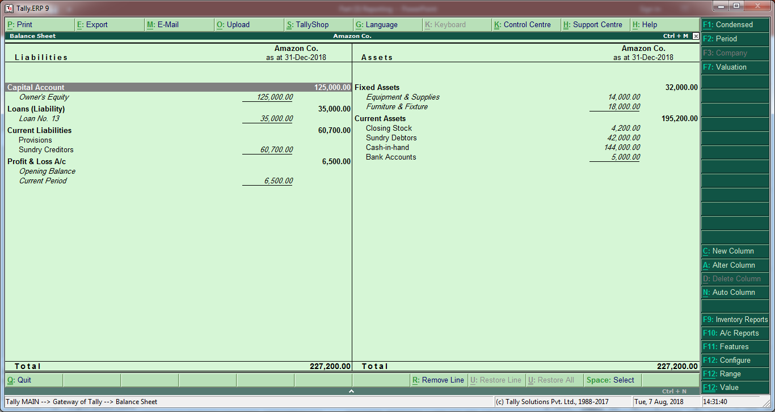
1. Balance Sheet Illustration
Dr. Samer H. Alssabagh

Slide 7
2. Profit & Loss A/c
How to generate “Profit & Loss A/c” in Tally.ERP 9?
Go to: Gateway of Tally → Reports → Profit & Loss A/c
Notes:
To view the P&L A/c in detailed format, press F1: Detailed.
To select the period of P&L A/c, press F2: Period.
To control the display options of P&L A/c, press F12: Configure.
Dr. Samer H. Alssabagh

Slide 8
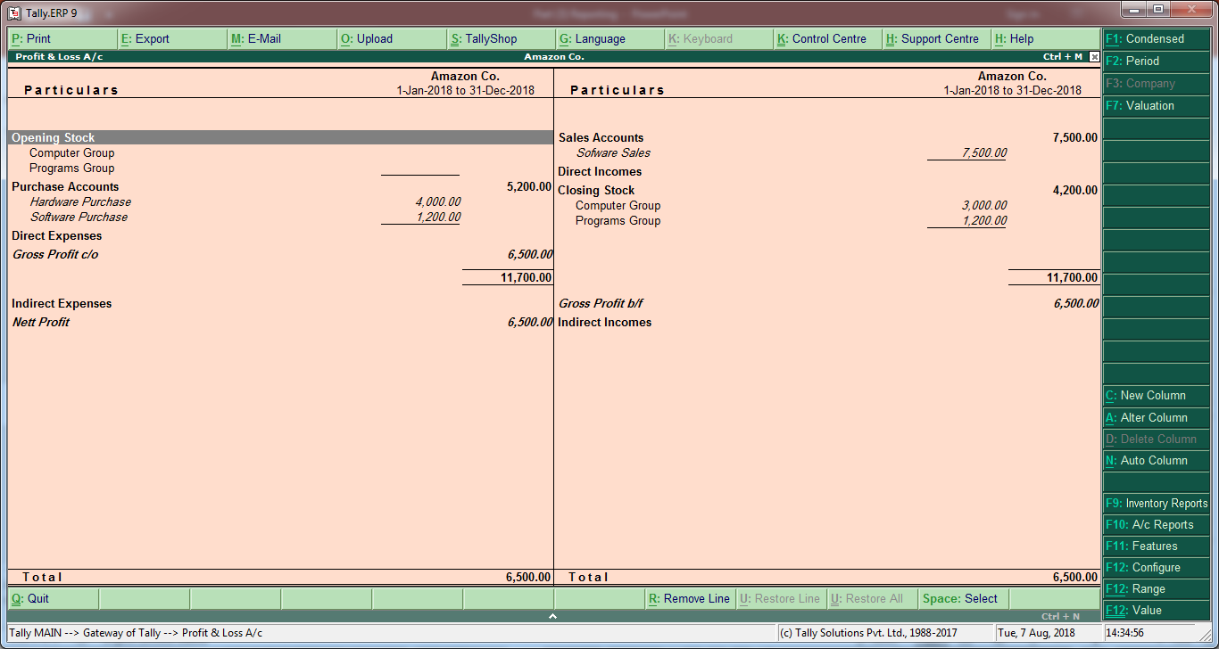
2. Profit & Loss A/c Illustration
Dr. Samer H. Alssabagh

Slide 9
3. Stock Summary
How to generate “Stock Summary” in Tally.ERP 9?
Go to: Gateway of Tally → Reports → Stock Summary
Notes:
To view the stock summary in detailed format, press F1: Detailed.
To select the period of stock summary, press F2: Period.
To control the display options of stock summary, press F12: Configure.
Dr. Samer H. Alssabagh

Slide 10
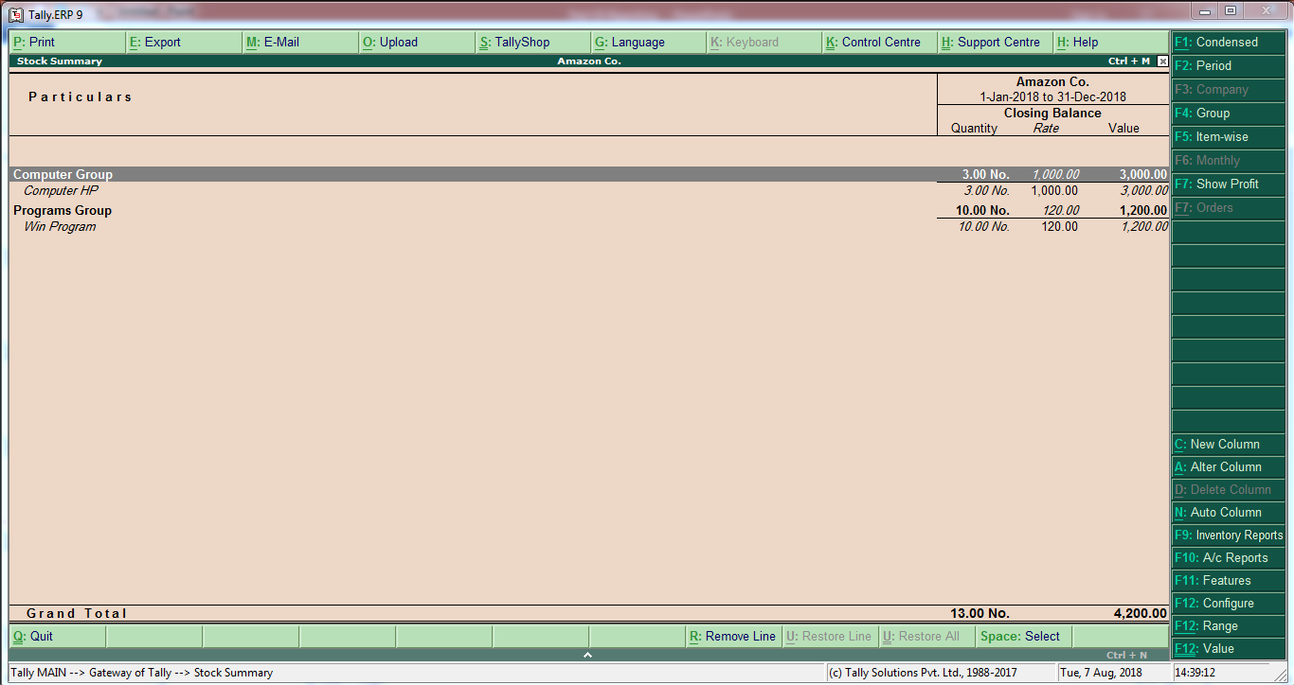
3. Stock Summary Illustration
Dr. Samer H. Alssabagh

Slide 11
4. Trial Balance (TB)
How to generate “Trial Balance” in Tally.ERP 9?
Go to: Gateway of Tally → Display → Trial Balance
Notes:
To view the TB in detailed format, press F1: Detailed.
To select the period of TB, press F2: Period.
To control the display options of TB, press F12: Configure.
Dr. Samer H. Alssabagh

Slide 12
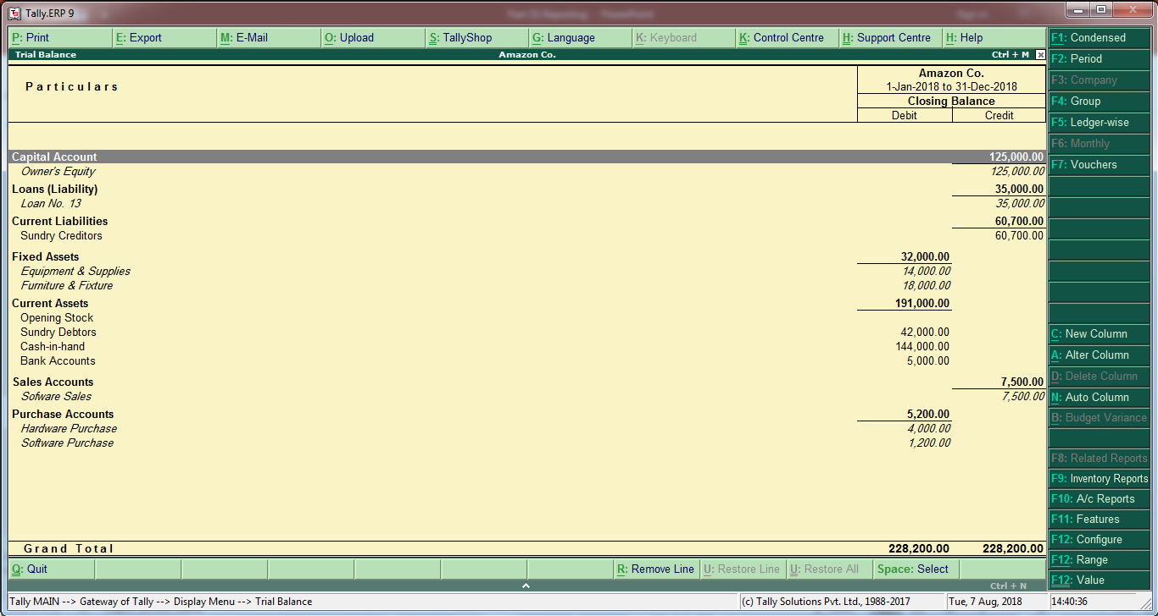
4. Trial Balance (TB) Illustration
Dr. Samer H. Alssabagh

Slide 13
5. Ledger
How to generate “Ledger” in Tally.ERP 9?
Go to: Gateway of Tally → Display → Accounts Books → Ledger.
Choose the account you want from the ledger list.
Notes:
To view the ledger in detailed format, press F1: Detailed.
To select the period of ledger, press F2: Period.
To control the display options of ledger, press F12: Configure.
Dr. Samer H. Alssabagh

Slide 14
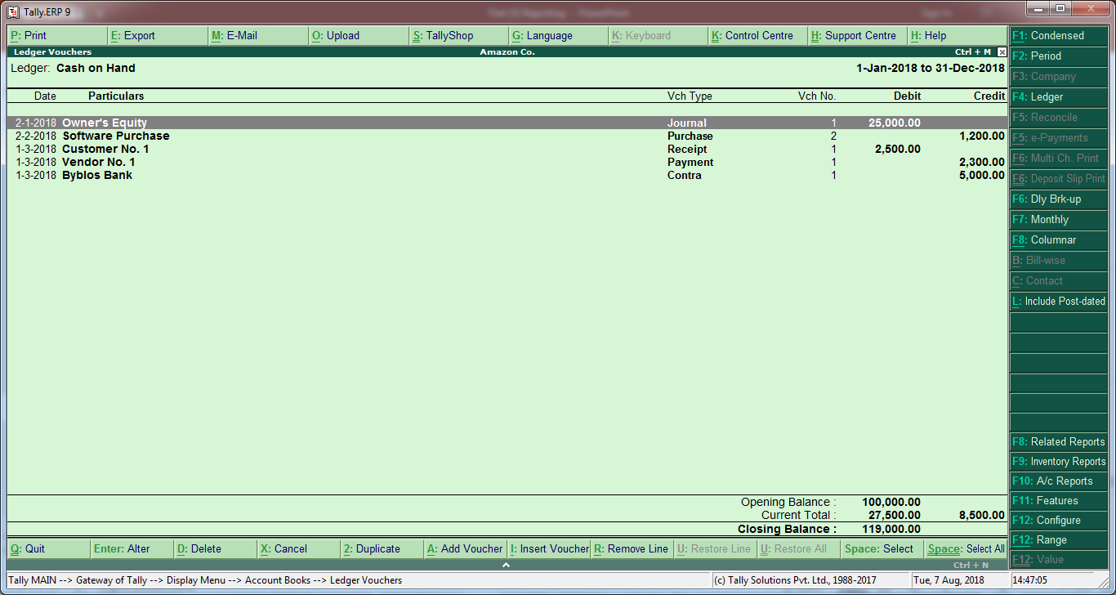
5. Ledger Illustration
Dr. Samer H. Alssabagh

Slide 15
6. Sales Register
How to generate “Sales Register” in Tally.ERP 9?
Go to: Gateway of Tally → Display → Accounts Books → Sales Register
Notes:
To view the sales register in quarter format, press F5: Quarterly.
To select the period of sales register, press F2: Period.
To control the display options of sales register, press F12: Configure.
Dr. Samer H. Alssabagh

Slide 16
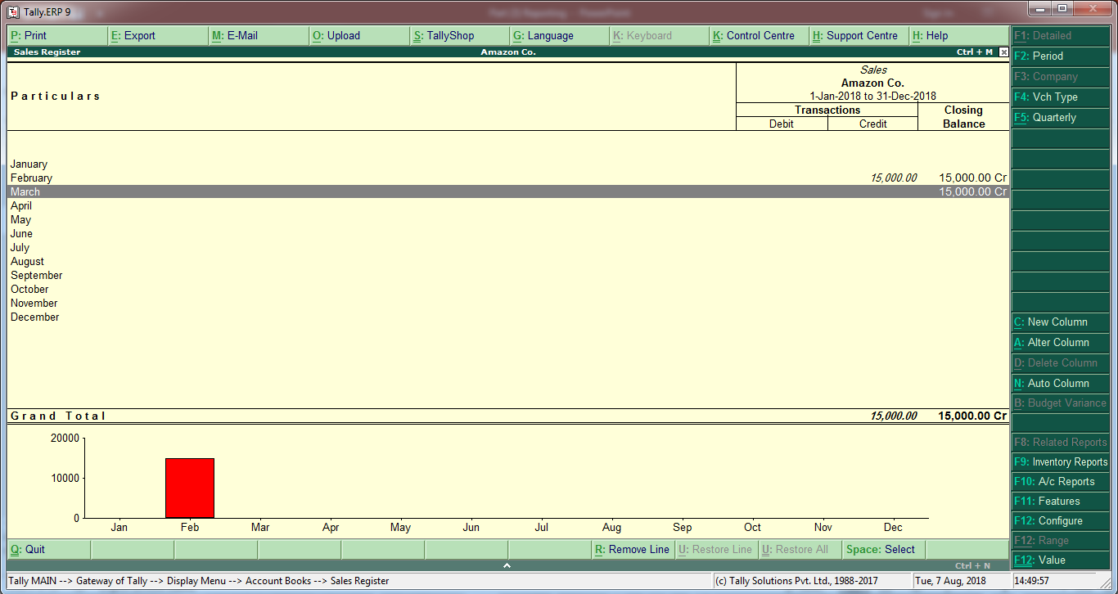
6. Sales Register Illustration
Dr. Samer H. Alssabagh

Slide 17
7. Purchase Register
How to generate “Purchase Register” in Tally.ERP 9?
Go to: Gateway of Tally → Display → Accounts Books → Purchase Register
Notes:
To view the purchase register in quarter format, press F5: Quarterly.
To select the period of purchase register, press F2: Period.
To control the display options of purchase register, press F12: Configure.
Dr. Samer H. Alssabagh

Slide 18
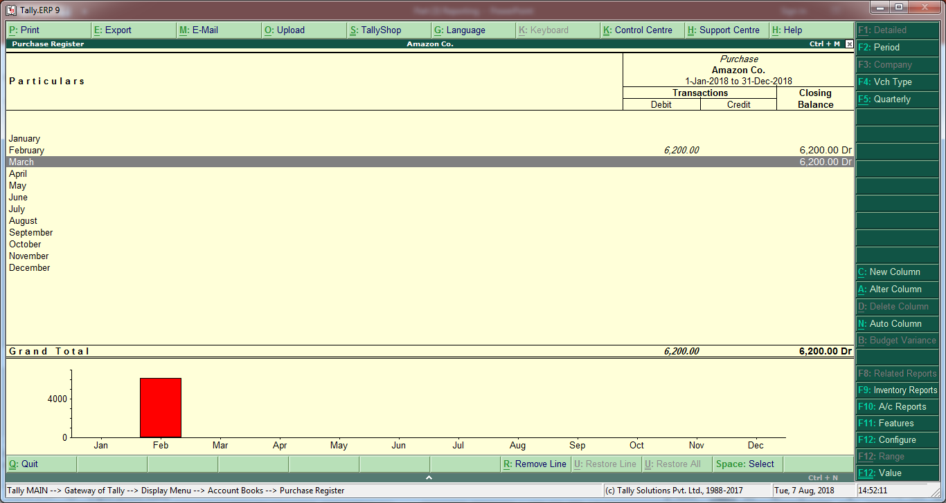
7. Purchase Register Illustration
Dr. Samer H. Alssabagh

Slide 19
Summary
This part explains how to report on your fiscal year results in Tally.ERP 9. This includes how to generate the following seven kinds of reports: balance Sheet, Profit & loss A/c (Income statement), Stock Summary, Trial Balance (TB), Ledger, Sales Register, and Purchase Register.
Dr. Samer H. Alssabagh

Slide 20
Any Questions?
Dr. Samer H. Alssabagh

