Slide 1
Chapter -3 GENDER AND EDUCATION Mohsin Uddin

Slide 2
Home work-1 Marks-5
Prepare a Chart paper(A2 size) to depict the status of women in our society by taking/ pasting pictures and headlines that appear in Newspapers and magazines.

Slide 3
Home work-2 Marks-5
Collect slogans and quotations that question gender discrimination and promote gender equality.

Slide 4
Group/Individual Presentation
2-3 Students
15 slides
10 Marks
Topics
Gender, Personal Experience on Gender, violation of rights of girls and women, Dowry, Girls Education,
DATE: 22 APRIL 2019

Slide 5
Learning Objectives
After going through this unit, you will be able to:
Issues Related to Gender In School
Define and Explain Gender Bias In School
Discuss the social attitude towards Girl’s education

Slide 6
Opening Discussion
following promotes gender bias and inequality in a school setting?
stereotyping of male and female roles in textbooks
teaching practices that are biased against girls
school uniforms that are different for boys and girls

Slide 7
Which one of the following statements made by a teacher is NOT gender biased?
Being a girl, how can you be so untidy in your work?
After all he is boy. He can get away with it!
It is important for both boys and girls to do well in all subjects including mathematics.
Boys will shift the furniture out of the room and then let girls clean up the room.

Slide 8
ISSUES RELATED TO GENDER IN SCHOOL
The socialization of gender within our schools assures that girls are made aware that they are unequal to boys.
When different behaviors are tolerated for boys than for girls because 'boys will be boys', schools are continuing the oppression/domination of females.
There is some evidence that girls are becoming more academically successful than boys,
Girls are praised for being neat, quiet, and calm, whereas boys are encouraged to think independently, be active and speak up.

Slide 9
Role of Schools in reinforcing gender equality
Undertaking gender sensitization of parents, community leaders and members, teachers, girls and boys in order to raise their awareness and understanding of the need to support girls’ education
Training teachers in the skills for making teaching and learning processes responsive to the specific needs of girls and boys.
Training teachers in the skills for making teaching and learning processes responsive to the specific needs of girls and boys.

Slide 10
Role of Teachers in reinforcing gender equality
Teachers and teacher educators should examine their syllabuses with the view of incorporating a gender dimension by: including the introductory themes on gender; and by exploring gender issues within some of the topics of existing syllabus.
Teacher educators themselves be gender sensitive through gender awareness and sensitization programmes.
Teacher educators and teachers should employ engendered patterns of classroom organisation and interaction, and
Teacher educators and teachers should engendered teaching approaches be employed.
Capacity building centres should be established in all educational regions intended to train teachers and teacher educators in gender-laden education

Slide 11
Difference between Patriarchy and Matriarchy
Characters | Patriarchy | Matriarchy
House Hold | Father is the head of the household | Mother is the head of the household
Power | The father has more power and control over others | The mother has more power and control over others
Property | The ownership of property goes to males. | The ownership of property goes to females
Governance | The society is governed by Males | The society is governed by females

Slide 12
Social Attitudes towards Girl’s Education
The social barriers and social attitudes standing in the way of girls attending schools - poverty, compulsions of older girls in families having to look after the home and siblings,
the conception or misconception that girls do not need education and/or that what is taught in schools is irrelevant to them, parents seeing limited (economic) benefits in educating daughters,
lack of women teachers and separate schools for girls, supportive facilities (like adequate and clean toilets in schools) and transport facilities to travel to school and back, all these inhibit parents from getting their girls enrolled.

Slide 13
Sexual Harassment
Verbal comments
sexually explicit media contact
Non-verbal actions
Physical touching
Unwanted requests

Slide 14
Teacher Biases
The gender biases of teachers are often expressed through language that reveals their personal beliefs/attitudes regarding women and men and the social norms related to women’s and men’s roles and responsibilities.
Notes:
Presenter
2018-10-18 08:59:29
--------------------------------------------
Teachers must remain aware of their own personal attitudes and beliefs regarding gender norms and the ways in which their attitudes and beliefs may adversely affect female and male students’ learning and academic performance.

Slide 15
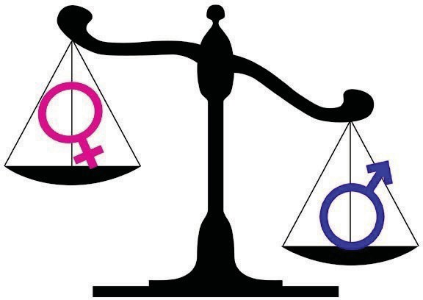
Teacher Biases, cont.
When a female student is assertive, she is told to stop behaving like a man.
“Women are not as good at science as men.”
“Women make better midwives than doctors because they are naturally nurturing.”
“Men are better doctors than women because they’re more rational and they are natural leaders.”
Notes:
Presenter
2018-10-18 08:59:29
--------------------------------------------
Some examples of gender biases.

Slide 16
Teacher Biases, cont.
Language use:
Gender biases can be expressed verbally and can reinforce gender differences and inequalities
In the classroom, teachers and students often use language that emphasizes men’s superiority over women, which can negatively impact on student performance
Teachers can enhance students’ performance by using gender-equitable language in the classroom
Teachers need to remain aware of the language they use, to ensure that it is gender-responsive!!
Notes:
Presenter
2018-10-18 08:59:29
--------------------------------------------
The language that educators use providesan important model for students and the larger community. Word choices often reflect unconscious assumptions about gender roles. As professionals, teachers need to examine their language to reduce or eliminate choices that silence, stereotype, or constrain students. For example, the use of he or his when referring to both a female and a male excludes the female. To be inclusive, teachers should use language that is gender-inclusive (use of both he and she) and gender-neutral (e.g., using people or persons instead of women and men; using “their” instead of “his” or “hers” [e.g., instead of saying “The average student is worried about his grades,” say “The average student is worried about grades,” or “The average student is worried about their grades”]). Teachers should also consciously balance use of pronouns by sometimes reversing their order (i.e., instead of placing he before she, placing she before he; or saying women and men instead of men and women)—sometimes, the order in which we use words can also reinforce gender inequalities.

Slide 17
Teacher Biases, cont.
Eliminate your own use of gender-insulting language, ban its use by your students, and speak up when fellow teachers and other adults speak this way.¹
Notes:
Presenter
2018-10-18 08:59:30
--------------------------------------------
Language use isn’t just about semantics, it’s also about avoiding making biased and stereotypical statements about women and men.

Slide 18
LET US SUM UP
Sex is nature given and gender is made by society and culture. Gender discrimination can affect both men and women.
Teachers have a crucial role to play in gender reconstruction and social transformation.

