Slide 1
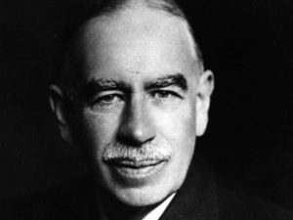
Macroeconomics
Theory of Employment
HE EDUCATOR
Dr. Waqar Ahmad
Faculty of Administrative Sciences and Economics

Slide 2
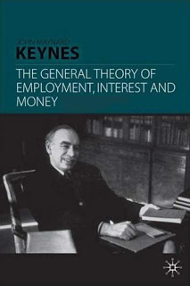
Keynes offered this theory in 1936. Keynes explained in this theory that employment depends upon the income. If the standard of national income is higher then rate of employment will also be higher.
On the other hand if the level of national income is lower then the level of employment will also be lower. The equilibrium level of income and employment will be that where aggregate demand is equal to the aggregate supply.

Slide 3
According to Keynesian, the main reason of unemployment is deficiency of aggregate demand. Aggregate demand can be increased by increasing investment, as consumption remains constant in short period.
During period of depression the expectation of profit is remote. Thus private sector will not make any investment. Hence to achieve the objective of full employment investment by government will be called.

Slide 4
Introduction to Keynesian Theory
Keynes was the first to develop a systematic theory of employment in his book. The General Theory of Employment, Interest and Money (1936).
The classical and the neoclassical economists almost neglected the problem of unemployment.
They regarded unemployment as a temporary phenomenon and assumed that there is always a tendency towards full employment. It was Keynes who led a vigorous and systematic attack on the traditional theory of employment and replaced it with a more general and more realistic theory.

Slide 5
Keynes’ main criticism of the classical theory was on the following two grounds:
(a) The classical prediction that full- employment equilibrium will be achieved in the long-run was not acceptable to Keynes, who wanted to solve the short run problem of unemployment. According to Keynes, in the long-run there is no problem; in the long-run, we are all dead.
(b) Keynes criticised the classical assumption of self-regulating economy. The great depression of 1930s led Keynes to believe that full employment equilibrium in the economy was not be automatically achieved in the short period; and that government intervention was necessary to tackle the problem of the economy.
Keynes’ theory of employment is called the effective demand theory of employment. According to this theory, unemployment arises due to the deficiency to effective demand and the method of remove unemployment is to raise effective demand.

Slide 6
Features of Keynesian Theory of Employment:
(i) It is general theory in the sense that-
(a) it deals with all levels of employment, whether it is full employment, widespread unemployment or some intermediate level;
(b) it explains inflation as readily as it does unemployment, because basically both situations are a matter of volume of employment, and
(c) it relates to changes in the employment and output in the economic system as a whole.
ii) Keynesian theory of employment is a short-run theory which attempts to analyze the short-run phenomenon of unemployment. He assumed constant all those strategic variables which remain stable and change very little in the short-run
(iii) Keynesian theory is based on empirical foundations and has important policy implications.
(iv) Keynes did not have much faith in the policy of laissez faire and automatic adjustment of the economic system. On the contrary, he advocated government intervention to reform the capitalist system.
(v) In this theory, Keynes gave money specially an important role in the determination of employment and output in the economic system as a whole.

Slide 7
Assumptions of the Theory:
(i) Keynes confines his analysis to the short-period.
(ii) He assumes that there is perfect competition in the market.
(iii) He carries out his analysis in the closed economy, ignoring the effect of foreign trade.
(iv) His analysis is a macro-economic analysis, i.e., it deals with aggregates.
(v) He assumes the operation of the law of diminishing returns or increasing costs.
(vi) The government is assumed to have no part play either as taxer or a spender, i.e., the fiscal operations of the government is not explicitly recognized.
(vii) He assumes that labour has money illusion. It means that a worker feels better when his wages double even when prices also double, thus leaving his real wage unchanged.

Slide 8
Determination of Equilibrium Level of Employment:
The central problem of the General Theory is What determines the level of employment? Keynes’ answer is effective demand. Effective demand is the logical starting point of Keynes’ theory of employment. Effective demand means desire plus ability and willingness to buy, i.e., actual expenditure. Effective demand depends upon aggregate demand function and aggregate supply function.
Aggregate demand function represents different amounts of money which the entrepreneurs expect to get from the sale of output at varying levels of employment. Or, to put it differently, aggregate demand function reveals planned or intended expenditure at different levels of income.
Aggregate demand schedule slopes upward to the right, indicating that as the expected sale proceeds increase, greater number of workers will be employed. The AD curve flattens at the later stages of employment because marginal propensity to consume declines as income increases.

Slide 9
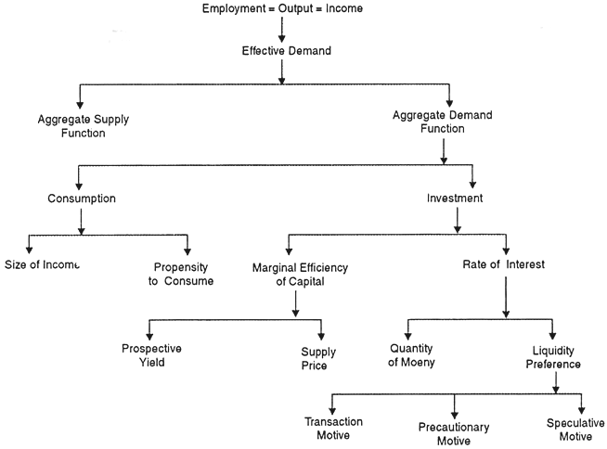

Slide 10
Aggregate supply function represents different amounts of money which the entrepreneurs must get from the sale of output at varying levels of employment. Or stated in a different way, aggregate supply function represents different levels of income (and thus output and employment) which the entrepreneurs will supply at different levels of expenditures.
Aggregate supply schedule also slopes upwards to the right, indicating that at higher levels of employment expected minimum sale proceeds increase. After the full employment level is reached. AS curve becomes perfectly inelastic (a vertical straight line) which shows that employment cannot increase further even if minimum expected sale proceeds increase.

Slide 11
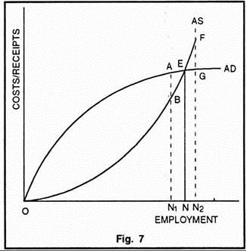

Slide 12
The equilibrium level of employment is determined at the point of intersection between aggregate demand function and aggregate supply function. This is also the point of effective demand. Aggregate supply represents costs, while aggregate demand represents expected receipts of the entrepreneurs.
So long as receipts are greater than costs, the employment will continue to increase. This process will go on till receipts become equal to costs. No employment will be offered to the workers if costs are greater than receipts.

Slide 13
Summary of Keynesian Theory of Employment:
Keynesian theory of employment, as developed in the General Theory is outlined in Chart-1.
The main propositions of the theory are given below:
(i) Total employment = total output = total income. As employment increases, output and income also increase proportionately.
(ii) Volume of employment depends upon effective demand.
(iii) Effective demand, in turn, is determined by aggregate supply function (representing costs of entrepreneurs) and aggregate demand function (representing receipts of entrepreneurs). It is determined at the point where aggregate demand and aggregate supply are equal.
(iv) Keynes assumed aggregate supply function as given in the short period and regarded aggregate demand as the most important element in his theory.

Slide 14
(v) Aggregate demand function is governed by consumption expenditure and investment expenditure.
(vi) Consumption expenditure depends upon the size of income and the propensity of consume. Consumption expenditure is fairly stable in the short-period because propensity to consume does not change quickly.
(vii) Investment expenditure is governed by marginal efficiency of capital (i.e., profitability of capital) and the rate of interest. Unlike consumption expenditure, investment expenditure is highly unstable.
(viii) The marginal efficiency of capital is determined by the supply price of capital assets on the one hand and the prospective yield on the other. Prospective yield, in turn, depends upon future expectations. This explains why the marginal efficiency of capital and hence investment expenditure fluctuates.
(ix) Rate of interest is a monetary phenomenon and is determined by the demand for money (liquidity preference) and the quantity of money. Liquidity preference depends upon three motives- transaction motive, precautionary motive, and speculative motive. Quantity of money is regulated by the monetary authority.

Slide 15
Thank You

