Slide 1
TIU
Tishk International University
FASE
IRD Department
Civilization History
Code: IRD 116
Unit v
Mexico: cradle of Mesoamerican civilizations
COURSE Educator: Associated Prof. Dr. Neville D’Cunha

Slide 2
Mesoamerica Civilization (1)
Repeated Reinventions
Civilization in Mesoamerica flourished and crashed repeatedly, giving rise to a distinctive worldview and some remaining mysteries.
The founding culture of Mesoamerica appeared along the southwestern curve of the Gulf of Mexico, near the present city of Veracruz.
This culture emerged in a series of river valleys, as Uruk did in Mesopotamia.
Called the Olmecs (the “rubber people”), this culture lasted from about 1400 BCE to 100 BCE.

Slide 3
Mesoamerica Civilization (2)
The last Olmec site, Tres Zapotes, declined by about 100 BCE for unknown reasons. Was it volcanic eruptions? A shift in the flow of rivers? Scholars believe that the Olmecs may have deliberately destroyed their capital. Was there civil unrest? Class strife? No one knows.
As the Olmecs declined, their neighbors to the east — the Maya — prospered around the curve of the Gulf of Mexico on the Yucatán Peninsula and south into present-day Guatemala, had poor, infertile soil and no large rivers, not what one would expect for a flourishing civilization.

Slide 4
Mesoamerica Civilization (3)
The Maya organized themselves into small city-states instead of one big empire.
The largest was Tikal, which by 750 CE had about 40,000 inhabitants, in specialized occupations and ruled by elites.
The city-states fought each other frequently with the main purpose being to capture their enemies in order to sacrifice them to the Mayan gods.
We know about the Maya because they developed the most elaborate and sophisticated writing system of the several different ones used in Mesoamerica. Mayan writing included both pictographs and symbols for syllables.

Slide 5
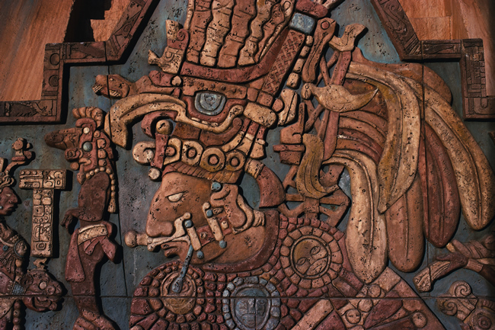
Mesoamerica Civilization (4)
Relief depicting Mayan king Bird-Jaguar

Slide 6
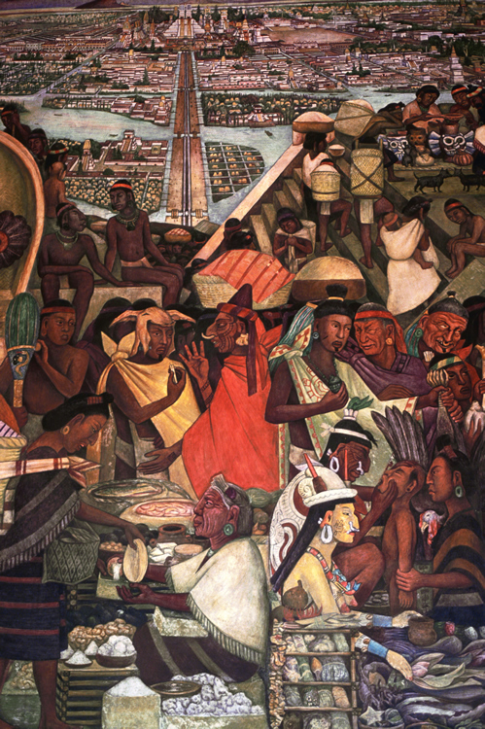
Mesoamerica Civilization (5)
Detail from The Great Tenochtitlan,

Slide 7
Mesoamerica Civilization (6)
Maya shaman/priests worked out remarkable systems of cosmology and mathematics.
The Maya calculated a solar year as 365.242 days, about 17 seconds shorter than the figures of modern astronomers.
They also introduced the concept of zero; the first evidence of zero as a number dates from 357 BCE, but it may go back further, to Olmec times.
In Afro-Eurasia, Hindu scholars first represented zero in the 800s CE.
Detail from The Great Tenochtitlan,

Slide 8
Mesoamerica Civilization (7)
Between 800 and 925 CE Mayan society experienced a rapid transition.
The world of cities ended as populations moved back into the countryside. Historians debate the possible causes of the change — civil revolts, invasions, erosion, earthquakes, disease, drought.
Likely some combination of these brought on an unusually rapid fading of a once-vibrant civilization. The Maya didn’t just disappear; several million descendants are still alive today.

Slide 9
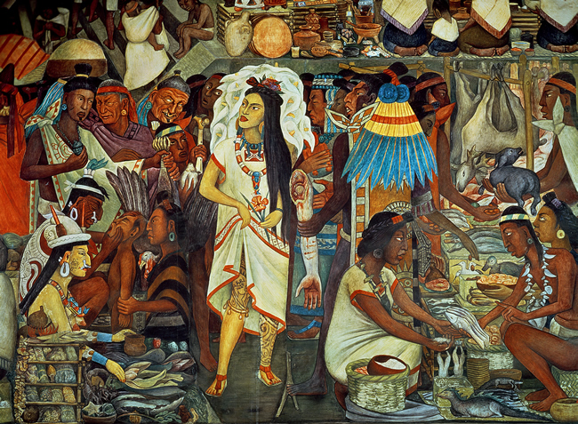
Mesoamerica Civilization (8)
The Market of Tlatelolco from The Great Tenochtitlan

Slide 10
Mesoamerica Civilization (9)
Tenochtitlan
The city that carried Mesoamerican civilization to its height proved to be Tenochtitlan (the-noch-tee-TLAHN), or “place of the cactus fruit” in their language, Nahuatl.
Its people, called the Mexica (me-SHI-ka), came from northern Mexico looking for a place to settle. All the desirable places were already inhabited, except an island on the shore of a large lake in the Valley of Mexico, where they settled in 1325.
They were given the name Aztecs by the German explorer and naturalist Alexander von Humboldt in the early 19th century.

Slide 11
Mesoamerica Civilization (10)
Tenochtitlan
By the early 1500s the Aztecs had conquered most of Mesoamerica and had imposed their rule on an estimated 11–12 million people.
The annual tribute they received in corn alone amounted to 7,000 tons. They also received 2 million cotton cloaks, as well as jewelry, obsidian knives, rubber balls, jaguar skins, parrot feathers, jade, emeralds, seashells, vanilla beans, and chocolate.
Without money, everyone was paid in food and goods.

Slide 12
Mesoamerica Civilization (11)
The Aztecs bestowed great honor to their warriors, building their society around a military elite.
A council of the most successful warriors chose the ruler. Warriors could wear fine cotton cloth and feathers instead of clothing made from the fibers of an agave-like plant.
Priests also ranked among the elite. Most people were commoners who cultivated land and a large number of slaves worked mostly as domestic servants.

Slide 13
Mesoamerica Civilization (12)
Aztec society provided universal schooling for both boys and girls between 15 and 20 years of age.
It’s likely they were the only people in the world to do this in the early 16th century.
Commoner boys learned to be warriors; girls learned songs, dances, and household skills.
A third kind of school provided lessons in administration, ideology, and literacy for elite boys.
At the same time that the elites supported warfare, they also devoted themselves to poetry, which they considered the highest art.

Slide 14
Comparing the Americas to Afro-Eurasia (13)
The Americas did not develop many of the technological innovations present in Afro-Eurasia.
For example, Americans did not use wheels (except the Maya, who put them on toys!), probably because they had no large domestic animals to pull wheeled devices.

Slide 15
Comparing the Americas to Afro-Eurasia (14)
Americans did not melt iron or steel; they used obsidian (glassy volcanic rock that can be sharpened to a thinness of one molecule) for blades.
They had no swords or guns. They had no horses, which had evolved in the Americas but which had gone extinct at the end of the last ice age, about when humans were arriving in the Americas.

Slide 16
Comparing the Americas to Afro-Eurasia (15)
How much long-distance trade and travel occurred in the Americas? Not as much as in Afro-Eurasia, which stretched out east to west so that people could travel at approximately the same latitude (the distance from the equator) in similar climates.
The Americas stretched north and south, with huge changes in climate. Crops could not be carried or exchanged because they would not grow at different latitudes without time to adapt.
Americans built large canoes but not sailing vessels, and they stayed close to the shore and in calm waters. They made north-south connections, but these were less frequent than the east-west connections of Afro-Eurasia.

Slide 17
Comparing the Americas to Afro-Eurasia (16)
As a result of these factors, states and civilizations arose somewhat later in the Americas than they did in Afro-Eurasia.
Once American civilizations emerged, they were not able to connect with each other, share their innovations, or learn collectively to the same extent as their counterparts in Afro-Eurasia.
The civilizations created were similar in all their basic characteristics to those in Afro-Eurasia and seemed likely to continue their development if they had not been prematurely cut down by Europeans.

Slide 18
Comparing the Americas to Afro-Eurasia (17)
Historical and geographical contingencies gave Europeans the edge in conquering the people of the Americas, while many Africans were swept into prevailing events as valuable slave commodities.
It is a disturbing story, but it is the one that helped create the modern world.
End of Topic

