Slide 1
Course Educator Associated Prof. Dr. Neville D’Cunha
Tishk
International University FASE IRD Department Civilization History Code: IRD 116
Unit III
Classical Civilizations: Greece and Persia

Slide 2
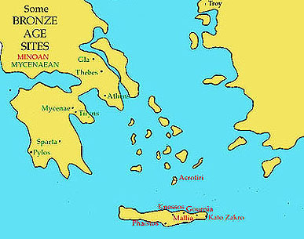
Early Mediterranean Civilizations
Two major cultures on the main islands
Crete
Home to the Minoans, lots of harbors, little good soil
Capital of Knossos was very wealthy, legendary King Minos
Mycenae
Located on the mainland of Greece
art and culture influenced later Greece

Slide 3
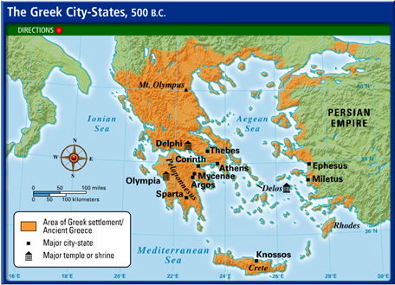
Rise of the Greek City States
Because of its geography it led to the creation of Poleis… or city states
Greece adopted the Phoenician alphabet
Poleiss’ would be sometimes at war (Peloponnesian) and united (Persian Wars)

Slide 4
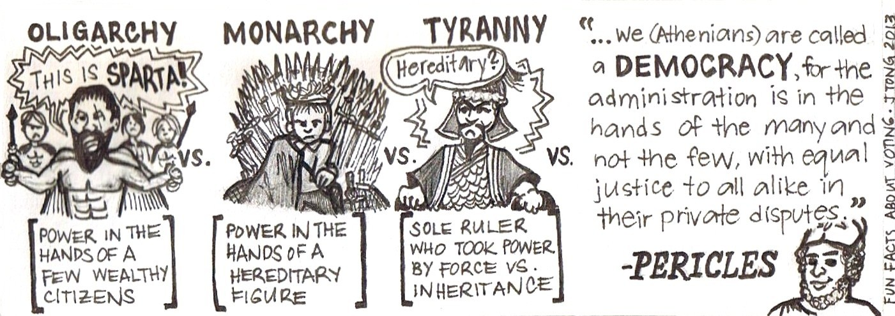
Different political systems
Monarchy
A king rules
Aristocracy
The nobles rule
Oligarchy
A few wealthy landowners and merchants rule
Democracy
All citizens participate

Slide 5
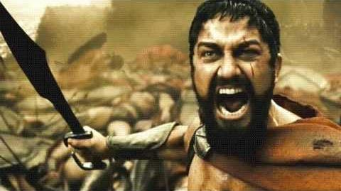
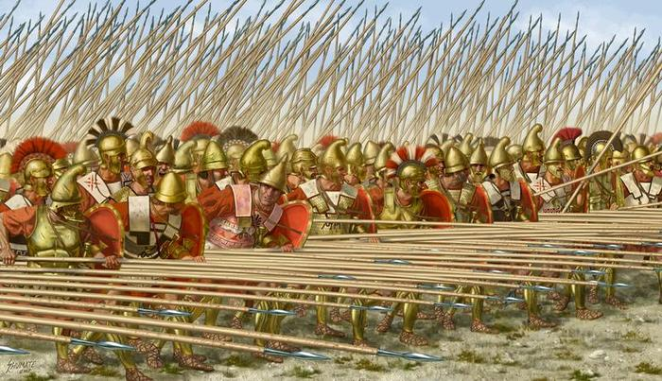
Sparta’s Military Society
Boys were taken away from their mothers at 7 for training
Grown men served in the active military or reserve till 60
Spartan women ran the households
Praised for fitness and education of children
Helots were Spartan slaves
Were an Oligarchy with two kings

Slide 6
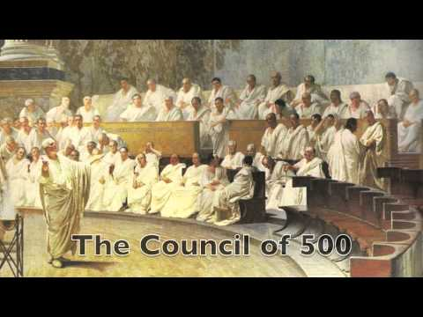
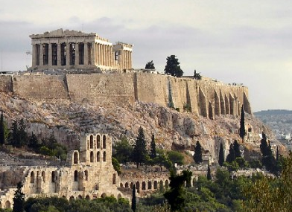
Athenian Democracy
At first was a Monarchy, but powerful merchants didn’t like that
Supported tyrants, then didn’t like them…. So?
Decided on a direct democracy, not a representative democracy
Pericles, most famous leader of the democracy, rebuilt the Parthenon, transferred power to the assembly

Slide 7
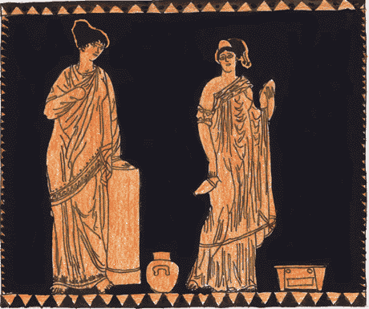
Women in Athens
In a nutshell… harsh
Could not own property
Did not receive education
Upper class women had to be accompanied by a man when they left the home (Saudi Arabia)
Believed to be intellectually inferior to men and thus incapable of being satisfying relationship partners… what does this mean?

Slide 8
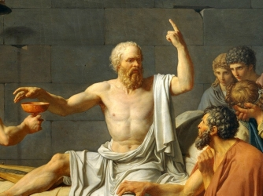
Athenian Philosophy (all about logic)
Socrates
The original philosopher of greek thought
Created the Socratic Method of questioning
By asking a series of questions to get to the heart of the answer
Typically used to catch someone contradicting themselves
Was put to death for questioning state religion

Slide 9
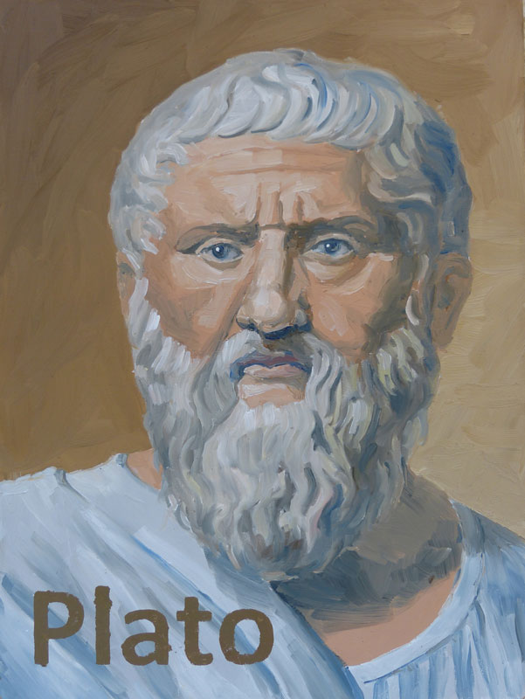
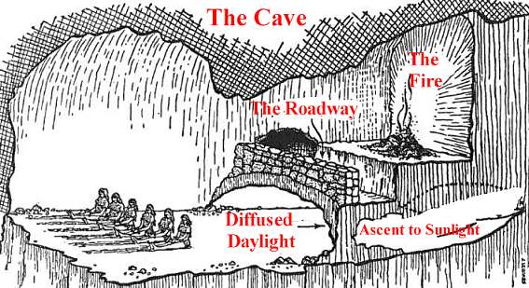
Plato
He wrote all of what we know about Socrates because he was his student
Wrote a work called The Republic where the thought people would be in three classes, workers, warriors, and philosopher kings
Came up the idea of the cave metaphor

Slide 10
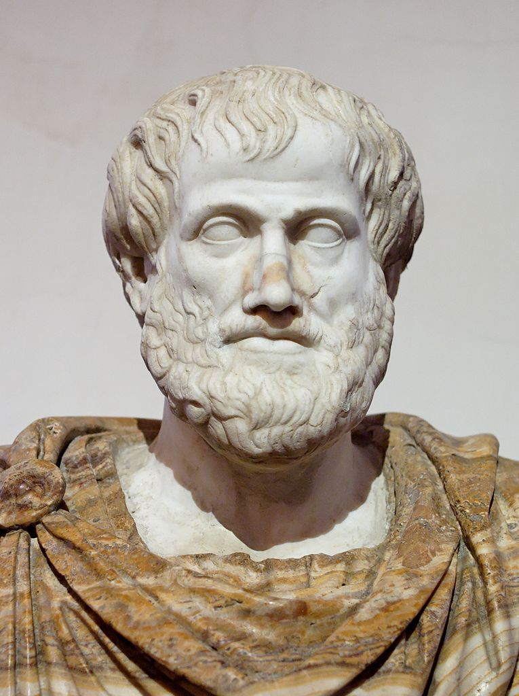
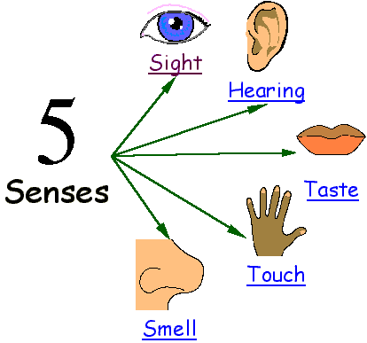
Aristotle
One of Plato’s students
Called his emphasis on moderation the Golden Mean
Believed in gaining knowledge through empiricism, trusting what he learned through observation and evidence of the senses
Was also the first one to define tragedy and comedy in theater
Tutor of Alexander the Great

Slide 11
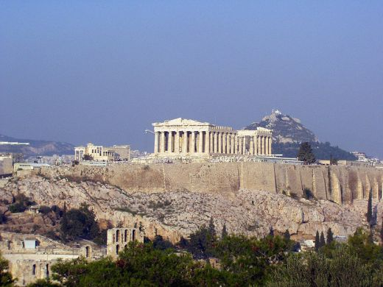
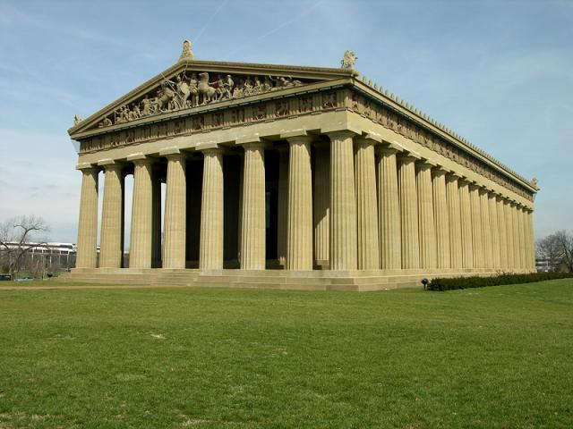
Athenian Religion and Culture
Greek Mythology still remains popular today
Attendance at religious functions, which theater was part of was considered a civic duty
Created the idea of Tragedies, dramas, and comedies
Greek architecture can be distinguished by its columns, topped with slanted roofs.

Slide 12
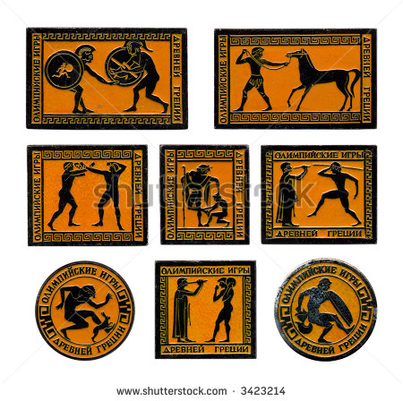
The Olympics!!!
Greek sports were all about emphasizing rituals and making offerings to the gods
All Greek city-states competed every 4 years at Olympia
Created a common feeling of “Greekness” that continued on for over 1,000 years to 400 C.E.

Slide 13
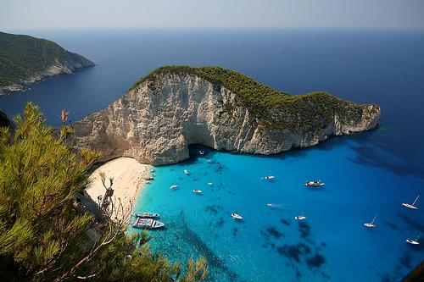
Greek Colonies
Established colonies in the Mediterranean because of population growth
The climate and soil of Greece made it difficult to farm and keep up with the population growth… what did that lead to?
Also, because of the climate, everything was outdoors

Slide 14
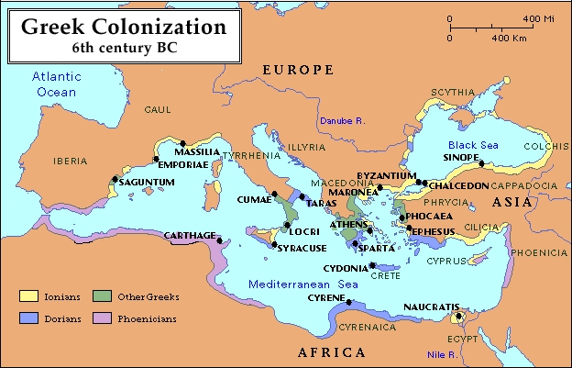

Slide 15
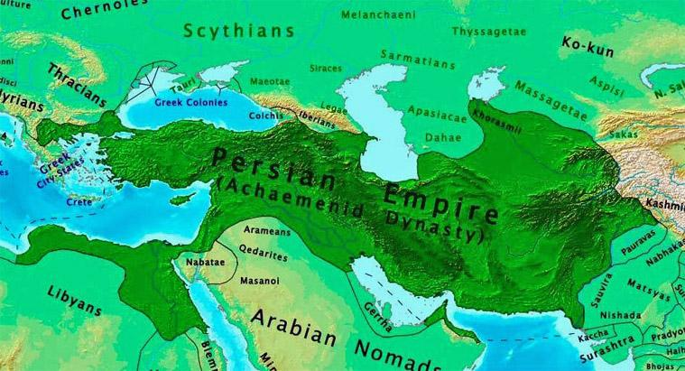
II. Persian Empire
Began in 559 B.C.E. under Cyrus the Great
Became known as the Achaemenid Empire uniting three of the earliest centers of civilization

Slide 16
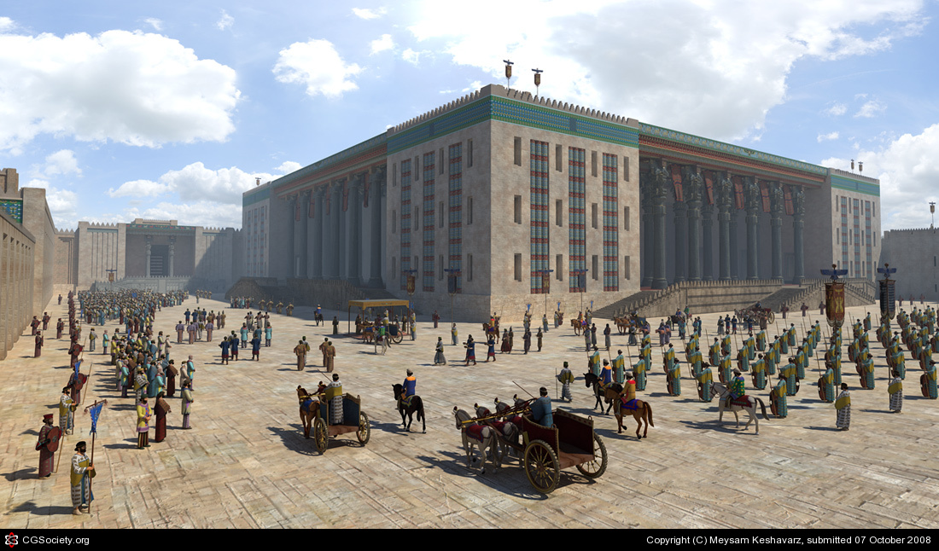
The Reign of Darius
Divided the lands into provinces so they could be easily administered
Created a new position a satrap, someone who was responsible to the emperor, not the local leaders
Also inspectors called: “The Eyes and Ears of the King”
Created the capital city Persepolis

Slide 17
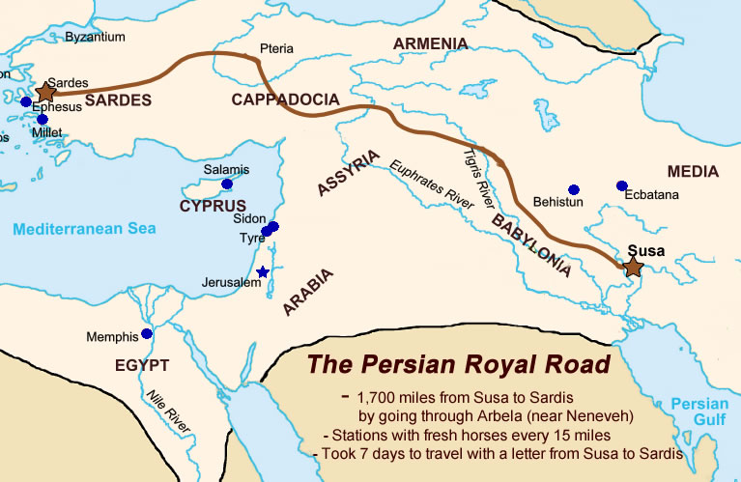
The Royal Road
Most famous road for trade at the time
Over 1,700 miles across the empire
Had a courier service with postal stations along the road
The army also protected the road from bandits
Constructed caravanserai, which were combo inns and markets along the road
Used a common currency

Slide 18
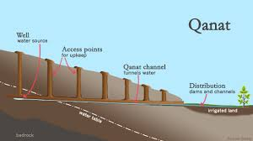
Other stuff on Persia
Darius tolerated everyone, as long as they paid their taxes and contributed soldiers
Main belief was that of Zoroastrianism
Similar to that of other emperors, but had a class of educated government workers
Used the qanat, or underground canals to reduce evaporation in irrigation
Conducted trade with Phoenicia for woolen fabrics and cedar, and wine and oil from Greece

Slide 19
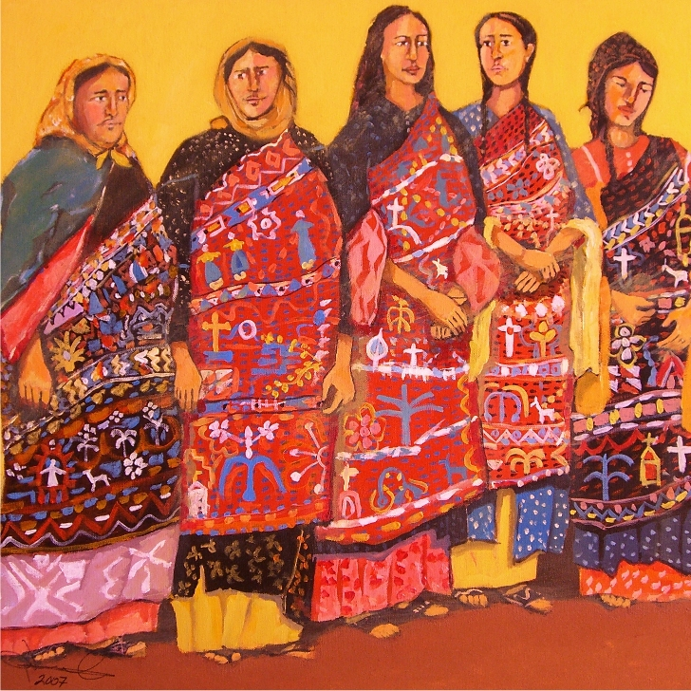
Women in Persia
Women could own and manage property
If worked in a shop. could keep their wages
Typical jobs were weaving textiles and trading them for food for their families
Divorce was also possible

Slide 20
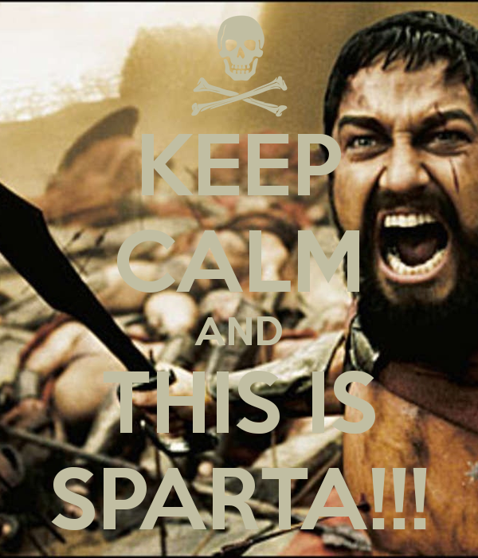
Persia vs. Greece
Fought a series of wars called the Persian Wars
The battles with Greece led to the decline of the empire… why?
This later led to the Athens vs. Sparta Peloponnesian War, and caused Sparta to defeat Athens

Slide 21
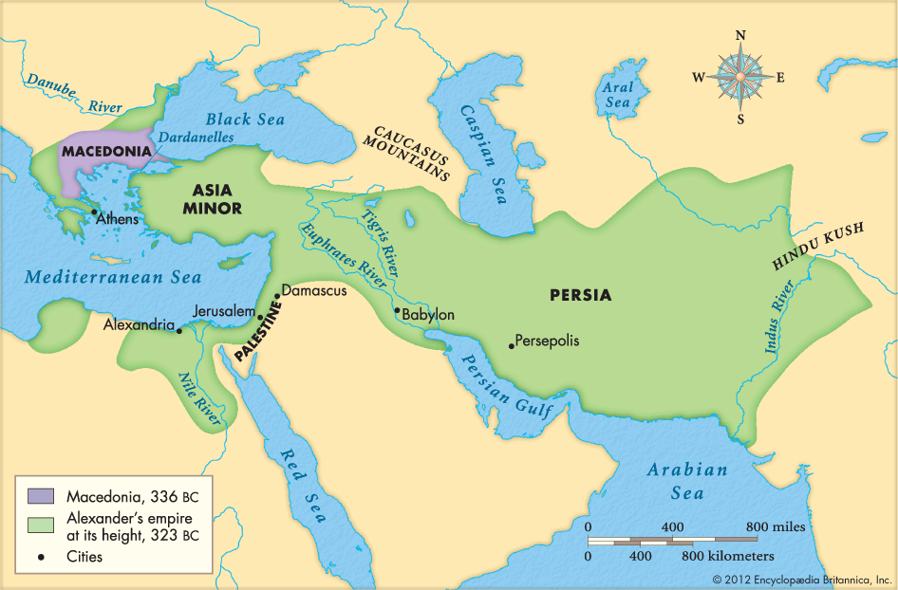
The Rise of Macedonia
Philip II conquered wanted to conquered all of the Greek city-states and Asia Minor… but was assassinated before he could finish
So his son Alexander takes over and extends Greek influence all the way to India

Slide 22
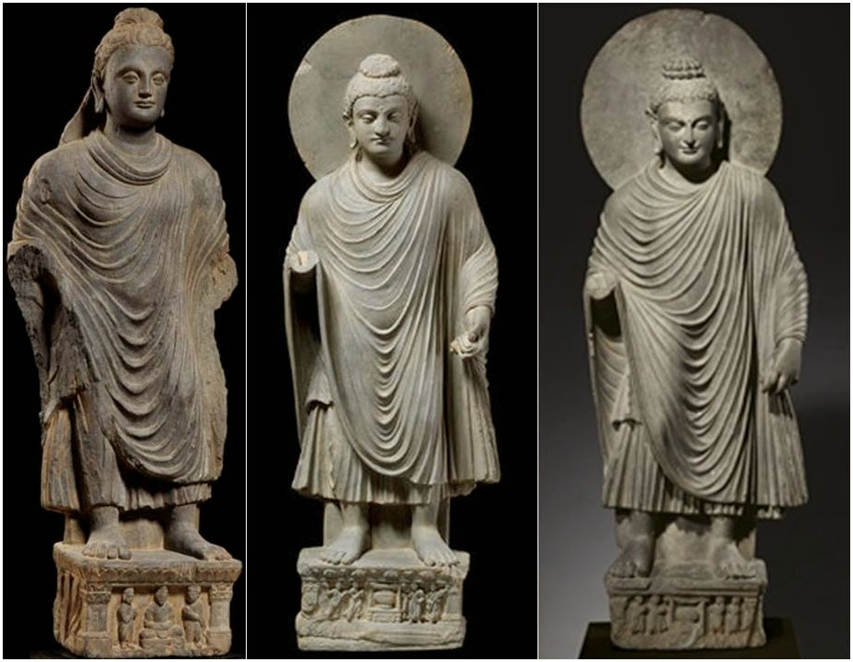
Alexander’s Hellenistic World
Picked native residents to help him rule
Founded Alexandria to become the center of culture and founded the library
An example of the spread of Greek culture can be seen in Greco-Buddhist art in South Asia
It does fall when he dies at 32

Slide 23
Other Empires of Persia
Seleucids
Responsible or losing the western half of the once Persian empire to the Romans
Parthians
Prevented the Roman army from going further than Syria
Rose in 247 B.C.E. and fell in 224 C.E.
Sassanids
224-621 C.E.
Promoted Zoroastrianism and persecuted Christians

Slide 24
The different Empires of the World

Slide 25
Comparing Greek and Persia Cultures
Go back and make a chart comparing and contrasting Greek and Persian cultures… in a nutshell:
Persia: Zoroast. religion, tolerant of diverse customs and cultures, uniting the empire, common coins, Royal Road
Greece: The OLYMPICS, polytheistic, city-states, democracy, all about Greece and nothing else, Sparta vs. Athens, Philosophy
Overall: United by Alexander and the Hellenistic World

