Slide 1
TIU Tishk International University FASE IRD Department Civilization History Code: IRD 116
Unit I : introduction
Course Educator
Associated Professor Dr. Neville D’Cunha

Slide 2
Civilization History (1)
Introduction
The term civilization refers to complex societies, but the specific definition is contested.
The advent of civilization depended on the ability of some agricultural settlements to consistently produce surplus food, which allowed some people to specialize in non-agricultural work, which in turn allowed for increased production, trade, population, and social stratification.
The first civilizations appeared in locations where the geography was favorable to intensive agriculture.

Slide 3
Civilization History (2)
Introduction
Governments and states emerged as rulers gained control over larger areas and more resources, often using writing and religion to maintain social hierarchies and consolidate power over larger areas and populations.
Writing allowed for the codification of laws, better methods of record-keeping, and the birth of literature, which fostered the spread of shared cultural practices among larger populations.

Slide 4
Civilization History (3)
Degrees of complexity
Today, almost every city has a supermarket with a wide variety of available foods. We take for granted the fact
that people have different types of jobs and
that governments exist.
But, reliable food sources, specialized work, and governments did not exist for most of human history!
They are the products of historical processes that began with the first civilizations several thousand years ago.

Slide 5
Civilization History (4)
Degrees of complexity
A civilization is a complex society that creates agricultural surpluses, allowing for specialized labor, social hierarchy, and the establishment of cities.
Developments such as writing, complex religious systems, monumental architecture, and centralized political power have been suggested as identifying markers of civilization, as well. When we see these changes occur, we should stop and ask, “Did people institute these practices because they were beneficial, or were they forced on them?”
Historians debate this very question, trying to determine whether civilization was a bottom-up or top-down development. Most likely, it was a bit of both.

Slide 6
Civilization History (5)
Some people think civilization is an advanced stage in the progression of human cultural evolution. But, when historians or anthropologists use the term civilization, they mean a society has many different, interconnected parts. So, rather than thinking about different forms of social organization as completely separate models, it’s helpful to think in terms of a spectrum of complexity. On one end, we have hunter-forager societies—which have little complexity—and on the other end, we have civilizations—which are highly complex. In between lie a wide variety of social structures of varying types and levels of complexity.
Degrees of complexity
Some people think civilization is an advanced stage in the progression of human cultural evolution. But, when historians or anthropologists use the term civilization, they mean a society has many different, interconnected parts.
So, rather than thinking about different forms of social organization as completely separate models, it’s helpful to think in terms of a spectrum of complexity.
On one end, we have hunter-forager societies—which have little complexity—and on the other end, we have civilizations—which are highly complex. In between lie a wide variety of social structures of varying types and levels of complexity.

Slide 7
Civilization History (6)
Some people think civilization is an advanced stage in the progression of human cultural evolution. But, when historians or anthropologists use the term civilization, they mean a society has many different, interconnected parts. So, rather than thinking about different forms of social organization as completely separate models, it’s helpful to think in terms of a spectrum of complexity. On one end, we have hunter-forager societies—which have little complexity—and on the other end, we have civilizations—which are highly complex. In between lie a wide variety of social structures of varying types and levels of complexity.
Degrees of complexity
On one end, we have hunter-forager societies—which have little complexity—and on the other end, we have civilizations—which are highly complex. In between lie a wide variety of social structures of varying types and levels of complexity.

Slide 8
Civilization History (7)
Some people think civilization is an advanced stage in the progression of human cultural evolution. But, when historians or anthropologists use the term civilization, they mean a society has many different, interconnected parts. So, rather than thinking about different forms of social organization as completely separate models, it’s helpful to think in terms of a spectrum of complexity. On one end, we have hunter-forager societies—which have little complexity—and on the other end, we have civilizations—which are highly complex. In between lie a wide variety of social structures of varying types and levels of complexity.
First civilizations
The first civilizations appeared in major river valleys, where floodplains contained rich soil and the rivers provided irrigation for crops and a means of transportation.
Foundational civilizations developed urbanization and complexity without outside influence and without building on a pre-existing civilization, though they did not all develop simultaneously. Many later civilizations either borrowed elements of, built on, or incorporated—through conquest—other civilizations. Because foundational civilizations arose independently, they are particularly useful to historians and archaeologists who want to understand how civilization first developed.

Slide 9
Civilization History (8)
Some people think civilization is an advanced stage in the progression of human cultural evolution. But, when historians or anthropologists use the term civilization, they mean a society has many different, interconnected parts. So, rather than thinking about different forms of social organization as completely separate models, it’s helpful to think in terms of a spectrum of complexity. On one end, we have hunter-forager societies—which have little complexity—and on the other end, we have civilizations—which are highly complex. In between lie a wide variety of social structures of varying types and levels of complexity.
Foundational civilizations:
Developed urbanization and complexity without outside influence and without building on a pre-existing civilization, though they did not all develop simultaneously.
Many later civilizations either borrowed elements of, built on, or incorporated—through conquest—other civilizations.
Because foundational civilizations arose independently, they are particularly useful to historians and archaeologists who want to understand how civilization first developed.

Slide 10
Civilization History (9:1)
Some people think civilization is an advanced stage in the progression of human cultural evolution. But, when historians or anthropologists use the term civilization, they mean a society has many different, interconnected parts. So, rather than thinking about different forms of social organization as completely separate models, it’s helpful to think in terms of a spectrum of complexity. On one end, we have hunter-forager societies—which have little complexity—and on the other end, we have civilizations—which are highly complex. In between lie a wide variety of social structures of varying types and levels of complexity.

Slide 11
Civilization History (9:2)
Some people think civilization is an advanced stage in the progression of human cultural evolution. But, when historians or anthropologists use the term civilization, they mean a society has many different, interconnected parts. So, rather than thinking about different forms of social organization as completely separate models, it’s helpful to think in terms of a spectrum of complexity. On one end, we have hunter-forager societies—which have little complexity—and on the other end, we have civilizations—which are highly complex. In between lie a wide variety of social structures of varying types and levels of complexity.
Map showing probable areas of independent development of agriculture, in green, and possible routes of diffusion.
Note that while there is much overlap between these regions and the locations of first civilizations, some areas—like the Indus Valley in northwest India—appear to have developed agriculture after the practice spread to the region.

Slide 12
Civilization History (10)
Some people think civilization is an advanced stage in the progression of human cultural evolution. But, when historians or anthropologists use the term civilization, they mean a society has many different, interconnected parts. So, rather than thinking about different forms of social organization as completely separate models, it’s helpful to think in terms of a spectrum of complexity. On one end, we have hunter-forager societies—which have little complexity—and on the other end, we have civilizations—which are highly complex. In between lie a wide variety of social structures of varying types and levels of complexity.
What do civilizations have in common?
Cities were at the center of all early civilizations. People from surrounding areas came to cities to live, work, and trade.
This meant that large populations of individuals who did not know each other lived and interacted with one another.
So, shared institutions, such as government, religion, and language helped create a sense of unity and also led to more specialized roles, such as bureaucrats, priests, and scribes.

Slide 13
Civilization History (11)
Some people think civilization is an advanced stage in the progression of human cultural evolution. But, when historians or anthropologists use the term civilization, they mean a society has many different, interconnected parts. So, rather than thinking about different forms of social organization as completely separate models, it’s helpful to think in terms of a spectrum of complexity. On one end, we have hunter-forager societies—which have little complexity—and on the other end, we have civilizations—which are highly complex. In between lie a wide variety of social structures of varying types and levels of complexity.
What do civilizations have in common?
Cities concentrated political, religious, and social institutions that were previously spread across many smaller, separate communities, which contributed to the development of states.
A state is an organized community that lives under a single political structure. A present-day country is a state in this sense, for example. Many civilizations either grew alongside a state or included several states.
The political structures that states provided were an important factor in the rise of civilizations because they made it possible to mobilize large amounts of resources and labor and also tied larger communities together by connecting them under a common political system.

Slide 14
Civilization History (12)
Some people think civilization is an advanced stage in the progression of human cultural evolution. But, when historians or anthropologists use the term civilization, they mean a society has many different, interconnected parts. So, rather than thinking about different forms of social organization as completely separate models, it’s helpful to think in terms of a spectrum of complexity. On one end, we have hunter-forager societies—which have little complexity—and on the other end, we have civilizations—which are highly complex. In between lie a wide variety of social structures of varying types and levels of complexity.
What do civilizations
have in common?
Early civilizations were often unified by religion—a system of beliefs and behaviors that deal with the meaning of existence.
As more and more people shared the same set of beliefs and practices, people who did not know each other could find common ground and build mutual trust and respect.

Slide 15
Civilization History (13)
Some people think civilization is an advanced stage in the progression of human cultural evolution. But, when historians or anthropologists use the term civilization, they mean a society has many different, interconnected parts. So, rather than thinking about different forms of social organization as completely separate models, it’s helpful to think in terms of a spectrum of complexity. On one end, we have hunter-forager societies—which have little complexity—and on the other end, we have civilizations—which are highly complex. In between lie a wide variety of social structures of varying types and levels of complexity.
What do civilizations have in common?
Both political and religious organization helped to create and reinforce social hierarchies, which are clear distinctions in status between individual people and between different groups.
Political leaders could make decisions that impacted entire societies, such as whether to go to war.
Religious leaders gained special status since they alone could communicate between a society and its god or gods.

Slide 16
Civilization History (14)
Some people think civilization is an advanced stage in the progression of human cultural evolution. But, when historians or anthropologists use the term civilization, they mean a society has many different, interconnected parts. So, rather than thinking about different forms of social organization as completely separate models, it’s helpful to think in terms of a spectrum of complexity. On one end, we have hunter-forager societies—which have little complexity—and on the other end, we have civilizations—which are highly complex. In between lie a wide variety of social structures of varying types and levels of complexity.
What do civilizations have in common?
Writing emerged in many early civilizations as a way to keep records and better manage complex institutions. Cuneiform writing in early Mesopotamia was first used to keep track of economic exchanges.

Slide 17
Civilization History (14)
Some people think civilization is an advanced stage in the progression of human cultural evolution. But, when historians or anthropologists use the term civilization, they mean a society has many different, interconnected parts. So, rather than thinking about different forms of social organization as completely separate models, it’s helpful to think in terms of a spectrum of complexity. On one end, we have hunter-forager societies—which have little complexity—and on the other end, we have civilizations—which are highly complex. In between lie a wide variety of social structures of varying types and levels of complexity.
What do civilizations have in common?
Another notable feature of many civilizations was monumental architecture. This type of architecture was often created for political reasons, religious purposes, or for the public good.

Slide 18
Civilization History (15)
Some people think civilization is an advanced stage in the progression of human cultural evolution. But, when historians or anthropologists use the term civilization, they mean a society has many different, interconnected parts. So, rather than thinking about different forms of social organization as completely separate models, it’s helpful to think in terms of a spectrum of complexity. On one end, we have hunter-forager societies—which have little complexity—and on the other end, we have civilizations—which are highly complex. In between lie a wide variety of social structures of varying types and levels of complexity.
What do civilizations have in common?
Writing offered new methods for maintaining law and order, as well.
The first legal codes, or written collections of laws, were the Code of Ur-Nammu from Sumer, written around 2100 to 2050 BCE and the Code of Hammurabi from Babylon, written around 1760 BCE. The benefit of written laws was that they created consistency in the legal system.

Slide 19
Civilization History (16)
Some people think civilization is an advanced stage in the progression of human cultural evolution. But, when historians or anthropologists use the term civilization, they mean a society has many different, interconnected parts. So, rather than thinking about different forms of social organization as completely separate models, it’s helpful to think in terms of a spectrum of complexity. On one end, we have hunter-forager societies—which have little complexity—and on the other end, we have civilizations—which are highly complex. In between lie a wide variety of social structures of varying types and levels of complexity.
What do civilizations have in common?
There were many features that early civilizations had in common.
Most civilizations developed from agrarian communities that provided enough food to support cities.
Cities intensified social hierarchies based on gender, wealth, and division of labor.
Some developed powerful states and armies, which could only be maintained through taxes.

Slide 20
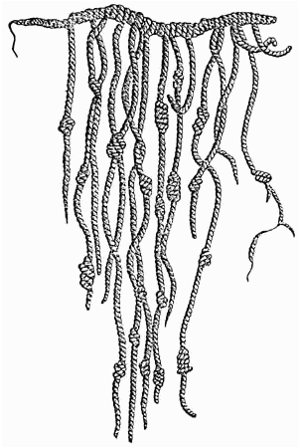
Civilization History (17)
Some people think civilization is an advanced stage in the progression of human cultural evolution. But, when historians or anthropologists use the term civilization, they mean a society has many different, interconnected parts. So, rather than thinking about different forms of social organization as completely separate models, it’s helpful to think in terms of a spectrum of complexity. On one end, we have hunter-forager societies—which have little complexity—and on the other end, we have civilizations—which are highly complex. In between lie a wide variety of social structures of varying types and levels of complexity.
What do civilizations have in common?
Is it writing? A quipu was a system of knotted strings that could be used to perform calculations and to record transactions. Evidence for the use of quipu has been found in many Andean cultures over the past several millennia. .

Slide 21
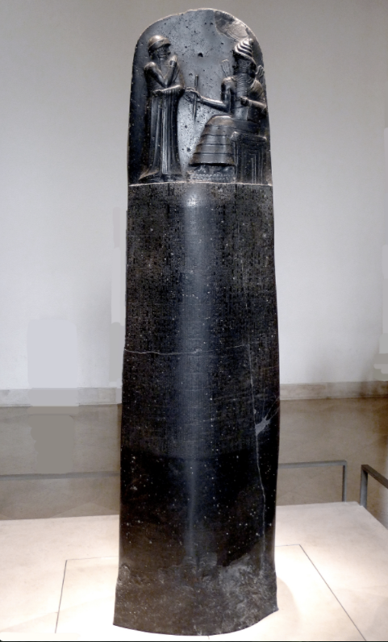
Civilization History (18)
Some people think civilization is an advanced stage in the progression of human cultural evolution. But, when historians or anthropologists use the term civilization, they mean a society has many different, interconnected parts. So, rather than thinking about different forms of social organization as completely separate models, it’s helpful to think in terms of a spectrum of complexity. On one end, we have hunter-forager societies—which have little complexity—and on the other end, we have civilizations—which are highly complex. In between lie a wide variety of social structures of varying types and levels of complexity.
What do civilizations have in common?
Law Code of Hammurabi inscribed on basalt stele. If you look closely, you can make out the cuneiform writing in the center.

Slide 22
Civilization History (19)
Some people think civilization is an advanced stage in the progression of human cultural evolution. But, when historians or anthropologists use the term civilization, they mean a society has many different, interconnected parts. So, rather than thinking about different forms of social organization as completely separate models, it’s helpful to think in terms of a spectrum of complexity. On one end, we have hunter-forager societies—which have little complexity—and on the other end, we have civilizations—which are highly complex. In between lie a wide variety of social structures of varying types and levels of complexity.
What do civilizations have in common?
What do you think?
When does a complex society become a civilization?
What factors were most important to establishing and maintaining a civilization?
Do you think that social hierarchies are necessary for civilization?
Are state-level political structures necessary for civilization? Or, can independent cities with a shared culture be a civilization?

