Slide 1
Chapter 2
Perceptions
Dr. Mohsin Uddin
Department of Accounting
Faculty of Economics and Administrative Sciences
Ishik University, Erbil

Slide 2
RECAP

Slide 3
Clinical Psychology
Clinical
Educational
Occupational
Counselling
Forensic
Health
Sport
Help people who have
• serious mental
illness
• depression
• anxiety
• child & family
problems

Slide 4
Life as a Clinical Psychologist
Where?
Mostly in : Hospitals, health centres, Community mental health teams, child and adolescent mental health, social services.
How?
Part of team with social workers, doctors, other health professionals.
Assess people’s mental health via psychometric tests, interviews . . . .

Slide 5
Educational Psychology
Clinical
Educational
Occupational
Counselling
Forensic
Health
Sport
• Help children and
young people
develop and learn
• Assessing child’s
special educational
needs

Slide 6
Life as an Educational Psychologist
Where?
Mostly for Local Education Authorities, some private, in nurseries, schools, colleges, special units.
How?
Assess child’s learning problems and plan support. May work with child, parents or school.
Involved in policy planning.

Slide 7
Occupational Psychology
Clinical
Educational
Occupational
Counselling
Forensic
Health
Sport & Exercise
Neuropsychology
Teaching and Research
• Improve the
effectiveness of
organisations
• satisfaction of
employees

Slide 8
Life as an Occupational Psychologist
Where?
In large organisations, both private and public (e.g. Civil Service), or private consultancies (e.g. management training centers).
How?
Working along with managers, trade union, etc.
to change working conditions. Involved in selection and training.

Slide 9
Counselling
Clinical
Educational
Occupational
Counselling
Forensic
Health
Sport & Exercise
Neuropsychology
Teaching and Research
Help people deal with
• personal and
family problems • sadness
• stress, effects
of trauma, etc.

Slide 10
Forensic Psychology
Clinical
Educational
Occupational
Counselling
Forensic
Health
Sport & Exercise
Neuropsychology
Teaching & Research
• Criminal profiling to
aid detection
• treatment programs
for offenders
• assessment for parole(Bail)
boards
• training & selection of
police & magistrates

Slide 11
Health Psychology . . .
Clinical
Educational
Occupational
Counselling
Forensic
Health
Sport & Exercise
• preventing ill health,
both physical & mental
• changing attitudes
and behaviours
• help patients in the
self-management of
their illness

Slide 12
Sport Psychology . . .
Clinical
Educational
Occupational
Counselling
Forensic
Health
Sport
• Assess athletes to determine the relationship between their mental state and physical performance.
• Teach visualization techniques to individuals to enhance performance.

Slide 13
Week | Hour | Date | Topic
1 | 2 | 3-7/2/2019 | An Introduction to Psychology
2 | 2 | 10-14/2/2019 | Attention and Perception
3 | 2 | 17-21/2/2019 | Memory
4 | 2 | 24-28/2/2019 | Groups
5 | 2 | 3-7/3/2019 | Practical
6 | 2 | 26-28/3/2019 | Motivation and Emotion
7 | 2 | 31/3-4/4/2019 | Attitude
8 | 2 | 7-11/4/2019 | Helping behavior
9 | 2 | 14-18/4/2019 | Midterm Exam
10 | 2 | 21-25/4/2019 | Personality
11 | 2 | 28/4-2/5/2019 | Practical
12 | 2 | 5-9/5/2019 | Unpleasant Social Behaviours
13 | 2 | 12-16/5/2019 | Environmental Stress
14 | 2 | 19-23/5/2019 | Understanding Individual Differences
15 | 2 | 26-30/5/2019 | Leadership
16 | 2 | 9-13/6/2019 | Final Exam
17 | 2 | 16-20/6/2019 | Final Exam

Slide 14
COURSE EVALUATION CRITERIA
Method | Quantity |  | Percentage (%)
Participation | 1 |  | 5
Quiz | 1 |  | 5
Homework | 1 |  | 5
Midterm Exam(s) | 1 |  | 20
Presentation | 1 |  | 10
Laboratory | 1 |  | 5
Lab/Practical Exam(s) | 1 |  | 10
Final Exam | 1 |  | 40
Total |  |  | 100

Slide 15
Understand the Concept of Perception
Learning Objectives

Slide 20
Perception
The process by which individuals organize and interpret their sensory impressions in order to give meaning to their environment.

Slide 23
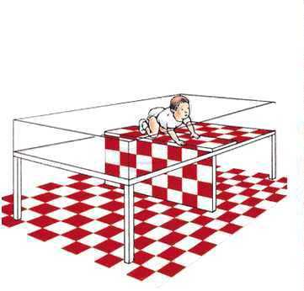

Slide 24
Chapter-5 2

Slide 25
Chapter-5 5

Slide 26
PERCEPTION
Chapter-5
6

Slide 27
Objectives of The Chapter
To understand
Meaning of Perception
Factors influencing Perception
Personality Type

Slide 28
What do You Understand by this Picture?

Slide 29
Meaning of Perception
Perception may be defined as the
process selects, stimuli
by which organizes
an individual and interprets
into a meaningful and
clear picture of the environment in which he lives.

Slide 30
Perceptual Selectivity
Though people are exposed to several stimuli , they tend to select only a few at a given point of time, this is perceptual selectivity.

Slide 31
Factors Influencing Perceptual
Selectivity
External Attention
Factors
Strength
Size
Contrast
Repetition
Motion
familiarity
Internal Set Factors
Learning and
Perception
Motivation and Perception
Personality and Perception

Slide 32
External Attention Factors
Size:
A larger object is more likely to be noticed than a smaller object.
Example:
Which you can read fast?
God is great
God is great

Slide 33
External Attention Factors
Contrast: According to the principles of contrast, the stimuli that contradict most with the background or the expectations of people receive maximum attention.
Example: Which white square is smaller?

Slide 34
External Attention Factors Contd…
Motion:
People gives more attention to moving objects than the static objects.
Example:
Moving object static object

Slide 35
External Attention Factors Contd…
Repetition
The more number of times a stimulus is
repeated, the more it is likely to be noticed

Slide 36
Internal Set Factors
Learning and Perception:
Learning by
itself plays a
major
role in
developing the perceptual set.
Example:
Hilly Terrrain Ahead

Slide 37
Motivation and Perception:
Personality and Perception:
The primary motives:
Personality of a person influence perception
Hunger and Thirst
The secondary motives:
The need for power, The need
and
for
for affiliation
The need
achievement

Slide 38
Factors Influencing Perception
The Perceiver
The Target
The Situation

Slide 39
Social Perception
It is directly concerned with how one
individual perceives other individuals; how we get to know others.
Factors affecting Social perception
Attribution
Stereotyping
The Halo Effect

Slide 40
Attribution
Attribution refers to
how people another’s or
depends on
explain the cause of
their own behavior.
The determination three factors:
Distinctiveness
Consensus
Consistency

Slide 41
Stereotyping
It is the tendency to perceive another person as belonging to a single class or category
Halo effect
The person is perceived on the basis of one trait or event.

Slide 42
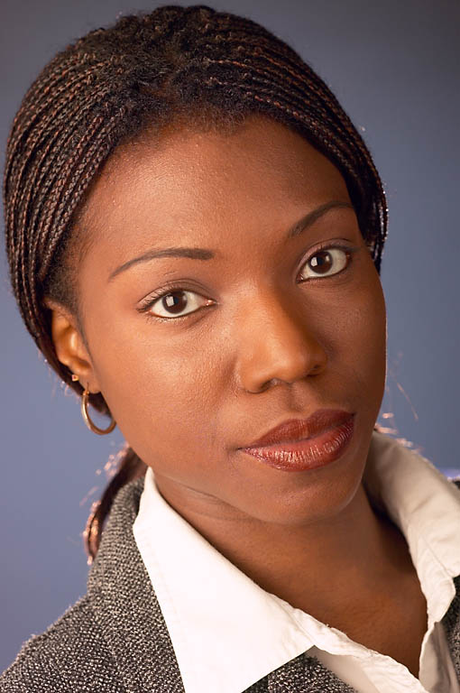
Stereotypes
A generalized set of beliefs about the characteristics of a group of individuals
What thoughts come to mind when you perceive the individuals in these photographs?

Slide 43
Impression Management
It is referred to as “self presentation”
It is the process by which people try to manage or control the perceptions formed by other people about themselves.

