Slide 1
Tishk International University
FASE: Dept. IRD
International
Negotiation and Mediation
Code: IRD 402
Week 5
negotiation: Process and strategies
He Educator
Dr Neville D’Cunha
Professor of IRD

Slide 2
IRD 402 N:PS
Topic 1
What Makes International Relations and Diplomacy
Negotiations Different?
Two overall contexts have an influence on international negotiations:
Environmental context
  Includes environmental forces that neither negotiator controls that influence the negotiation
Immediate context
  Includes factors over which negotiators appear to have some control

Slide 3
IRD 402 N:PS
Environmental Context
Factors that make international negotiations
more challenging than domestic negotiations include:
Political and legal pluralism
International economics
Foreign governments and bureaucracies
Instability
Ideology
Culture
External stakeholders

Slide 4
IRD 402 N:PS
Culturally Responsive Negotiation Strategies
A. When choosing a strategy, negotiators should:
  Be aware of their own and the other party’s culture in general
  Understand the specific factors in the current relationship
  Predict or try to influence the other party’s approach
B. Strategies are arranged based on the level of familiarity (low, moderate, high) that a negotiator has with the other party’s culture

Slide 5
IRD 402 N:PS
How Do We Explain International Negotiation Outcomes?
International negotiations can be much more complicated
Simple arguments cannot explain conflicting international negotiation outcomes
The challenge is to:
  Understand the multiple influences of several factors on the negotiation process
  Update this understanding regularly as circumstances change

Slide 6
IRD 402 N:PS
Masculinity/Femininity in
International Negotiation Outcomes?
The extent cultures hold values that are traditionally perceived as
masculine or feminine
Influences negotiation by increasing the competitiveness when negotiators from masculine cultures meet

Slide 7
IRD 402 N:PS
Low Familiarity
Employ agents or advisers (unilateral strategy)
  Useful for negotiators who have little awareness of the other party’s culture
Bring in a mediator (joint strategy)
  Encourages one side or the other to adopt one culture’s approaches or mediator culture approach
Induce the other party to use your approach
(joint strategy)
  The other party may become irritated or be insulted

Slide 8
IRD 402 N:PS
Moderate Familiarity
Adapt to the other negotiator’s approach (unilateral strategy)
  Involves making conscious changes to your approach so it is more appealing to the other party
Coordinate adjustment (joint strategy)
  Involves both parties making mutual adjustments to find a common process for negotiation

Slide 9
IRD 402 N:PS
High Familiarity
Embrace the other negotiator’s approach (unilateral strategy)
  Adopting completely the approach of the other negotiator (negotiator needs to be completely bilingual and bicultural)
Improvise an approach (joint strategy)
  Crafts an approach that is specifically tailored to the negotiation situation, other party, and circumstances
Effect symphony (joint strategy)
  The parties create a new approach that may include aspects of either home culture or adopt practices from a third culture

Slide 10
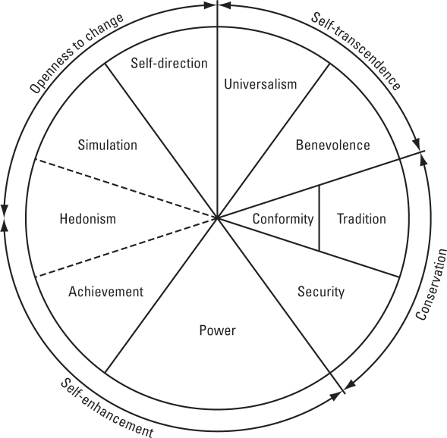
IRD 402 N:PS Culture as Values

Slide 11
The Contexts of International Negotiations

Slide 12
IRD 402 N:PS
Topic 2
Diplomatic Negotiations:
The Surprising Benefits of Conflict and Teamwork at the Negotiation Table
Coalitions and cooperation have tangible benefits for negotiators engaged in diplomatic negotiations

Slide 13
IRD 402 N:PS
Negotiating Skills and Tactics for Diplomatic Negotiations: The pros and cons of teamwork
When a negotiation is a complex one that requires a broad set of knowledge, skills, and experience, gathering a team can be a smarter choice than trying to go it alone, according to professor Elizabeth Mannix of Cornell University.
Negotiation research supports the notion that teams are more effective than individuals in many situations. Yet without adequate coordination and planning, teams are unlikely to meet their full potential, and the results can be disappointing.

Slide 14
IRD 402 N:PS
Negotiating Skills and Tactics for Diplomatic Negotiations: The pros and cons of teamwork
What determines whether team negotiations succeed or fail?
The degree to which teams effectively meet their unique challenges with appropriate strategies depends on how well
they manage their internal dynamics.
2. Notably, the type of disputes that occur within teams can have very different effects on performance.
When teams face disagreements that centre on substantive issues related to the negotiation task, such as those related to interests, priorities, and goals, the resolution of such conflicts can actually spur better outcomes.
By contrast, when conflicts get personal—deteriorating into bitter denunciations and criticism, for example—team performance may suffer.

Slide 15
IRD 402 N:PS
3 Negotiation Tips for Diplomatic Negotiations
The following three suggestions can help you foster productive rather than debilitating conflict within your negotiating team:
Seek familiarity, not friendship.
Discuss differences in advance.
Assign roles and responsibilities.

Slide 16
IRD 402 N:PS
1. Seek familiarity, not friendship.
In their research, Deborah Gruenfeld and Margaret Neale of Stanford University, Katherine Philips of Northwestern University, and Elizabeth Mannix found:
Those team members who had not worked together before were unable to pool the information necessary to solve a problem.
By contrast, teams of individuals who were familiar with one another easily pooled information and solved the same problem. Familiarity enables team members to share information and engage in the constructive conflict needed to find a solution.

Slide 17
IRD 402 N:PS
2. Discuss differences in advance.
To prevent conflicts among diverse, strong-minded team members from overshadowing group goals, Mannix advises negotiation teams to spend at least twice as much time preparing for upcoming talks as they expect to spend at the table.
Because the other side will be ready and willing to exploit any chinks in your team’s armour, it’s important to hash out your differences in advance.

Slide 18
IRD 402 N:PS
2. Discuss differences in advance.
Start by encouraging the team to brainstorm and debate the issues to be discussed during talks. Spend time debating goals, the team’s best alternatives to the present agreement, and your reservation point—the worst outcome you, as a team, will accept.
Then, spend just as much time exploring the other side’s likely goals, background, alternatives, and reservation point. Having trouble coming to agreement on the facts? Teams sometimes resolve substantive differences by bringing in experts for guidance on areas of confusion.

Slide 19
IRD 402 N:PS
3. Assign roles and responsibilities.
Before negotiating, teams should also discuss how to take advantage of members’ different skills, suggests Mannix.
Which member has the best listening skills? This person could be put in charge of watching and reading members of the other team and reporting his observations to his own team during breaks.
Which team member has the most negotiation experience? This person could be appointed the team leader—the chief decision maker who corrals the rest of the group.
Who is the best communicator? The team spokesperson should be a calm, articulate individual who is willing to follow the leader and the team’s negotiation plan.

Slide 20
IRD 402 N:PS
3. Assign roles and responsibilities.
In addition to brainstorming different scenarios that could occur at the table and role-playing how you will respond, your team should discuss the decision rules you will use when you confer privately to weigh the various offers on the table.
Because unanimity can be difficult to achieve, you might opt for a majority-decision rule that allows most parties to get what they need from a deal.

Slide 21
IRD 402 N:PS
Diplomatic Negotiations:
The Surprising Benefits of Conflict and Teamwork at the Negotiation Table
By dividing up key responsibilities, debating differences of opinion before negotiating, and keeping talks respectful, your team will be in a strong position to capitalize on its differences.

