Slide 1
International Economics II
Exchange Rates and the Foreign Exchange Market:
An Asset Approach
HE EDUCATOR
Dr. Waqar Ahmad
Faculty of Administrative Sciences and Economics

Slide 2
Introduction
Exchange rates are important because they enable us to translate different counties’ prices into comparable terms.
Exchange rates are determined in the same way as other asset prices.
The general goal of this chapter is to show:
How exchange rates are determined
The role of exchange rates in international trade

Slide 3
Exchange Rates and International Transactions
An exchange rate can be quoted in two ways:
Direct
The price of the foreign currency in terms of dollars
Indirect
The price of dollars in terms of the foreign currency

Slide 4
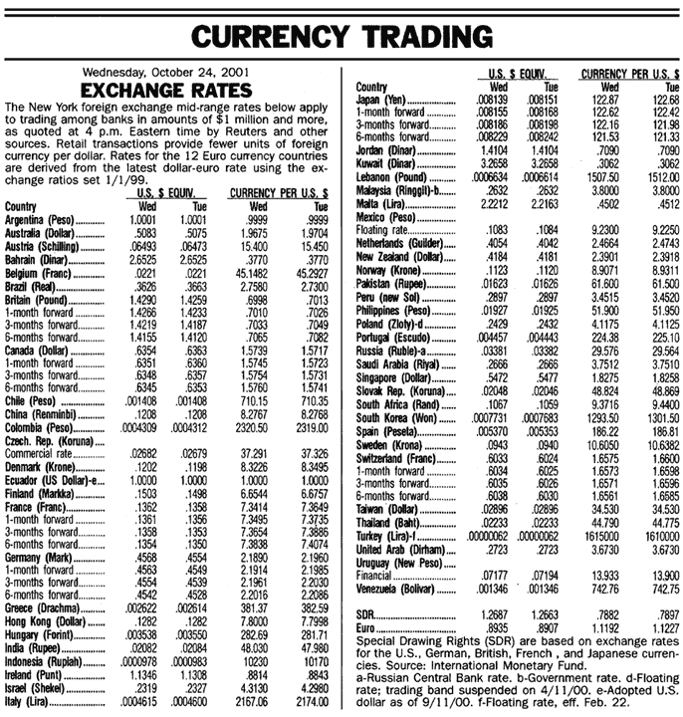
Exchange Rates and International Transactions
Table 13-1: Exchange Rate Quotations

Slide 5
Exchange Rates and International Transactions
Domestic and Foreign Prices
If we know the exchange rate between two countries’ currencies, we can compute the price of one country’s exports in terms of the other country’s money.
Example: The dollar price of a £50 sweater with a dollar exchange rate of $1.50 per pound is (1.50 $/£) x (£50) = $75.

Slide 6
Exchange Rates and International Transactions
Two types of changes in exchange rates:
Depreciation of home country’s currency
A rise in the home currency prices of a foreign currency
It makes home goods cheaper for foreigners and foreign goods more expensive for domestic residents.
Appreciation of home country’s currency
A fall in the home price of a foreign currency
It makes home goods more expensive for foreigners and foreign goods cheaper for domestic residents.

Slide 7
Exchange Rates and International Transactions
Exchange Rates and Relative Prices
Import and export demands are influenced by relative prices.
Appreciation of a country’s currency:
Raises the relative price of its exports
Lowers the relative price of its imports
Depreciation of a country’s currency:
Lowers the relative price of its exports
Raises the relative price of its imports

Slide 8
Exchange Rates and International Transactions
Table 13-2: $/£ Exchange Rates and the Relative Price of American Designer Jeans and British Sweaters

Slide 9
The Foreign Exchange Market
Exchange rates are determined in the foreign exchange market.
The market in which international currency trades take place
The Actors
The major participants in the foreign exchange market are:
Commercial banks
International corporations
Nonbank financial institutions
Central banks

Slide 10
Exchange Rates and International Transactions
Interbank trading
Foreign currency trading among banks
It accounts for most of the activity in the foreign exchange market.

Slide 11
Exchange Rates and International Transactions
Characteristics of the Market
The worldwide volume of foreign exchange trading is enormous, and it has ballooned in recent years.
New technologies, such as Internet links, are used among the major foreign exchange trading centers (London, New York, Tokyo, Frankfurt, and Singapore).
The integration of financial centers implies that there can be no significant arbitrage.
The process of buying a currency cheap and selling it dear.

Slide 12
Exchange Rates and International Transactions
Vehicle currency
A currency that is widely used to denominate international contracts made by parties who do not reside in the country that issues the vehicle currency.
Example: In 2001, around 90% of transactions between banks involved exchanges of foreign currencies for U.S. dollars.

Slide 13
Exchange Rates and International Transactions
Spot Rates and Forward Rates
Spot exchange rates
Apply to exchange currencies “on the spot”
Forward exchange rates
Apply to exchange currencies on some future date at a prenegotiated exchange rate
Forward and spot exchange rates, while not necessarily equal, do move closely together.

Slide 14
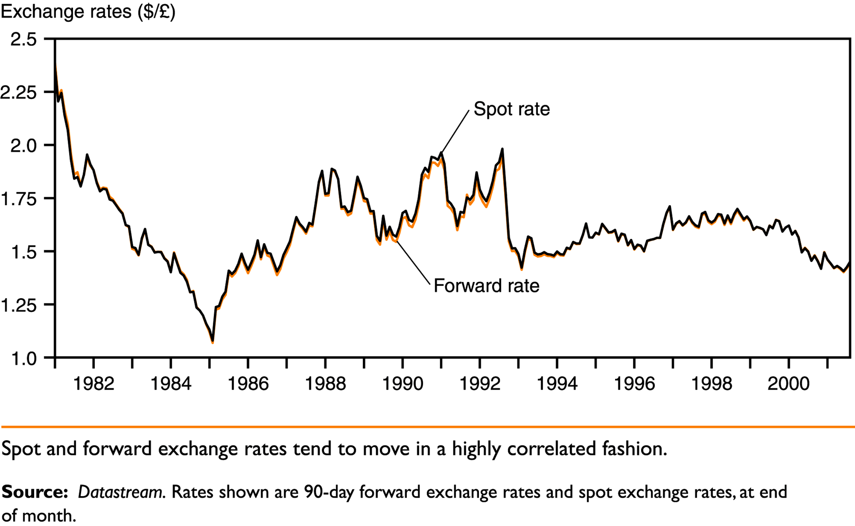
Exchange Rates and International Transactions
Figure 13-1: Dollar/Pound Spot and Forward Exchange Rates, 1981-2001

Slide 15
Exchange Rates and International Transactions
Foreign Exchange Swaps
Spot sales of a currency combined with a forward repurchase of the currency.
They make up a significant proportion of all foreign exchange trading.

Slide 16
Exchange Rates and International Transactions
Futures and Options
Futures contract
The buyer buys a promise that a specified amount of foreign currency will be delivered on a specified date in the future.
Foreign exchange option
The owner has the right to buy or sell a specified amount of foreign currency at a specified price at any time up to a specified expiration date.

Slide 17
The Demand for Foreign Currency Assets
The demand for a foreign currency bank deposit is influenced by the same considerations that influence the demand for any other asset.
Assets and Asset Returns
Defining Asset Returns
The percentage increase in value an asset offers over some time period.
The Real Rate of Return
The rate of return computed by measuring asset values in terms of some broad representative basket of products that savers regularly purchase.

Slide 18
The Demand for Foreign Currency Assets
Risk and Liquidity
Savers care about two main characteristics of an asset other than its return:
Risk
The variability it contributes to savers’ wealth
Liquidity
The ease with which it can be sold or exchanged for goods

Slide 19
The Demand for Foreign Currency Assets
Interest Rates
Market participants need two pieces of information in order to compare returns on different deposits:
How the money values of the deposits will change
How exchange rates will change
A currency’s interest rate is the amount of that currency an individual can earn by lending a unit of the currency for a year.
Example: At a dollar interest rate of 10% per year, the lender of $1 receives $1.10 at the end of the year.

Slide 20
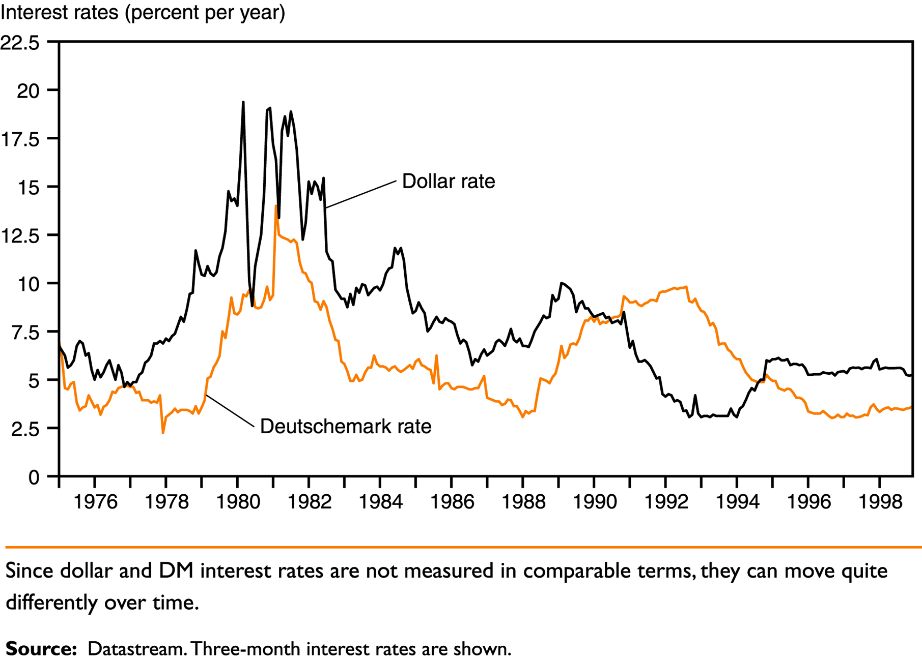
The Demand for Foreign Currency Assets
Figure 13-2: Interest Rates on Dollar and Deutschemark Deposits, 1975-1998

Slide 21
The Demand for Foreign Currency Assets
Exchange Rates and Asset Returns
The returns on deposits traded in the foreign exchange market depend on interest rates and expected exchange rate changes.
In order to decide whether to buy a euro or a dollar deposit, one must calculate the dollar return on a euro deposit.

Slide 22
The Demand for Foreign Currency Assets
A Simple Rule
The dollar rate of return on euro deposits is approximately the euro interest rate plus the rate of depreciation of the dollar against the euro.
The rate of depreciation of the dollar against the euro is the percentage increase in the dollar/euro exchange rate over a year.

Slide 23
The Demand for Foreign Currency Assets
The expected rate of return difference between dollar and euro deposits is:
R$ - [R€ + (E^{e}$/ € - E$/€ )/E$/€ ]= R$ - R€ - (E^{e}$/€ -E$/€ )/E$/€ (13-1)
where:
R$ = interest rate on one-year dollar deposits
R€ = today’s interest rate on one-year euro deposits
E$/€ = today’s dollar/euro exchange rate (number of dollars per euro)
E^{e}$/€ = dollar/euro exchange rate (number of dollars per euro) expected to prevail a year from today

Slide 24
The Demand for Foreign Currency Assets
When the difference in Equation (13-1) is positive, dollar deposits yield the higher expected rate of return. When it is negative, euro deposits yield the higher expected rate of return.

Slide 25
The Demand for Foreign Currency Assets
Table 13-3: Comparing Dollar Rates of Return on Dollar and
Euro Deposits

Slide 26
The Demand for Foreign Currency Assets
Return, Risk, and Liquidity in the Foreign Exchange Market
The demand for foreign currency assets depends not only on returns but on risk and liquidity.
There is no consensus among economists about the importance of risk in the foreign exchange market.
Most of the market participants that are influenced by liquidity factors are involved in international trade.
Payments connected with international trade make up a very small fraction of total foreign exchange transactions.
Therefore, we ignore the risk and liquidity motives for holding foreign currencies.

Slide 27
Equilibrium in the Foreign Exchange Market
Interest Parity: The Basic Equilibrium Condition
The foreign exchange market is in equilibrium when deposits of all currencies offer the same expected rate of return.
Interest parity condition
The expected returns on deposits of any two currencies are equal when measured in the same currency.
It implies that potential holders of foreign currency deposits view them all as equally desirable assets.
The expected rates of return are equal when:
R$ = R€ + (E^{e}$/€ - E$/€)/E$/€ (13-2)

Slide 28
Equilibrium in the Foreign Exchange Market
How Changes in the Current Exchange Rate Affect Expected Returns
Depreciation of a country’s currency today lowers the expected domestic currency return on foreign currency deposits.
Appreciation of the domestic currency today raises the domestic currency return expected of foreign currency deposits.

Slide 29
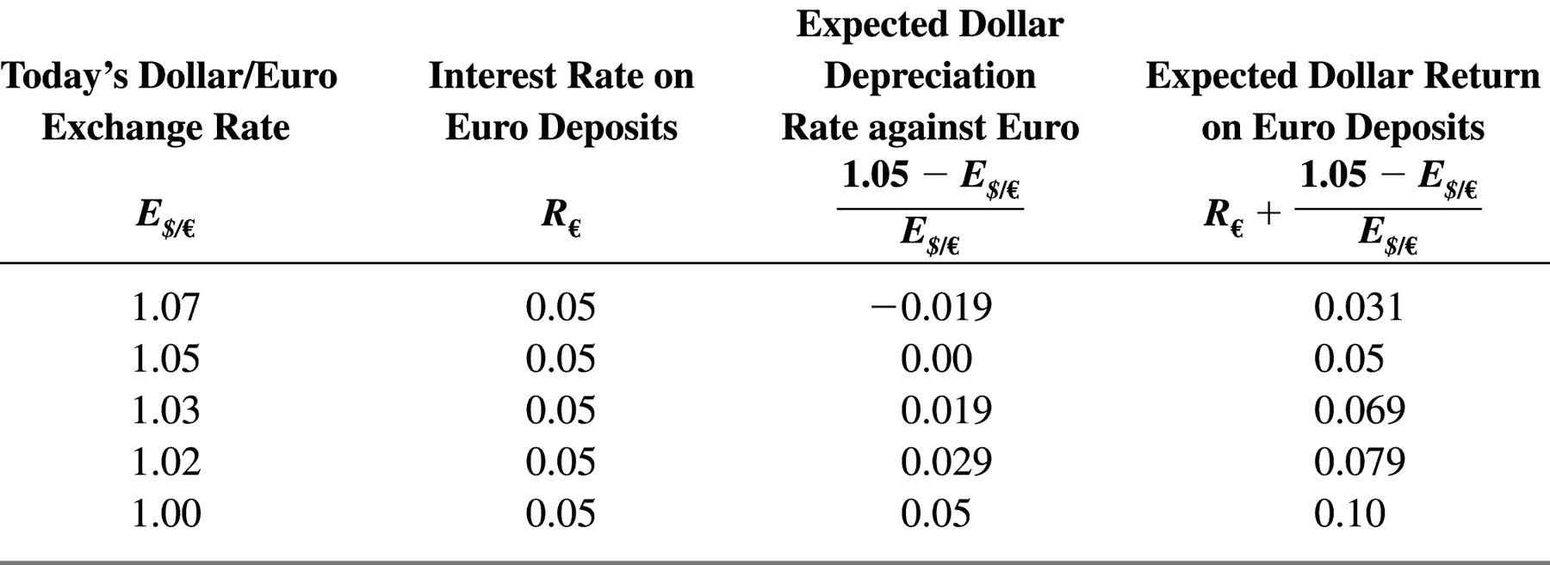
Equilibrium in the Foreign Exchange Market
Table 13-4: Today’s Dollar/Euro Exchange Rate and the Expected Dollar Return on Euro Deposits When E^{e}$/€ = $1.05 per Euro

Slide 30
Equilibrium in the Foreign Exchange Market
Figure 13-3: The Relation Between the Current Dollar/Euro Exchange Rate
and the Expected Dollar Return on Euro Deposits
Today’s dollar/euro
exchange rate, E$/€
1.07
1.05
1.03
1.02
1.00
0.031
0.050
0.069
0.079
0.100
Expected dollar return on euro deposits, R€ + (E^{e}$/€ - E$/€)/(E$/€)

Slide 31
Equilibrium in the Foreign Exchange Market
The Equilibrium Exchange Rate
Exchange rates always adjust to maintain interest parity.
Assume that the dollar interest rate R$, the euro interest rate R€, and the expected future dollar/euro exchange rate E^{e}$/€, are all given.

Slide 32
Equilibrium in the Foreign Exchange Market
Figure 13-4: Determination of the Equilibrium Dollar/Euro Exchange Rate
Exchange rate, E$/€
Return on
dollar deposits
E²$/€
2
E¹$/€
1
3
E³$/€
Expected return
on euro deposits
R$
Rates of return
(in dollar terms)

Slide 33
Interest Rates, Expectations, and Equilibrium
The Effect of Changing Interest Rates on the Current Exchange Rate
An increase in the interest rate paid on deposits of a currency causes that currency to appreciate against foreign currencies.
A rise in dollar interest rates causes the dollar to appreciate against the euro.
A rise in euro interest rates causes the dollar to depreciate against the euro.

Slide 34
Interest Rates, Expectations, and Equilibrium
Figure 13-5: Effect of a Rise in the Dollar Interest Rate
Exchange rate, E$/€
Dollar return
E¹$/€
1
1'
E²$/€
2
Expected
euro return
R¹$
R²$
Rates of return
(in dollar terms)

Slide 35
Interest Rates, Expectations, and Equilibrium
Figure 13-6: Effect of a Rise in the Euro Interest Rate
Exchange rate, E$/€
Dollar return
Rise in euro
interest rate
E²$/€
2
E¹$/€
1
Expected
euro return
R$
Rates of return
(in dollar terms)

Slide 36
Interest Rates, Expectations, and Equilibrium
The Effect of Changing Expectations on the Current Exchange Rate
A rise in the expected future exchange rate causes a rise in the current exchange rate.
A fall in the expected future exchange rate causes a fall in the current exchange rate.

Slide 37
Summary
Exchange rates play a role in spending decisions because they enable us to translate different countries’ prices into comparable terms.
A depreciation (appreciation) of a country’s currency against foreign currencies makes its exports cheaper (more expensive) and its imports more expensive (cheaper).
Exchange rates are determined in the foreign exchange market.

Slide 38
Summary
An important category of foreign exchange trading is forward trading.
The exchange rate is most appropriately thought of as being an asset price itself.
The returns on deposits traded in the foreign exchange market depend on interest rates and expected exchange rate changes.

Slide 39
Summary
Equilibrium in the foreign exchange market requires interest parity.
For given interest rates and a given expectation of the future exchange rate, the interest parity condition tells us the current equilibrium exchange rate.
A rise in dollar (euro) interest rates causes the dollar to appreciate (depreciate) against the euro.
Today’s exchange rate is altered by changes in its expected future level.

