Slide 1
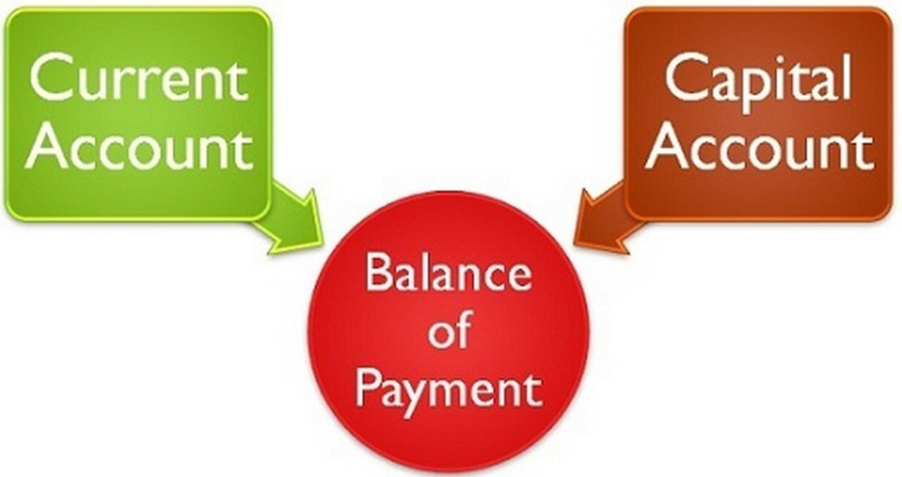
International Economics II
Educator
Dr. Waqar Ahmad

Slide 2
Learning Objective
Balance of Payment
How Do the Balance of Payments Accounts Balance
Examples of BOP surplus and deficit
Gross Foreign Assets and Liabilities
Record in accounts
Role of Central banks in BOP

Slide 3
Balance of Payments Accounts
A country’s balance of payments accounts keep track of both its payments to and its receipts from foreigners. Any transaction resulting in a receipt from foreigners is entered in the balance of payments accounts as a credit. Any transaction resulting in a payment to foreigners is entered as a debit.
A country’s balance of payments accounts for its payments to and its receipts from foreigners.
An international transaction involves two parties, and each transaction enters the accounts twice: once as a credit (+) and once as a debit (–).

Slide 4
Balance of Payments Accounts
The balance of payments accounts less confusing if you keep in mind the following simple rule of double-entry bookkeeping:
Every inter-national transaction automatically enters the balance of payments twice, once as a credit and once as a debit. This principle of balance of payments accounting holds true because every transaction has two sides: If you buy something from a foreigner, you must pay him in some way, and the foreigner must then somehow spend or store your payment.

Slide 5
Balance of Payments Accounts (cont.)
The balance of payments accounts are separated into 3 broad accounts:
current account: accounts for flows of goods and services (imports and exports).
When a French consumer imports American blue jeans, for example, the transaction enters the U.S. balance of payments accounts as a credit on the current account.
financial account: accounts for flows of financial assets (financial capital).
The financial account of the balance of payments records all international purchases or sales of financial assets. When an American company buys a French factory, the transaction enters the U.S. balance of payments as a debit in the financial account.
The difference between a country’s purchases and sales of foreign assets is called its financial account balance, or its net financial flows.
capital account: flows of special categories of assets (capital): typically nonmarket, non-produced, or intangible assets like debt forgiveness, copyrights and trademarks.
Certain other activities resulting in transfers of wealth between countries are recorded in the capital account

Slide 6
Examples of Paired Transactions
Some examples will show how the principle of double-entry bookkeeping operates in practice.
Imagine you buy an ink-jet fax machine from the Italian company Olivetti and pay for your purchase with a $1,000 check. Your payment to buy a good (the fax machine) from a foreign resident enters the U.S. current account as a debit. But where is the off-setting balance of payments credit? Olivetti’s U.S. salesperson must do something with your check—let’s say he deposits it in Olivetti’s account at Citibank in New York. In this case, Olivetti has purchased, and Citibank has sold, a U.S. asset—a bank deposit worth $1,000—and the transaction shows up as a $1,000 credit in the U.S. financial account. The transaction creates the following two offsetting bookkeeping entries in the U.S. balance of payments
 | Credit | Debit
Fax machine purchase (Current account, U.S. good import) |  | $1,000
Sale of bank deposit by Citibank
(Financial account, U.S. asset sale) | $1,000

Slide 7
Example of Balance of Payments Accounting
You import a fax machine from Olivetti.
Olivetti deposits your check in a U.S. bank.
Fax machine (current account, U.S. good import) –$80
Bank deposit (financial account, U.S. asset sale) +$80

Slide 8
Example of Balance of Payments Accounting (cont.)
You buy lunch in France and pay by credit card.
French restaurant receives payment from your credit card company.
Meal purchase (current account, U.S. service import) –$30
Sale of credit card claim (financial account, U.S. asset sale) +$30

Slide 9
Example of Balance of Payments Accounting (cont.)
You buy a share of BP.
BP deposits the money in a U.S. bank.
Stock purchase (financial account, U.S. asset purchase) –$90
Bank deposit (financial account, U.S. asset sale) +$90

Slide 10
Example of Balance of Payments Accounting (cont.)
U.S. banks forgive a $50 M debt owed by the government of Argentina through debt restructuring.
U.S. banks who hold the debt thereby reduce the debt by crediting Argentina's bank accounts.
Debt forgiveness (capital account, U.S. transfer payment) –$50 M
Reduction in bank’s claims (financial account, U.S. asset sale) +$50 M

Slide 11
The Fundamental Balance of Payments Identity
Because any international transaction automatically gives rise to offsetting credit and debit entries in the balance of payments, the sum of the current account balance and the capital account balance automatically equals the financial account balance:
Current account + Capital account = Financial account.

Slide 12
How Do the Balance of Payments Accounts Balance?
Due to the double entry of each transaction, the balance of payments accounts will balance by the following equation:
current account +
financial account +
capital account = 0

Slide 13
Balance of Payments Accounts
The 3 broad accounts are more finely divided:
Current account: imports and exports
merchandise (goods like DVDs)
services (payments for legal services, shipping services, tourist meals, etc.)
income receipts (interest and dividend payments, earnings of firms and workers operating in foreign countries)

Slide 14
Balance of Payments Accounts (cont.)
Current account: net unilateral transfers
gifts (transfers) across countries that do not purchase a good or service nor serve as income for goods and services produced
Capital account: records special transfers of assets, but this is a minor account for the U.S.

Slide 15
Balance of Payments Accounts (cont.)
Financial account: the difference between sales of domestic assets to foreigners and purchases of foreign assets by domestic citizens.
Financial inflow
Foreigners loan to domestic citizens by buying domestic assets.
Domestic assets sold to foreigners are a credit (+) because the domestic economy acquires money during the transaction.
Financial outflow
Domestic citizens loan to foreigners by buying foreign assets.
Foreign assets purchased by domestic citizens are a debit (–) because the domestic economy gives up money during the transaction.

Slide 16
Balance of Payments Accounts (cont.)
Financial account has at least 3 subcategories:
Official (international) reserve assets
All other assets
Statistical discrepancy

Slide 17
Balance of Payments Accounts (cont.)
Statistical discrepancy
Data from a transaction may come from different sources that differ in coverage, accuracy, and timing.
The balance of payments accounts therefore seldom balance in practice.
The statistical discrepancy is the account added to or subtracted from the financial account to make it balance with the current account and capital account.

Slide 18
Balance of Payments Accounts (cont.)
Official (international) reserve assets: foreign assets held by central banks to cushion against financial instability.
Assets include government bonds, currency, gold, and accounts at the International Monetary Fund.
Official reserve assets owned by (sold to) foreign central banks are a credit (+) because the domestic central bank can spend more money to cushion against instability.
Official reserve assets owned by (purchased by) the domestic central bank are a debit (–) because the domestic central bank can spend less money to cushion against instability.

Slide 19
Balance of Payments Accounts (cont.)
The negative value of the official reserve assets is called the official settlements balance or “balance of payments.”
It is the sum of the current account, the capital account, the nonreserve portion of the financial account, and the statistical discrepancy.
A negative official settlements balance may indicate that a country
is depleting its official international reserve assets, or
may be incurring large debts to foreign central banks so that the domestic central bank can spend a lot to protect against financial instability.

Slide 20
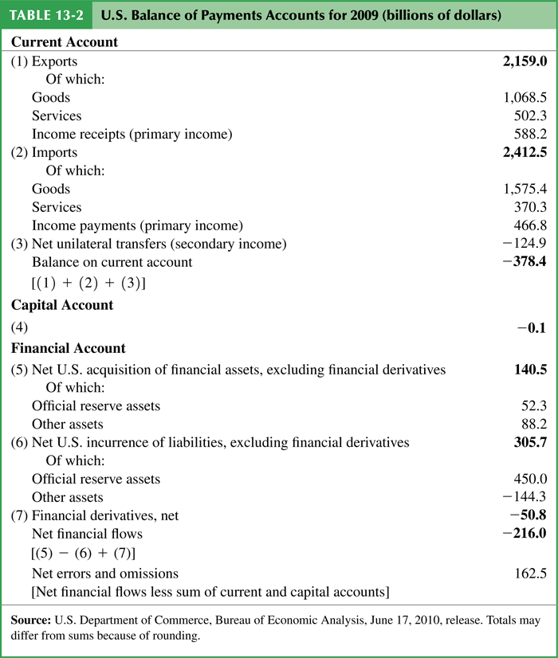
Table : U.S. Balance of Payments Accounts for 2009 (billions of dollars)

Slide 21
U.S. Balance of Payments Accounts
The U.S. has the most negative net foreign wealth in the world, and so is therefore the world’s largest debtor nation.
Its current account deficit in 2009 was $378 billion dollars, so that net foreign wealth continues to decrease.
The value of foreign assets held by the U.S. has grown since 1980, but liabilities of the U.S. (debt held by foreigners) has grown faster.

Slide 22
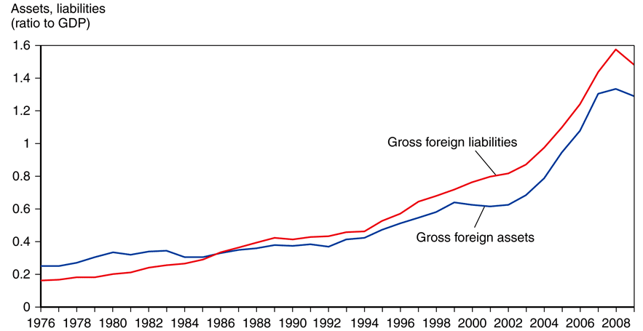
Fig. : U.S. Gross Foreign Assets and Liabilities, 1976-2009
Source: U.S. Department of Commerce, Bureau of Economic Analysis, June 2010.

Slide 23
U.S. Balance of Payments Accounts (cont.)
About 70% of foreign assets held by the U.S. are denominated in foreign currencies and almost all of U.S. liabilities (debt) are denominated in dollars.
Changes in the exchange rate influence value of net foreign wealth (gross foreign assets minus gross foreign liabilities).
Appreciation of the value of foreign currencies makes foreign assets held by the U.S. more valuable, but does not change the dollar value of dollar-denominated debt for the U.S.

Slide 24
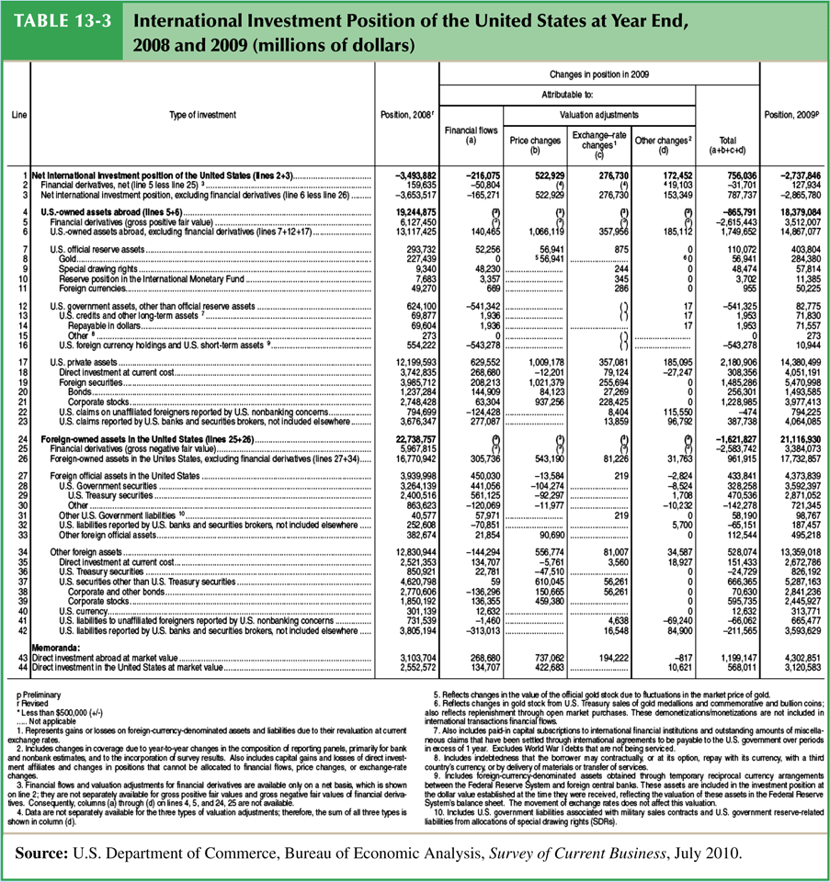
Table : International Investment Position of the United States at Year End, 2008 and 2009 (millions of dollars)

Slide 25
Summary
A country’s GNP is roughly equal to the income received by its factors of production.
In an open economy, GNP equals the sum of consumption, investment, government purchases, and the current account.
GDP is equal to GNP minus net income from foreign countries for factors of production. It measures the value of output produced within a country’s borders.

Slide 26
Summary (cont.)
National saving minus domestic investment equals the current account (≈ exports minus imports).
The current account equals the country’s net foreign investment (net outflows of financial assets).
The balance of payments accounts records flows of goods & services and flows of financial assets across countries.
It has 3 parts: current account, capital account, and financial account, which balance each other.
Transactions of goods and services appear in the current account; transactions of financial assets appear in the financial account.

Slide 27
Summary (cont.)
Official international reserve assets are a component of the financial account, which records official assets held by central banks.
The official settlements balance is the negative value of official international reserve assets, and it shows a central bank’s holdings of foreign assets relative to foreign central banks’ holdings of domestic assets.
The U.S. is the largest debtor nation, and its foreign debt continues to grow because its current account continues to be negative.

Slide 28
Thank You

