Slide 1
Chapter 6 ENVIRONMENTAL ETHICS
Dr. Mohsin Uddin
Department of Accounting
Faculty of Economics and Administrative Sciences
Ishik University, Erbil

Slide 2
The “environment”
Consists of both:
Biotic factors (living things)
and
Abiotic factors (nonliving things) that surround us and with which we interact.

Slide 3
Humans and the environment
We humans exist within the environment and are a part of the natural world.
Like all other species, we depend for our survival on a properly functioning planet.
Thus, our interactions with our environment matter a great deal.

Slide 4
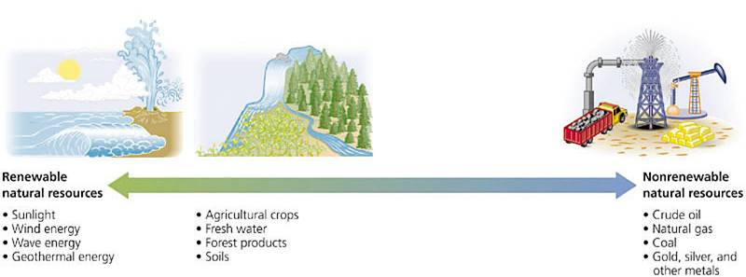
Natural resources
Renewable resources like sunlight cannot be down.
Nonrenewable resources like oil CAN be down.
Resources like timber and clean water are renewable only if we do not overuse them.
Figure 1.1

Slide 5
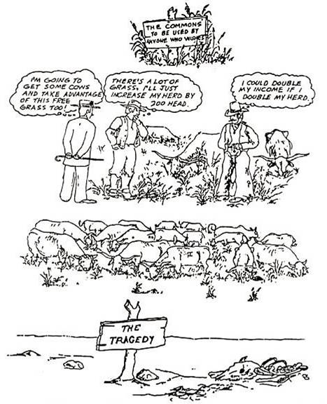
The tragedy of the commons
Garrett Hardin, 1968:
In a “commons” open to all, unregulated use will reduce limited resources.
Figure 1.4

Slide 6
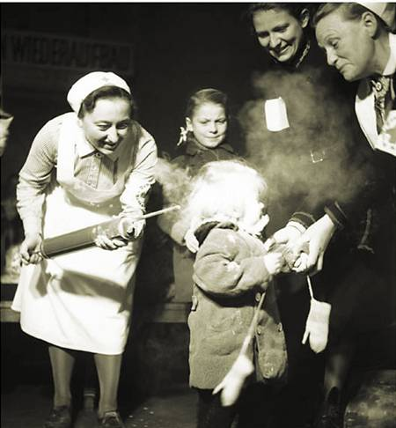
What is an “environmental problem?”
Definitions differ.
The pesticide DDT:
was thought safe in 1945
is known to be toxic today
but is used widely in Africa to combat malaria
Figure 1.5

Slide 7
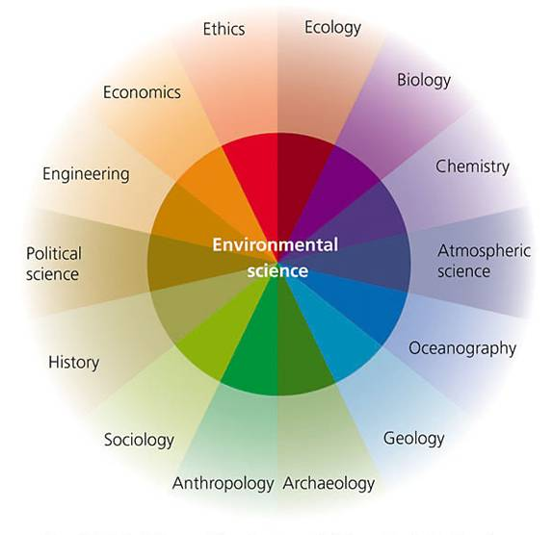
Environmental science
… is an interdisciplinary field, drawing on many diverse disciplines.
Figure 1.6

Slide 8
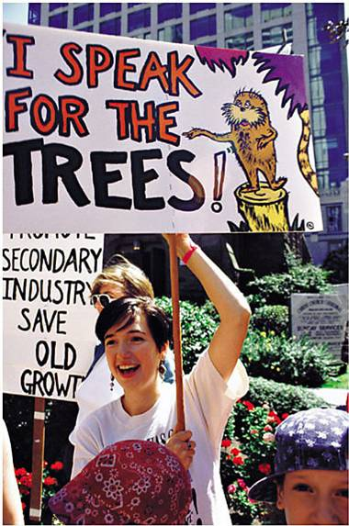
Environmental science
… is NOT the same as environmentalism.
It is science, NOT advocacy.
Figure 1.7

Slide 9
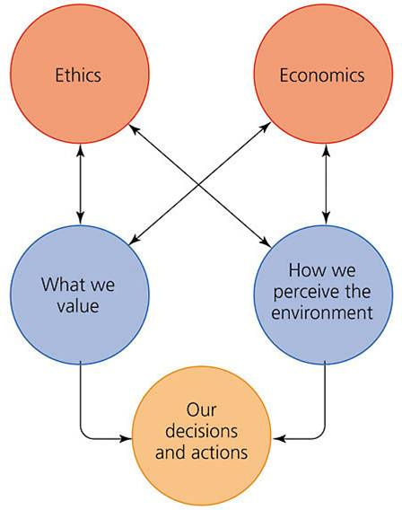
Ethics
Ethics is a discipline that deals with how we value and perceive our environment.
Ethics influence our decisions and actions.
Figure 2.1

Slide 10
Worldview
Worldview = a person’s or group’s beliefs about the meaning, purpose, operation, and essence of the world.

Slide 11
Some questions in environmental ethics
Should the present generation conserve resources for future generations?
Are humans justified in driving other species to extinction/loss?
Is it OK to destroy a forest to create jobs for people?
Is it OK for some communities to be exposed to more pollution than others?

Slide 12
Environmental Ethics
Moral = the distinction between right and wrong
Values = the ultimate worth of actions or things

Slide 13
Environmental Ethics
is concerned with the moral relationships between humans and the world around us?
Do we have special duties, obligations, or responsibilities to other species or nature in general?
Are our dispositions towards humans different than towards nature? How are they different?
Are there moral laws objectively valid and independent of cultural context, history, situation, or environment?

Slide 14
Environmental Ethics
Universalists
1. Fundamental principles of ethics are universal, unchanging.
2.The rules of right and wrong are valid regardless of our interests, attitudes, desires or preferences.

Slide 15
Environmental Ethics
Relativists
Moral principles are always relative to a particular person, society, or situation. Ethical values are contextual, that is they depend on the person, the society, or the situation. There is right and wrong or at least better or worse but no principles are absolute regardless of context.

Slide 16
Environmental Ethics
Utilitarians
An action is right that produces the greatest good for the greatest number of people.
Goodness = Happiness = Pleasure
Bentham (Plato, Aristotle)
John Stuart Mill held that the greatest pleasure is to be educated and to act according to enlightened, humanitarian principles

Slide 17
Environmental Perspectives (World views)
Worldview = a person’s or group’s beliefs about the meaning, purpose, operation, and essence of the world.
There are lots of them

Slide 18
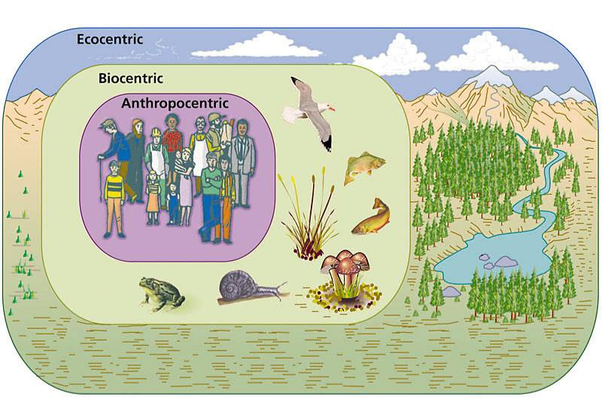
Three ethical worldviews
Figure 2.4

Slide 19
Environmental Perspectives
Ecocentrism
Ecologically centered, because
individuals are doomed to suffering and pain
evolution, adaptation, and biogeochemical cycles are really more important than individuals.
The whole ecosystem is more important than the individuals and populations that make up the ecosystem.
Moral values for ecological process and systems

Slide 20
Environmental Perspectives
Ecofeminism
Western civilization in opposition to nature
life is interconnected
maintenance of diversity
restructuring human society
Bounty rather than scarcity
Cooperation rather than competition
A network of personal relationships rather than isolated egos

Slide 21
Environmental Perspective
Sustainability based on ecosystem processes
A recycling of elements
Sunlight as a source of energy
Carrying capacities are realized and maintained
Biodiversity is maintained

Slide 22
Environmental Perspectives
Critical Thinking
Elements of thought
Intellectual standards

Slide 23
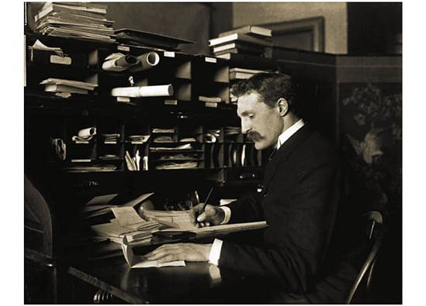
The conservation ethic
Gifford Pinchot advocated using natural resources, but exploiting them wisely, for the greatest good for the greatest number for the longest time.
Figure 2.6

Slide 24
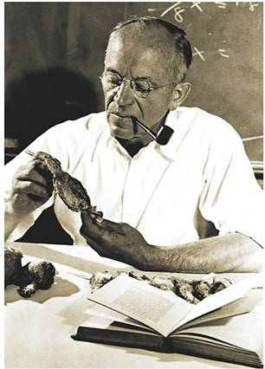
The land ethic
Aldo Leopold urged people to view themselves as part of nature, and to strive to maintain “the integrity, stability, and beauty of the biotic community.”
Figure 2.7

Slide 25
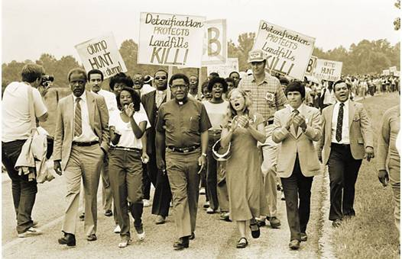
Environmental justice (EJ)
Poor people and minorities suffer more than their share of environmental problems, EJ advocates say.
The EJ movement began with a protest against a toxic waste dump in an African-American community in North Carolina.
Figure 2.8

Slide 26
Sustainability
The key concept for our future:
Limiting human impact on the natural world so that our civilization can continue to exist

Slide 27
Sustainable development
UN: Development that “meets the needs of the present without sacrificing the ability of future generations to meet theirs”.
Figure 1.17

Slide 28
What is Environmental Ethics?
-the moral relationship of human beings to and the value and moral status of the environment and its nonhuman content.
-Study of the ethical basis of environment or discussion of the ethical basis of environmental protection.

Slide 29
Why need to study Environmental Ethics?
To overcome the following questions.
What are the environment damage produce by the present generation?
What acts must be give up to slow such damage?

Slide 30
Environmental Damage
1) Pollution:
Air pollution
Water pollution
Land pollution
2) Resource depletion:
Depletion of Species & Habits
Depletion of Fossil fuels etc..

Slide 31
Environmental Ethics Principles
We should have profound respect for nature.
We must maintain a harmonious relation with other species.
Everyone should take responsibility for this impact on nature.

Slide 32
Environmental Ethics Principles
Local & indigenous environmental knowledge should be respected.
We must plan for the long term.

Slide 33
The Ethical Values for Pollution Control
We should recognize our moral duty to protect the welfare not only human beings, but also of other non- human parts of this system.
Usefulness of non-human world for human purposes.

Slide 34
The Ethical Values for Pollution Control
Humans have no rights to reduce this richness & diversity expect to satisfy vital needs.
The ideological changes is mainly that of appreciating life quality, rather than to increase higher standard of living.

Slide 35
Ethical Values for Conserving depletable resources
Proper utilisation of resources
i.e. the people should maintain Ecological balance.
We should adopt voluntary measures to conserve the resources.

Slide 36
Ethical Values for Conserving depletable resources
If we are to preserve enough scarce resources, so that future generation can maintain their quality of life at a satisfactory level.

