Slide 1
Macroeconomics
Accounting
HE EDUCATOR
Dr. Waqar Ahmad
Assistant Professor

Slide 2
Learning Objective
Measures of Nations Income
Methods of National Income
Difficulties in Measurement of National Income
Importance of National Data
National Income and Economic Welfare
Sustainable Development

Slide 3
What is National Income?

Slide 4
What is National Income?
The methodology to measure the flow of income, expenditure and output in an economy is called national income

Slide 5
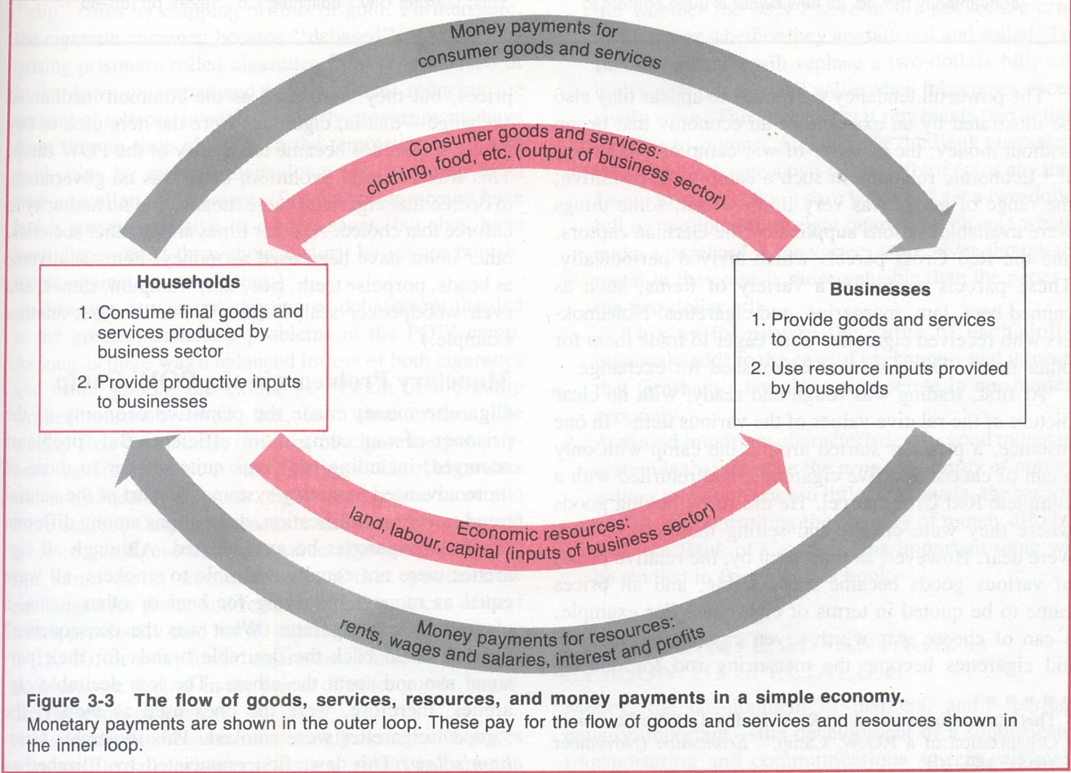
Measures of Nations Income
Gross National Product (GNP)
Net National Product (NNP)
National Income (NY)
Personal Income (PY)
Disposable Income (D Y)
Discretionary Income (D Y)
Domestic Income (D Y)
Outside Income (O Y)
Measuring National Product and National Income

Slide 6
Gross National Product (GNP)
It is the largest denomination to measure the size of economic activity in an economy. It is define as a aggregate of the market value of final good and services produced by an economy over a period of one year.

Slide 7
2. Net National Product (NNP)
The market value of a nation's goods and services minus depreciation (often referred to as capital consumption).
NNP = Market Value of Finished Goods + Market Value of Finished Services - Depreciation
NNP=GNP-Depreciation (Capital Consumption Allowance)

Slide 8
3. National Income (NY)
The third measurement of national income accounting is called National Income. It is aggregate of income received by factors of production in an economy during a period of one year.
NY = NNP – Indirect Taxes + Subsidies

Slide 9
4. Personal Income (PY)
Personal Income is income which is receive by individuals.
PY= National Income – (Corporate taxes + Corporate retained earrings + social security) + transfer payments
5. Disposable Income (D.Y)
Disposable Income (D.Y) is that income which is received by the individuals and is their disposal.
DY = Personal Income – Direct Taxes

Slide 10
6. Discretionary Income (D.Y)
It income indicates the income which an individual or individual can spend at their discretion. i.e. at their free will.
Discretionary Income = Disposable Income – Compulsory Saving and loan repayments
7. Domestic Income (D.Y)
8. Outside Income (O.Y)

Slide 11
Methods of National Income
Different measurement of national income e.g. GNP, NNP, NY can be calculated through three methods which are
Product Method/Output Method
Income Method
Expenditure Method

Slide 12
Product Method
According to this method, the total value of final goods and services produced in a country during a year is calculated at market prices. To find out the GNP, the data of all productive activities, such as agricultural products, wood received from forests, minerals received from mines, commodities produced by industries, the contributions to production made by transport, communications, insurance companies, lawyers, doctors, teachers, etc. are collected and assessed at market prices.
Only the final goods and services are included and the intermediary goods and services are left out.

Slide 13
2. Income Method
1. This method measures national income at the phase of distribution and appears as income paid and or received by individuals of the country.
2. Thus, under this method, national income is obtained by summing up of the incomes of all individuals of a country. Individuals earn incomes by contributing their own services and the services of their property such as land and capital to the national production.
3. Therefore, national income is calculated by adding up the rent of land, wages and salaries of employees, interest on capital, profits of entrepreneurs (including undistributed corporate profits) and incomes of self-employed people.

Slide 14
3. Expenditure Method
In this method, the national product is broadly divided into three categories i.e. consumption expenditure, investment and government expenditure.
Expenditure method arrives at national income by adding up all expenditures made on goods and services during a year. Income can be spent either on consumer goods or capital goods. Again, expenditure can be made by private individuals and households or by government and business enterprises.

Slide 15
Difficulties in Measurement of National Income
Non – monetized Sector
There are certain transactions in which a considerable part of output does not come into the market at all.
For example:
Agriculture in which a major part of output is consumed at the farm level itself. The national income statistician, therefore, has to face the problem of finding a suitable measure for this part of output.
2. Illiteracy:
The majority of people in India are illiterate and they do not keep any accounts about the production and sales of their products. Under the circumstances the estimates of production and earned incomes are simply guess work.
3. Occupational Specialisation is Still Incomplete and Lacking:
There is the lack of occupational specialisation in our country which makes the calculation of national income by product
method difficult. Besides the crop, farmers are also engaged is supplementary occupations like—dairying, poultry, cloth-
making etc. But income from such productive activities is not included in the national income estimates.

Slide 16
4. Lack of Availability of Adequate Statistical Data:
Adequate and correct produc­tion and cost data are not available in our country. For estimating national income data on unearned incomes and on persons employed in the service are not available. Moreover data on consumption and investment expenditures of the rural and urban population are not available for the estimation of national income. Moreover, there is no machinery for the collection of data in the country
5. Value of Inventory Changes:
The value of all inventory changes (i.e., changes in stock etc.) which may be either positive or negative are added or subtracted from the current production of the firm. Remember, if in the change in inventories and not total inventories for the year that are taken into account in national income estimates.
6. The Calculation of Depreciation
The calculation of depreciation on capital consumption presents another formidable difficulty. There are no accepted standard rates of depreciation applicable to the various categories of machine. Unless from the gross national income correct deductions are made for depreciation the estimate of net national income is bound to go wrong

Slide 17
7. Difficulty of Avoiding the Double Counting System:
The very important difficulty which a calculator has to face in measurement is the difficulty of avoiding double counting.
For example:
If the value of the output of sugar and sugar cane are counted separately, the value of the sugarcane utilised in the manufacture of sugar will have been counted twice, which is not proper. This must be avoided for a correct measurement.
8. Difficulty of Expenditure Method:
The application of expenditure method in the calculation of national income has become a difficult task and it is full of difficulties. Because in this method it is difficult to estimate all personal as well as investment expenditures.

Slide 18
Importance of National Income Data
The national income data have the following importance:
Measure of economic activity
National income data are of great importance for the economy of a country. These days the national income data are regarded as accounts of the economy, which are known as social accounts. These refer to net national income and net national expenditure, which ultimately equal each other.
2. National Policies
National income data form the basis of national policies such as employment policy, because these figures enable us to know the direction in which the industrial output, investment and savings, etc. change, and proper measures can be adopted to bring the economy to the right path
3. Economic Planning:
In the present age of planning, the national data are of great importance. For economic planning, it is essential that the data pertaining to a country’s gross income, output, saving and consumption from different sources should be available. Without these, planning is not possible.

Slide 19
4. Economic Models:
The economists propound short-run as well as long-run economic models or long-run investment models in which the national income data are very widely used.
5. Research:
The national income data are also made use of by the research scholars of economics. They make use of the various data of the country’s input, output, income, saving, consumption, investment, employment, etc., which are obtained from social accounts.
6. Per Capita Income:
National income data are significant for a country’s per capita income which reflects the economic welfare of the country. The higher the per capita income, the higher the economic welfare of the country.
7. Distribution of Income:
National income statistics enable us to know about the distribution of income in the country. From the data pertaining to wages, rent, interest and profits, we learn of the disparities in the incomes of different sections of the society. Similarly, the regional distribution of income is revealed.

Slide 20
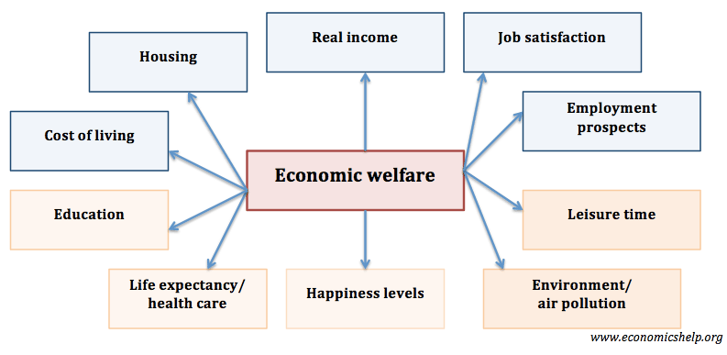
National Income and Economic Welfare
National Income is the income received by factors of production. It also roughly represents the net value of output produced in the economy.
National Income really represents increase in the welfare of the people and vive = versa or not?

Slide 21
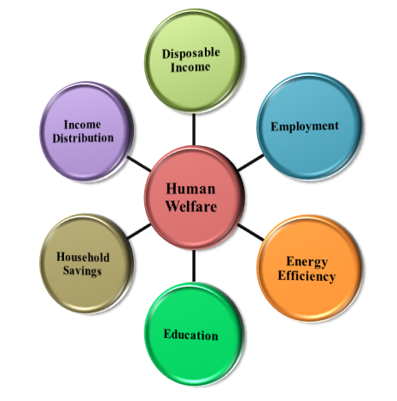
National Income and Economic Welfare
National income, or more accurately per capita income, is often used as an index of economic welfare. However, in recent years, recognition of the shortcomings in national income accounts of various countries has prompted considerable interest in developing improved measures of out­put and economic welfare.

Slide 22
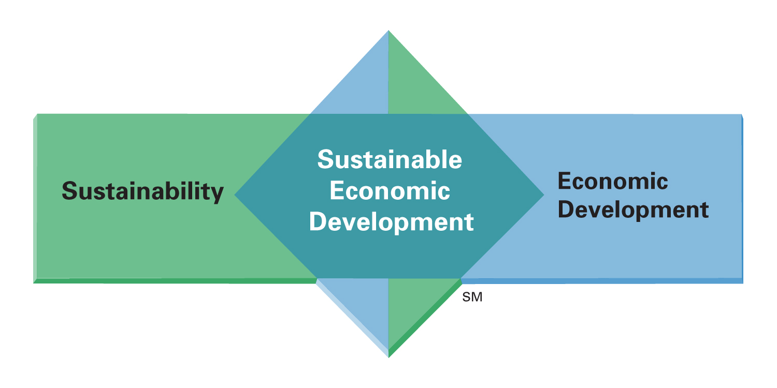
Sustainable development
Sustainable development is development that meets the needs of the present, without compromising the ability of future generations to meet their own needs
The concept of sustainable development can be interpreted in many different ways, but at its core is an approach to development that looks to balance different, and often competing, needs against an awareness of the environmental, social and economic limitations we face as a society.
All too often, development is driven by one particular need, without fully considering the wider or future impacts. We are already seeing the damage this kind of approach can cause, from large-scale financial crises caused by irresponsible banking, to changes in global climate resulting from our dependence on fossil fuel-based energy sources. The longer we pursue unsustainable development, the more frequent and severe its consequences are likely to become, which is why we need to take action now.

Slide 23
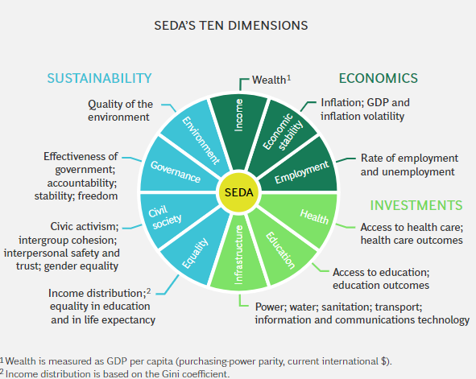

Slide 24
THANK YOU

