Slide 1
International Economics II
Accounting
Teacher Educator
Dr. Waqar Ahmad

Slide 2
Learning Objective
National Income
Circular flow of income trend
National Income and national Product
Gross domestic product
National Income accounting for an open economy
Consumption, investment and government purchase
Saving and current account
Private and government savings

Slide 3
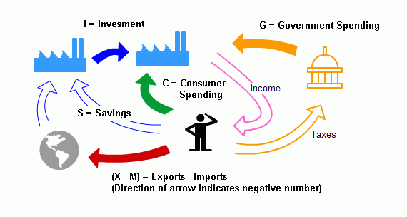
National Income Accounting
A country’s gross national product (GNP), the value of all final goods and services produced by the country’s factors of production and sold on the market in a given time period. GNP therefore includes the value of goods like bread sold in a supermarket and textbooks sold in a bookstore, as well as the value of services provided by stock brokers and plumbers.

Slide 4
GNP among the four possible uses for which a country’s final output is purchased: consumption (the amount consumed by private domestic residents), investment (the amount put aside by private firms to build new plant and equipment for future production), government purchases (the amount used by the government), and the current account balance (the amount of net exports of goods and services to foreigners).
The national income accounts can be thought of as classifying each transaction that contributes to national income according to the type of expenditure that gives rise to it

Slide 6
National Product and National Income
National product is the value of all the goods and services produced in the nation
National income is the total income created by producing the national product.

Slide 7
Accounting identity: national income equals national product. The production of one dollar of goods or services creates one dollar of income.
Consider a one-firm economy. It produces $130 of a good, so the national product is $130.
The firm pays $80 of wages and $20 of interest.
Profit is the residual of the product minus the costs:
$130 − ($80 +$20) = $30.
National income is total income—wages plus interest plus profit:
$80 +$20 +$30 = $130.
Thus national income equals national product.

Slide 8
GNP does not take into account the economic loss due to the tendency of machinery and structures to wear out as they are used. This loss, called depreciation, reduces the income of capital owners. To calculate national income over a given period, we must therefore subtract from GNP the depreciation of capital over the period. GNP less depreciation is called net national product (NNP).
A country’s income may include gifts from residents of foreign countries, called unilateral transfers. Examples of unilateral transfers of income are pension payments to retired citizens living abroad, reparation payments, and foreign aid
National income equals GNP less depreciation plus net unilateral transfers

Slide 9
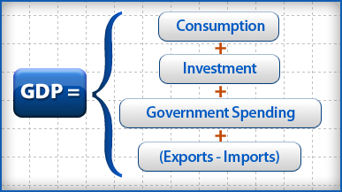
Gross Domestic Product
Gross domestic product is the total value of everything produced in the country. It doesn't matter if it's produced by are citizens or foreigners. If they are located within the country's boundaries, their production is included in GDP.. To avoid double-counting, GDP includes the final value of the product, but not the parts that go into it. For example, a U.S. footwear manufacturer uses laces and other materials made in the United States. Only the value of the shoe gets counted; the shoelace does not.

Slide 10
National Income accounting for an open economy
An open economy the closed-economy national income accounting framework you may have seen in earlier economics courses.
A discussion of the national income accounts because they highlight the key role of international trade in open-economy macroeconomic theory.
Since a closed economy’s residents cannot purchase foreign output or sell their own to foreigners, all of national income must be allocated to domestic consumption, investment, or government purchases
In an economy open to international trade, however, the closed-economy version of national income accounting must be modified because some domestic output is exported to foreigners while some domestic income is spent on imported foreign products

Slide 11
Consumption
The portion of GNP purchased by private households to fulfill current wants is called consumption.
Purchases of movie tickets, food, dental work, and washing machines all fall into this category.
Consumption expenditure is the largest component of GNP in most economies.
In the United States, for example, the fraction of GNP devoted to consumption has fluctuated in a range from about 62 to 70 percent over the past 60 years.

Slide 12
Investment
The part of output used by private firms to produce future output is called investment. Investment spending may be viewed as the portion of GNP used to increase the nation’s stock of capital.
Steel and bricks used to build a factory are part of investment spending, as are services provided by a technician who helps build business computers

Slide 13
Government Purchases
Any goods and services purchased by federal, state, or local governments are classified as government purchases in the national income accounts. Included in government purchases are federal military spending, government support of cancer research, and government funds spent on highway repair and education.
Government purchases include investment as well as consumption purchases. Government transfer payments such as social security and unemployment benefits do not require the recipient to give the government any goods or services in return. Thus, transfer payments are not included in government purchases.

Slide 14
National Income = Y
Y = C + I + G
C = Consumption, I = Investment, G = Government Purchase
Y = C + I + G + EX - IM. EX = Export, IM = Import

Slide 15
An Imaginary Open Economy
Agraria, whose only output is wheat. Each citizen of Agraria is a consumer of wheat, but each is also a farmer and therefore can be viewed as a firm. Farmers invest by putting aside a portion of each year’s crop as seed for the next year’s planting. There is also a government that appropriates part of the crop to feed the Agrarian army. Agraria’s total annual crop is 100 bushels of wheat. Agraria can import milk from the rest of the world in exchange for exports of wheat. We cannot draw up the Agrarian national income accounts without knowing the price of milk in terms of wheat because all the compo-nents in the GNP identity (13-1) must be measured in the same units. If we assume the price of milk is 0.5 bushel of wheat per gallon, and that at this price, Agrarians want to consume 40 gallons of milk, then Agraria’s imports are equal in value to 20 bushels of wheat.

Slide 16
The Current Account and Foreign Indebtedness
A country’s foreign trade is exactly balanced only rarely. The difference between exports of goods and services and imports of goods and services is known as the current account balance (or current account).
CA = EX - IM.
When a country’s imports exceed its exports, we say the country has a current
account deficit. A country has a current account surplus when its exports exceed
its imports.
The current account is also important because it measures the size and direction of international borrowing.

Slide 18
Saving and the Current Account
GNP identity has many illuminating implications. To explain the most important of these implications, we define the concept of national saving, is, the portion of output, Y, that is not devoted to household consumption, C, or government purchases, G.⁶ In a closed economy, national saving always equals investment.
This tells us that the closed economy as a whole can increase its wealth only by accumulating new capital.
Let S stand for national saving. Our definition of S tells us that
S = Y - C – G
Since the closed-economy GNP identity, Y = C + I + G, may also be written as
= Y - C - G, then
S = I,
and national saving must equal investment in a closed economy. Whereas in a closed econ-omy, saving and investment must always be equal, in an open economy they can differ. Remembering that national saving, S, equals Y - C - G and that CA = EX - IM, we can rewrite the GNP identity (13-1) as S = I + CA

Slide 19
Private and Government Saving
Private saving is defined as the part of disposable income that is saved rather than consumed. Disposable income is national income, Y, less the net taxes collected from house-holds and firms by the government, T.⁷ Private saving, denoted S^{p}, can therefore be expressed as
S^{p} = Y - T - C
Government saving is defined similarly to private saving. The government’s “income” is
its net tax revenue, T, while its “consumption” is government purchases, G. If we let S^{g}
stand for government saving, then
S^{g} = T - G.
The two types of saving we have defined, private and government, add up to
national saving. To see why, recall the definition of national saving, S, as
Y - C – G. Then S = Y - C - G = 1Y - T - C2 + 1T - G2 = S^{p} + S^{g}
We can use the definitions of private and government saving to rewrite the national income identity in a form that is useful for analyzing the effects of government saving decisions on open economies

Slide 20
Balance of Payment Accounts
Cont.…

