Slide 1
Week -1
Introduction of International Economics II
Gains and trade pattern of trade, how much trade, Balance of Payment
Prepared by: Dr Waqar Ahmad, Asstt. Prof.

Slide 2
Learning Objective
What is international economics about?
International trade topics
Gains from trade, explaining patterns of trade, effects of
government policies on trade
International finance topics
Balance of payments, exchange rate determination, international policy coordination and capital markets
4. International trade versus finance

Slide 3
Introduction
• International economics is about how nations interact through:
trade of goods and services, flows of money, and investment.
• International economics is an old subject, but continues to grow in importance as countries become tied more to the international economy.
• Nations are now more closely linked than ever before.

Slide 4
Introduction Cont.
U.S. exports and imports as shares of gross domestic product have been on a long-term upward trend.
International trade has roughly tripled in importance compared to the economy as a whole in the past 50 years.
Both imports and exports fell in 2009 due to the recession.

Slide 5
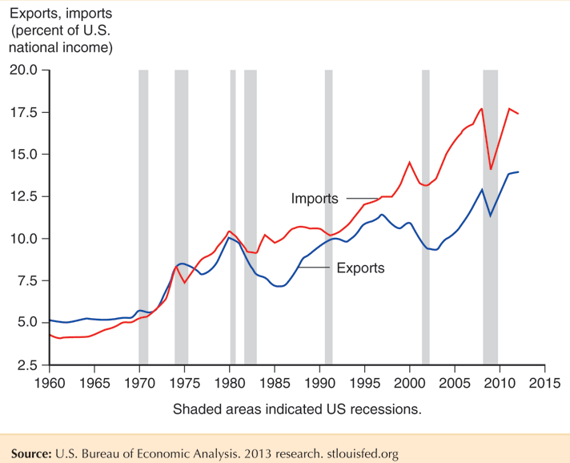
Introduction Cont.
Fig. 1-1: Exports and Imports as a Percentage of U.S. National Income

Slide 6
Introduction Cont.
Compared to the United States, other countries are even more tied to international trade.
Their imports and exports as a share of GDP are substantially higher.
The United States, due to its size and diversity of resources, relies less on international trade than almost any other country.

Slide 7
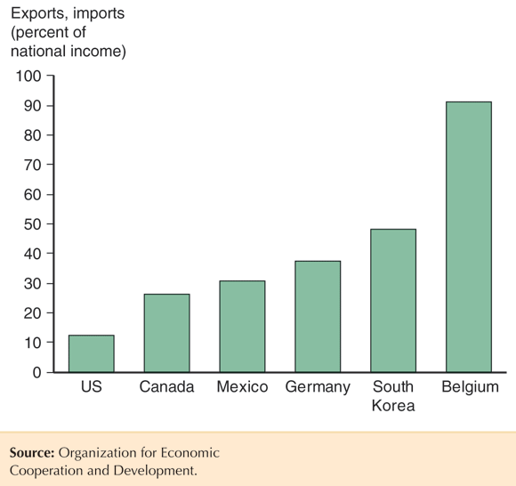
Introduction Cont.
Fig. 1-2: Average of Exports and Imports as Percentage of National Income in 2011

Slide 8
Gains from Trade
That there are gains from trade is probably the most important insight in international economics.
• Countries selling goods and services to each other almost always generates mutual benefits.
1. When a buyer and a seller engage in a voluntary transaction, both can be made better off.
Norwegian consumers import oranges that they would have a hard time producing.

Slide 9
Gains from Trade Cont.
2. How could a country that is the most (least) efficient producer of everything gain from trade?
• Countries use finite resources to produce what they are most productive at (compared to their other production choices), then trade those products for goods and services that they want to consume.
• Countries can specialize in production, while consuming
many goods and services through trade.

Slide 10
Gains from Trade Cont.
3. Trade benefits countries by allowing them to export goods made with relatively abundant resources and imports goods made with relatively scarce resources.
4. When countries specialize, they may be more efficient due to larger-scale production.
5. Countries may also gain by trading current resources for future resources (international borrowing and lending) and due to international migration.

Slide 11
Gains from Trade Cont.
• Trade is predicted to benefit countries as a whole in several ways, but trade may harm particular groups within a country.
1. International trade can harm the owners of resources that are used relatively intensively in industries that compete with imports.
2. Trade may therefore affect the distribution of income within a country.

Slide 12
The Pattern of trade
• The pattern of trade describes who sells what to whom.
• Differences in climate and resources explain why Brazil exports coffee and Saudi Arabia exports oil.
• But why does Japan export automobiles, while the U.S. exports aircraft?
• Why some countries export certain products can stem from differences in:
– Labor productivity
– Relative supplies of capital, labor and land and their use in the
production of different goods and services

Slide 13
Effects of Government Policies on Trade
• Policy makers affect the amount of trade through
– tariffs: a tax on imports or exports,
– quotas: a quantity restriction on imports or exports,
– export subsidies: a payment to producers that export,
– or through other regulations (ex., product specifications)
that exclude foreign products from the market, but still allow domestic products.
• What are the costs and benefits of these policies?

Slide 14
Effects of Government Policies on Trade
If a government restricts trade, what are the costs if foreign governments respond likewise?
• Trade policies are often chosen to cater to special interest groups, rather than to maximize national welfare.
• Governments tend to adopt tariffs, then negotiate them down in exchange for reduction in trade barriers of other countries.

Slide 15
International Trade Versus Finance
• International trade focuses on transactions involving movement of goods and services across nations.
International trade theory and International trade policy
• International finance focuses on financial or monetary transactions across nations.

Slide 16
International Trade Versus Finance Cont.
The Balance of Payments statements set out a country's transactions with the rest of the world. The current account balance is the sum of the balances of trade in goods and services, current transfers, and investment income.

Slide 17
Exchange rate determination
Factors that cause the supply and demand schedules of currencies to change
Market fundamentals (economic variables)
Productivity, inflation rates, real interest rates, consumer preferences, and government trade policy
Market expectations
News about future market fundamentals
Traders’ opinions about future exchange rates

Slide 18
Exchange rate determination Cont.
Factors affecting exchange rates
Short term: transfers of assets
Differences in real interest rates and to the shifting expectations of future exchange rates
Interim: cyclical factors
Fluctuations in economic activity
Long term: flows of goods, services, and investment capital
Inflation rates, investment profitability, consumer tastes, productivity, and government trade policy

Slide 19
International Policy Coordination
There are two ways that nations may work together to achieve their economic objectives.
International Policy Cooperation is the adoption of institutions and procedures by which policymakers can inform each other of their objectives and share data.
International Policy Coordination is the joint determination of economic policies within a group of nations, intended to benefit the whole.

Slide 20
Potential Benefits of Coordination
Take account of and minimize policy externalities
Achieve a larger number of policy objectives with available instruments
Policymakers may present a “united front” in the face of home political pressures that could push them to adopt harmful policies.

Slide 21
International Capital Market
International capital market
The group of closed interconnected markets in which residents of different countries trade assets such as currencies, stocks and bonds
This chapter focus on three main questions:
How has the international capital market enhanced countries’ gains from trade?
What caused the rapid growth in international financial activity that has occurred since the early 1960s?
How can policymakers minimize problems raised by a worldwide capital market without sharply reducing the benefits it provides?

Slide 22
Summary
Know about the overview of International economics – 1
International trade is possible in present scenario and easy to get information
Know about policies and trade information

Slide 23
Thank You

