Slide 1
Economic Development BUS420
Ms. Khadija Alaa
khadija.alaa@ishik.edu.iq

Slide 2
Welcome Back from the Break ☺

Slide 3
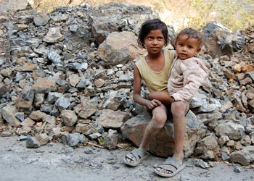
Poor Kids in Rishikesh, India

Slide 4
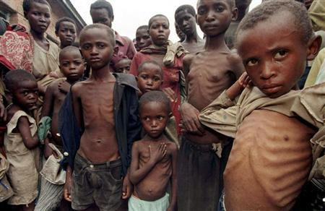
Severely malnourished Rwandan refugee children wait for food within a makeshift camp some 25 miles south of Kisangani
https://borgenproject.org/10-facts-about-rwanda-refugees/

Slide 5
What do we mean by being poor?
Almost 3 billion people lack access to toilets and almost 1 billion lack access to clean drinking water
“The poorest 20% of the world’s children are twice as likely as the richest 20% to be stunted by poor nutrition and to die before their 5th birthday.”
2.7 million newborns worldwide die within their first month of life

Slide 6
Almost 200 million children under the age of 5 in developing regions are underweight for their age.
179 million infants in the least developed countries are not protected from diseases by routine immunization.
3.2 million children under the age of 15 currently live with HIV.
161 million children do not attend primary school.
UNICEF

Slide 7
Is Iraq a poor country?
Iraq ranks 86 out of 179 countries on the World Bank list.
On average people make $5,420 a year. ($5,420/12month=$452)
Turkey is 54 with $11,230 GNI per capita
Iran is 85 with $5,470 GNI per capita
https://en.wikipedia.org/wiki/List_of_countries_by_GNI_(nominal,_Atlas_method)_per_capita

Slide 8
GNI per capita
Economic performance is measured by an annual increase in gross national product (GNP). For the purpose of comparability, GNP is expressed in a common currency, usually US dollars, and reported in per-capita terms to take into account the size of a nation’s population. The World Bank now replaces GNP per capita with gross national income (GNI) per capita to compare wealth among countries. The World Bank defines GNI as the sum of value added by all resident producers plus any product taxes not included in the valuation of output plus net receipts of primary income (compensation of employees and property income) from abroad.

Slide 9
Growth and Development
Economic growth is an increase in the capacity of an economy to produce goods and services, compared from one period of time to another. It can be measured in nominal or real terms, the latter of which is adjusted for inflation. The goal of economic development in its simplest form is to create the wealth of a nation. Prior to the 1970s, rapid economic growth has been considered a good proxy for other attributes of development.

Slide 10
Development
Economic development economic development can be defined as efforts that seek to improve the economic well-being and quality of life for a community by creating and/or retaining jobs and supporting or growing incomes and the tax base.

Slide 11
Another Definition
Economic development is the process by which emerging economies become advanced economies. In other words, the process by which countries with low living standards become nations with high living standards. Economic development also refers to the process by which the overall health, well-being, and academic level the general population improves.

Slide 12
Examples
1- During the development, there is a population shift from agriculture to industry, and then to services.
2- A longer average life expectancy, for example, is one of the results of economic development. Improved productivity, higher literacy rates, and better public education, are also consequences.
3- Put simply; economic development is all about improving living standards. ‘Improved living standards refers to higher levels of education and literacy, workers’ income, health, and lifespans.

Slide 13
What happened in Kurdistan over the last 10 years?
1- Change in quality of food and nutrition.
2- Change in income.
2- Change in health services.
3- Change in infrastructure.
4- Change in quality of telecommunication, technology, and transportation.
5- Change in mentality of people.
6- Change in education level.

Slide 14
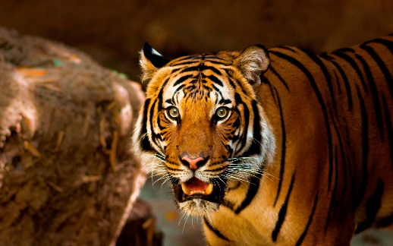
Four Asian Tigers commonly referred to as “the Asian Miracle”
The Four Asian Tigers or Asian Dragons are the highly developed economies of Hong Kong, Singapore, South Korea and Taiwan. These countries underwent rapid industrialization and maintained exceptionally high growth rates (in excess of 7 percent a year) between the early 1960s (mid-1950s for Hong Kong) and 1990s.

Slide 15
Singapore
Modern Singapore is a remarkable phenomenon, which has attracted the attention of social scientists from several disciplines and a wide range of ideological viewpoints. The island city state located at the tip of the Malay peninsula is now home to some four million people, and has one of the highest per capita gross domestic products in the world.

Slide 16
Singapore
The economy of Singapore is a highly developed free-market economy.
Singapore's economy has been ranked as the most open in the world, 7th least corrupt, most pro-business, with low tax rates (14.2% of Gross Domestic Product, GDP).
It has the third highest per-capita GDP in the world in terms of Purchasing Power Parity (PPP). Average GDP per capita is 57,714.30 USD (2017). Iraq GDP per capita 5,165.71 USD (2017)

Slide 17
Singapore
Singapore’s largest industry by far is the manufacturing sector, which contributes 20%-25% of the country’s annual GDP. Key industry clusters in Singapore’s manufacturing include electronics, chemicals, biomedical sciences, logistics and transport engineering. In the third quarter of 2017, the manufacturing sector grew by 35%, with clusters like electronics and engineering benefiting from high demand.

Slide 18
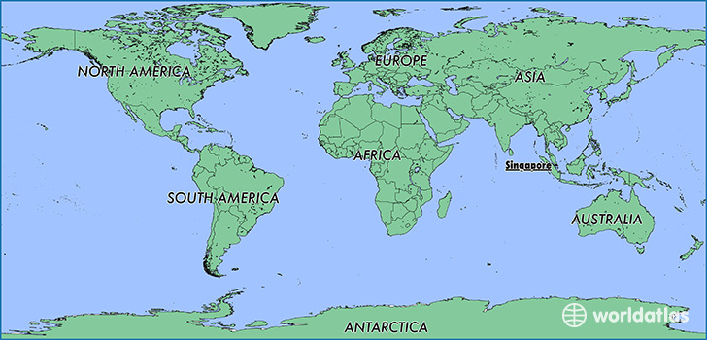

Slide 19
How did Singapore Achieve this Economic Success?
Singapore owes its success as a highly developed free-market economy in large part to its remarkably open and corruption-free business environment, prudent monetary and fiscal policies, and a transparent legal framework.

Slide 20
How did Singapore Achieve this Economic Success?
The government has continued to promote economic growth through an active industrial policy that targets fiscal incentives, increases public investment, promotes development of skill sets attractive to foreign investors, and focuses on economic diversification. Well-secured property rights promote entrepreneurship and productivity growth.
The rule of law is undergirded by a societal intolerance of corruption.

Slide 21
Question Bank
What do we learn from Singapore?

