Slide 1
Chapter 3 Ethics in Daily Life
Dr. Mohsin Uddin
Department of Accounting
Faculty of Economics and Administrative Sciences
Ishik University, Erbil

Slide 2
Course Evaluation Criteria
Method | Quantity | Percentage (%)
Class Participation | 1 | 10
Quiz | 1 | 10
Midterm Exam | 1 | 20
Presentation | 1 | 10
Home work | 1 | 10
Final Exam | 1 | 40
Total |  | 100

Slide 3
Week | Hour | Topic
1 | 2 | Introduction: What is Ethics all about?
2 | 2 | Ethics in daily life
3 | 2 | Variety of Moral Issues
4 | 2 | Principals of Ethics, Competence and Morality
5 | 2 | Cyber ethics : internet communication and moral responsibility
6 | 2 | Ethics in Public Life
7 | 2 | Mid Term Exam
8 | 2 | Risk Benefit Analysis
9 | 2 | Collegiality an Loyalty
10 | 2 | Corporate Code of Ethics
11 | 2 | Competence and Professional Ethics
12 | 2 | Rights and Responsibilities Regarding Intellectual Property
13 | 2 | Workplace Rights and Responsibilities
14 | 2 | Responsibility for the Environment
15 | 2 | Final Exam
16 | 2 | Final Exam

Slide 4
Learning objectives
After studying this chapter, you should be able to:
Describe the ethics
Explain the nature and the different aspects of ethics
Describe Scope of Ethics
Importance of Etics in Daily life

Slide 5
Ethics in daily life

Slide 6
Ethics
Etymologically the term “ethics” correspond to the Greek word “ethos” which means character, habit, customs, ways of behaviour, etc.
Ethics is also called “moral philosophy”. The word “moral” comes from Latin word “mores” which signifies customs, character, behaviour, etc.
Ethics may be defined as the systematic study of human actions from the point of view of their rightfulness or wrongfulness, as means for the attainment of the ultimate happiness.

Slide 7
Ethics
Ethics is the attitude of being good or bad in behavior, action and taking the decision in different situations. It deals with the ethical beliefs.
It helps to individual or an organization for honesty.

Slide 8
SCOPE OF ETHICS
Ethics deals with voluntary actions. We can distinguish between human actions and actions of human.
Human actions are those actions that are done by human consciously, purposely and in view of an end.
Actions of human may not be willfully, voluntarily, consciously and deliberately done but all the same they are done by human (e.g. sleeping, walking, etc.). It is the intention which makes the difference between human action and action of human. In ethics we deal only with human actions.

Slide 9
Cont.
Ethics is a branch of philosophy that deals with the principles of conduct of an individual or group.
It works as a guiding principle as to decide what is good or bad. They are the standards which govern the life of a person. Ethics is also known as moral philosophy.

Slide 10
Activity
Have you visited any work place (like an office, shop, company, etc.) and make a note of four ethical and four unethical practices.

Slide 11
Some examples of Ethics are :
Truthfulness
Honesty
Loyalty (Reliability)
Respect
Fairness(Justice)
Integrity(Honesty)

Slide 12
Examples and discussion
If the son of a big politician has committed a crime and he uses his powers to free his son from legal consequences. Then this act is immoral because the politician is trying to save a criminal.

Slide 13
Example and Discussion
A very close friend or relative of an interviewer comes for an interview and without asking a single question, he selects him. This act is unethical because the selection process must be transparent and unbiased.

Slide 14
Ethics are the guiding principles which help the individual or group to decide what is good or bad.
Governed By
Individual or Legal and Professional norms
Applicability in Business
Yes/No
Consistency
Ethics are generally uniform

Slide 15
What is right and wrong?
A 12-year-old girl was taken in marriage in the village of Lohutok, S. Sudan. Is that good or bad? Why?

Slide 16
Human value in Islam
Individual value seems to be based upon performance and obedience to Allah.
Allah loves those who do right, but does not love the transgressor or prodigals (Surah 2:195, 222; 5:87). Human worth is conditional, not based upon God’s grace.

Slide 17
How are ethics and law related?
Ethical
Illegal & Ethical
Legal & Ethical
Illegal
Legal
Illegal & Unethical
Legal & Unethical
Unethical
Notes:
It is an interesting question as to how law and ethics relate.
Students should have done this exercise in the pre-reading. Might want to ask for examples they came up with for each quadrant. The following examples were given in the module:
Coming to class
Speeding to for an emergency, not waiting for stop light during emergency
Fraud, theft, murder
Advertising in a self-selected way (drug ads before disclaimers) or sharing the content of an exam for the students who have not yet taken the exam
Summary: Ethics is related but different from and above the law. Ethical behavior is references to, but more than legal behavior. Mostly involves action (what we do), not knowledge (what we know). May “know” the law and a) still not know what is morally or ethically correct, or b) may chose to violate the law. The personalized way you see your values profile to make value-laden decisions is involved.

Slide 18
WHAT ARE ETHICS?
Ethics tell us about our moral duties and obligations so that our behaviour at work or at home is right, truthful.
Ethics are a set of standards and rules that are required by an individual for leading a satisfactory family life and being a good worker. Therefore, you require a set of ethics at home as well as at your work place.

Slide 19
You can observe the ethical behaviour through the following habits.
sincerity
honesty
truthfulness
respect for self and others
respect for time
respect for work
respect for our environment

Slide 20
Besides these ethics in our domestic life, our work place demands certain specific ethics. These are:
regularity and punctuality
confidentiality
loyalty
maintaining friendly relations with colleagues and clients
willingness to learn and take on new responsibilities

Slide 21
Ethics in our domestic life
Respect for self, others and elders
Respect for time
Respectful relations with young and old
Willingness to learn and take new responsibilities
Ability to judge the right and wrong and make right decision at given time.

Slide 22
NEED FOR ETHICS
Now let us find out why it is essential to have good ethics and how they affect our interpersonal relationship and work performance. Any work situation either at the office or at home has three major components: Work, Worker and the Work Place.
The Work is the actual task to be done.
The Worker is the person who does the task.
Work Place includes the place for doing the task, tools and equipment's required and the storage space for them.

Slide 23
Why ethics for organisations?
* To motivate employees
* Perhaps demanded by customers
* For good relationships to stakeholders
* An overall check on plans
* To avoid various exposures and risks
* Part of governance
* Sustainability

Slide 24
CARING AND RESPECTING OTHERS
Answer the five questions given below to test yourself and see if you sometimes show disrespect to others. There is no score or marking system. You are your own best judge.

Slide 25
Q.1 When you enter a room do you remember to greet every single person in the room?
Q.2 When your friends visit you, do you introduce them to your other family members?
Q.3 Do you raise your voice when you argue with elders?
Q.4 Do you make a plan to go out without informing your mother or change the channel to your favourite TV programme without caring about the other family members?
Q.5 Do you always stay away on important days in the family?

Slide 26
Speak to others a. when two people are talking
Think before b. when talking to your parents
Don’t interrupt c. which can be understood by all in
the group
Never speak d. when talking about yourself
Be respectful e. while sitting in a group
Converse in the language f. ill of others
Be humble g. you speak
Do not whisper h. cheerfully
i. successfully

Slide 27
Your Ethics in daily life
Rights and responsibilities of an individual as a member of a family and community
Importance of caring and respecting elders
Developing dignity of labour and positive attitude in life.

Slide 28
Why ethics
* The finance crisis
* A number of crimes, near-crimes
* Management not contributing to organisation growth/health
* Not contributing to society
* Money only management
* «Greed is good»
* Short term and limited plans

Slide 29
Relevance of ethics to Information Communication and Technology(ICT)
* Do good work
* Plan holistically
* Consider end use
* Evaluate both ends and means
* Be stakeholder oriented (ISO 26000)
* Take care of the environment (ISO 26000)
* Contribute to knowledge

Slide 30
Definition Ethics
Moral philosophy.
Determining rights and wrongs, selecting actions to achieve good results, evaluating motives.
(attempting to summarise several definitions)

Slide 31
Forms of ethics
1. Metaethics (what is good? etc)
2. Normative ethics (what should we do?)
3. Applied ethics (how do we apply ethics to work and lives?)
Moral psychology (the biological and psychological bases) Moral psychologists may study the origins and applications of moral principles. For example, two similarly responsible adults consume alcohol, drive home during inclement weather and crash their vehicles.
5. Descriptive ethics (what morals people follow)
(how do individuals process and resolve perceived conflicts?)
.

Slide 32
Codes of ethics
Applying ethics to a profession or discipline, examples:
* ICT
* Engineering
* Medicine
* Law
* Journalism
* Psychology

Slide 33
Symmetrical ethics – the golden rule
* Do to others what you want them to do to you.
* If you demand from others, demand the same from yourself
(perhaps more if you are a leader)
* See yourself as the other (good even for design!)
* Empathy

Slide 34
Assymetrical ethics
* When one party has more resources, knowledge, power
* Often in professions (engineering, nursing, law...)
* Need to be careful (professional!)
* Need to be considerate

Slide 35
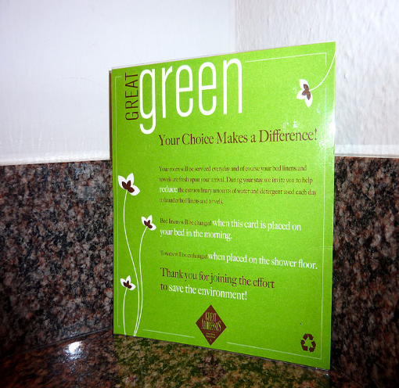
Instrumental ethics
Ethics an instrument for achieving something else.
Not based on principles or conviction.
«Greenwashing»
Philantrophy used as an «excuse»
|

Slide 36
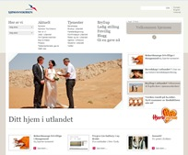
Principle based ethics
Based on principles like (from websites):
* We want to deliver first class design
* We want to be best in our discipline
* We will contribute to society
* We consider ecological impact
* We contribute to environmentalism
Preferably followed by action
Picture from www.bouvet.no, design for Sjømannskirken.

Slide 37
Compliance ethics
Within existing laws, standards, guidelines, morals
May need a «compliance officer» in large organisations
- e.g. what does it mean to «follow standard»?
Ensures that organisation «does no wrongs», but difficult

Slide 38
Positive ethics
* Contributing positively to:
- Organisation
- Profession
- Society
- Environment
- and other stakeholders
Normally cannot balance lack of compliance

Slide 39
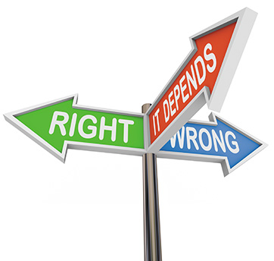
Personal Ethics What are Personal Ethics?
Set of formal or informal principles
Some people have clear, well-defined
Notes:
As you choose your words and actions, you are following a set of personal ethics—a set of formal or informal ethical principles you use to make decisions in your life.
Some people have a clear, well-defined set of principles they follow.
Others’ ethics are inconsistent or are applied differently in different situations.
It can be challenging to adhere to ethical principles if the consequences lead to an unhappy result.

Slide 40
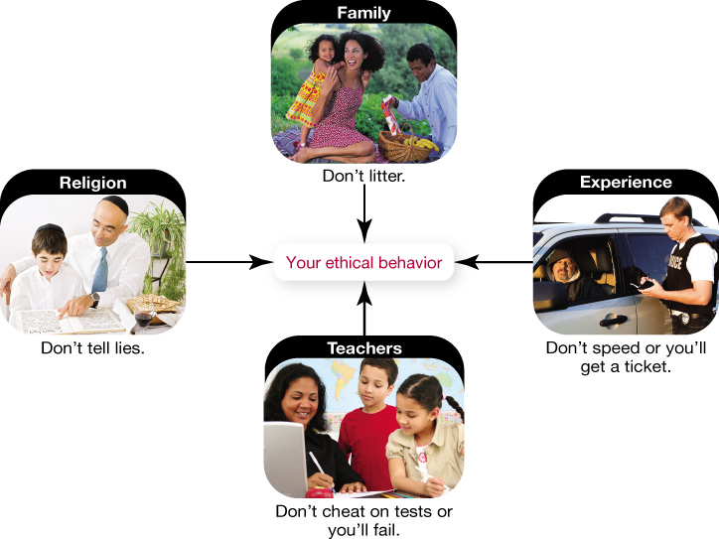
Personal Ethics How do a Person's Ethics Develop?
Family
Cultural bias
Religious affiliation
Life experiences
Notes:
Your family has a major role in establishing the values you cherish in your own life, and these might include a cultural bias toward certain moral positions.
Your religious affiliation is another major influence in your ethical life, because most religions have established specific codes of ethical conduct.
As you mature, your life experiences also affect your personal ethics.

Slide 41
Personal Ethics What are the Benefits to Ethical Living?
Society has established rules of conduct
Ignoring or being inconsistent can have immediate impact
Consistent ethical living provides health benefits
Inconsistent ethical decisions produce stress and anger
Notes:
Society has established its own set of rules of conduct in the form of laws.
Ignoring or being inconsistent in following these rules can have an immediate impact. And more and more research is showing the health benefits of ethical living.
When your day-to-day decisions are in conflict with your ethical principles, you often develop stress and anger.

Slide 42
Personal Ethics What are the Benefits to Ethical Living?
Positive psychology
Dr. Martin Seligman
Discover causes of happiness
Identify personal strengths and values
Align your life
Can impact your health and happiness
Notes:
Positive psychology is a new focus in the field of psychology.
Pioneered by Dr. Martin Seligman, this field works to discover the causes of happiness instead of addressing the treatment of dysfunctions.
Identifying your personal strengths and values, and then aligning your life and applying them every day, you can experience an increase in happiness.
Finding a way to identify and apply your ethics and values can have an impact on your health and happiness.

Slide 43
Personal Ethics and Your Work Life How do Employers Affect Personal Ethics?
Do your ethics change when you go to work?
Employers expect you to follow ethics and rules of conduct
Do not blindly follow unethical practices
Notes:
You may have a set of personal ethics that guide your behavior, but do your ethics change when you go to work?
Of course, your employer expects you to follow the rules of conduct established for the business.
However, this doesn’t mean you need to blindly follow corporate practices that you feel are unethical or detrimental to society.

Slide 44
Ethics and Technology Issues
Intellectual property
Privacy
E-commerce
Electronic communication
Computer abuse
Notes:
This figure shows a summary of the ethical issues that will be discussed in this chapter.

Slide 45
Privacy
Privacy is a basic human right
Employers might misuse data or violate law
Privacy settings on social media sites should allow user the ultimate control of data
Business concerns balance privacy concerns
In digital age, loss of privacy is expectable
Notes:
Point
The right to privacy is a basic human right.
Employers might misuse or lose control of the data or violate current employment law.
Privacy settings on social media sites should allow users control over who views their data.
Counterpoint
Business concerns outweigh privacy concerns. Businesses should screen data in social media sites to determine the character and fitness of employment candidates.
In the digital age, loss of a certain amount of privacy is inevitable.

Slide 46
E-Commerce Geolocation: Who Knows Where You Are?
People comfortable sharing personal information
Without sharing, businesses lose revenue
Useful for public safety
Society too complacent with privacy issues
Consumers to be educated and make informed choices
Notes:
Point
People have become comfortable with sharing information.
Businesses would lose revenue if geolocation ceased.
Devices and apps might become useful as public safety and news-gathering devices.
Counterpoint
Society has become too complacent with privacy issues.
Consumers need to be educated about geolocation and the ways it can impact them so that they are able to make informed choices.

Slide 47
Computer Abuse Cyberbullying: Who Should Protect Children From Each Other?
Individuals responsible for own behavior
Parents are responsible to protect children
Education is key and needs to be controlled by parents
Society is affected
Educators have more resources than parents
Notes:
Point
Bullying is a personal behavior issue, and those decisions should be made by parents.
Because educating children about bullying is key to preventing it, decisions about the content of such training needs to be controlled by parents.
Counterpoint
Parents need to be assured that publicly funded institutions are “safe havens” where their children will not be exposed to malicious activities.
Educators have better resources for teaching children about the serious effects of cyberbullying.

Slide 48
Discussion
Wikileaks
Villains or heroes?

Slide 49
Quality information (as applied to website)
* Correct
* Timely
* Relevant
* Interesting
* Useful

Slide 50
Ethics applies to:
Professional duties
Employee care
Customer care, and supplier responsibilities
Environment care
Ownership (price, value, opportunities..)
Financing
Exploration
* - the list is being extended

Slide 51
Categories of ethical problems
Crimes
Greed
Poor quality
Incompetence
Other

Slide 52
Common Causes of Unethical Behavior
Pressure
Fear
Greed
Convenience

Slide 53
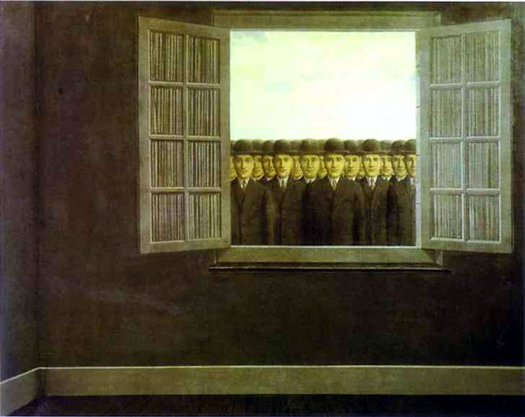
Causes of Unethical Behavior (cont’d)
Following boss’s directives
Meeting overly aggressive business/financial objectives
Helping the organization survive
Meeting schedule pressures
Be a team player (group think)
Rationalizing that others do it
Resisting competitive threats
Advancing own career

Slide 54
Ethical Tips for Individuals
Establish personal values.
Be aware of ethical events.
Develop critical thinking techniques.
Be reflective.
Make it a priority every day.

Slide 55
Summing up Ethics is the theory of right and wrong conduct.
Right and Wrong: Ethics is defined as the science of rightfulness or wrongfulness of conduct.
What makes an action right or wrong? The word “right” derives from the Latin “rectus”, meaning ‘straight’ or ‘according to norm’.

Slide 56
Case Study
Hari Om opened a grocery store in an upcoming middle class colony. Since this was the only store in a new colony, the business picked up. Soon, Hari realized he needed help. He employed a young boy Ramu to help him in the shop during peak hours and in delivering things to the homes of the clients. For one week things went off well, but soon Hari noticed that Ramu was slackening and had started reporting late to work and took a long time to come back after home delivery.
Whenever Hari needed him in the shop Ramu was not available. Hari tried his best to talk Ramu into mending his ways, to value time and pay more attention to his work. But even four months latter the situation did not improve. Ramu was often found sitting at the teashop drinking tea and whiling away time talking or playing pitthu. After six months of trying to reform Ramu without success, Hari got fed up and sacked him and employed another helper.

Slide 57
Is this case familiar to you?
Have you come across such people in your life who are not sincere to their work?
Why is sincerity to work important?
Why is the employer unhappy with his workers to the extent that it costs them their jobs?
In this lesson we will familiarize you with everything that is important to be a good worker if you are taking up a job. This information is also relevant and important for you or for anybody to be a lovable member of the family, school, college, university or friends’ circle.

