Slide 1
Chapter 5
Dr. Mohsin Uddin
Department of Accounting
Faculty of Economics and Administrative Sciences
Ishik University, Erbil

Slide 2
What are Ethics anyway?
◆ Understanding how your actions affect other people
◆ Knowing right from wrong
◆ Taking personal responsibility for your actions
◆ So , “Ethics is about putting principles into action. Consistency between what we say and … what our actions say… is a matter of integrity.”

Slide 3
Unethical vs. Illegal
◆ What is unethical is not necessarily illegal.
◆ For example, the issue of a company legally monitoring Employee‟s E-mail is
very controversial issues.
◆ Employees have limited protection against employer‟s electronic surveillance.
◆ The law appears to support employer‟s rights to read electronic mail and other electronic documents of their employees.
◆ Here, The definitions of “Right” and “Wrong” are not clear. Also, the
distinction between what is illegal and what is unethical is not always clear

Slide 4
Illegal
Ethical but Illegal | Unethical And Illegal
Legal And Ethical | Legal But Unethical
Legal
Ethical
Unethical
Business Ethics - Gihan Aboueleish
4

Slide 5
 Business Ethics:
The principles and standards that define acceptable conduct in business
 Social Responsibility:
A business’s obligation to maximize its positive impact and minimize its negative impact on society
Business Ethics - Gihan Aboueleish
5

Slide 6
 An ethical issue is an identifiable problem, situation, or opportunity that requires a person to choose from among several actions that may be evaluated as right or wrong, ethical or unethical.
Business Ethics - Gihan Aboueleish
8

Slide 8
Business Ethics - Gihan Aboueleish
8

Slide 9
 Conflict of interest
 Fairness and honesty
 Communications
 Business relationships
Business Ethics - Gihan Aboueleish
9

Slide 10
 Happens when a person must choose whether to advance their own personal interest or those of others
Business Ethics - Gihan Aboueleish
10

Slide 11
 The heart of business ethics
General values of
decision makers
Business Ethics - Gihan Aboueleish

Slide 12
 False and misleading advertising and misleading personal- selling tactics anger customers and may cause a business to fail.
Business Ethics - Gihan Aboueleish

Slide 13
 Business people must be ethical toward their customers, suppliers, and others in their workplace.
Business Ethics - Gihan Aboueleish

Slide 14
 Would this activity be accepted by your coworkers?
Business Ethics - Gihan Aboueleish

Slide 15
 How does this activity fit with your own beliefs and values?
Question: Will my action violate any of my personal ethics, religious beliefs, or social values?
Business Ethics - Gihan Aboueleish

Slide 16
Individual Standards and Values
Managers’ and Coworkers’ Influence
Opportunity: Codes and Compliance Requirements
Ethical/Unethical Choices
in Business
Business Ethics - Gihan Aboueleish

Slide 17
 Formalized rules and standards that describe what a company expects of its employees
Business Ethics - Gihan Aboueleish

Slide 18
Whistleblowing (Blame) The act of an employee exposing the employer’s wrongdoing to outsiders
The media
Government regulatory agencies
Business Ethics - Gihan Aboueleish

Slide 19
 Four Dimensions:
Economic – earn profits
Legal – comply with the law
Ethical
Not just ―for profit‖ only
Voluntary & Charity
Promote human welfare and goodwill
Business Ethics - Gihan Aboueleish

Slide 20
Voluntary Responsibilities being a
“good corporate citizen;” contributing to the community and quality of life
Ethical Responsibilities
being ethical; doing what is right, just, and fair; avoiding harm
Legal Responsibilities
obeying the law (society’s codification of right and wrong)
Economic Responsibilities
being profitable
Business Ethics - Gihan Aboueleish
24

Slide 21
Green Mountain Coffee
Hewlett-Packard
Advanced Micro Devices
Motorola
Agilent Technologies
Timberland
Salesforce.com
Cisco Systems
Dell
Texas Instruments
Intel
Johnson and Johnson
NIKE
General Mills
Pitney Bowes
Wells Fargo
Starbucks
Wainright Bank & Trust
St. Paul Travelers
Ecolab
Business Ethics - Gihan Aboueleish

Slide 22
 Environmental issues:
Animal rights
Pollution
Global warming
 Community relations:
Responsibility to the general welfare of the
community
Business Ethics - Gihan Aboueleish

Slide 23
 The right to safety
 The right to be informed
 The right to choose
 The right to be heard
Did You Know?
John F. Kennedy was the 35th President of the United States.
Business Ethics - Gihan Aboueleish

Slide 24
Organizational
Individual
Environmental
oValues
oWork Background
oTop Level Mgmt.
Philosophy
oThe Firm’s Reward
System
oJob Dimensions
oCompetition
oEconomic Conditions
oSocial/Cultural Institutions
oFamily Status
oPersonality

Slide 25
Is It Legal?
Is It Balanced?
How Will It Make Me Feel About Myself?

Slide 26
 Religious Teachings
 Individual Rights
 Legislation
 Court Decisions

Slide 27
 Compliance-Based
Increasing control and penalizing criminals
 Integrity-Based
Define guiding values
Support ethical behaviour
Shared accountability

Slide 28
Top management support
Expectations begin at the top
Ethics imbedded in training
Ethics office set up
External stakeholders informed
There must be enforcement

Slide 29
Three Levels of Social Responsibility
Societal Responsibility
Stakeholder Responsibility
General Public
Profit Responsibility
Ecological
Customers
^{Employees} Environment
Owners/Stockholders
Suppliers/Distributors
Public Interest Groups

Slide 30
 Pesticides
 Waste disposal
 Clear-cut logging
 Deforestation
 Auto exhaust
 Conservation
 Recycling
 Ozone depletion
 Extinction of species
 Populations explosion
 Nuclear proliferation and testing

Slide 31
 Corporate Social Responsibility -the concern businesses have for the welfare of society.
 Corporate Charity – charitable donations.
 Corporate Responsibility – acting responsibly within society.
 Corporate Policy –position on social and political issues

Slide 32
 Many companies have undertaken a Social Audit - a systematic evaluation of the company’s position and progress on social issues
 Shareholders and other stakeholders have actively encouraged companies to become proactive on social issues

Slide 33
1) Nokia
Finland Japan Japan Switzerland Japan Britain Singapore France Britain &
Japan
Toyota Motor
Sony
Nestle’
Honda Motor
BP
Singapore Airlines
L’Oreal
Royal Dutch/Shell Netherlands
Canon
Business Ethics - Gihan Aboueleish
59

Slide 34
Ethics in Advertising
Secret Sins of the Industry
Notes:
http://www.aef.com/on_campus/classroom/speaker_pres/data/3001

Slide 35
Ethics
Ethics: Guidelines for good behavior
Concept is do what is in the best interest of the biggest number
In advertising, companies want to grab your attention
Entertain, persuade, and inform

Slide 36
Advertisements = 1st Impression
For a company trying to sell you something an advertisement is like trying to get a job interview with millions of people at one time
Make good first impression
Don’t make anyone angry or mad
Difficult to please all because people view things differently
The bolder the ad, the more polarizing it becomes
Big events bring about such ads
Examples: Olympics, Super Bowl, Oscars, etc..

Slide 37
Ethics in Advertising
Tobacco Advertising
Would you do an ad campaign for a cigarette company?
Over $1.5 billion in free advertising takes place each year for public service announcements denouncing cigarette use
Beer Commercials
What do all these beer commercials have in common?

Slide 38
Children
L’Oreal Kids Shampoo
There is no adult supervision shown around the swimming pool.
The Children's Advertising Review Unit (CARU) of the Better Business Bureau (BBB), which also monitors kid's programming, requires that adults be shown supervising children when products or activities could be risky.
L'Oreal changed the commercial to model good parental behavior.
Aim toothpaste showed a child who went to the bathroom in a museum to brush her teeth.
Had to be taken off the air when teachers complained that they'd never let a child leave the group unattended.

Slide 39
Pharmaceutical Advertising
Information is ethically neutral
Most people welcome more information because it enables individuals to form their own judgments
Used to be doctors informed citizens about medicine, now commercials introduce them
Ads have raised awareness
More people go to the doctor now than before
Drugs advertised are not the cheapest (generic version)
FDA requires companies to reveal any possible side effects
Killed the weight loss drug industry

Slide 40
Product Placement
Do you think its ethical for movie companies, television networks, music artists, etc.. To use product placement in their advertising?
In the theatre we have no way of knowing whether the director chose those cars because they fulfilled his artistic vision - or because the car manufacturer made a deal with the producer.
Audiences like realism in movies.
Made-up brands affect the audience because they feel like their being lied to
They're obvious fakes

Slide 41
Guerilla Advertising
Product placement happens in real life
If you go out to a club tonight, you might see some particularly good-looking young people using a new kind of cell phone.
Will voluntarily let you use product
The phone is very cool & so are the people hired
They're also actors and this is a gig for them.
Their job is creating the impression that using this phone is The Next Trend.
If you ask them directly if they are actors, they won't lie.
If you don't ask, they won't tell.

Slide 42
Subliminal Messaging
Subliminal advertising is one of those "urban legends."
Take a photograph of a glass of ice water or the beverage of your choice and make a fake ad out of it.
Then invite people to find or guess the subliminal messages in your ad.
Most will be able to come up with something
This is what advertising companies do.
They present an idea in a way that allows you to form your own opinion but the way gain information is based off how they present it

Slide 43
Assignment Option #1:
Create an advertisement that is intentionally unethical. The advertisement can promote any product, service, or idea you wish but must use questionable marketing tactics to accomplish this task.
An advertisement is considered unethical in the following situations:
When it has degraded or underestimated the substitute or rival’s product
When it gives false or misleading information on the value of a product
When it fails to give useful information on the possible reaction or side effects of the product.
When it is immoral

Slide 44
Surrogate Advertisement
Surrogate Advertisement: Used to promote a banned product in the disguise of another product.
Uses a different product to advertise their name
84% of viewers pickup on the unintended brand being advertised
Example:
Bicardi Blasts music CD’s
Bagpiper Club Soda
Officer’s Choice Playing Cards

Slide 45
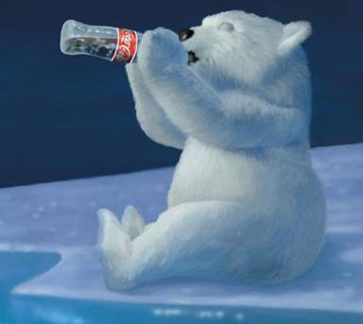
Puffery
Puffery refers to claims that express subjective rather than objective views
Most reasonable people would take not take literally.
However, a two-year old might believe that polar bears enjoy sipping Coca-Cola.

Slide 46
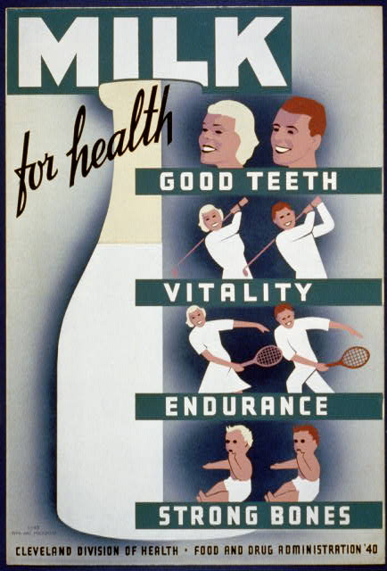
Unverified claims
Unverified claims: It includes advertisements of “energy drinks” which tells us about the number of vitamins and how they help children to grow strong and tall.

Slide 47
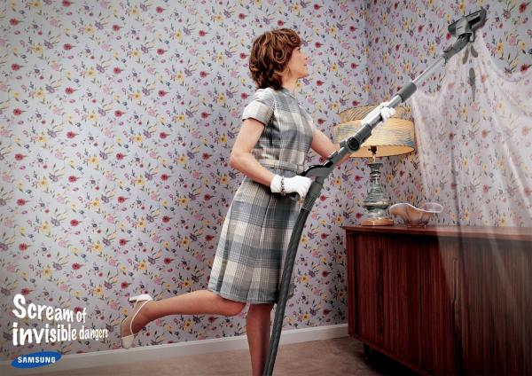
Women Stereotyping
Women Stereotyping: Using women to promote household cleaners

Slide 48
Comparative Ad
Comparative advertisement: Occurs when a company compares itself to its competitor.
Examples:
Coke v. Pepsi
Colgate v. Pepsodent.

Slide 49
Children
Use of children in advertisements:
Children watch more advertisements than almost anyone.
They can sing jingles, recognize logos, and typically have strong feelings about a product.

Slide 50
Fair Advertising
What is this ad saying?
Messages like these want to convince people that alcohol is magic.
These ads tell us that alcohol can make us successful, sophisticated and even sexy. Without it, life is dull, ordinary and boring.

