Slide 1
UNIT - V
TRANSPORATION PROBLEM

Slide 2
Transportation Problem
Formulation of Transportation Problem
Steps in Transportation Methods
North-West Corner Method
Least Cost method
Vogel’s Approximation Method
Loop in Transportation Problem
Modified Distribution Method

Slide 3
Origins :-
The producing centers of various items are known as origins. These are denoted by 0₁, 0₂……
Destination :-
The places which require various items from the origins are known as destination. These are denoted by d₁, d₂……
Transportation Problem :-
The problem of transporting various items from origins to the various destinations in such a way that the total transportation cost is minimum is known as transportation problem.

Slide 4
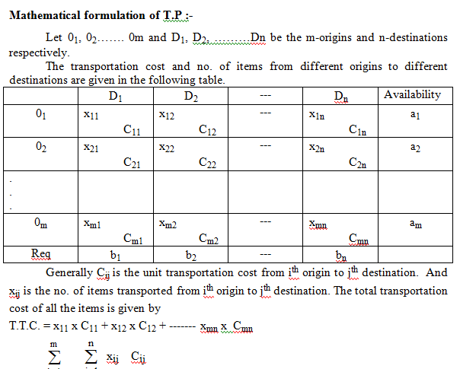

Slide 5
Feasible solution :-
The set of non negative individual allocations xij 0. Which simultaneously removes deficiency is called a feasible solutions.
Basic feasible solution :-
A feasible solution to ‘m’ origins ‘n’ destination problem is said to be basic if the no. of positive allocations are m + n – 1
Optimum Solution :-
A feasible solution is said to be optimal if it minimizes the total transportation cost.
* Balanced transportation problem :-
The total availability is equal to total requirement in any transportation problem it is known as balanced transportation problems.

Slide 6
For finding an optimum solution t.p. consist of 2 main steps :
Step 1 :-
To find an initial basic feasible solution (IBFS)
Step 2 :-
To find an optimal solution by making successive improvement to IBFS until no future decrease in the transportation cost is possible.
i) IBFS can be obtained by using the following methods :-
a) North West corner (NW) method
b) Matrix Minima method / Least cost method
c) Vogel’s oppoximation method (VAM)
ii) Optimum solution can be obtained by MODI method.

Slide 7
North-West Corner Method(NWC)
IBFS by NW corner method can be obtained by using the following steps.
Step 1 :-
The given transportation problem must be balanced
Step 2 :-
Select the nw corner element & allocate the maximum possible amount to the cell.
Case 1 :-
If the availability is less than the requirement then cross off remaining elements then cross off the remaining elements of the row and find the remaining requirement.
Case 2 :-
If the availability is greater than the requirement then cross off the remaining elements of the column and find remaining availability.
Case 3 :-
If availability = requirement than cross off either row or column but not both.
Step 4 :-
Again select the next NW corner element and repeat the same procedure until all requirements get satisfied.

Slide 8
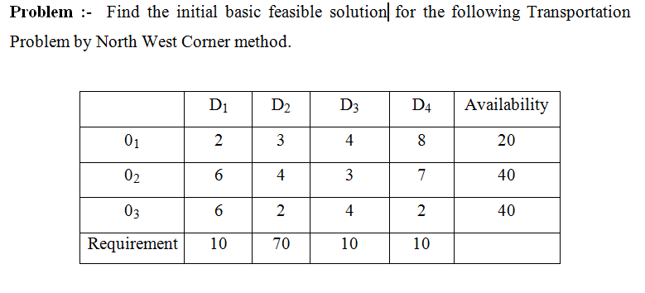

Slide 9
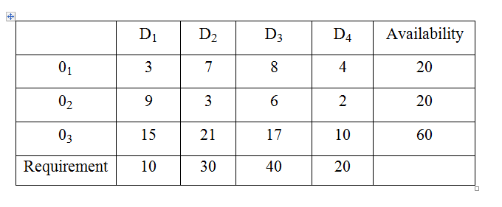

Slide 10
Least Cost Method
Step 1 :-
The given T.P. must be balanced
Step 2 :-
From the given t.p. find the minimum transportation cost allocate maximum possible amount to that cell
Case 1 :-
If the availability less than the requirements then cross off the remaining elements of the row
Case 2 :-
If the availability greater than the requirement then cross of the remaining elements of the column.
Case 3 :-
If the availability = requirement than cross off the remaining elements of either row or column but not both.
Step 3 :-
Again select the cell containing the next minimum cost and repeat the same procedure until all the requirements get satisfied.

Slide 11
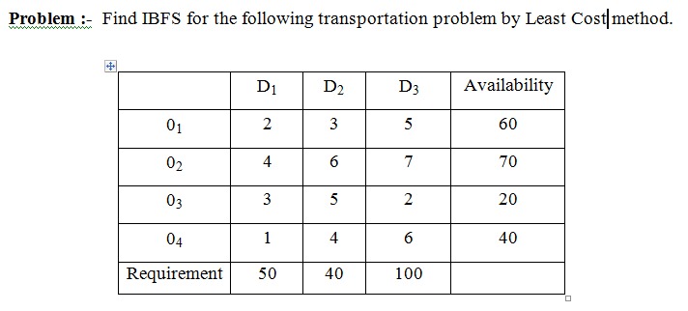

Slide 12
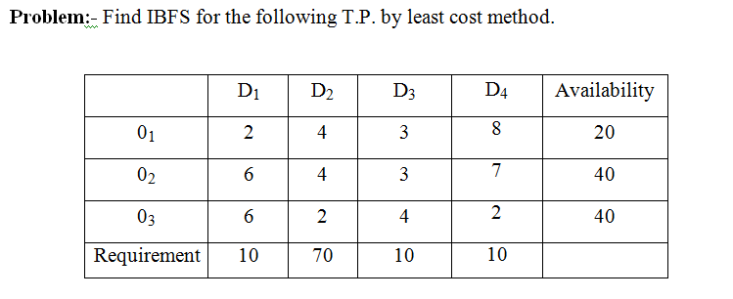

Slide 13
