Slide 1
Iraq Economy BUS415
Ms. Khadija Alaa

Slide 2
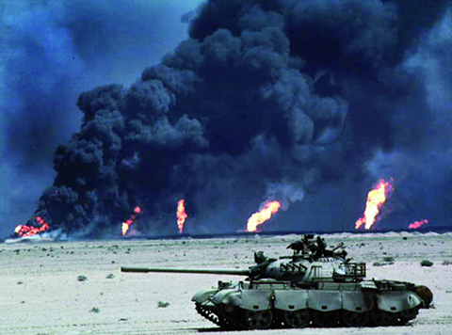

Slide 3
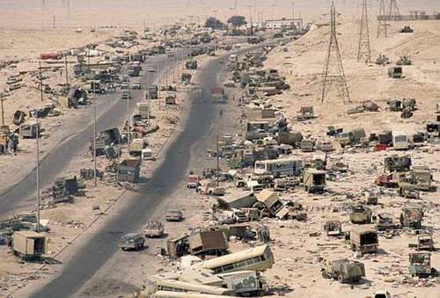
The Invasion of Kuwait and the Destruction of Development
When the war with Iran was finally ended in 1988, Iraq had experienced some $452 billion, nearly ten times its average GDP during the war period, in explicit economic cost.
It would be no exaggeration to say that Iraq started the postwar period with its economy in ruin and its people impoverished.

Slide 4
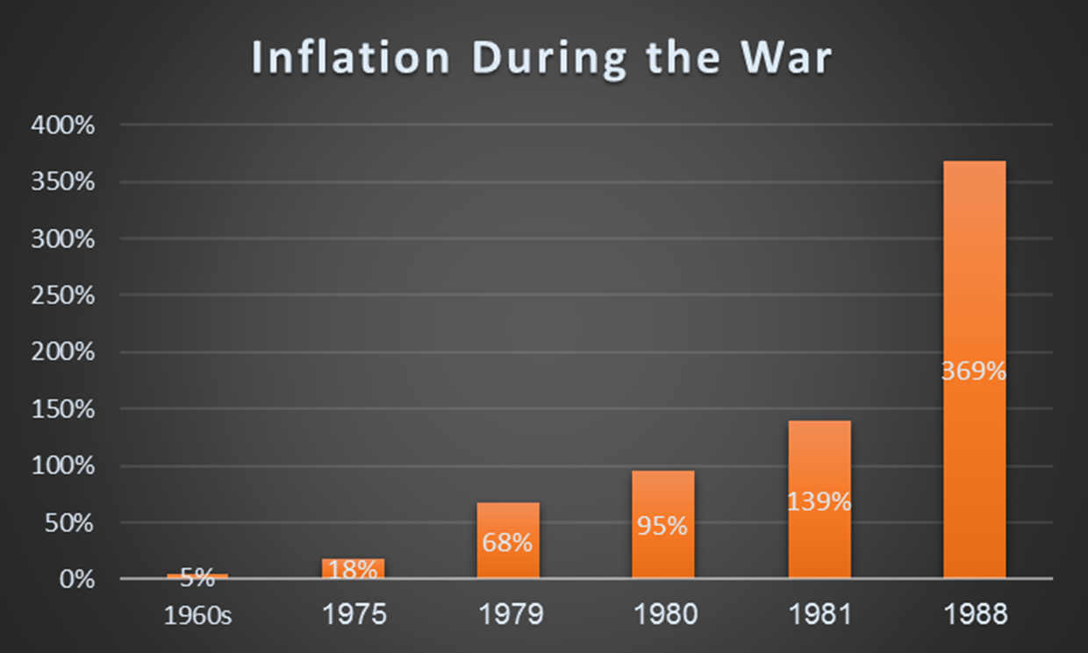

Slide 5
What can we do to solve this issue?
In a country like Iraq, where the contribution of tax revenue to total government revenue has traditionally been very low, war time was not the right time to raise taxes.
Nor could the government borrow in the open market, since there was no financial system outside the government-owned banking system.

Slide 6
Borrow from the Central Bank
Given these constraints, in order to finance its war effort in the face of declining revenue, the government found itself increasingly borrowing from the banking system.
This practice, which resulted in raising the supply of money in the system, had the effect of growing inflationary pressure in the economy, causing the budget deficit to increase and thus forcing the government into another round of borrowing and setting the stage for inflationary spiral.
Since the central bank is government owned and the commercial banking system was a government monopoly, such borrowing from the banking system was equivalent to printing money.

Slide 8
Do You Remember Foreign Debt from the War with Iran?
As the war with Iran continued, the government found itself forced to borrow to finance the war. Three sources of loans were identified:
First, loans extended by the Arab Gulf states, mainly Saudi Arabia and Kuwait, soon after the outbreak of the war. The government of Iraq has always maintained that such funds, which amounted to $40 billion, were supplied as assistance rather than loans to help it in its war with Iran.
Another $35 billion was owed to Western governments and banks.
Third, another $11 billion was owed to the Soviet Union and other East European governments.

Slide 9
National Interest Vs. Collective Interest of the Group in OPEC
Over its life since 1960 when OPEC was created, its decisions over
prices and output were guided by the perceptions of its member countries
of their own national interests. The principle of the sovereignty of
the state was, in the final analysis, the guiding principle of each state.
In this context, national interest took precedent over the collective
interest of the group.

Slide 10
How Countries Decide about Oil Production
Since member countries differ considerably
in their resource endowment of oil reserves,
in the size of their populations,
in the stage of their economic development,
and in the network of their commitments outside OPEC.
It was natural that they would have different assessments of the value of their oil reserves and consequently the amount of oil to be produced and the price at which it would be sold.

Slide 11
Output Maximizers
One group of countries, led by Saudi Arabia and supported by other Arab Gulf states-Kuwait, United Arab Emirates, and Qatar viewed stable or even relatively low price to be important for all member countries‘ long-term interests.
In order to keep prices from rising, these states were prepared to increase oil output. Their ability to pump more oil to sell at lower prices and still maintain their revenue was bolstered by the fact that they had small populations, considerable accumulated financial investments, and large oil reserves.

Slide 12
Why Maximize Output?
The Gulf states argued that it was in the interest of oil-producing
countries to maintain prices at levels acceptable to the main consuming
countries-the industrialized countries of the West—in order to
avoid driving the West to finding alternative sources of oil or of energy
or to adopt excessive conservation measures. Another factor that
influenced the oil policies of these states was their considerable investment
in Western economies.

Slide 13
Price Maximizers
Countries with smaller oil reserves but larger populations tend to have lower per capita incomes than members of the other group. Moreover, these countries tend to run balance-of-payments deficits and therefore incur foreign debt obligations. Their position on the price of oil is dictated by their smaller oil reserves. They want to get as much income as possible.
Their position is also influenced by their ambitious development plans which call for a large component of foreign exchange. Since all oil-exporting countries are paid in U.S. dollars for their oil, these countries want to see upward price adjustments to offset any erosion in the value of the dollar caused by inflation or foreign exchange fluctuations. Countries in this group include Algeria, Iran, Iraq, Libya, Nigeria, and Venezuela.

Slide 14
Saudi Oil Policy
One of the notable features of Saudi oil policy and OPEC since the 1973 oil price explosion was the ability of the Saudi government to impose its policy of relative price freeze on other members of OPEC. The tactic was simple but effective.
Whenever member countries advocated a price increase that was not in line with Saudi thinking, the Saudi government threatened an increase in output that would lower prices and yield a smaller market share to the country raising prices.
This Saudi oil policy in turn helped serve the U.S. government's longstanding objective of access to adequate supplies of Middle East oil at reasonable prices.

Slide 15
Kuwait Side
In February 1990 the oil minister of Kuwait, Ali Khalifa Al-
Sabah, stated the following:
(1) the nominal price of oil should remain stable at
$18 per barrel,
(2) the OPEC quota system should be scrapped, and
(3) whenever market forces push the price above $18 per barrel, member
countries should expand their output to force it down.

Slide 16
Iraq Side
The consequences of the downward slide in the price of oil, which declined by one-third in the first six months of 1990 from nearly $20 per barrel to $13.67 per barrel, triggered a series of reactions by Iraq.
On May 30, 1990 Saddam Hussein made a statement at the Arab Emergency Summit Conference in Baghdad in which he spoke of the economic damage inflicted upon Iraq as a result of the oil price decline.
Given Iraq's export capacity at the time, he asserted that a drop in price of $1 per barrel meant a loss of $1 billion in oil revenue per year.
Moreover, he expressed the Iraqi government's belief that the price could be raised to $25 per barrel within two years without harming export levels.
This in turn meant that the longer the price remained low the larger the economic loss that Iraq would have to endure.

Slide 17
Economic Warfare
Iraq accused the government of the UAE of participating with the Kuwaiti government in what was described as "a planned operation to flood the oil market with excess production." The Iraqi memorandum characterized Kuwait's actions as equivalent to military aggression and accused its government of being determined to cause a collapse of Iraq's economy.

Slide 18
Other Issues besides Oil Output and Price
In addition to the issues of oil production and borders, the Iraqi government added two other issues to the list of its grievances against Kuwait.
The first relates to the dispute over the Rumaila oil field where Iraq accused Kuwait of using sloping drilling to pump oil from that part of the field located in Iraq's territory.
The second relates to the financial assistance Kuwait had extended during the war with Iran. While Kuwait maintained that those funds were loans, Iraq insisted that they were grants.

Slide 19
The War Started
On August 2, Saddam Hussein decided to invade and occupy Kuwait; and on August 8, the Iraqi government announced the annexation of Kuwait. The ensuing imposition of a blockade against any exports from Iraq and Kuwait gave rise to demands that OPEC member countries be allowed to increase output beyond their quotas.

Slide 20
Iraqi Dreams
Iraqi deputy prime minister for the economy said that
Iraq would now be able to pay its debt in less than five years;
that the new Iraq's oil reserves had doubled;
that the "new Iraq" would have an oil production quota of 4.6 MBD instead of 3.1 MBD;
that its oil income would reach $38 billion per year and rise to $60 billion in the near future;
that there would be considerable expansion in the private sector once the two economies were integrated;
and that Iraq would be able to vastly increase spending on development projects and imports 0.81

Slide 21
These economic dreams turned into ashes when a number of countries, under the leadership of the United States, took it upon themselves to undo what the Iraqi regime had done on August 2.

Slide 22
United Nations Security Council Resolution (UNSCR) 660
On the day of the invasion, United Nations Security Council Resolution (UNSCR) 660 was passed, condemning the invasion and urging the withdrawal of Iraqi troops from Kuwait.
The United States, Britain, and France decided on the same day to freeze Iraqi and Kuwaiti assets and to ban trade with Iraq.
For its part, the Soviet Union decided to halt arms deliveries to Iraq.
On August 6 UNSCR 661 was passed, imposing mandatory sanctions and embargo on Iraq and occupied Kuwait.
This resolution banned all transactions with Iraq and sealed Iraq's economic fate for years to come.
As has been stated several times in this study, Iraq's economy is totally dependent on the world market for its oil exports; its foreign exchange earnings; its imports of foodstuffs; consumer goods; raw materials; and other inputs, technology, spare parts, and capital goods.

Slide 23
Results of War
A measure of the effectiveness of the embargo may be seen in the 86 percent decline in Iraq's oil output from 3.3 MBD before the invasion to less than 0.5 MBD in subsequent months—enough only to meet the needs of local consumption.
The six-week bombing campaign, which started on January 16, 1991, was aimed not only at military targets but also at such assets as civilian infrastructure, power stations, transport and telecommunications networks, fertilizer plants, oil facilities, iron and steel plants, bridges, hospitals, storage facilities, industrial plants, and civilian buildings. And the assets that were not bombed were made useless by the destruction of power-generating facilities.

Slide 24
Sanctions and Reparations
The sanctions against Iraq were a near-total financial and trade embargo imposed by the United Nations Security Council on Ba'athist Iraq.
They began August 6, 1990, four days after Iraq's invasion of Kuwait, stayed largely in force until May 2003 (after Saddam Hussein's being forced from power), and persisted in part, including reparations to Kuwait, through the present.
The original stated purposes of the sanctions were to compel Iraq to withdraw from Kuwait, to pay reparations, and to disclose and eliminate any weapons of mass destruction.

Slide 25
Oil-for-Food Programme
The Oil-for-Food Programme (OIP), established by the United Nations in 1995 (under UN Security Council Resolution 986) to allow Iraq to sell oil on the world market in exchange for food, medicine, and other humanitarian needs for ordinary Iraqi citizens without allowing Iraq to boost its military capabilities.

Slide 26
End of Sanctions in 2003
The US and UK governments always made it clear that they would block any lifting or serious reforming of sanctions as long as Hussein remained in power.
After more than twelve years of sanctions had passed, the US and the UK made war on Iraq again in March, 2003, sweeping away Hussein's government.
Soon after, Washington called for and obtained the lifting of sanctions, a step that gave the US occupation authority full control over Iraq's oil sales and oil industry.

Slide 27
Question Bank
What were the economic conditions in Iraq after the war?
What were some ways to get out of economic issues in Iraq after the war with Iran?
How did the severe inflation happen in Iraq after in 1990?
IN OPEC, there is a conflict between National Interest and Collective Interest. Explain.
Write an essay in which you describe and discuss the profit maximizers, the output maximizers, Saudi oil policy, and the impact of these policies on Iraqi economy. (250 words).
What were some Iraqi dreams upon the invasion of Kuwait? Did these dreams come true?
Discuss the United Nations Security Council Resolution (UNSCR) 660.
Discuss the UN Security Council Resolution 986 and the end of Sanctions in 2003.

