Slide 1
Groups and Intergroup Relations Ethnicity, Nationalism and Identity
Basics of Sociology
Ishik University
Department of IRD
Fall 2018-19
Course delivery: Dr. Dilshad Hamad

Slide 2
Learning Objectives
Introduce students to the most important grouping in society (race, ethnicity and nation).
Explore domination-subordination relations between groups and the cognitive dynamics that involved in this process.
examine various form of intergroup relations (tolerance to intolerance).

Slide 3
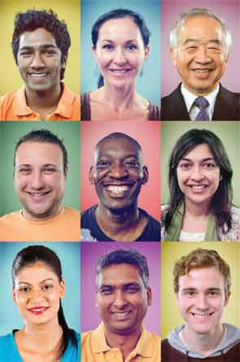
Race
Race: refers to superficial physical differences that a particular society considers significant.

Slide 4
Race: from a biological definition to the “social construct of race”
In the past, theorists have posited categories of race based on various geographic regions, ethnicities, skin colors, and more. Their labels for racial groups have connoted regions (Mongolia and the Caucus Mountains, for instance) or skin tones (black, white, yellow, and red, for example).

Slide 5
Social Construct of Race
Race is not a biological fact. In other words, there is no biological basis for differences between racial groups. What we come to think of as race, or physical difference, is called phenotype. Your phenotype refers to your physical characteristics like eye color and skin color. Phenotype means the observable physical differences in people. The problem is we've taken phenotype and used it to justify domination and exclusion based on physical difference. Sociologists believe that race is the product of our social world.

Slide 6
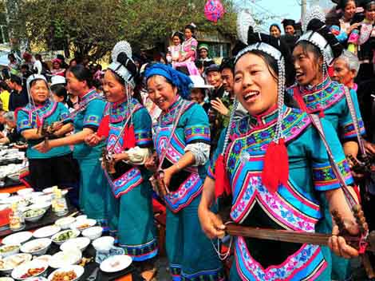
Ethnicity
Ethnicity: describes shared culture. This culture might include shared language, religion, and traditions, among other commonalities.

Slide 7
Nation and Nationalism
Nations as historic entity
They have clear, national identity
Based on language, custom and historic memory
They have a clear “national territory
Self-awareness of an already existing nation
Right to self-determination (independent state)
Obstacles that prevent a nation from realizing the nation’s rights

Slide 8
Minority Group
Minority group: describe groups that are subordinate, or that lack power in society regardless of skin color or country of origin.

Slide 9
Minority Group
Sociologist Louis Wirth (1945) defined a minority group as “any group of people who, because of their physical or cultural characteristics, are singled out from the others in the society in which they live for differential and unequal treatment, and who therefore regard themselves as objects of collective discrimination.”

Slide 10
Subordinate and Dominant Group
The term minority connotes discrimination, and in its sociological use, the term subordinate group can be used interchangeably with the term minority, while the term dominant group is often substituted for the group that’s in the majority. These definitions correlate to the concept that the dominant group is that which holds the most power in a given society, while subordinate groups are those who lack power compared to the dominant group.

Slide 11
Characteristics of Minority Groups
According to Charles Wagley and Marvin Harris (1958), a minority group is distinguished by five characteristics:
1- unequal treatment and less power over their lives,
2- distinguishing physical or cultural traits like skin color or language,
3- involuntary membership in the group,
4- awareness of subordination, and
5- high rate of in-group marriage.

Slide 12
Stereotype, prejudice and discrimination
Stereotypes are oversimplified generalizations about groups of people. Stereotypes can be based on race, ethnicity, age, gender, sexual orientation—almost any characteristic. They may be positive (usually about one’s own group, such as when women suggest they are less likely to complain about physical pain) but are often negative (usually toward other groups, such as when members of a dominant racial group suggest that a subordinate racial group is stupid or lazy). In either case, the stereotype is a generalization that doesn’t take individual differences into account.

Slide 13
Prejudice and Racism
Prejudice refers to the beliefs, thoughts, feelings, and attitudes someone holds about a group. A prejudice is not based on experience; instead, it is a prejudgment, originating outside actual experience.
Racism is a stronger type of prejudice used to justify the belief that one racial category is somehow superior or inferior to others; it is also a set of practices used by a racial majority to disadvantage a racial minority.
Discrimination consists of actions against a group of people.

Slide 14
Intergroup Relations
Intergroup relations (relationships between different groups of people) range along a spectrum between tolerance and intolerance. The most tolerant form of intergroup relations is pluralism, in which no distinction is made between minority and majority groups, but instead there’s equal standing. At the other end of the continuum are amalgamation, expulsion, and even genocide—stark examples of intolerant intergroup relations.

Slide 15
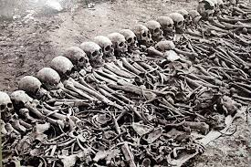
Genocide
The deliberate annihilation of a targeted (usually subordinate) group, is the most toxic intergroup relationship. Historically, we can see that genocide has included both the intent to exterminate a group and the function of exterminating of a group, intentional or not.

Slide 16
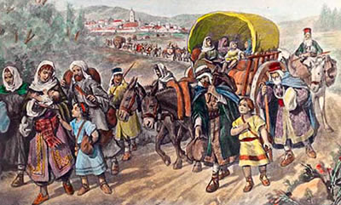
Expulsion
a subordinate group being forced, by a dominant group, to leave a certain area or country.

Slide 17
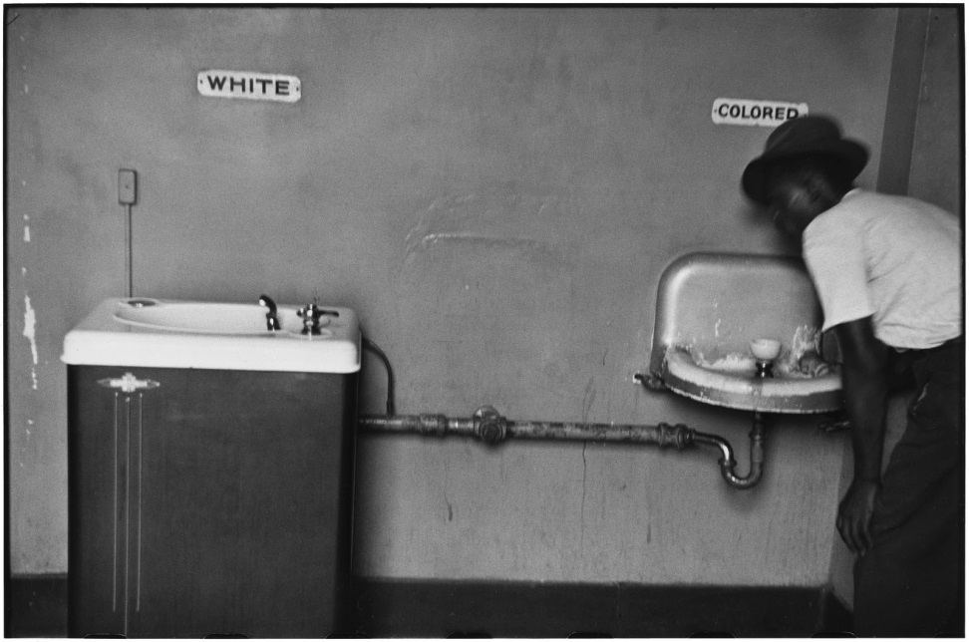
Segregation
Segregation refers to the physical separation of two groups, particularly in residence, but also in workplace and social functions. It is important to distinguish between de jure segregation (segregation that is enforced by law) and de facto segregation (segregation that occurs without laws but because of other factors).

Slide 18
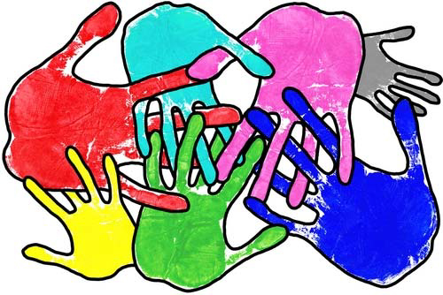
Pluralism
Pluralism is represented by the ideal of the United States as a “salad bowl”: a great mixture of different cultures where each culture retains its own identity and yet adds to the flavor of the whole. True pluralism is characterized by mutual respect on the part of all cultures, both dominant and subordinate, creating a multicultural environment of acceptance.

Slide 19
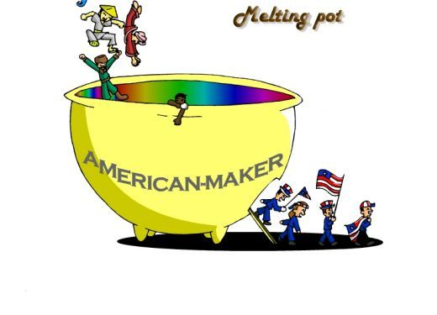
Assimilation
Assimilation describes the process by which a minority individual or group gives up its own identity by taking on the characteristics of the dominant culture. In the United States, which has a history of welcoming and absorbing immigrants from different lands, assimilation has been a function of immigration.

Slide 20
Amalgamation
Amalgamation is the process by which a minority group and a majority group combine to form a new group. Amalgamation is achieved through intermarriage between races.

