Slide 1
ADVANCED MARKETING MANAGEMENT
Porter's Value Chain
Presented By
Dr. Uma Shankar Singh
Faculty of administrative science and economics
ISHIK University

Slide 2
Instructions
Objective: To know the differentiation and positioning in
marketing .
Dos : Ask questions.
Supplement or complement with learning.
Don’ts : Break silence and discipline.
Ring phones.
Talk friends.

Slide 3
Porter's Value Chain Understanding How Value Is Created Within Organizations?

Slide 4
How does your organization create value?
How do you change business inputs into business outputs in such a way that they have a greater value than the original cost of creating those outputs?
This isn't just a dry question: it's a matter of fundamental importance to companies, because it addresses the economic logic of why the organization exists in the first place.
Manufacturing companies create value by acquiring raw materials and using them to produce something useful. Retailers bring together a range of products and present them in a way that's convenient to customers, sometimes supported by services such as fitting rooms or personal shopper advice. And insurance companies offer policies to customers that are underwritten by larger re-insurance policies. Here, they're packaging these larger policies in a customer-friendly way, and distributing them to a mass audience.

Slide 5
The value that's created and captured by a company is the profit margin:
Value Created and Captured – Cost of Creating that Value = Margin
The more value an organization creates, the more profitable it is likely to be. And when you provide more value to your customers, you build competitive advantage.
Understanding how your company creates value, and looking for ways to add more value, are critical elements in developing a competitive strategy. Michael Porter discussed this in his influential 1985 book "Competitive Advantage," in which he first introduced the concept of the value chain.
A value chain is a set of activities that an organization carries out to create value for its customers. Porter proposed a general-purpose value chain that companies can use to examine all of their activities, and see how they're connected. The way in which value chain activities are performed determines costs and affects profits, so this tool can help you understand the sources of value for your organization.

Slide 6
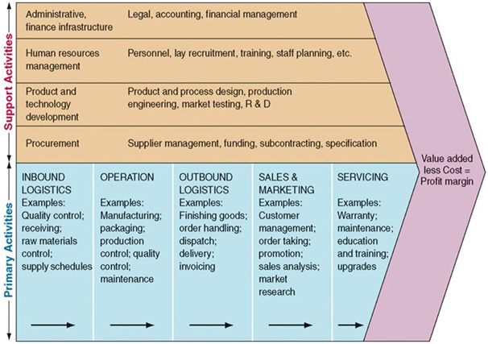
Porter's Value Chain

Slide 7
Primary Activities
Primary activities relate directly to the physical creation, sale, maintenance and support of a product or service. They consist of the following:
Inbound logistics – These are all the processes related to receiving, storing, and distributing inputs internally. Your supplier relationships are a key factor in creating value here.
Operations – These are the transformation activities that change inputs into outputs that are sold to customers. Here, your operational systems create value.
Outbound logistics – These activities deliver your product or service to your customer. These are things like collection, storage, and distribution systems, and they may be internal or external to your organization.
Marketing and sales – These are the processes you use to persuade clients to purchase from you instead of your competitors. The benefits you offer, and how well you communicate them, are sources of value here.
Service – These are the activities related to maintaining the value of your product or service to your customers, once it's been purchased.

Slide 8
Support Activities
These activities support the primary functions above. In our diagram, the dotted lines show that each support, or secondary, activity can play a role in each primary activity. For example, procurement supports operations with certain activities, but it also supports marketing and sales with other activities.
Procurement (purchasing) – This is what the organization does to get the resources it needs to operate. This includes finding vendors and negotiating best prices.
Human resource management – This is how well a company recruits, hires, trains, motivates, rewards, and retains its workers. People are a significant source of value, so businesses can create a clear advantage with good HR practices.
Technological development – These activities relate to managing and processing information, as well as protecting a company's knowledge base. Minimizing information technology costs, staying current with technological advances, and maintaining technical excellence are sources of value creation.
Infrastructure – These are a company's support systems, and the functions that allow it to maintain daily operations. Accounting, legal, administrative, and general management are examples of necessary infrastructure that businesses can use to their advantage.

Slide 9
Please Ask Questions !
Contact: Room No. 417
Mail: umashankar.singh@ishik.edu.iq
umabrain@gmail.com
…….Thank You…….

