Slide 1
ADVANCED MARKETING MANAGEMENT
Differentiation and Positioning
Presented By
Dr. Uma Shankar Singh
Faculty of administrative science and economics
ISHIK University

Slide 2
Instructions
Objective: To know the differentiation and positioning in
marketing .
Dos : Ask questions.
Supplement or complement with learning.
Don’ts : Break silence and discipline.
Ring phones.
Talk friends.

Slide 3
Differentiation
Consumers or organizational customers choose what they buy for one of two reasons:
What they choose is better.
What they choose is cheaper.
In either case, the choice is, in some way, almost always different from others they could have chosen.

Slide 4
Differentiation
Most of the time, differentiation is why people buy.
Differentiation among competing brands
Differences can be physical or perceptual.
Brand positioning seeks to create both physical and perceptual differences using all the elements of the marketing mix.

Slide 5
Product Position
The way the product is defined by consumers on important attributes--the place the product occupied in consumers’ minds relative to competing products.
“Products are created in the factory, but brands are created in the mind.”

Slide 6
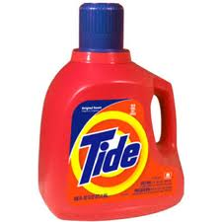
Product Position Samples
Tide: a powerful, all-purpose family detergent
Ivory: the gentle detergent for fine washables and baby clothes.
Subway restaurants: eat fresh

Slide 7
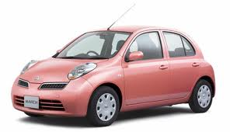
Product Position Samples
Nissan March and Honda Jazz: economy
Mercedes and Cadillac: luxury

Slide 8
Product Position Samples
Porsche and BMW: performance
Volvo: safety

Slide 9
Product Position Samples
Toyota’s fuel-efficient
Hybrid Prius: high-tech solution to the energy shortage

Slide 10
Product Position
Consumers position products with or without the help of marketers.
Marketers must…
Plan positions that will give their products the greatest advantage in selected target markets
Design marketing mixes (4Ps) to create these planned positions.

Slide 11
Physical Positioning
Physical positioning analysis can provide useful information in the early stages of identifying and designing new product offerings.
Based primarily on technical rather than on market data
Physical comparisons can be an essential step in undertaking a positioning analysis.

Slide 12
Physical Positioning
Limitations
A comparison of the physical dimensions does not provide a complete picture of relative positions.
Customers’ attitudes toward a product are often based on social or psychological attributes not amenable to objective comparison.
Consequently, perceptual positioning analysis is critically important.

Slide 13
Positioning Maps
Perceptual positioning maps show consumer perceptions of their brands versus competing products on important buying dimensions.
Important buying dimension:
Price
Quality
Service environment/ location
Choice of products/services
Etc.

Slide 14
Perceptual Positioning
Consumers often know very little about the essential physical attributes of the brands they buy.
The same is true for many services.
Even if they did, they might not understand the physical attributes well enough to use them as a basis for choosing between competitive offerings.

Slide 15
Perceptual Positioning
A consumer can typically evaluate a product better on the basis of benefits it provides.
The evaluation of many goods and services is subjective.

Slide 16
Positioning Map “U.S. Large Luxury Sport Utility Vehicle Market”
*Location of each circle shows where consumers position a brand on two dimensions: price and luxury-performance orientation.
*Size for each circle indicates the brand’s relative market share in the segment.
160
Escalade
Escalade ESV
120
Hummer H1
Hummer H2
Price (thousands of $)
Infiniti QX56
Range Rover
Lexus LX470
80
Navigator
Land Cruiser
40
luxury
Performance
Orientation

Slide 17
Choosing a Differentiation and Positioning Strategy
A brand’s positioning must serve the needs and preferences of well-defined target markets.

Slide 18
Choosing a Differentiation and Positioning Strategy
3 steps of differentiation and positioning task:
Identifying a set of differentiating competitive advantages upon which to build a position
Choosing the right competitive advantages
Selecting an overall positioning strategy
Then the company must effectively communicate and deliver the chosen position to the market.

Slide 19
1) Identifying Possible Value Differences and Competitive Advantages
Competitive Advantage: an advantage over competitors gained by offering greater customer value, either through lower prices or by providing more benefits that justify higher prices.

Slide 20
1) Identifying Possible Value Differences and Competitive Advantages
To find points of differentiation, marketers must think through the customer’s entire experience with the company’s product or service.
It can differentiate along the line of product, services, channels, people, or image.

Slide 21
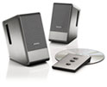
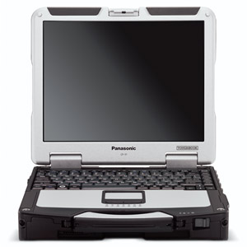
Product Differentiation
Brands can be differentiated on features, performance, or style and design.
Bose positions its speakers on the striking design and sound characteristics.
Panasonic positions its Toughbook PCs, designed to stand up to rugged use on the road or in the field, as “durable, reliable, wireless—protect your work no matter where you work.”

Slide 22
Service Differentiation
Some companies gain service differentiation through speedy, convenient, or careful delivery.
TD Bank has positioned itself as “the most convenient bank in America”—it remains access to the bank 24 hours a day, 7 days a week.

Slide 23
Channel Differentiation
Firms that practice channel differentiation gain competitive advantage through the way they design their channel’s coverage, expertise, and performance.
Amazon.com and GEICO set themselves apart with their smooth functioning direct channels.

Slide 24
People Differentiation
Companies can hire and train better people than their competitors do. People differentiation requires company select its customer-contact people carefully and train them well.
Singapore Airlines has an excellent reputation, largely because of the grace of its flight attendants.

Slide 25
Image Differentiation
A company brand image should convey the product’s distinctive benefits and positioning.
Developing a strong and distinctive image cannot do overnight using a few advertisements.

Slide 26
2) Choosing the Right Competitive Advantages
How Many Differences to Promote?
Many marketers think that companies should aggressively promote only one benefit (unique selling proposition: USP) to the target market.
Buyers tend to remember number one better, esp. in this overcommunicated society.

Slide 27
2) Choosing the Right Competitive Advantages
Which Differences to Promote?
Not every difference make a good differentiator. Each difference has the potential to create company costs as well as customer benefits.

Slide 28
2) Choosing the Right Competitive Advantages
Which Differences to Promote?
A difference is worth establishing to extent that it satisfies the following criteria:
Important: the difference delivers a highly valued benefit to target buyers
Distinctive: competitors don’t offer the difference, or company can offer it in a more distinctive way.
Superior: the difference is superior to other ways that customers might obtain the same benefit.

Slide 29
2) Choosing the Right Competitive Advantages
Which Differences to Promote?
A difference is worth establishing to extent that it satisfies the following criteria:
Communicable: the difference is communicable and visible to buyers
Preemptive: competitors can’t easily copy the difference.
Affordable: Buyers can afford to pay for the difference.
Profitable: the company can introduce the difference profitably.

Slide 30
3) Selecting an Overall Positioning Strategy
Value proposition: the full positioning of a brand—the full mix of benefits upon which it is positioned.
It is the answer to the customer’s question “why should I buy your brand?”
Volvo’s value proposition: safety also include reliability, roominess, and styling, all for a price that is higher than average but seems fair for this mix of benefits.

Slide 31
Developing a Positioning Statement
Positioning statement:
A statement that summarizes company or brand positioning—it takes this form: To (target segment and need) our (brand) is (concept) that (point-of-difference).

Slide 32
Developing a Positioning Statement
Positioning statement sample:
“To busy, mobile professionals who need to always be in the loop, Blackberry is a wireless connectivity solution that gives you an easier, more reliable way to stay connected to data, people, and resources while on the go.”
State the product’s membership in a category
Show its point of difference from other members of the category

Slide 33
Communicating and Delivering the Chosen Position
Positioning the company calls for concrete action, not just talk. If the company decides to build a position on better quality and service, it must deliver that position.

Slide 34
Levers Marketers Can Use to Establish Brand Positioning
Marketing decision makers seek to endow their brand with various kinds of attributes:
Simple physically based attributes.
Complex physically based attributes.
Essentially abstract attributes.
Price.
Perceptual attributes must be considered in positioning most products.

Slide 35
The Brand Positioning Process
Step 1: Identify a relevant set of competitive products
A positioning analysis at the product or brand level can be helpful.
Marketers who omit important substitute products or potential competitors risk being blindsided by unforeseen competition.

Slide 36
The Brand Positioning Process
Step 2: Identify determinant attributes
Positioning can be based on a variety of attributes:
Features, benefits, parentage, manufacturing process, ingredients, endorsements, comparison with a competitor’s product, proenvironment positioning, and price/quality.
Marketers should rely primarily on determinant attributes.

Slide 37
The Brand Positioning Process
Step 3: Collect data about customers’ perceptions for brands in the competitive set
The marketer needs to know what attributes are determinant for the target market and the product category under consideration.
The marketer also needs to know how different brands in the competitive set are viewed on these attributes.

Slide 38
The Brand Positioning Process
Step 4: Analyze the current positions of products in the competitive set
The positioning grid, also called a perceptual map provides a visual representation of the positions of various products or brands in the competitive set in terms of two determinant attributes.
Value curve comprises more than just two dimensions.

Slide 39
The Brand Positioning Process
Building a positioning grid
Positioning for a new store could be done by examining the positioning map for empty spaces (competitive gaps) where no existing store is currently located .
Building a value curve
Value curves indicate how products within a category compare in terms of the level—high or low.
Value curves are more multidimensional

Slide 40
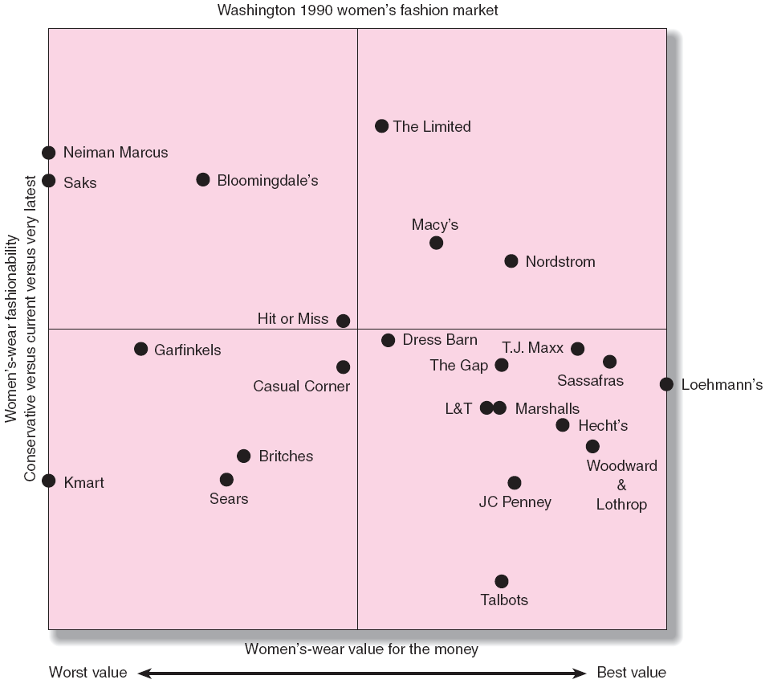
Perceptual Map of Women’s Clothing Retailers in Washington, D.C.

Slide 41
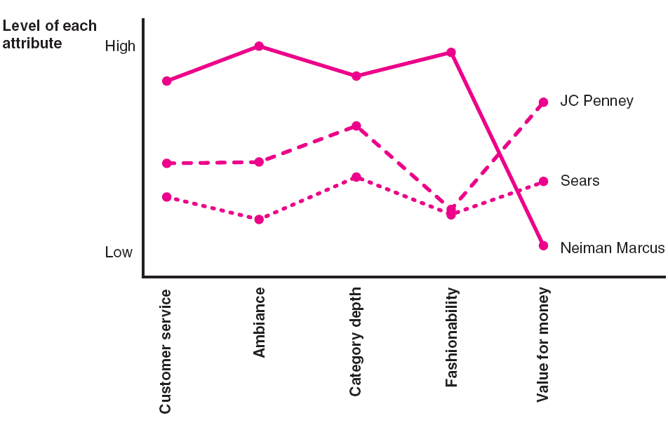
Value Curves for Neiman Marcus, JC Penney, and Sears

Slide 42
The Brand Positioning Process
Marketing opportunities to gain a distinct position
Competing head-on against the leaders on the basis of attributes appropriated by larger competitors is not likely to be effective.
A better option is to concentrate on an attribute prized by members of a given market segment.

Slide 43
The Brand Positioning Process
Constraints imposed by an intense position
Threat of alienating part or all of the product’s current users regardless of success with its newly targeted group.
Dilution of an existing intense position as a result of consolidation.
Temptation to overexploit the position by using the brand name on line extensions and new products.

Slide 44
The Brand Positioning Process
Limitations of product positioning analysis
It does not tell the marketer which positions are most appealing to customers.
There is no way to determine if there is a market for a new brand or store.
To solve such problems it is necessary to measure customers’ preferences and locate them in the product space along with their perceptions of the positions of existing brands.
This is called a market positioning analysis.

Slide 45
The Brand Positioning Process
Step 5: Determine customers’ most preferred combination of attributes
Survey respondents can be asked to think of the ideal brand within a category.
Respondents could be asked not only to judge the degree of similarity among pairs of existing brands but also to indicate their degree of preference for each.
Conjoint analysis

Slide 46
The Brand Positioning Process
Step 6: Consider fit of possible positions with customer needs and segment attractiveness
A market positioning analysis can simultaneously identify distinct market segments as well as the perceived positions of different brands.

Slide 47
The Brand Positioning Process
By examining the preferences of customers in different segments along with their perceptions of the positions of existing brands, analysts can learn much about:
The competitive strength of different brands in different segments.
The intensity of the rivalry between brands in a given segment.
The opportunities for gaining a differentiated position within a specific target segment.

Slide 48
The Brand Positioning Process
Step 7: Write positioning statement or value proposition to guide development of marketing strategy
A positioning statement identifies the target market for which the product is intended and the product category in which it competes and states the unique benefit.
A value proposition is similarly explicit about what the product does for the customer and typically also includes information about pricing relative to competitors.

Slide 49
The Brand Positioning Process
Both positioning statements and value propositions should generally reflect a unique selling proposition (USP) that the product embodies.
In its shortest form, a value proposition typically looks like this:
Target market
Benefits offered (and not offered)
Price range (relative to competitors)

Slide 50
The Brand Positioning Process
Positioning statement or value proposition should state benefits that the user of the product will obtain, rather than features or attributes of the product itself.
Typically not written in catchy consumer language.

Slide 51
The Outcome of Effective Positioning: Building Brand Equity
Brand equity reflects how consumers feel, think, and act toward the brand.
When companies create differences between their brands and other brands, differences that consumers view as meaningful, brand equity is the result.

Slide 52
The Outcome of Effective Positioning: Building Brand Equity
Managing brand equity
Brand reinforcement
Brand revitalization
The emergence of new competitors or changes in consumer tastes and preferences can affect a brand’s fortunes.
Brand positioning is an ongoing, never-ending process.

Slide 53
Some Caveats In Positioning Decision Making
Marketing strategists should focus their efforts on delivering the benefits that matter most to the target customer.
For customers, it’s the benefits that matter.

Slide 54
Take-Aways
Clear and distinctive positioning that differentiates a brand from others with which it competes is usually essential for developing a winning marketing strategy.
The positioning process outlined in this chapter helps decision makers choose a position that maximizes their chance of establishing sustainable competitive advantage.

Slide 55
Take-Aways
Distinctive and intense positioning is best accomplished when based on one or at most two attributes. More are likely to be confusing to customers.
Writing clear and succinct positioning statements or value propositions can play an important role in ensuring effective development and execution of a marketing strategy.

Slide 56
Take-Aways
Effective brand positioning decisions establish the foundation upon which successful marketing strategies and programs are built, thereby setting the stage for the creation of brand equity.

Slide 57
Please Ask Questions !
Contact: Room No. 417
Mail: umashankar.singh@ishik.edu.iq
umabrain@gmail.com
…….Thank You…….

