Slide 1

Chapter 8
Motivation-From Concept to Application
Dr. Mohsin Uddin
Department of Accounting
Faculty of Economics and Administrative Sciences
Ishik University, Erbil

Slide 2
After studying this chapter, you should be able to:
Describe the way in which employees can be motivated by changing their work environment.
Compare and contrast the three main ways jobs can be redesigned.
Give examples of employee involvement measures and how they can motivate employees.
Describe the four major strategic rewards decisions.
Demonstrate how the different types of variable-pay programs can increase employee motivation.

Slide 3

Motivating by Changing the Work Environment
The Job Characteristics Model - jobs are described in terms of five core dimensions:
  Skill variety
  Task identity
  Task significance
  Autonomy
  Feedback

Slide 4
MOTIVATION – FROM CONCEPTS TO APPLICATIONS
Skill variety: The degree to which a job requires a variety of different activities.
Example: The work of a garage owner-operator who does electrical repairs, rebuilds engines, does bodywork, and interacts with customers scores high on skill variety.
The job of a bodyshop worker who sprays paint 8 hours a day scores high on skill variety.

Slide 5
Task identity: The degree to which a job requires completion of a whole and recognizable piece of work.
Example: A cabinet maker/carpenter who designs a piece of furniture, selects the wood, builds the object, and finishes it to perfection – high task identity. Only making the legs of the table- low task identity.

Slide 6
Task significance: The degree to which a job has a important impact on the lives or work of other people. Example: A nurse in an I.C.U. score high on task significance.

Slide 7
Autonomy: The degree/step to which a job provides significant freedom and pleasure to the individual in scheduling the work and in determining the procedures to be used in carrying it out.
Autonomy in the workplace refers to how much freedom employees have while working.
For some organizations, autonomy means employees are allowed to set their own schedules.

Slide 8
Feedback : The degree/step to which carrying out the work activities required by a job results in the individual obtaining direct and clear information about the effectiveness of his or her performance.
The degree to which the employees work receives direct feedback on their performance. Employees need feedback (both positive and negative) in order to stay motivated.

Slide 9
The Job Characteristics Model

Slide 10

Job Characteristics Model(JCM) : Designing
Motivational Jobs
JCM-designed jobs give internal rewards
Individual’s growth needs are moderating factors
Motivating jobs must be:
  Autonomous
  Provide feedback, and
  Have at least one of the three significance factors

Slide 11
How Can Jobs be Redesigned?
Job Rotation
  The periodic shifting of an employee from one task to another
Job Enlargement
  Increasing the number and variety of tasks
Job Enrichment
  Increasing the degree to which the worker controls the planning, execution and evaluation of the work

Slide 12
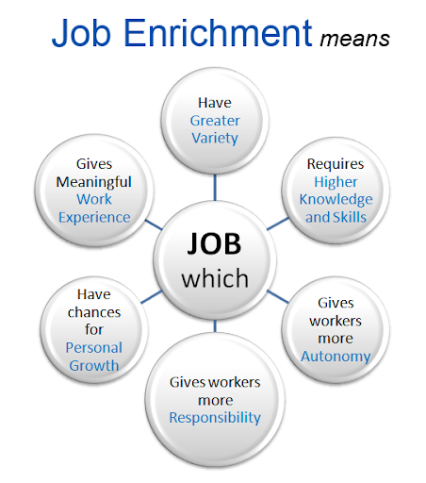

Slide 13
Job Enrichment
Managers can provide employees with greater opportunities to exercise preference by making the following changes:
  Direct feedback
  New learning
  Uniqueness
  Control over resources
  Personal accountability

Slide 14
Benefits of an enriched jobs Effects of job enrichment
Less employee errors
Less employee overload
More employee creativity
Growth of the individual
Individuals have better job satisfaction
Self-actualization of the individual

Slide 15
Better employee performance for the organization
Organization gets intrinsically motivated employees
Less absenteeism, and grievances for the organization
Full use of human resources for society
Society gains more effective organizations

Slide 16
Guidelines for Enriching a Job Using JCM

Slide 17

Alternate Work Arrangements
Flextime
  Some discretion(Option) over when worker starts and leaves
Job Sharing
  Two or more individuals split a traditional job
Telecommuting (Homeworking)
  Work remotely at least two days per week

Slide 18

Employee Involvement
A participative process that uses the input of employees to increase their commitment to the organization’s success
Two types:
Participative Management
Representative Participation

Slide 19
Participative Management
Subordinates share a significant degree of decision-making power with superiors
Required conditions:
  Issues must be relevant
  Employees must be competent and knowledgeable
  All parties must act in good faith
Only a modest influence on productivity, motivation, and job satisfaction

Slide 20
Representative Participation
Workers are represented by a small group of employees who participate in decisions affecting personnel
  Works Councils
  Board membership
Desires to redistribute/reallocate power within an organization
Does not appear to be very motivational

Slide 21

Rewarding Employees
Major strategic rewards decisions:
  What to pay employees
  How to pay individual employees
  What benefits to offer
  How to construct employee
  recognition programs

Slide 22
1. What to Pay
Need to establish a pay structure
Balance between:
  Internal equity – the worth of the job to the organization
  External equity – the external competitiveness of an organization’s pay relative to pay elsewhere in its industry
A strategic decision with trade-offs(a compromise)

Slide 23
2. How to Pay:
Variable-Pay Programs
Bases a portion of the pay on a given measure of performance
  Piece-Rate Pay – workers are paid a fixed sum for each unit of production completed
  Merit-Based Pay – pay is based on individual performance assessment ratings
  Bonuses – rewards employees for recent performance
  Skill-Based Pay – pay is based on skills acquired instead of job title or rank – doesn’t address the level of performance

Slide 24
More Variable Pay Programs
Profit-Sharing Plans – organization-wide programs that distribute compensation based on an established formula designed around profitability
Gainsharing – compensation based on sharing of gains from improved productivity

Slide 25

What Benefit to Offer:
Flexible Benefits
Each employee creates a benefit package tailored to their own needs and situation
  Modular plans – predesigned packages to meet the needs of a specific group
  Core-plus plans – core of essential benefits and menu of options to choose from
  Flexible spending plans – full choice from menu of options

Slide 26

How to Recognize Them: Employee Recognition Programs
In addition to pay there are intrinsic rewards
  Can be as simple as a spontaneous comment
  Can be formalized in a program
Recognition is the most powerful workplace motivator – and the least expensive!

Slide 27
Implications for Managers
Recognize and allow for individual differences
Use specific goals and feedback
Allow employees to participate in decisions that affect them
Link rewards to performance
Check the reward system for equity

Slide 28
Keep in Mind…
Variable-pay plans can enhance motivation

