Slide 1
National Income Concept
and
Measurement
Week -12
Prepared by: Dr Waqar Ahmad, Asstt. Prof.

Slide 7
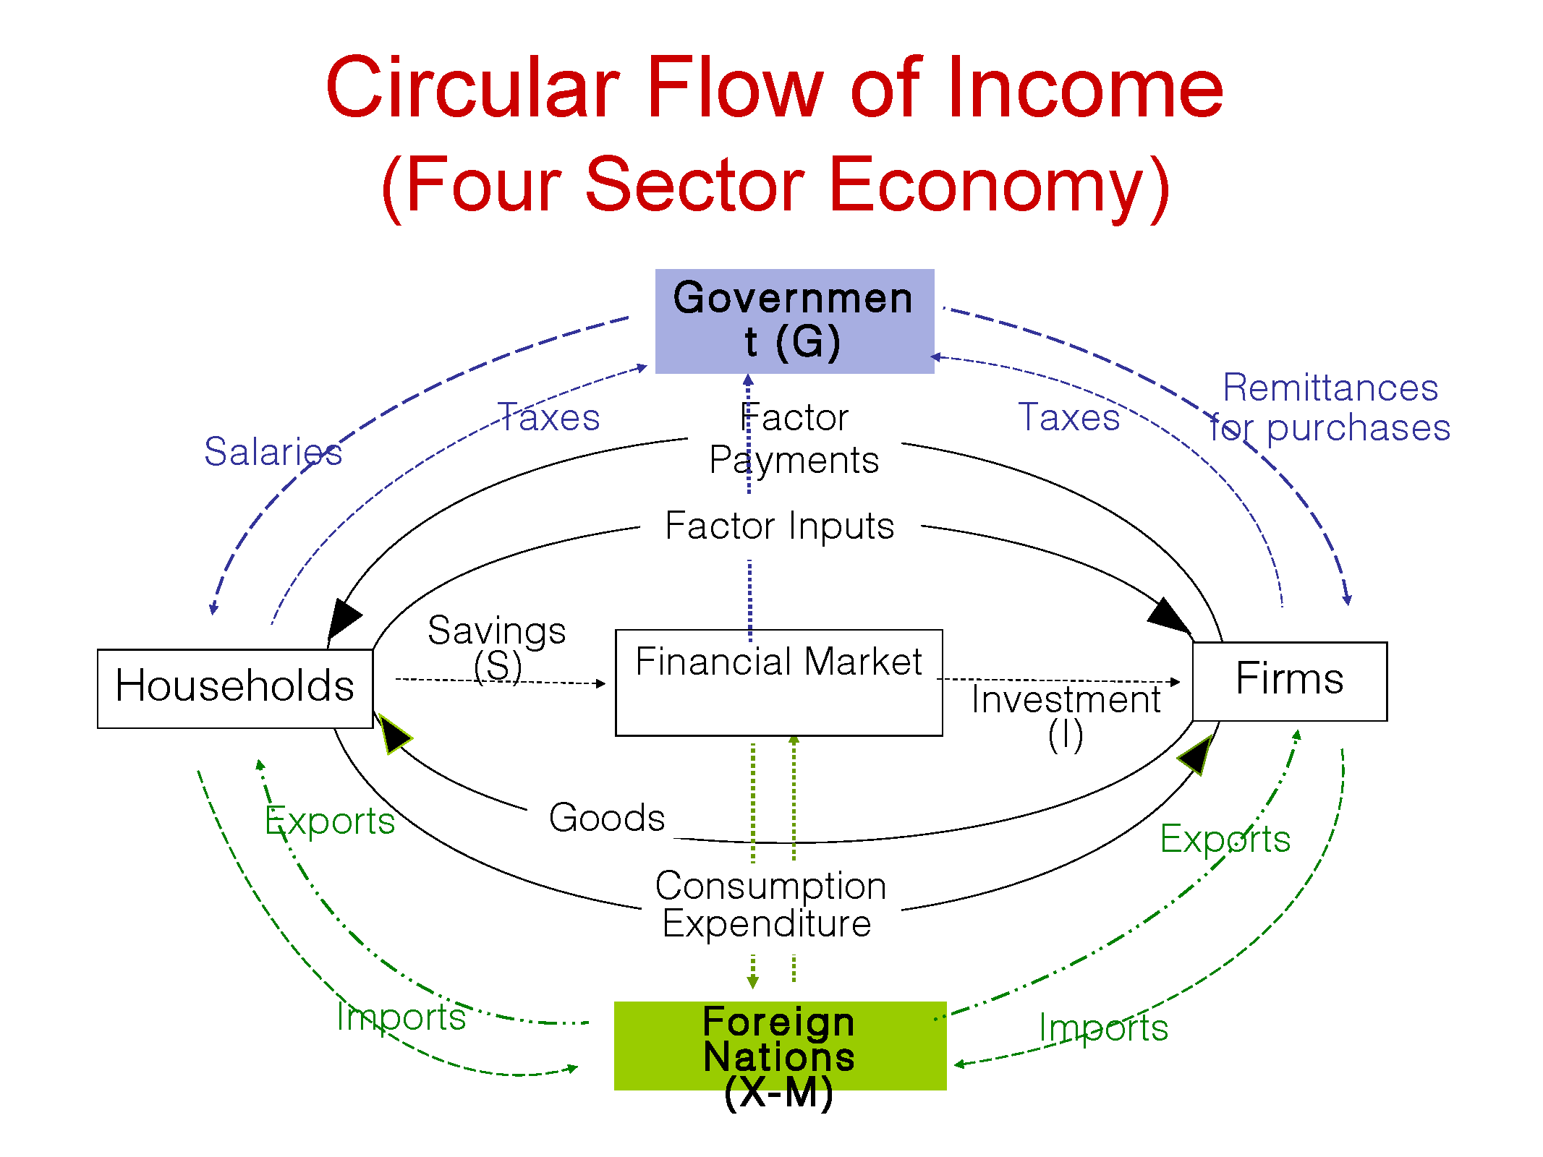

Slide 38
Thank you

