Slide 1

Chapter-6
Brand & Branding and Dealing with competitions
Dr. Mohsin Uddin
Department of Accounting
Faculty of Economics and Administrative Sciences
Ishik University, Erbil

Slide 2
Objectives
To explain the value of branding
To understand brand loyalty
To analyze the major components of brand equity
To recognize the types of brands and their benefits
To understand competitions

Slide 3
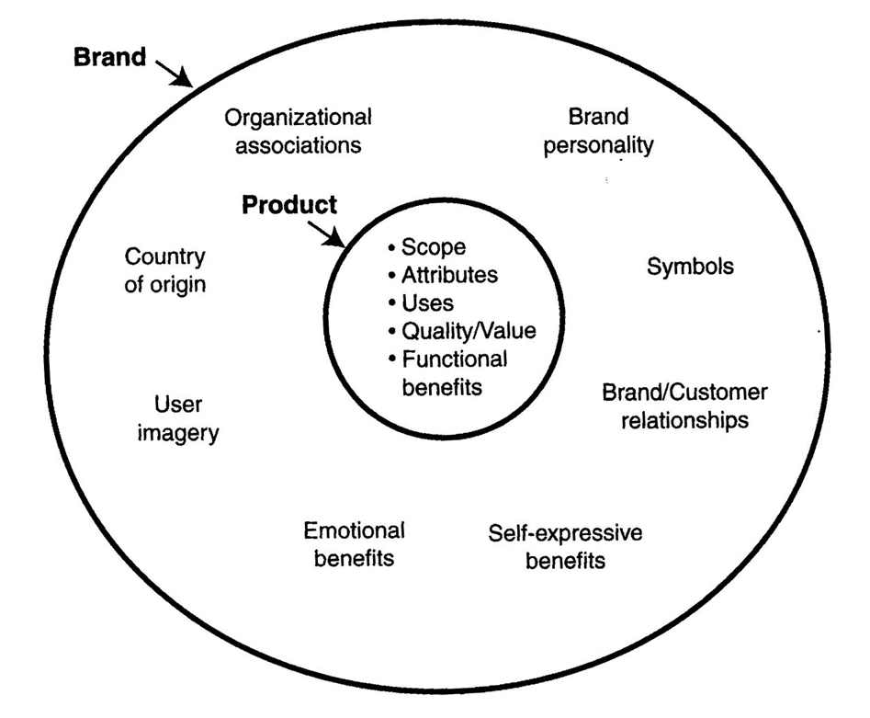
Brand is not just a product

Slide 4
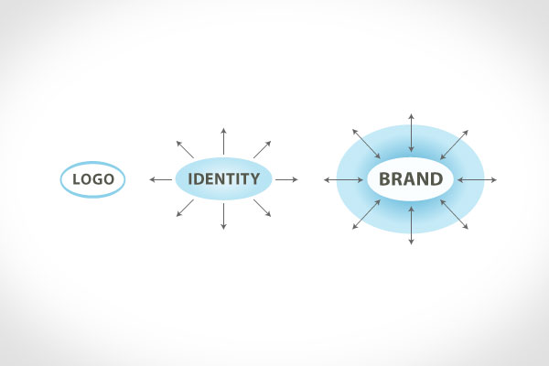
Brand is not just a logo nor identity

Slide 5
What’s brand?
Activity: Who are you?
Describe yourself by:
          Kind of food
          Home appliance
          Car
          Sport

Slide 6
Brand Architecture:
Corporate Brand
Product Brand: Pros/Cons
Family Brand (Umbrella Brand).
Unilever
Vodafone
Coca cola
Dove
Chipsy
Apple
Automotive industry.
Lipton
Johnson & Johnson
Starbucks
Fedx
Facebook

Slide 7
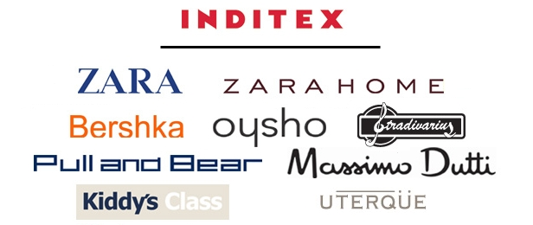
Brand Architecture:

Slide 8
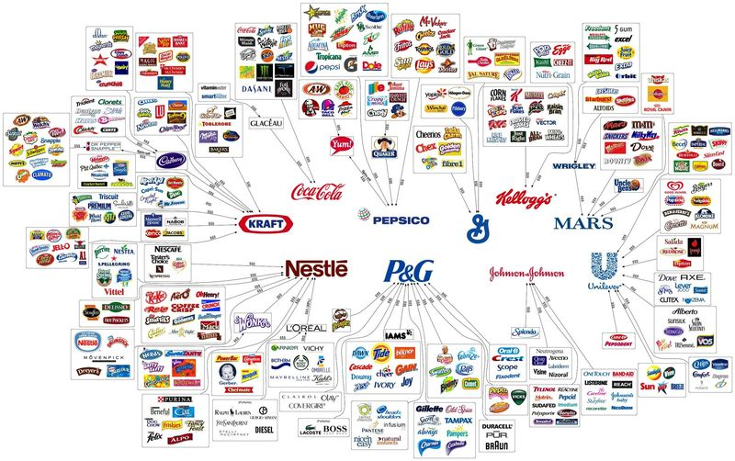
Brand Architecture:

Slide 9

What’s branding?
It’s the marketing practice of creating a name, symbol or design that identifies and differentiates a product from other products.
“Branding is the art of line up what you want people to think about your company with what people actually think about your company.”

Slide 10
Branding: Key Terms
Brand
  An identifying name, term, design, or symbol
  One item, family of items, or all items of a seller
    General Motors
Brand Name
  The part of a brand that can be spoken
  Words, letters, numbers
    Union 76, 49’ers
Brand Mark
  The part of a brand not made up of words
  Symbols or designs
    Mercedes star, McDonald’s arches

Slide 11
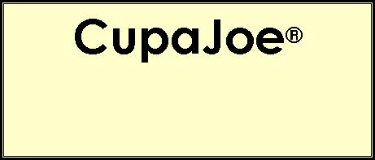
Branding
Trademark
  A legal designation of exclusive use of a brand
    Coca-Cola®
Trade Name
  Full legal name of
  an organization
    American Telephone
    and Telegraph Corporation
    (AT&T)

Slide 12

Types of Brands
Manufacturer Brands
  Brands initiated by producers
Private Distributor Brands
  Brands initiated and owned by resellers
    Dealer brands, private
    brands, store brands
Generic Brands
  Brands indicating only
  the product category

Slide 13
Selecting a Brand Name
The name should
  be easy to say, spell, and recall.
  indicate the product’s major benefits.
  suggest the product’s major uses and special characteristics.
  be distinctive, setting it apart
  from competing brands.
  be compatible with all products
  in line.
  be designed for use and recognition
  in all types of media.

Slide 14
Protecting a Brand
Degree of brand protection through registration
  Fanciful
  Arbitrary
  Suggestive
  Descriptive
  Generic
Surnames and descriptive, geographic, or functional names are also difficult to protect.
Registration with the U.S. Patent and Trademark Office protects a brand for ten years with indefinite renewals.
Most
Least

Slide 15
Branding Policies
Individual Branding
  A policy of naming each product differently
  Avoids stigmatizing all products due to a failed product
Family Branding
  Branding all of a firm’s products with the same name
  Promotion of one item also promotes all other products

Slide 16
Co-Branding
Using two or more brands on one product to capitalize on the brand equity (customer confidence and trust) of multiple brands
Brands involved must represent a complementary fit in the minds of consumers.
Helps differentiate a firm’s product from those of its competitors
Helps take advantage of distribution capabilities of co-branding partners

Slide 17

Branding vs marketing
Marketing may contribute to a brand, but the brand is bigger than any particular marketing effort.
The brand is ultimately what determines if you will become a loyal customer or not.
The marketing may convince you to buy a particular Toyota, but it is the brand that will determine if you will only buy Toyotas for the rest of your life.

Slide 18

Branding vs Marketing
Is branding a cost centre ?
On the surface, yes, but the return is loyalty.
The return is
-Sales people whose jobs are easier and more effective,
-Employees who stay longer and work harder,
-Customers who become ambassadors and advocates for the organization.

Slide 19

How to create a brand name?
DIFFERENTIATED
MEANINGFUL
DURABILITY
IMAGERY
EMOTIONAL
MUSICAL
TRADEMARK-ABLE

Slide 20
Domestic/ Honest/ Genuine/ Cheerful
Brand Personality
Sincerity
Excitement
Competence
Sophistication
Ruggedness
Tough/ Strong/ Outdoorsy
Daring/ Spirited/ Imaginative/
Up-to-date
Glamorous/ Presentation/ Charming/ Romantic
Reliable/ Responsible/ Dependable/ Efficient

Slide 21
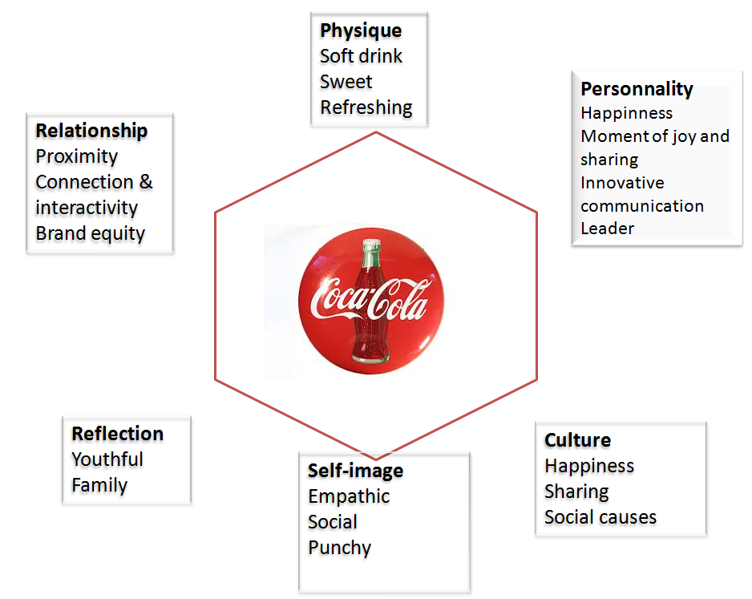

Slide 22
Product attribute fixation
A brand is clearly more than a product or a service. Focusing your entire strategy and brand identity on the attributes of your product is an erroneous strategy, especially on a long-term.
Complications:
Failure to differentiate
Easy to copy
Assume a normal consumer
Limit brand extension strategies.
Notes:
Most of the brand strategists position the brand identity creation as an entirely external oriented process, something that gets the customers to buy. The external perspective trap occurs when firms fail to realize the role that a brand identity can play in helping an organization understand its basic values and purpose.t is hard to expect employees to make a vision happen if they do not understand and buy into that vision.

Slide 23
Brands Model:
Bonding
Advantage
Performance
Relevance
Presence
Nothing else beats it?
Can it offer something better than others?
Can it deliver?
Does it offer something to me?
Do you know about it?

Slide 24
Brand as a product
Perspective | Description
Product Scope | - Associations with product class: - With what product(s) the brand is associated? Baskin Robbins → Ice Cream Compaq → Computers HP Jet line → Printers (ink jet, laser jet)
Product Attributes | - Functional/Emotional Benefits - A product related attribute can create a value proposition by offering something extra (like features or services) or better
Quality / Value | Value is closely related to quality; it enriches the concept by adding the price dimension.

Slide 25
Brand as an organization
It focuses on attributes of the organization rather than those of the product or the service such as:
            Innovation
            Drive for quality
            Concern for the environment
            Culture
            Values
            Programs of the company
            Vision
            Global Vs. Local
Organizational attributes usually apply to set of products not only one product, so that if any competitor can compete to one product will not be able to compete to the organizational attributes

Slide 26
Brand as a person: brand personality
A brand can be perceived as being competent, impressive, trustworthy, fun, active, humorous, casual, formal, youthful or intellectual.
Brand personality:
    Can help create self-expressive benefit that the customer can express his/her own personality through this brand
    Brand personality = the basis of a relationship between the customer and the brand
    May help communicate a product attribute and contribute to a functional benefit (Michelin man’s strong personality)

Slide 27
Brand as a symbol
Anything that represents the brand can be a symbol, including programs such as the Ronald McDonald House for McDonald’s .
Symbols involving visual imagery can be memorable and powerful:
      Nike’s “Swoosh”
      McDonald’s golden Arches
      Kodak Yellow
      Coke Classic can or bottle
  Each strong visual image captures much of its respective brand’s identity
  Connections between the symbol and the identity elements have been built up over time.

Slide 28
Brand (Name) Awareness
In the long run, a brand is nothing more than a name.
Another factor contributing to brand equity is brand awareness.
It is the ability of a potential buyer to recognize or recall that a brand is a part of a product category. The customer must be able to identify a firm's product in the retail stores or able to recall its brand whenever he thinks of a product class. It is the strength of a brand's presence in the consumer mind.

