Slide 1
International Law
Introduction to IR (IRD211)
Lecture 5
Dilshad Hamad
December 2017

Slide 2
Definition
A set of rules and regulation (both formal and informal) that regulate the conduct of states and non-state actors internationally
UN definition
International law consists of ‘conventions, treaties and standards—central to promoting economic and social development, as well as to advancing international peace and security’.

Slide 3
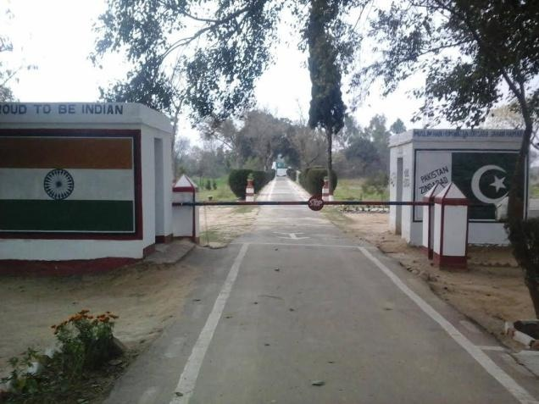
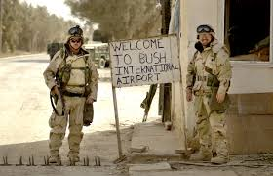

Slide 4
The scope of IL
from regulating international travel to waging wars
Regulating the international system
War and peace making
Economics, trade, market and business
Geographical borders of states, waterways, aviation and natural resources
International crime and policing

Slide 5
Subjects of IL
Each of these entities may be the subject of IL:
1- States
2- Inter-governmental Organizations
(constituted by States and have States as their
members and are based on constitutive treaty –
e.g. the United Nations)
3- The Individual
4- Multi-national Corporations

Slide 6
Sources of IL
Primary sources
1- Customary law – states follow certain practices generally and consistently out of a sense of legal obligation (Law of the Sea)
2- Conventional Law – derives from national agreements (bilateral or multilateral)
- established by
A) the United Nations
– advisory standards
(the Universal Declaration of
Human Rights)
Secondary source
– general principles common to systems of national law
B) through international treaties e.g.
- the Geneva Conventions on the conduct of war or armed conflict
- The World Health Organisation
- UNESCO
- The World Trade Organisation
- The International Monetary Fund etc.

Slide 7
Governing bodies of IL
UN bodies
ICJ
WTO
Specialized bodies:
Maritime courts
International Organizations

Slide 8
The law of peace and the law of war
The Law of Peace
regulates peaceful relations and includes such subject matters as international treaty law, the law of diplomatic and consular relations, international organisation law, the law of state responsibility, the law of the sea, the environment and outer space or international economic law.
International Humanitarian Law (IHL)
is the law of armed conflicts (jus in bellum – the law applicable in war) and regulates the conduct of international and non-international hostilities.

Slide 9
The scope of IHL
Conditions for going to war
Rules of engagement (during war)
Limited use of weapons (certain types of weapons prohibited)
Distinction between military and civilian targets
Provision of humanitarian assistance

Slide 10
Main “commercial” conventions:
CONVENTION ON THE INTERNATIONAL SALE OF GOODS (CISG)
HAGUE CONVENTIONS
NEW YORK CONVENTION
CONVENTIONS ON THE TRANSPORT OF GOODS (CMR)

Slide 11
CONVENTION ON THE INTERNATIONAL SALE OF GOODS (CISG)
DEVELOPED BY UNCITRAL
(UN Commission on International Trade Law)
HQ in Vienna, Austria
60 representatives from nations in every world region
69 COUNTRIES
2/3 of all world trade
5 continents

Slide 12
ICC INCOTERMS 2000
STANDARD CONTRACT TERMS
CREATED BY ICC IN 1936
- Amended in 1953, 1967, 1976,1980, 1990,2000, 2010
13 TERMS
4 GROUPS: C, D, E, F

Slide 13
HAGUE CONVENTIONS
SERVICE OF PROCESS
DISCOVERY
CHOICE OF COURTS AGREEMENT

Slide 14
NEW YORK CONVENTION
arbitration 1958
139 countries
(Gabon & Bahamas 3/07)
presumption of enforcement
award in country member of treaty
arbitration agreement in writing signed by the parties
authenticated original or certified copy

