Slide 1
Introduction to Economics Chapter 2: Economics and Data Analysis

Slide 2
Economics as Social Science
Economists try to understand and predict the effects of economic forces by using the scientific method first developed by physicists. The scientific method is a commonsense way of systematically checking what works and what doesn’t work.
A scientist begins with a question or a puzzle about cause and effect arising
from some observed facts. An economist might wonder why smart phones are getting cheaper and more smart phones are being used.

Slide 3
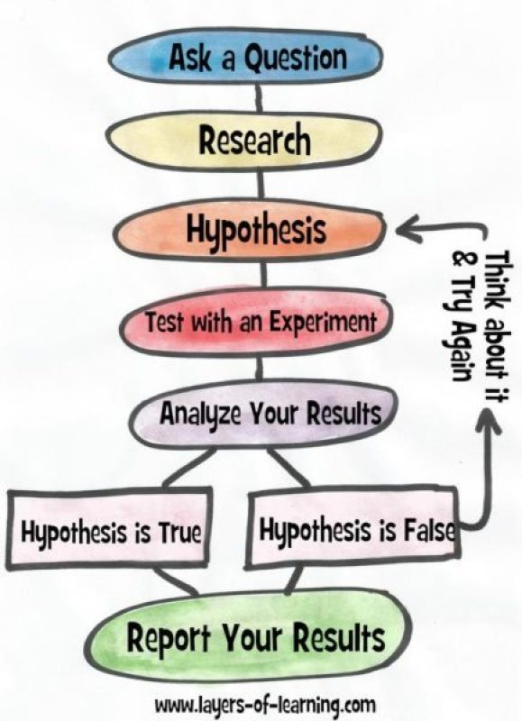

Slide 4
An economic model is a description of some feature of the economic world that includes only those features assumed necessary to explain the observed facts.
A model is analogous to a map. If you want to know about valleys and mountains, you use a physical map; if you’re studying nations, you use a political map.
Sometimes, in the natural sciences, models are physical objects such as a plastic model of an atom or DNA. But models are also mathematical and often can be visualized in graphs. So in economics we use mathematical and graph-based models.
For example: Supply and Demand model and the Production Possibilities Model

Slide 5
Check Models Against Facts
To check an economic model against the facts, economists use statistical investigations and economic experiments (they collect data).
A statistical investigation looks for a correlation—a tendency for the values of two variables to move together (either in the same direction or in opposite directions) in a predictable and related way.
For example, cigarette smoking and lung cancer are correlated. Sometimes a correlation shows a causal influence of one variable on the other. Smoking does cause lung cancer. But sometimes the direction of causation is hard to determine.

Slide 6
Data Analysis
A graph represents a quantity as a distance and enables us to visualize the relationship between two variables. To make a graph, we set two lines called axes perpendicular to each other;
The vertical line is called the y-axis;
the horizontal line is called the x-axis.
The common zero point is called the origin.

Slide 7
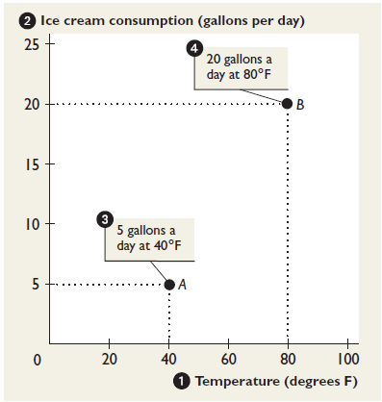

Slide 8
To make a graph, we need a value of the variable on the x-axis and a corresponding value of the variable on the y-axis.
Temperature is 40°F, ice cream consumption is 5 gallons a day at point A
If the temperature is 80°F, ice cream consumption is 20 gallons a day at point B
quantitative data on two variables.

Slide 9
Scatter diagram
A graph of the value of one variable against the value of another variable.
Figure A1.2(a and b) shows the relationship between expenditure and income.

Slide 10
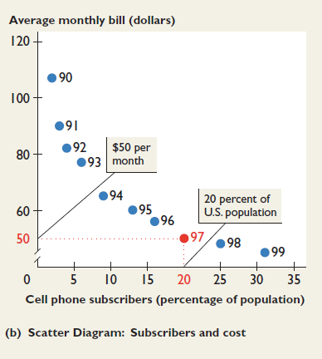
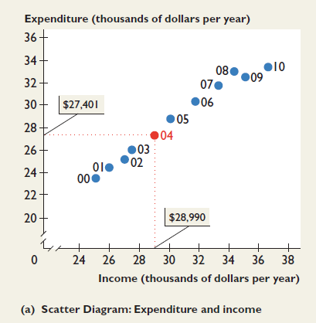

Slide 11
Time-series graph
A graph that measures time on the x-axis and the variable or variables in which we are interested on the y-axis.
A1.2(c) shows an example. In this graph, time (on the x-axis) is measured in years, which run from 1980 to 2010.

Slide 12
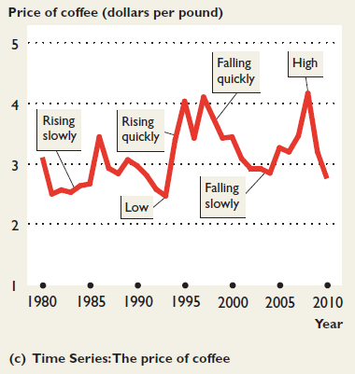

Slide 13
Cross-section graph
A graph that shows the values of an economic variable for different groups in a population at a point in time.
A1.2(d) shows the participation rate in the United States in each of ten sporting activities.

Slide 14
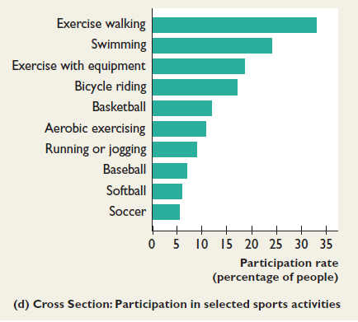

Slide 15
Interpreting Graphs
Positive relationship or direct relationship: A relationship between two variables that move in the same direction.
Linear relationship: A relationship that graphs as a straight line.

Slide 16
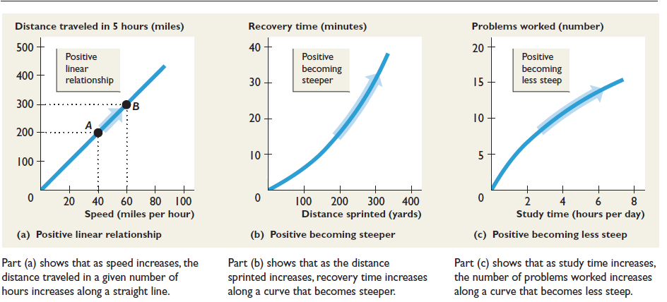

Slide 17
Negative relationship or inverse relationship
A relationship between two variables that move in opposite directions.

Slide 18
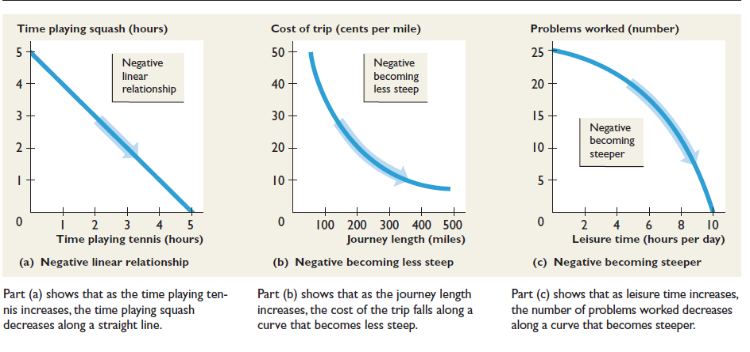

Slide 19
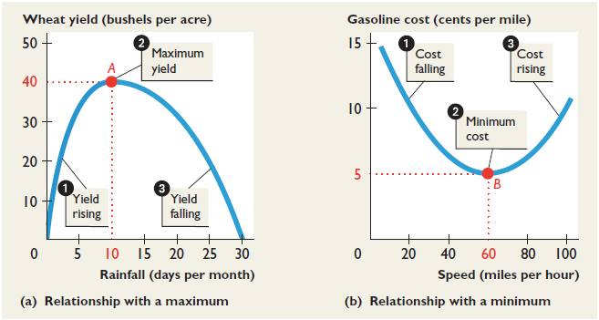
Maximum and Minimum Points

Slide 20
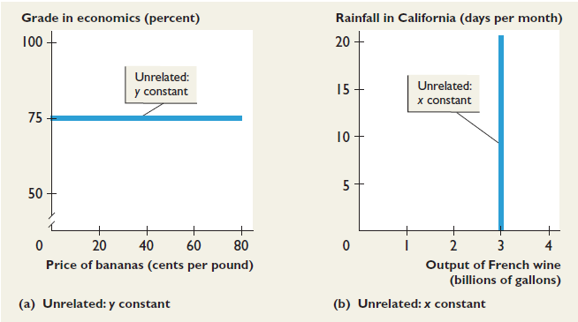
Variables That Are Unrelated

Slide 21
The Slope of a Relationship
Slope: The change in the value of the variable measured on the y-axis divided by the change in the value of the variable measured on the x-axis.
We use the Greek letter ∆ (delta) to represent “change in.” So ∆y means the change in the value of y, and ∆X means the change in the value of x.
slope = ∆Y /∆X

Slide 22
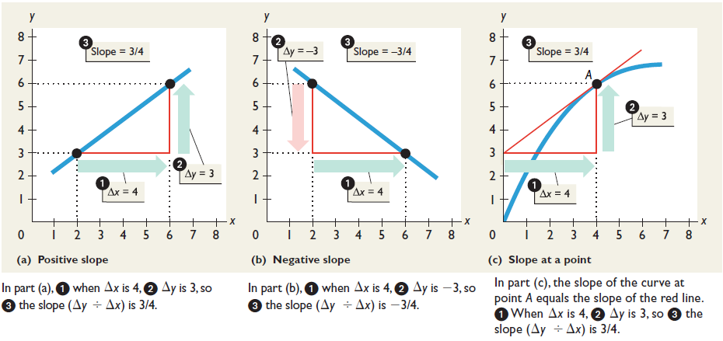

Slide 23
Question Bank
The following data shows the relationship between two variables x and y.
x 0 1 2 3 4 5
y 32 31 28 23 16 7
Is the relationship between x and y positive or negative? Calculate the slope of the relationship when x equals 2 and when x equals 4. How does the slope change as the value of x increases?

Slide 24
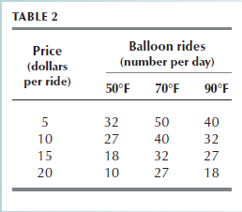
Question Bank
Table 2 provides data on the price of a balloon ride, the temperature, and the number of rides a day. Draw graphs to show the relationship between The price and the number of rides, when the temperature is 70°F. The number of rides and the temperature, when the price is $15 a ride.

