Slide 1

Chapter-5
Connecting with customers and Customers satisfaction
Dr. Mohsin Uddin
Department of Accounting
Faculty of Economics and Administrative Sciences
Ishik University, Erbil

Slide 2
Understanding
Today’s Customers
Sophisticated
Price sensitive
Demanding
Informed

Slide 3
Understanding
Today’s Customers
Organizational market
  Industry and commerce
  Resellers
  Government
Consumer market
  Individuals
  Families
  Households

Slide 4
The Consumer
Decision Process
Need recognition
Information search
Evaluation of alternatives
Purchase
Postpurchase evaluation

Slide 5
Factors That Influence the Buyer’s Decision Process
Culture
Social class
Reference groups
Self-image
Situational factors

Slide 6
Purchasing in Organizations
Decision-making factors
  Economics and logic
  Formal buying procedures
  Multi-party participation
  Buyer-seller relationship

Slide 7
Planning Marketing Strategies
Examine current marketing situation
Assess opportunities and set objectives
Develop marketing strategies

Slide 8
Examine the Current Marketing Situation
Reviewing performance
Evaluating competition
Examining strengths and weaknesses
Analyzing the external environment

Slide 9
Assess Opportunities and Set Objectives
Market penetration
New product development
Geographic expansion
Diversification

Slide 10
Develop the Marketing Strategy
Segments
Target markets
Marketing mix

Slide 11
Segmenting Markets
Demographics
Geographics
Psychographics
Geodemographics
Behavior
Usage

Slide 12
Target Market Strategies
Undifferentiated
Differentiated
Concentrated

Slide 13
Positioning the Product
Features
Services
Image
Category leadership

Slide 14
Developing the Marketing Mix
Target market
  Product
  Price
  Place
  Promotion

Slide 15
CUSTOMER LOYALTY
Customer loyalty is defined as the degree to which customers are liable to stay with one company and resist competitive offers.
Winning the new customer is costly, but keeping the existing customer is profitable. More companies have realized this fact, leading to establishment of loyalty programmes.

Slide 16
Loyalty programmes may take form of bonus points, gifts, etc. Some ways to enhance loyalty include:
1. offer guarantee for the products
2. realistic promises
3. attend to customer complaints and responding promptly
4. constantly innovate products
5. Build rapport with customers.

Slide 17
IMPORTANCE
Profit
Profit is the main motive for doing business. Customers do not mind paying more for the product that matches their needs. A loyal customer is likely to repeat purchases, recommend to others and reduces price sensitivity about the product or services.
Higher prices
Satisfied and loyal customers often are prepared to pay more price for a service or product they trust rather than making small savings by taking the risk of non-performance or decline of the product.

Slide 18
Reduction in advertising expenditure
Reduces customer complaints
Enhances firm's reputation
Increase in market share
Helps in introducing new products
Longer product life cycle

Slide 19
MARKETING ACTIVITIES OF BUILDING LOYALTY
Customer Database
Suggestion Schemes
Greeting Customers by Name
Special Gifts on Special Occasions
Premium Offers
Satisfaction Surveys

Slide 20
ACTIVITY
For your own organization or any other power utility provider that you are familiar with, identify the mechanisms which are used by connection holders to reduce the size of their bills. How do you think practices will enable you to tackle this problem?

Slide 21
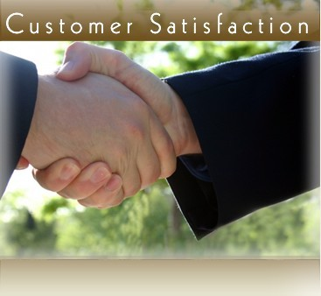

Slide 22
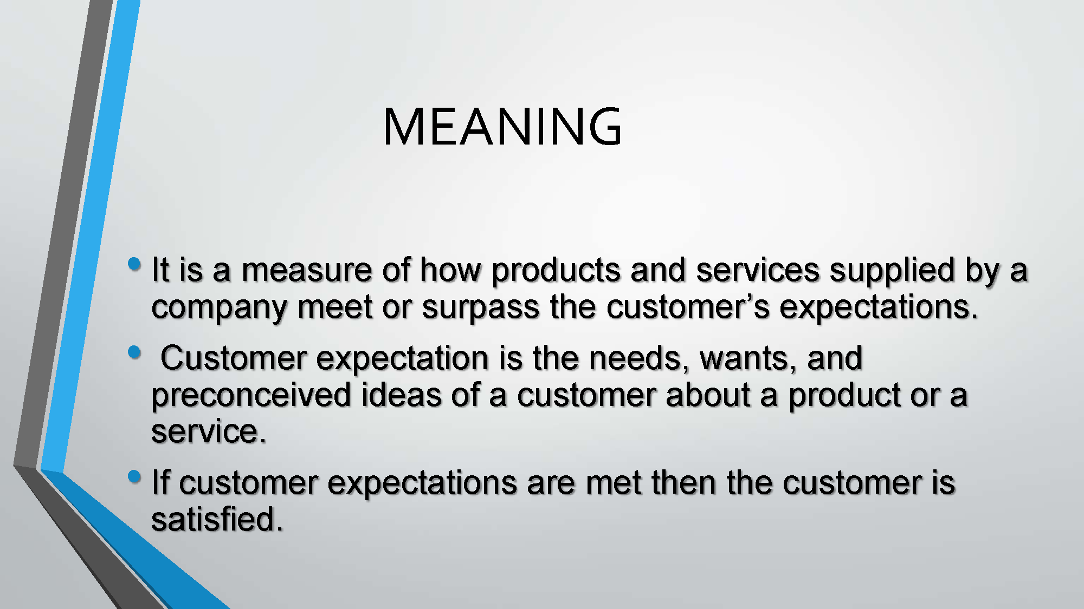

Slide 23
Who is the customer?
One who uses the product or service, the one who purchases the product or service.
Two types of customers:
Internal customers External customers
ν
ν

Slide 24
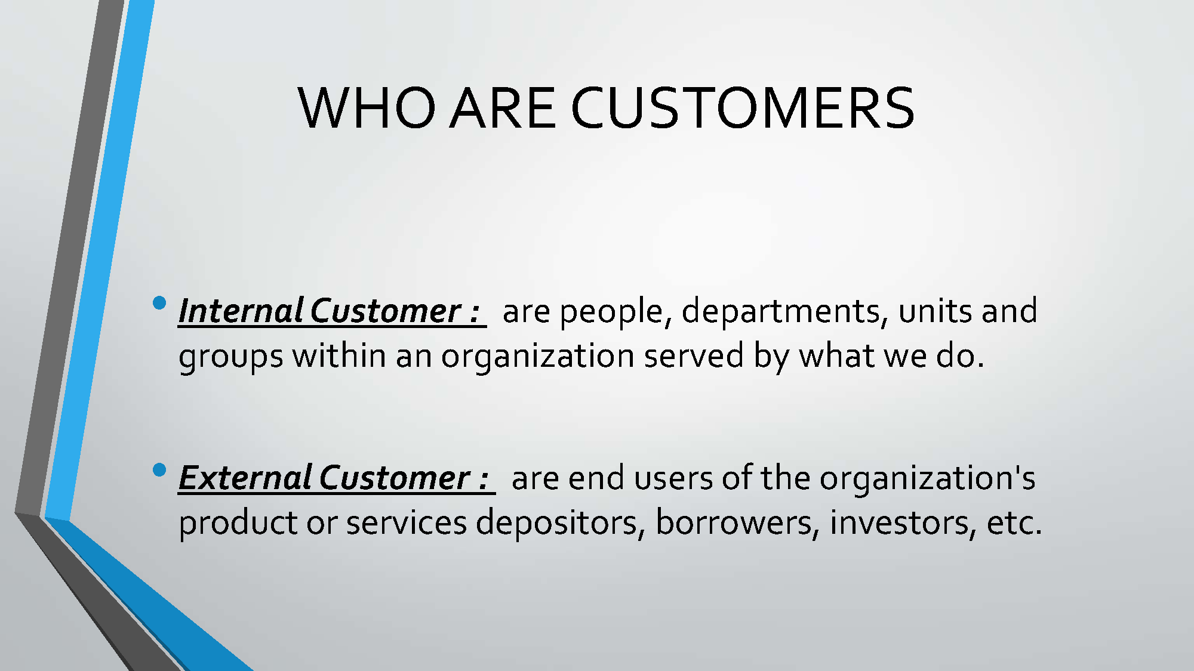

Slide 25
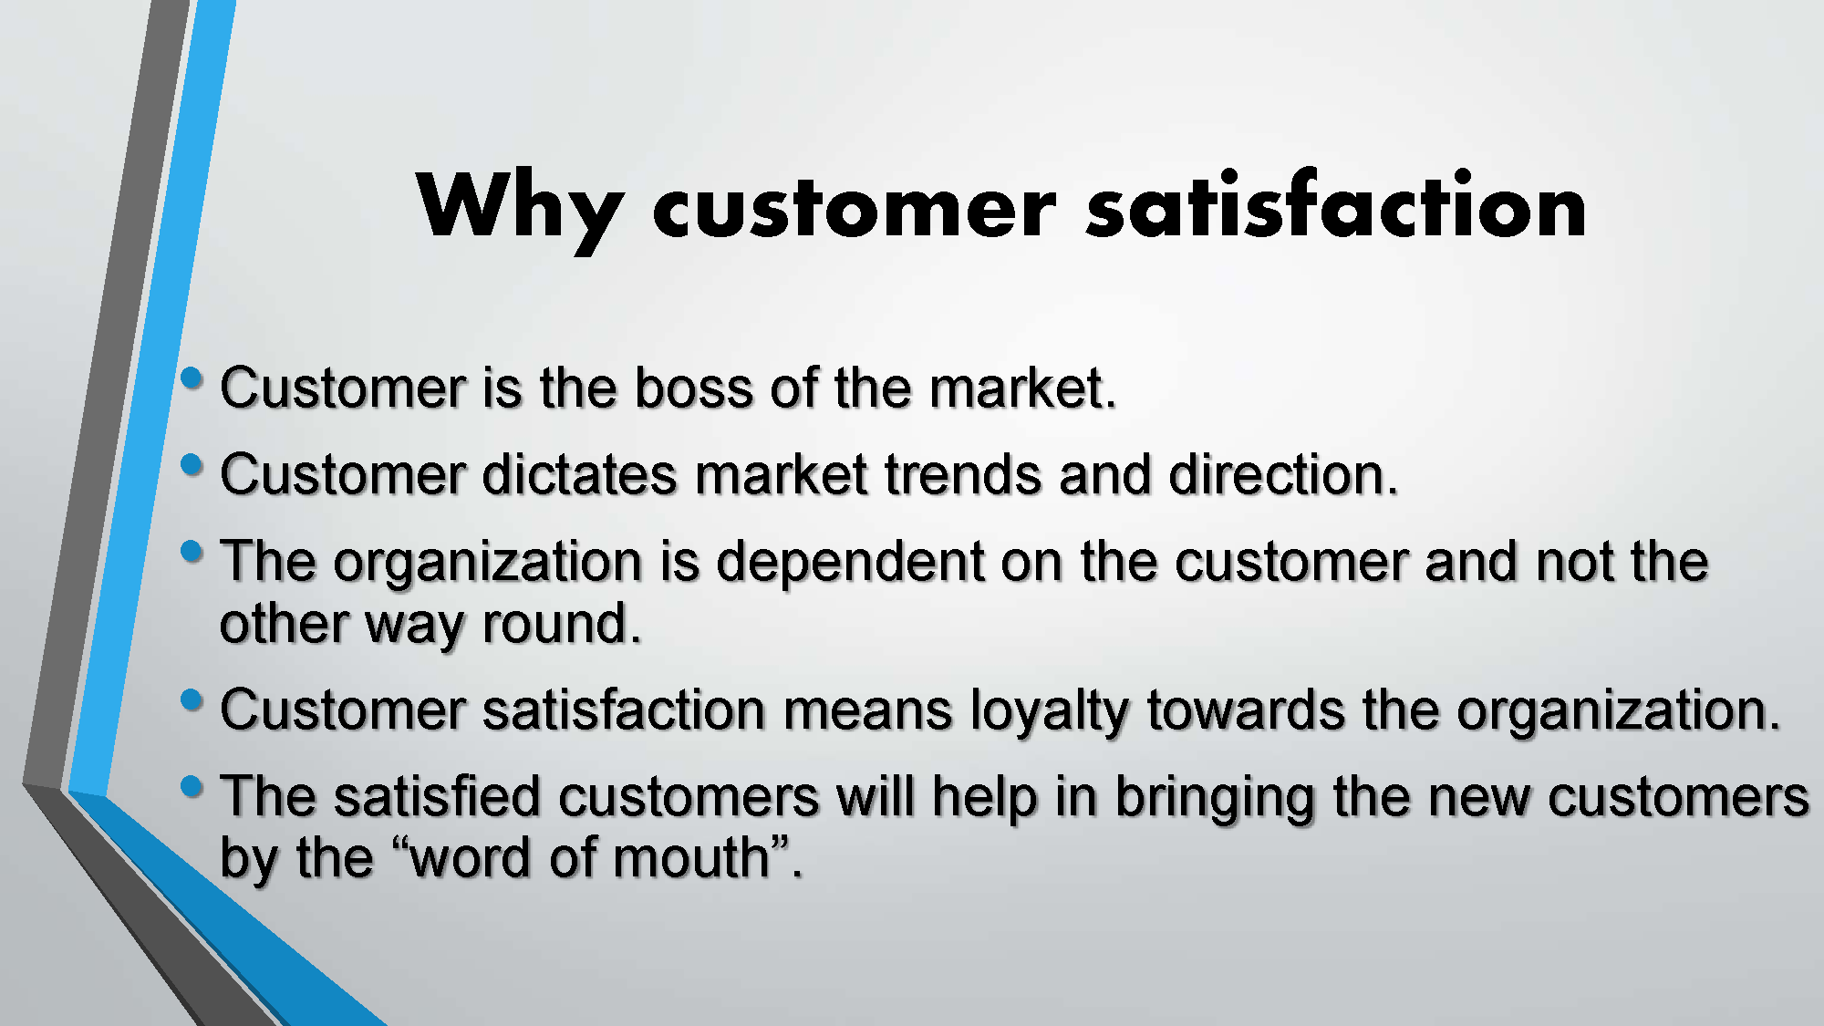

Slide 26
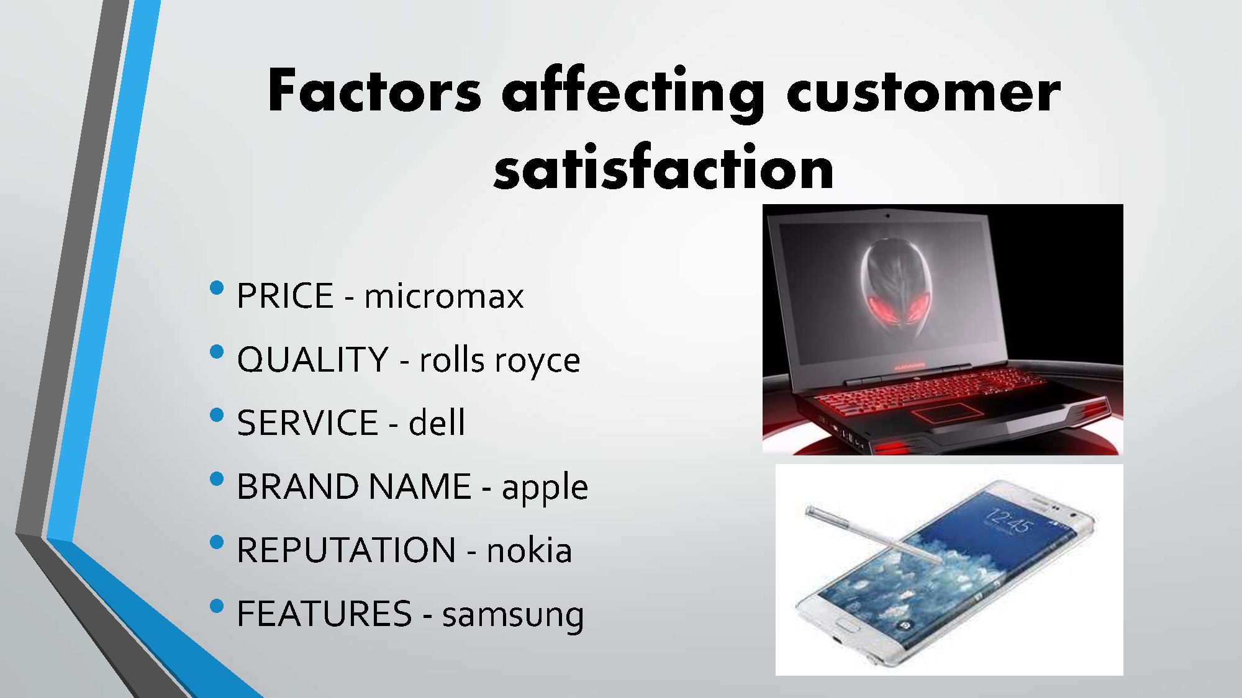

Slide 27
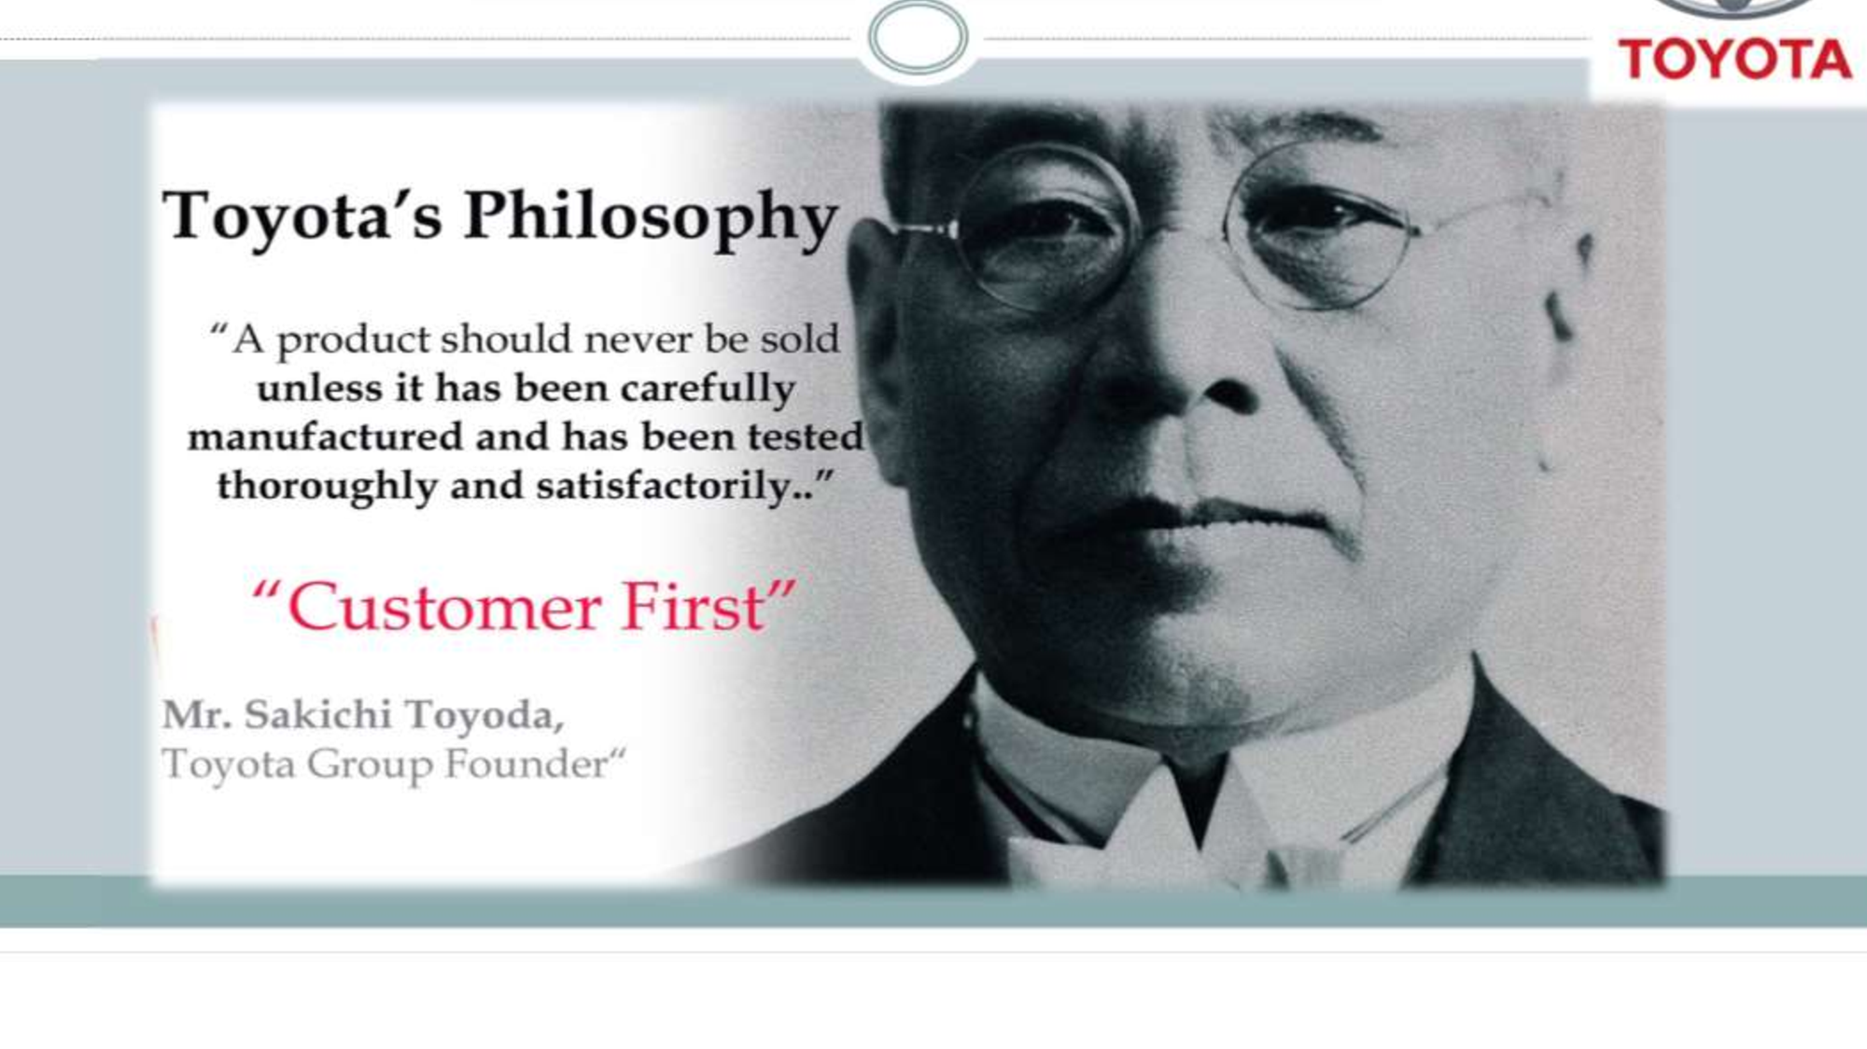

Slide 28
Customer Satisfaction
Positive
Customer Experiences
Negative
Customer Experiences
Greater customer loyalty
Positive “word of mouth”
More sales opportunities
Less price sensitivity
Damaged business reputation
Negative “word of mouth”
Fewer sales opportunities
Reduced business prospects

Slide 29
Customer satisfaction Model
Company offer (product or service)
Customer needs
Needs not fulfilled
Customer satisfaction
Total satisfaction is achieved when offer matches the need i.e. circle is superimposed on the square

Slide 30
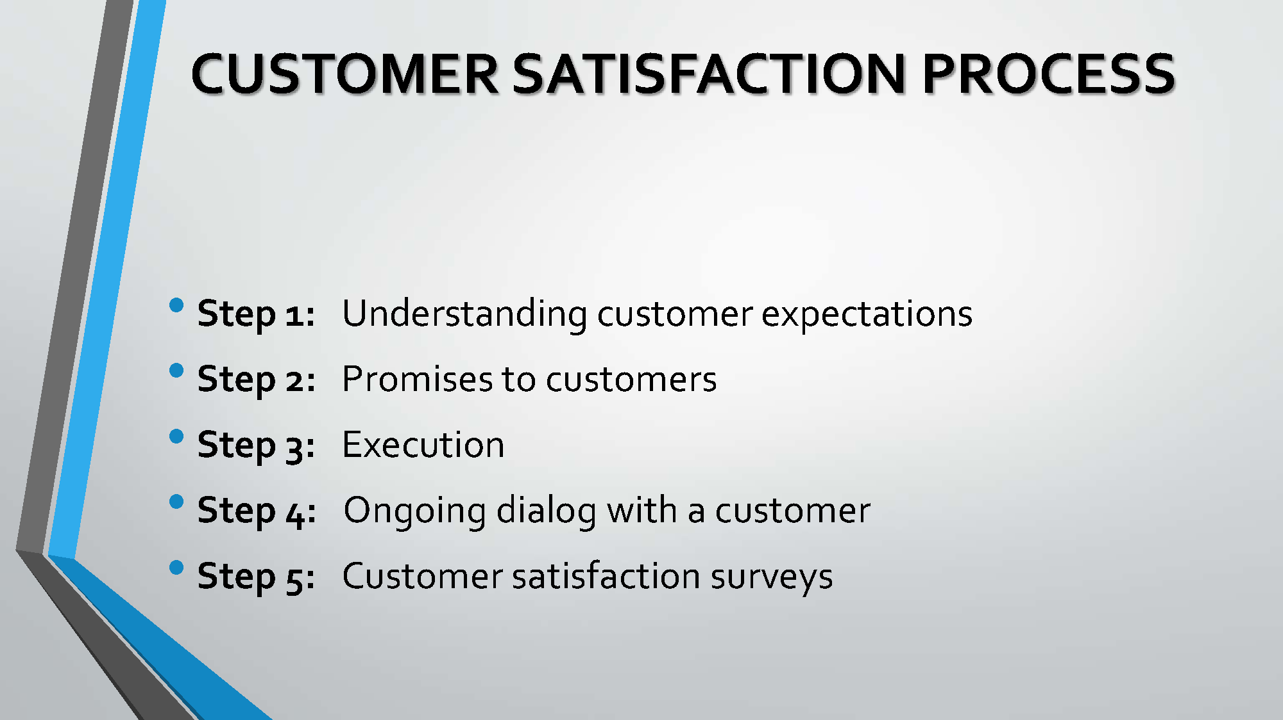

Slide 31
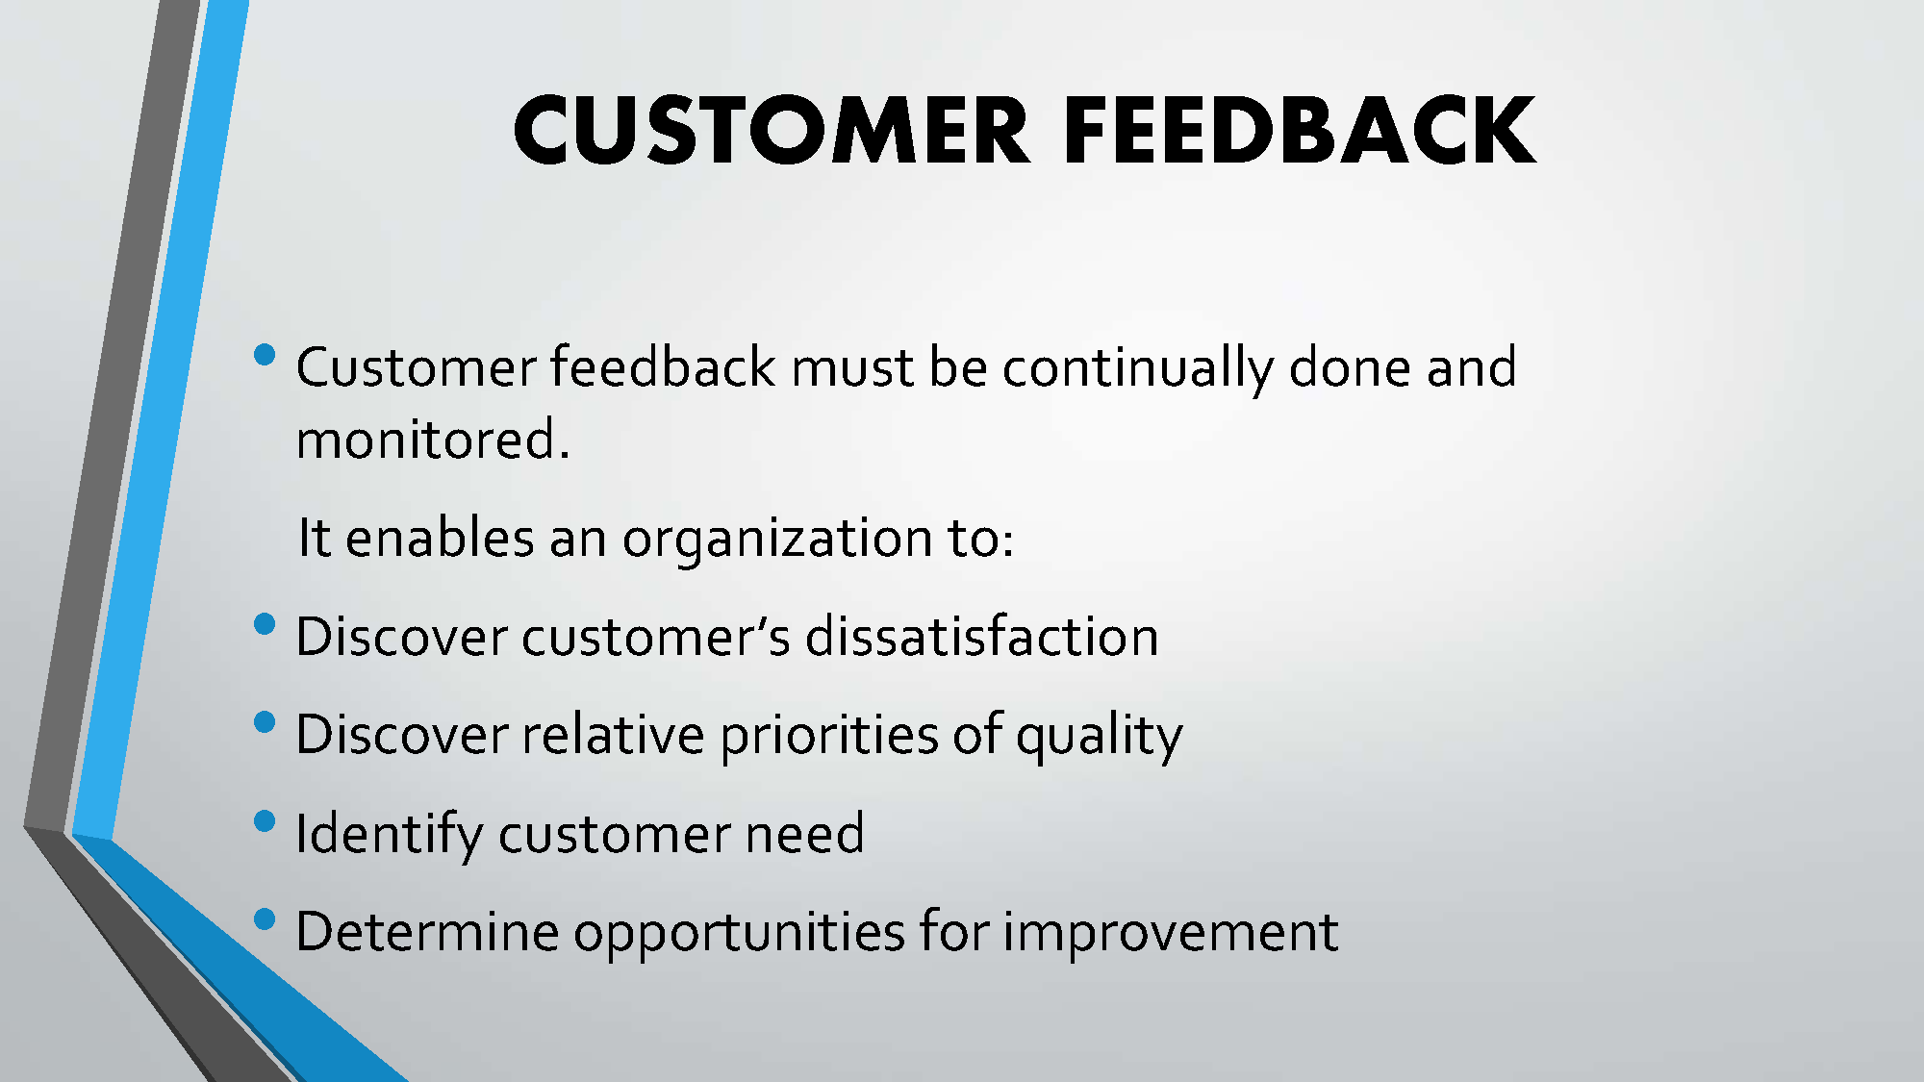

Slide 32
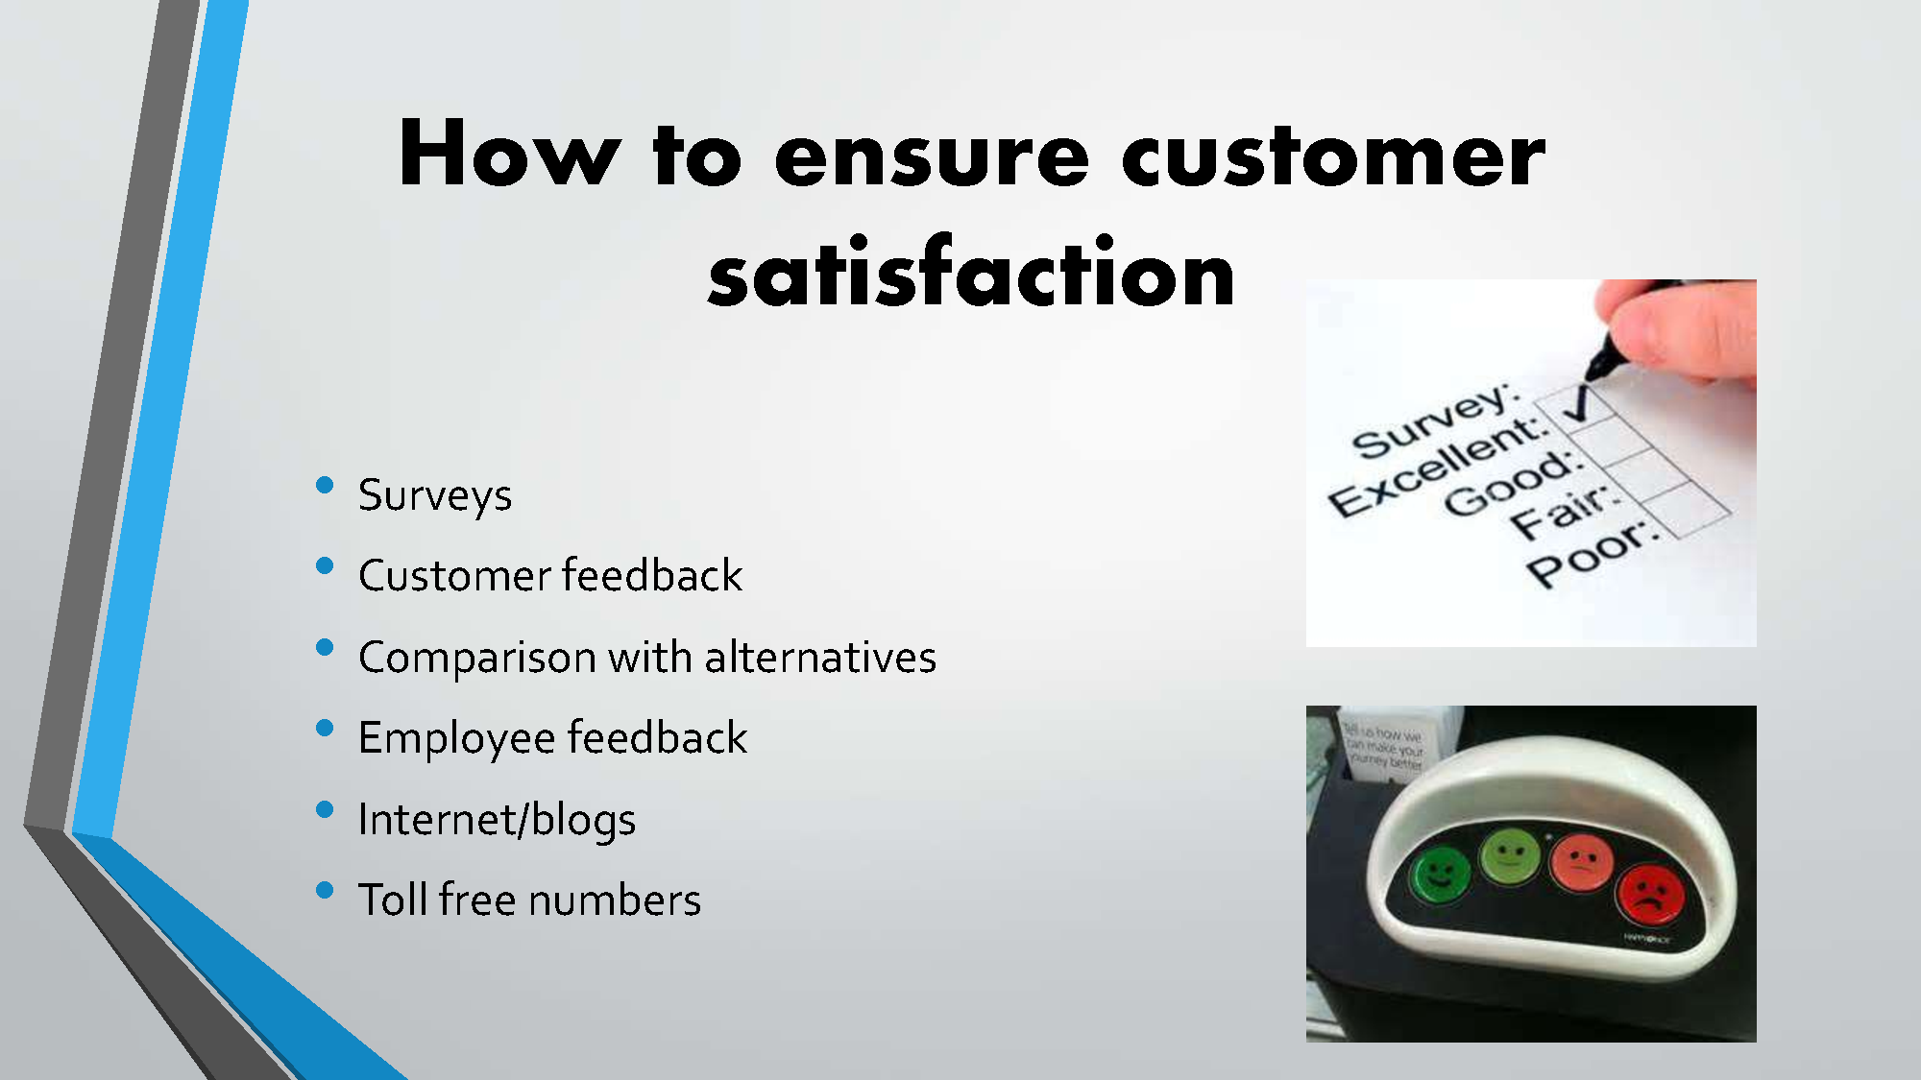

Slide 33
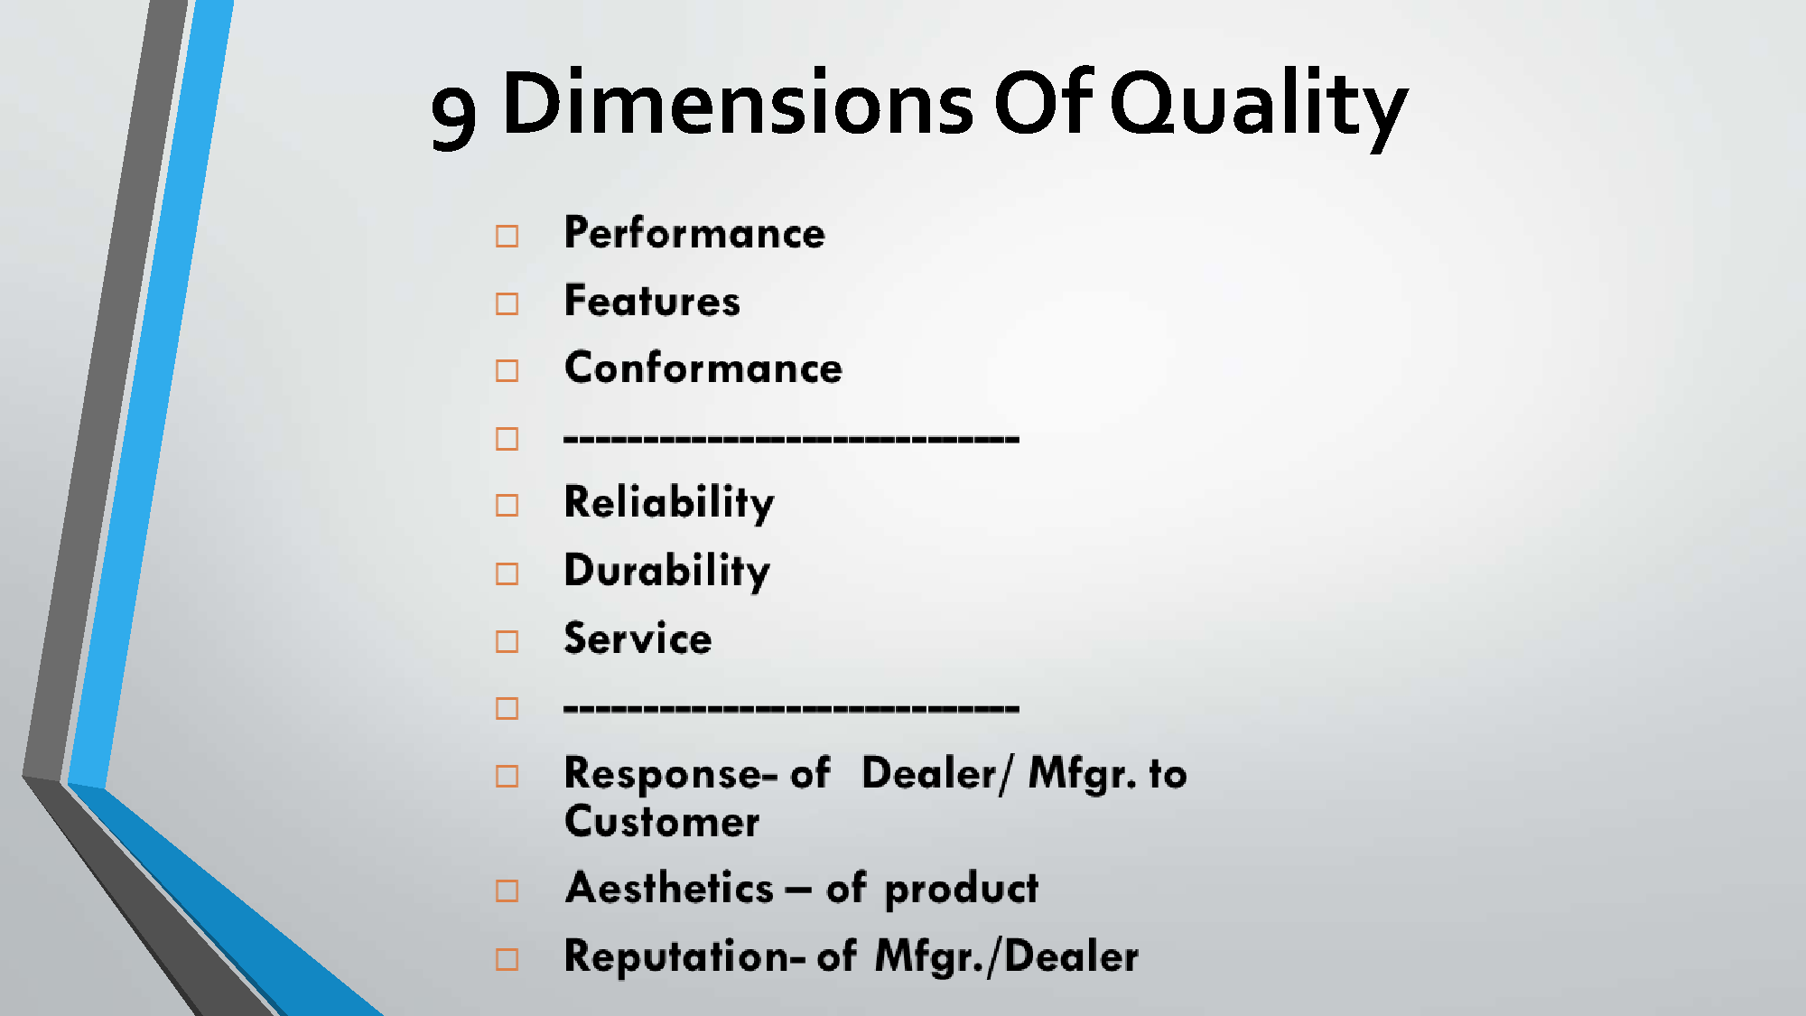

Slide 34
Customer perception of quality:
An American Society for quality (ASQ) survey on customer perception about quality of product or service shows the following ranking.
Performance
Features
Service
Warranty
Price
Reputation

Slide 35


Service organizations and customer satisfaction
•
Difficult but not impossible
•
•
•
•
•
•
Determine key performance indicators Set Targets – SMART goals
Make teams
Analyze them on weekly basis Standardize

Slide 36
Why customers leave?
Others, 9%
Better prices elsewhere, 9%
Product dissatisfaction, 13%
Poor service 69%

Slide 37
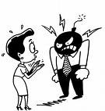
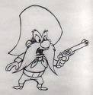

Categories of customers:
Angry customers
Demanding customers
Passive customers

Slide 38
Customer Characteristics:
1. Innovators
Representing about 3 % of the market
They are the first to adopt an innovation
Young, high social status, good financial shape, broad social relationship
Trust on non personal sources of info. Such as advertisement.
o

Slide 39
2. Early adopters:
Comprising about 13 % of the market
They purchase a new product or service after innovators but sooner than other consumers
High social status
Sales people are used as info. sources
3. Early Majority:
Comprising about 34 % of the market
This group is above average in social & economic measures
Rely on ads, sales person & contact with early adopters
o

Slide 40
4. Late Majority :
Representing about 34 % of the market
Adopt an innovation to save money or in response to social pressure from their peers
Rely on members of the early & late majorities as source of info.
5. Laggards:
Comprising about 16 % of the market
Last to adopt an innovation
Older & usually are at the low end of the social & economic scales
o

