Slide 1
The Industrial Sector

Slide 2
Industrialization
Do you know anyone who has or works in a factory in Kurdistan?
What is produced?
Cement, bricks, steel, plastic chairs, plastic bins, recycling, packaging, plastic bags, glass, iron bars, pharmaceuticals, chips, fizzy drinks, salt, spices, juice, jam, yogurt, cheese, chocolate, delights, baklava, chicken, flour, pickles, tomato sauce, date syrup, sesame paste.

Slide 3
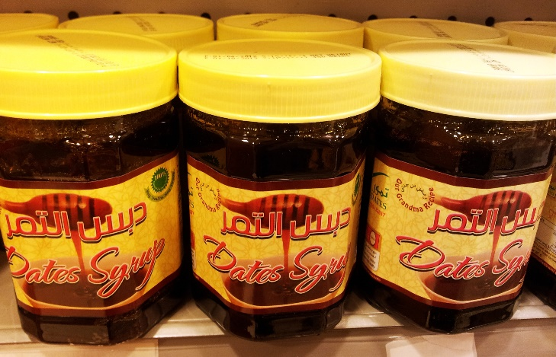
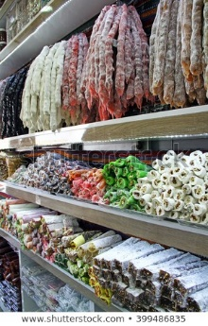

Slide 4
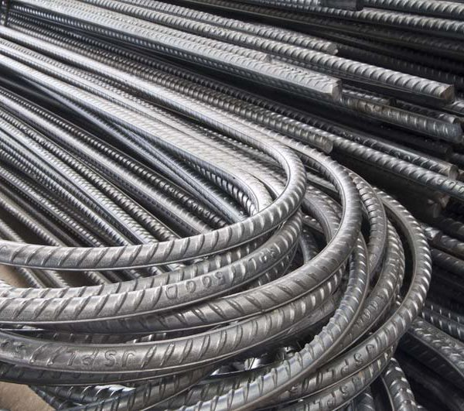
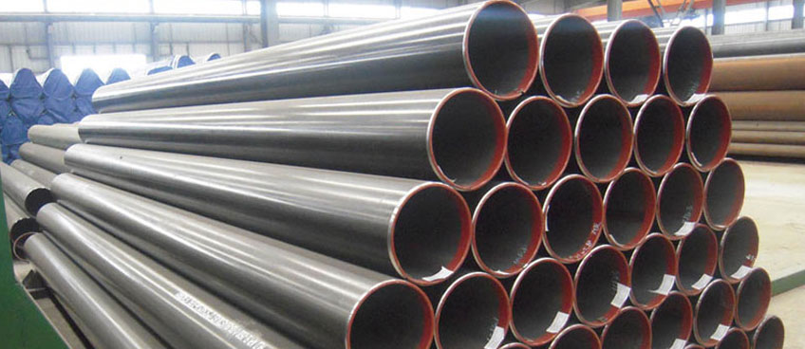

Slide 5
Industrialization
Industrialization is defined as the large-scale introduction of manufacturing into a society. It shifts an underdeveloped agricultural economy focused on human labor to an industrial economy based on machine labor. It's a process whereby individual labor is replaced by mechanized mass production and specialized laborers, which boosts productivity.

Slide 6
The three-sector model in economics divides economies into three sectors of activity: extraction of raw materials (primary), manufacturing (secondary), and services (tertiary).
There are primary, secondary, tertiary jobs. Primary jobs involve getting raw materials from the natural environment e.g. Mining, farming and fishing. Secondary jobs involve making things (manufacturing) e.g. making cars and steel. Tertiary jobs involve providing a service e.g. teaching and nursing.

Slide 8
Why is Industrialization Important?
Provides market to other sectors: industries buy raw materials from the primary sector, e. g. cotton from agriculture. The industrial sector also buys services from the tertiary sector, e. g. banking, insurance, transport and communication.
Provides inputs to other sectors: the industrial sector provides the necessary inputs to other sectors of the economy. For instance, it provides agriculture with farm inputs such as tractors, fertilizers, chemicals and drugs.

Slide 9
Why is Industrialization Important?
Creates employment opportunities: The industrial sector is an important employer for both skilled and unskilled labor. Agriculture and other sectors cannot absorb all the labor force. As industries expand, they account for a much share of employment.

Slide 10
Why is Industrialization Important?
Conserves and earns foreign exchange: Through industrialization, a country is able to conserve foreign exchange by reducing on imports. This is particularly so when industries are established to produce goods that were previously imported. At the same time, where a country manufactures goods for export, it earns foreign exchange. This foreign exchange can be used to import essential capital goods and stimulate capital formation.

Slide 11
The Development Board And The Industrial Sector
Before the Board Planning there were two approaches to encourage local industries:
First, certain laws were forced allowing exemptions from income tax, customs duty, and property tax and permitting use of state land.
Second, the state-owned Industrial Bank was authorized to establish industrial enterprises, sponsor and subscribe to the capital of private and public companies, and extend short- and long-term loans.

Slide 12
The Industrial Sector in the Development Programs
With the flow of oil revenue and the creation of the Development Board, the question of industrial development should have taken a lot of attention; but this was not the case, especially in the early years of development planning:
The first program did not allocate any funds for this sector.
The second allocated 20 percent of its total budget.
The third and fourth programs allocated 14 percent and 13 percent respectively.

Slide 13
World Bank's Mission Report
You should NOT encourage low quality industries. You should only help the industries that compete with imports.
You have too much protection. In a limited market (Iraq) that affords opportunity for only one or two plants in each field and where the entrepreneurial class is small there is an acute danger of monopoly and attendant high prices.

Slide 14
World Bank's Mission Report
it seems to be in the best interest of Iraq to concentrate on raising the efficiency of agricultural production.
forced industrialization with the aid of tariff protection or government subsidy might lead to inefficiency and waste of economic resources.

Slide 15
Reasons for These Recommendations?
The first is that since Iraq is an agricultural country with a relative abundance of water and cultivable land, it has a comparative advantage in developing its agriculture. Iraq could then sell its agricultural products abroad.

Slide 16
Reasons for These Recommendations?
Another reason behind these recommendations was the fact that Iraq did not have the skilled labor force necessary for a broad program of industrialization.
Don’t Jump stages! (Lord Salter)

Slide 17
Reasons for These Recommendations?
A third explanation is that an accelerated program of industrialization will raise the prices of the domestically produced manufactured products which will have effect of lowering rural real incomes relative to urban earnings. Imbalance in the distribution of income.

Slide 18
Do you think industrialization is profitable for Kurdistan or Iraq?
Should the government give more financial support to industries?

Slide 19
Question Bank
Why is industrialization important? Give two reasons with explanation and examples.
Explain the three sector model and give examples about jobs in each sector.
How did the government support industries before the creation of the Development Board?
What did the World Bank Mission recommend to do about industrialization?
Why did the World Bank Mission recommend that Iraq does not concentrate on manufacturing?

