Slide 1
International Economics - 1
World Trade: An Overview,
Who trade with whom
Week -3
Prepared by: Dr Waqar Ahmad, Asstt. Prof.

Slide 2
Learning Objective Week - 3
World trade patterns
US trade patterns
Largest trading partners of the United States
Gravity model:
Influence of an economy’s size on trade
Distance, barriers, borders and other trade impediments
Globalization: then and now
Changing composition of trade
Service outsourcing
Why do people and nations choose to be economically interdependent?
How can trade make everyone better off?
What is absolute advantage?
What is comparative advantage?
How are these concepts similar?
How are they different?

Slide 3
INTRODUCTION OF WORLD WIDE OVERVIEW
International trade has changed our world drastically over the last couple of centuries. In this entry we begin by analyzing available data on historical trade patterns around the world, and then move on to discuss more recent data, outlining trade patterns from the last couple of decades.
In the last section, we turn to analyze empirical evidence regarding the determinants and consequences of international trade.

Slide 4
STARTING PHASE OF INTERNATIONAL TRADE
last couple of decades, transport and communication costs have decreased across the world, and preferential trade agreements have become more and more common, particularly among developing countries from 2008-2011.
Free international trade is often seen as desirable because it allows countries to specialize, in order to produce goods that they are relatively efficient at producing, while importing other goods.
In the course of the 19th century, when technological advances triggered a period of marked growth in world trade – the so-called 'first wave of globalization'. Until 1913, worldwide trade grew by more than 3% annually.

Slide 5
STARTING PHASE OF INTERNATIONAL TRADE
The first wave of globalization came to an end with the beginning of the First World War, when the decline of liberalism and the rise of nationalism led to a slump in international trade.
After the Second World War trade started growing again. This new and ongoing wave of globalization has seen international trade grow faster than ever before. Today the sum of exports and imports across nations is higher than the value of 50% of the global production.

Slide 6
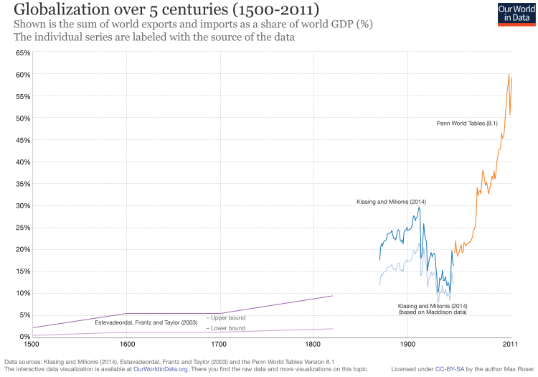

Slide 8
Export Globally till 2014
Throughout the last two centuries, the rate of growth increased constantly the trade grew faster and faster.
This remark can be best appreciated in the following visualization, presenting estimates of world exports for the period 1800-2014.
The data comes from Federico and Tena-Junguito (2016)² and the vertical axis is in constant prices (i.e. world exports have been indexed, so that values are relative to the value of exports in the year 1913).
The trade growth roughly followed an exponential path in the period 1800-2010.
Growth in exports has been so large in the last century that the interwar slump is almost not visible when we use this scale.

Slide 9
Largest trading partners of the United States
Who Trades with Whom?
More than 30% of world output is sold across national borders.
World trade in goods and services exceeded $21 trillion in 2015.
The 5 largest trading partners with the U.S. in 2015 were China, Canada, Mexico, Japan, and Germany.
The largest 15 trading partners with the U.S. accounted for 75% of the value of U.S. trade in 2015.

Slide 10
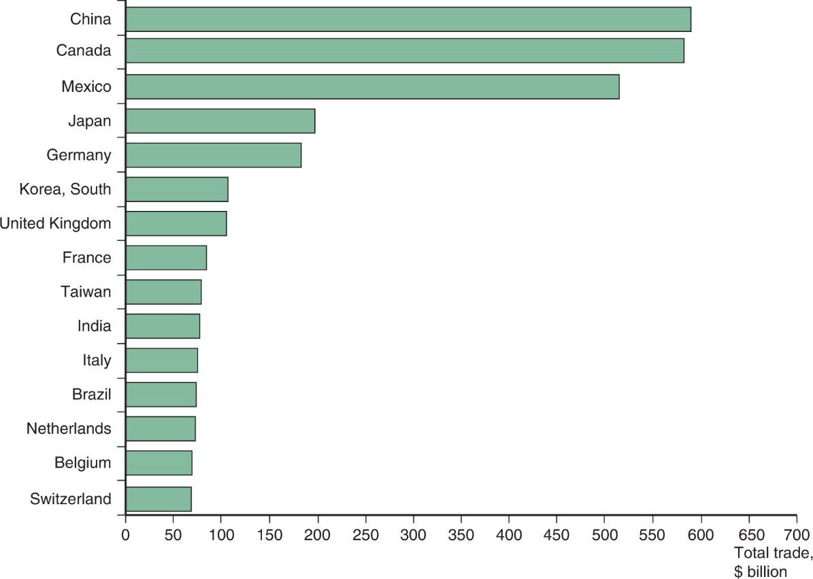
Figure 2.1 Total U.S. Trade with Major Partners, 2015
U.S. trade—measured as the sum of imports and exports—is mostly with 15 major partners.
Source: U.S. Department of Commerce.

Slide 11
Gravity force in Physics

Slide 12
Gravity Analogy
Gravity force equation

Slide 13
What is the gravity model?
The value of trade between the two countries is proportionate, other things equal, to the product of the two countries' GDP and diminishes with distance between the two countries is know as gravity model.
Gravity model is a very popular econometric model in international trade
The name came from its utilizing the gravitational force concept as an analogy to explain the volume of bilateral trade flows – Proposed by Tinbergen (1962)
Initially, it was not based on theoretical model, but just intuition only
Later on, a range of rigorous theoretical foundation has been given.
– The most well-known benchmark so far is Anderson and van Wincoop (2003).

Slide 14
Intuitive gravity model of trade:
Larger countries trade more than smaller ones
• Trade costs between two trade partners reduce trade between them.

Slide 15
Proxies for trade costs
Proxies for trade costs
Distance
Adjacency
Common language
Colonial links
Common currency
Island, landlocked
Institutions, infrastructures, migration flows,..
Bilateral tariff barriers

Slide 16
Size Matters: The Gravity Model
3 of the top 10 trading partners with the U.S. in 2012 were also the 3 largest European economies: Germany, the United Kingdom, and France.
Why does the United States trade more with these European countries than with others?
These countries have the largest gross domestic product (GDP), the value of goods and services produced in an economy, in Europe. Each European country’s share of U.S. trade with Europe is roughly equal to its share of European GDP.

Slide 17
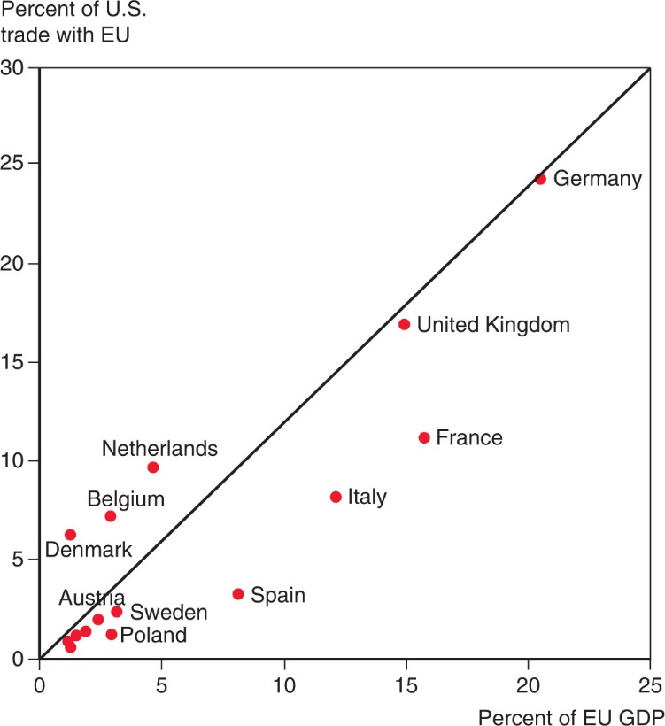
Figure 2.2 The Size of European Economies, and the Value of their Trade with the United States
Shows the correspondence between the size of different European economies and those countries’ trade with the United States.
Source: U.S. Department of Commerce, European Commission.

Slide 18
Size Matters: The Gravity Model
The size of an economy is directly related to the volume of imports and exports.
Larger economies produce more goods and services, so they have more to sell in the export market.
Larger economies generate more income from the goods and services sold, so they are able to buy more imports.
Trade between any two countries is larger, the larger is either country.

Slide 19
Size Matters: The Gravity Model
The gravity model assumes that size and distance are important for trade in the following way:
where A is a constant term
T_{ij} is the value of trade between country i and country j
Y_{i} the GDP of country I, Y_{j} is the GDP of country j
D_{ij} is the distance between country i and country j
Or more generally
where a, b, and c are allowed to differ from 1.

Slide 20
Using the Gravity Model: Looking for Anomalies
A gravity model fits the data on U.S. trade with European countries well but not perfectly.
The Netherlands, Belgium and Ireland trade much more with the United States than predicted by a gravity model.
Ireland has strong cultural affinity due to common language and history of migration.
The Netherlands and Belgium have transport cost advantages due to their location.

Slide 21
Impediments to Trade: Distance, Barriers, and Borders
Other things besides size matter for trade:
Distance between markets influences transportation costs and therefore the cost of imports and exports.
Cultural affinity: close cultural ties, such as a common language, usually lead to strong economic ties.
Geography: ocean harbors and a lack of mountain barriers make transportation and trade easier.
Multinational corporations: corporations spread across different nations import and export many goods between their divisions.
Borders: crossing borders involves formalities that take time, often different currencies need to be exchanged, and perhaps monetary costs like tariffs reduce trade.

Slide 22
Impediments to Trade: Distance, Barriers, and Borders
Estimates of the effect of distance from the gravity model predict that a 1% increase in the distance between countries is associated with a decrease in the volume of trade of 0.7% to 1%.
Besides distance, borders increase the cost and time needed to trade.
Trade agreements between countries are intended to reduce the formalities and tariffs needed to cross borders, and therefore to increase trade.

Slide 23
Impediments to Trade: Distance, Barriers, and Borders
The U.S. signed a free trade agreement with Mexico and Canada in 1994, the North American Free Trade Agreement (NAFTA).
Because of NAFTA and because Mexico and Canada are close to the U.S., the amount of trade between the U.S. and its northern and southern neighbors as a fraction of GDP is larger than between the U.S. and European countries.
Canada’s economy is roughly the same size as Spain’s (around 10% of EU GDP) but Canada trades as much with the United States as does all of Europe.

Slide 24
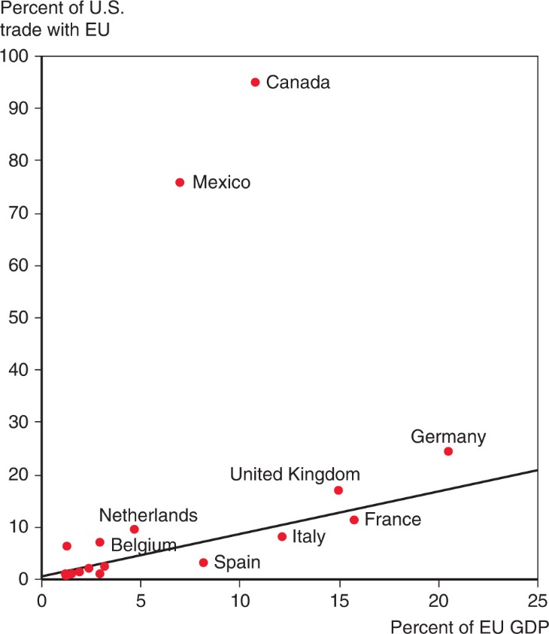
Figure 2.3 Economic Size and Trade with the United States
The United States does markedly more trade with its neighbors than it does with European economies of the same size.
Source: U.S. Department of Commerce, European Commission.

Slide 25
Impediments to Trade: Distance, Barriers, and Borders
Yet even with a free trade agreement between the U.S. and Canada, which use a common language, the border between these countries still seems to be associated with a reduction in trade.
Data shows that there is much more trade between pairs of Canadian provinces than between Canadian provinces and U.S. states, even when holding distance constant.
Estimates indicate that the U.S.-Canadian border deters trade as much as if the countries were 1,500-2,500 miles apart.

Slide 26
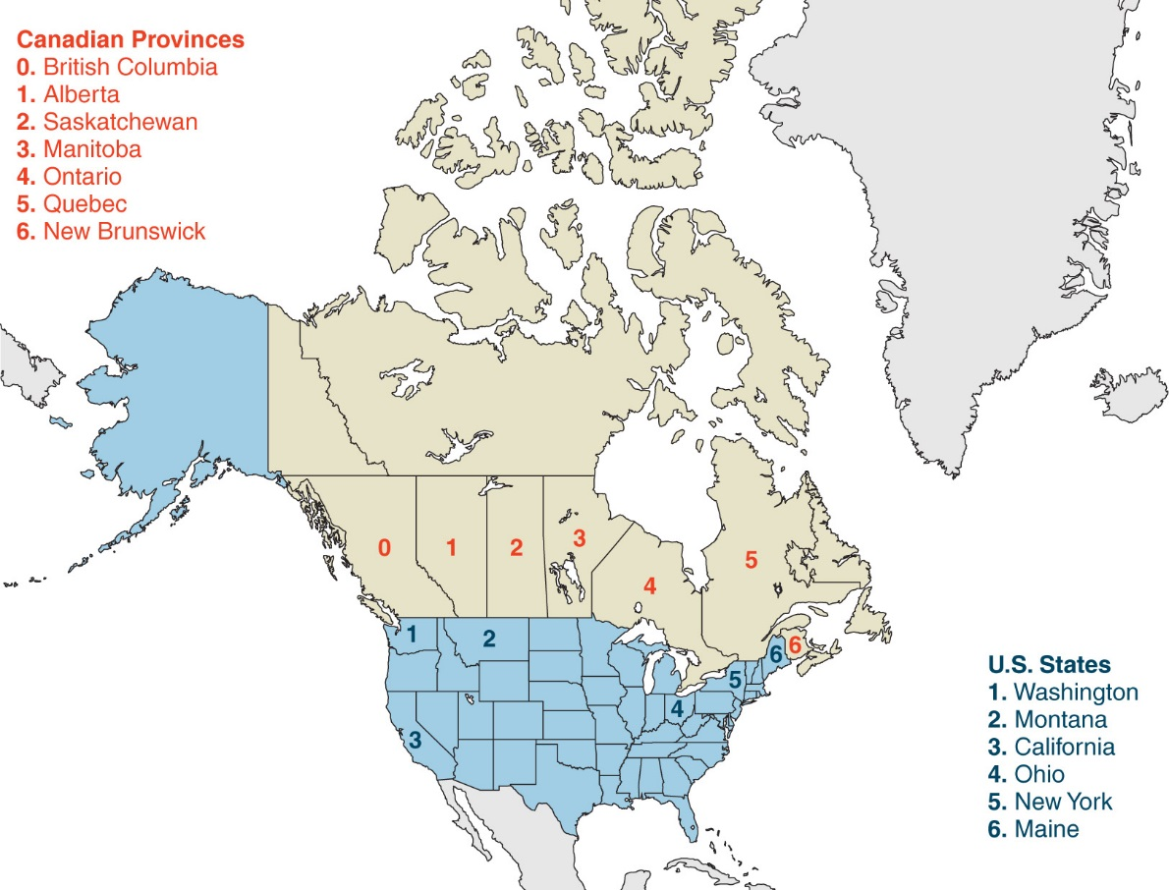
Figure 2.4 Canadian Provinces and U.S. States that Trade with British Columbia
Source: Statistics Canada, U.S. Department of Commerce.

Slide 27
Table 2.1 Trade with British Columbia, as Percent of GDP, 2009
Canadian Province | Trade as Percent of GDP | Trade as Percent of GDP | U.S. State at Similar Distance From British Columbia
Alberta | 6.9 | 2.6 | Washington
Saskatchewan | 2.4 | 1.0 | Montana
Manitoba | 2.0 | 0.3 | California
Ontario | 1.9 | 0.2 | Ohio
Quebec | 1.4 | 0.1 | New York
New Brunswick | 2.3 | 0.2 | Maine
Source: Statistics Canada, U.S. Department of Commerce.

Slide 28
The Changing Pattern of World Trade: Has the World Gotten Smaller?
The negative effect of distance on trade according to the gravity models is significant, but has grown smaller over time due to modern transportation and communication.
Technologies that have increased trade:
Wheels, sails, compasses, railroads, telegraph, steam power, automobiles, telephones, airplanes, computers, fax machines, Internet, fiber optics, personal digital assistants, GPS satellites…

Slide 29
The Changing Pattern of World Trade: Has the World Gotten Smaller?
Political factors, such as wars, can change trade patterns much more than innovations in transportation and communication.
World trade grew rapidly from 1870 to 1913.
Then it suffered a sharp decline due to the two world wars and the Great Depression.
It started to recover around 1945 but did not recover fully until around 1970.

Slide 30
The Changing Pattern of World Trade: Has the World Gotten Smaller?
Since 1970, world trade as a fraction of world GDP has achieved unprecedented heights.
Vertical disintegration of production has contributed to the rise in the value of world trade through extensive cross-shipping of components.
A $100 product can give rise to $200 or $300 worth of international trade flows.

Slide 31
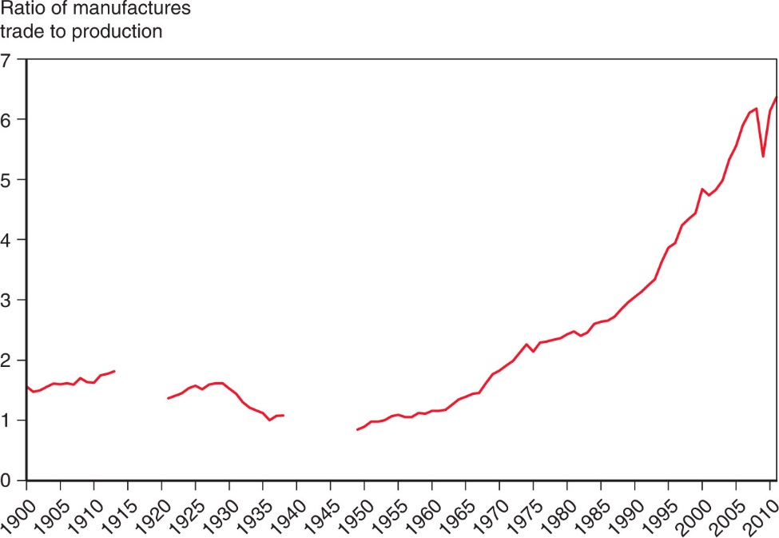
Figure 2.5 The Fall and Rise of World Trade
The ratio of world exports of manufactured goods to world industrial production rose in the decades before World War I but fell sharply in the face of wars and protectionism. It didn’t return to 1913 levels until the 1970s but has since reached new heights.
Source: UN Monthly Bulletin of Statistics, World Trade Organization.

Slide 32
What Do We Trade?
What kinds of products do nations trade now, and how does this composition compare to the past?
Most (about 57%) of the volume of trade today is in manufactured products such as automobiles, computers, and clothing.
Services such as shipping, insurance, legal fees, and spending by tourists account for about 24% of the volume of trade.
Mineral products (ex., petroleum, coal, copper) remain an important part of world trade at 12%
Agricultural products are a relatively small part of trade at 8%.

Slide 33
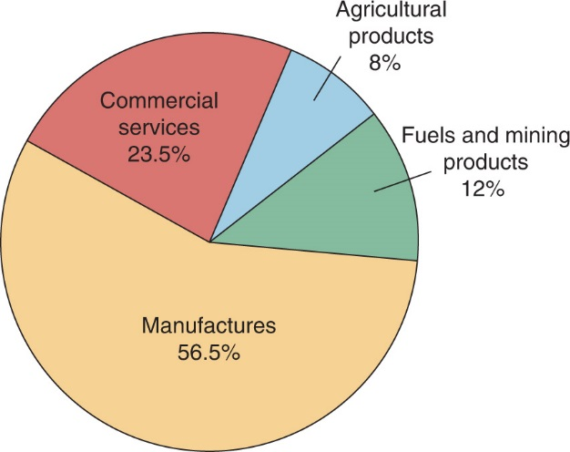
Figure 2.6 The Composition of World Trade, 2015
Most world trade is in manufactured goods, but minerals—mainly oil—remain important.
Source: World Trade Organization.

Slide 34
What Do We Trade?
In the past, a large fraction of the volume of trade came from agricultural and mineral products.
In 1910, Britain mainly imported agricultural and mineral products, although manufactured products still represented most of the volume of exports.
In 1910, the U.S. mainly imported and exported agricultural products and mineral products.
In 2002, manufactured products made up most of the volume of imports and exports for both countries.

Slide 35
Table 2.2 Manufactured Goods as a Percent of Merchandise Trade
blank | Exports of United Kingdom | Imports of United Kingdom | Exports of United States | Imports of United States
1910 | 75.4 | 24.5 | 47.5 | 60.7
2015 | 72.3 | 73.6 | 74.8 | 78.4
Source: 1910 data from Simon Kuznets, Modern Economic Growth: Rate, Structure and Speed. New Haven: Yale Univ. Press, 1966. 2015 data from World Trade Organization.

Slide 36
What Do We Trade?
Low- and middle-income countries have also changed the composition of their trade.
In 2001, about 65% of exports from low- and middle-income countries were manufactured products, and only 10% of exports were agricultural products.
In 1960, about 58% of exports from low- and middle-income countries were agricultural products and only 12% of exports were manufactured products.
More than 90 percent of the exports of China, the largest developing country and a rapidly growing force in world trade, consist of manufactured goods.

Slide 37
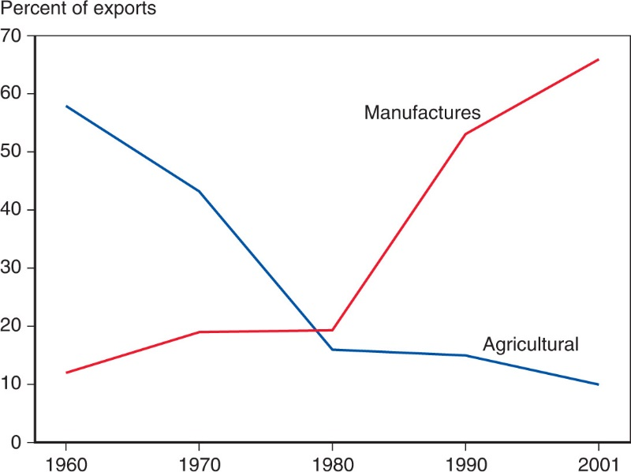
Figure 2.7 The Changing Composition of Developing-Country Exports
Over the past 50 years, the exports of developing countries have shifted toward manufactures.
Source: United Nations Council on Trade and Development.

Slide 38
Service Outsourcing
Service outsourcing (or offshoring) occurs when a firm that provides services moves its operations to a foreign location.
Service outsourcing can occur for services that can be transmitted electronically.
A firm may move its customer service centers whose telephone calls can be transmitted electronically to a foreign location.
Other services may not lend themselves to being performed remotely.

Slide 39
Service Outsourcing
Service outsourcing is currently not a significant part of trade.
Some jobs are “tradable” and thus have the potential to be outsourced.
Most jobs (about 60%) need to be done close to the customer, making them nontradable.

Slide 40
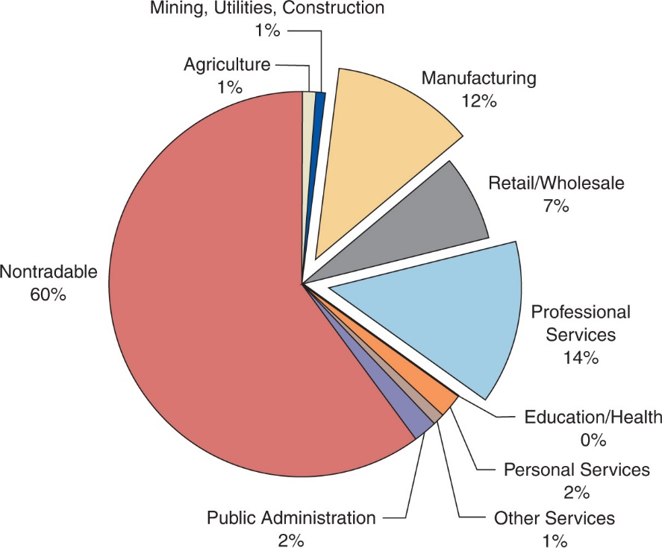
Figure 2.8 Tradable Industries’ Share of Employment
Estimates based on trade within the United States suggest that trade in services may eventually become bigger than trade in manufactures.
Source: J. Bradford Jensen and Lori. G. Kletzer, “Tradable Services: Understanding the Scope and Impact of Services Outsourcing,” Peterson Institute of Economics Working Paper 5–09, May 2005.

Slide 41
Summary
The 5 largest trading partners with the U.S. are China, Canada, Mexico, Japan, and Germany.
The largest economies in the EU undertake the largest fraction of the total trade between the EU and the U.S.
The gravity model predicts that the volume of trade is directly related to the GDP of each trading partner and is inversely related to the distance between them.

Slide 42
Summary
Besides size and distance, culture, geography, multinational corporations, and the existence of borders influence trade.
Modern transportation and communication have increased trade, but political factors have influenced trade more in history.
Today, most trade is in manufactured goods, while historically agricultural and mineral products made up most of trade.

Slide 43
Questions
Describe how the value of trade between any two countries depends on the size of these countries’ economies and explain the reasons for that relationship.
Discuss how distance and borders reduce trade.
Describe how the share of international production that is traded has fluctuated over time and why there have been two ages of globalization.
Explain how the mix of goods and services that are traded internationally has changed over time.

Slide 44
Thank You

