Slide 1
Demand, Determinant of Demand and Law of Demand, Elasticity of Demand Price, Cross and Income Elasticity
Week - 2
Prepared by: Dr Waqar Ahmad, Asstt. Prof.

Slide 2
Learning Objectives
What is demand?
What is law of demand?
What is elasticity?
What are the types of elasticity?
What is demand elasticity?
What are the determinant of demand?
Week -2

Slide 3
Introduction of Demand
If you demand something, then you
1. Want it.
2. Can afford it.
3. Plan to buy it.
Wants are the unlimited desires or wishes that people have for goods and services
The quantity demanded of a good or service is the amount that consumers plan to buy during a given time period at a particular price.
The quantity demanded is measured as an amount per unit of time.

Slide 4
Introduction of Demand Cont.
What is 'Demand‘ ?
Demand is an economic principle referring to a consumer's desire and willingness to pay a price for a specific good or service. Holding all other factors constant, an increase in the price of a good or service will decrease demand, and vice versa. Think of demand as your willingness to go out and buy a certain product. For example, market demand is the total of what everybody in the market wants.

Slide 5
Introduction of Demand Cont.
Aggregate Demand vs. Individual Demand
Aggregate demand refers to the overall or average demand of many market participants.
Individual demand refers to the demand of a particular consumer. For example, a particular consumer’s demand for a product is strongly influenced by her personal income

Slide 6
Introduction of Demand Cont.
Many factors influence buying plans, and one of them is the price. We look first at the relationship between the quantity demanded of a good and its price. To study this relationship, we keep all other influences on buying plans the same and we ask:
How, other things remaining the same, does the quantity demanded of a good change as its price changes?
The law of demand provides the answer.

Slide 7
Introduction of Law of Demand
The law of demand states that the…………..
Other things remaining the same, the higher the price of a good, the smaller is the quantity demanded; and the lower the price of a good, the greater is the quantity demanded.
Why does a higher price reduce the quantity demanded? For two reasons:
Substitution effect
Income effect
Price Effect

Slide 8
Demand Curve and Demand Schedule
You are now about to study one of the two most used curves in economics:
the demand curve. You are also going to encounter one of the most critical distinctions: the distinction between demand and quantity demanded.
The term demand refers to the entire relationship between the price of a good and the quantity demanded of that good.
Demand is illustrated by the demand curve and the demand schedule.
The term quantity demanded refers to a point on a demand curve the quantity demanded at a particular price.

Slide 9
Demand Curve and Demand Schedule
A demand schedule lists the quantities demanded at each price when all the other influences on consumers’ planned purchases remain the same.

Slide 10
Introduction of Law of Demand Cont.

Slide 11
Introduction of Law of Demand Cont.
Change in Demand
When any factor that influences buying plans changes, other than the price of the good, there is a change in demand.

Slide 12
Introduction of Law of Demand Cont.
Six main factors bring changes in demand. They are changes in
The prices of related goods
Expected future prices
Income
Expected future income and credit
Population
Preferences

Slide 13
Introduction of Law of Demand Cont.
The prices of related goods
A substitute is a good that can be used in place of another good. For example, a bus ride is a substitute for a train ride; a hamburger is a substitute for a hot dog; and an energy drink is a substitute for an energy bar.
2. Expected Future Prices
If the expected future price of good rises and if the good can be stored, the opportunity cost of obtaining the good for future use is
lower today than it will be in the future when people expect the price to be higher.

Slide 14
Introduction of Law of Demand Cont.
3. Income
Income Consumers’ income influences demand. When income increases, consumers buy more of most goods; and when income decreases, consumers buy less of most goods. Although an increase in income leads to an increase in the demand for most goods.
4. Expected Future Income
When expected future income increases or credit becomes easier to get, demand for a good might increase. now. For example, a salesperson gets the news that she will receive a big bonus at the end of the year, so she goes into debt and buys a new car right.

Slide 15
Introduction of Law of Demand Cont.
5. Population
Demand also depends on the size and the age structure of the population. The larger the population, the greater is the demand for all goods and services; the smaller the population, the smaller is the demand for all goods and services.
6. Preferences
Demand depends on preferences. Preferences determine the value that people place on each good and service. Preferences depend on such things as the weather, information, and fashion.

Slide 16
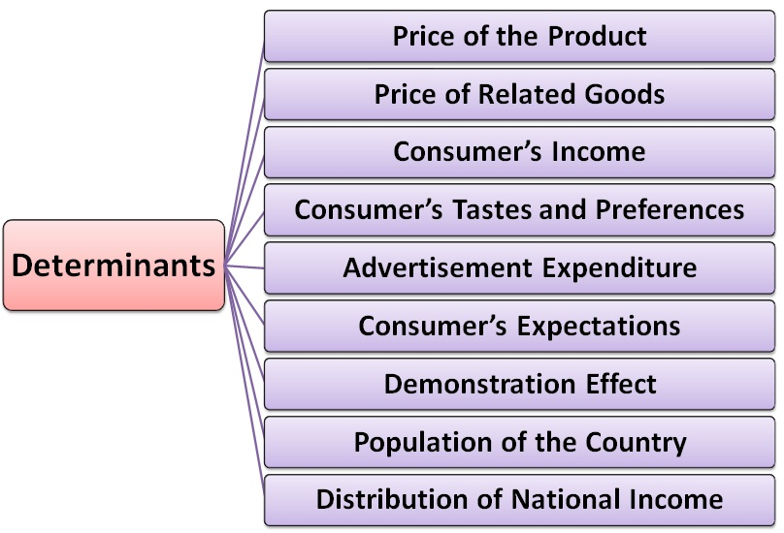

Slide 17
A Change in the Quantity Demanded Versus a Change in Demand
Changes in the influences on buying plans bring either a change in the quantity demanded or a change in demand.
The distinction between a change in the quantity demanded and a change in demand is the same as that between a movement along he demand curve and a shift of the demand curve.

Slide 18
Movement Along the Demand Curve
If the price of the good changes but no other influence on buying plans changes, we illustrate the effect as a movement along the demand curve.
A fall in the price of a good increases the quantity demanded of it.
A rise in the price of a good decreases the quantity demanded of it.

Slide 19
Movement Along the Demand Curve
If the price of a good remains constant but some other influence on buying plans changes, there is a change in demand for that good.

Slide 20
Elasticity
Elasticity is used to determine how changes in product demand and supply relate to changes in consumer income or the producer's price.
To calculate this change, we can use the following formula:
Elasticity = % Change in Quantity
% Change in Price

Slide 21
Elasticity of Demand
The demand elasticity (elasticity of demand) refers to how sensitive the demand for a good is to changes in other economic variables, such as prices and consumer income.

Slide 22
Types of Elasticity of Demand
According to the source of the change, the following types of
elasticity of demand can be mentioned:
Price Elasticity of Demand
Cross Elasticity of Demand (the elasticity in relation to the change of the price of other good and services)
Income Elasticity of Demand
Advertisement Elasticity of Demand (the elasticity in relation to the advertisement expenditure)

Slide 23
Types of Elasticity of Demand
The price elasticity of demand, commonly known as the elasticity of demand refers to the responsiveness and sensitiveness of demand for a product to the changes in its price.
The cross elasticity of demand is the proportional change in the quantity demanded, relative to the proportional change in the price of another good.
The income elasticity of demand is the proportional change in the quantity demanded, relative to the proportional change in the income.
The advertisement elasticity of demand is the proportional change in the quantity demanded, relative to the proportional change in the price of another good.

Slide 24
Degrees of the change in the demand, the elasticity can be classified in

Slide 25
Elasticity of Demand
The following are the main types of Price Elasticity of Demand:
Perfectly Elastic Demand
Perfectly Inelastic Demand
Relatively Elastic Demand
Relatively Inelastic Demand
Unitary Elastic Demand

Slide 26
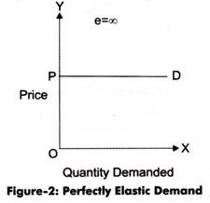
Types of Price Elasticity of Demand
Perfectly Elastic Demand:
When a small change in price of a product causes a major change in its demand, it is said to be perfectly elastic demand. In perfectly elastic demand, a small rise in price results in fall in demand to zero, while a small fall in price causes increase in demand to infinity. In such a case, the demand is perfectly elastic or e_{p} = 00.

Slide 27
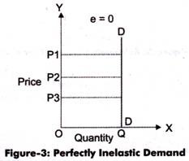
Types of Price Elasticity of Demand Cont.
2. Perfectly Inelastic Demand:
A perfectly inelastic demand is one when there is no change produced in the demand of a product with change in its price. The numerical value for perfectly inelastic demand is zero (e_{p}=0).

Slide 28
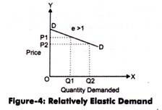
Types of Price Elasticity of Demand Cont.
3. Relatively Elastic Demand
Relatively elastic demand refers to the demand when the proportionate change produced in demand is greater than the proportionate change in price of a product. The numerical value of relatively elastic demand ranges between one to infinity.

Slide 29
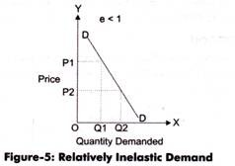
Types of Price Elasticity of Demand Cont.
4. Relatively Inelastic Demand
Relatively inelastic demand is one when the percentage change produced in demand is less than the percentage change in the price of a product. For example, if the price of a product increases by 30% and the demand for the product decreases only by 10%, then the demand would be called relatively inelastic.

Slide 30
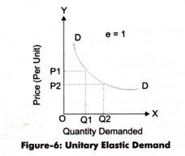
Types of Price Elasticity of Demand Cont.
5. Unitary Elastic Demand:
When the proportionate change in demand produces the same change in the price of the product, the demand is referred as unitary elastic demand. The numerical value for unitary elastic demand is equal to one (e_{p}=1).

Slide 31
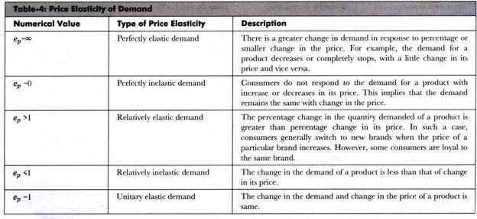
Types of Price Elasticity of Demand Cont.

