Slide 1

Chapter-1
Introduction to Marketing Strategies
Dr. Mohsin Uddin
Department of Accounting
Faculty of Economics and Administrative Sciences
Ishik University, Erbil

Slide 2
Expectations from Students
Students must report to the respective sessions well before the announced time.
Read the Case Study / material well prior to the class discussion.
In the class discussion student is expected to participate actively and contribute to individual and group learning. Evaluation is based on active participation.
Evaluation is a continuous process. Every student needs to be aware of the timelines given in the section below.
Wherever applicable, group assignments require each student to contribute to the group effort. This enhances group effectiveness and leads to greater appreciation of working in groups.
Students are expected to show high regard and appreciation for in class discipline and desist from using mobile phones. This disturbs the class ambience and unnecessarily diverts attention of other students as well as the faculty member.

Slide 3
Week | Hour | Topic
1 | 3 | Introduction to marketing strategy
2 | 3 | The strategic marketing process
3 | 3 | Strategic Marketing – situation assessment - Market definition and Industry Analysis
4 | 3 | Product Life cycle
5 | 3 | Connecting with customers and Customers satisfaction
6 | 3 | Brand & Branding and Dealing with competitions
7 | 3 | Midterm Exam
8 | 3 | Generic-Frameworks of Marketing Strategies
9 | 3 | Product strategies and New Product Development
10 | 3 | Marketing communication and promotional tools
11 | 3 | Customer orientated market research and pricing strategies
12 | 3 | Budgets, forecasts and objectives
13 | 3 | Entrepreneurial Marketing & New Product -Service Marketing Strategies
14 | 3 | Recent Trends
15 | 3 | Final Exam
16 | 3 | Final Exam

Slide 4
Marketing is the activity, set of instructions, and processes for creating, communicating, delivering, and exchanging offerings that have value for customers, clients, partners, and society at large.
OLD view of marketing
Making a sale—“telling and selling
NEW view of marketing
Satisfying
customer needs

Slide 5
Goals:
Attract new customers by promising superior value.
Keep and grow current customers by delivering satisfaction.

Slide 6

Marketing
The Exchange Relationship – act of giving up one thing (money, credit, labor, goods) in return (exchange) for something else (goods, services, or ideas)

Slide 7
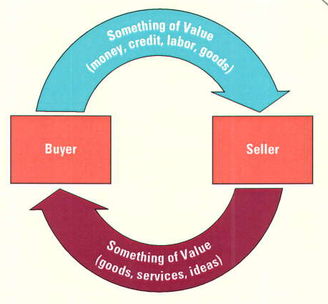
Marketing – The Exchange Relationship
The Exchange Process: Giving Up One Thing in Return for Another

Slide 8
The Importance of Marketing
Planning & execution to satisfy customer goals –
  Product development
  Product pricing
  Product promotion
  Distribution of goods, ideas, services

Slide 9
The Marketing Concept
The idea that an organization should try to satisfy customers’ needs through coordinated activities that also allow it to achieve its own goals.

Slide 10

The Marketing Concept
Marketing Goal –
Customer satisfaction
Achieve business objectives
Boost productivity
Reduce costs
Capture market share

Slide 11
Implementing the Marketing Concept
Good information re: customer wants
Consumer orientation
Coordinate organizational efforts
Customer’s perception of value = measure of success

Slide 12

The Nature of Marketing
MARKETING
The group of activities that add value and designed to expedite transactions by creating, distributing, pricing, and promoting goods, services and ideas.

Slide 13

The Nature of Marketing
Marketing is NOT –
  Manipulating consumers
  Selling & advertising
Marketing IS –
  Satisfying consumers

Slide 14
Functions of Marketing
Buying
Selling
Transporting
Storing
Grading
Financing
Marketing research
Risk taking

Slide 15
Strategy
A plan of action designed to achieve a long term or overall aim

Slide 16




Marketing Strategy
Marketing strategy – plan of action for developing, pricing, distributing and promoting products meeting the needs of specific customers.

Slide 17
Cont.
A comprehensive marketing strategy specifies the who, what, when(Occasion), where, why and how.
Target Segment: Where it does these things(geographic market)
Competitive Advantages: How the firm serves those target segments and the competition
Singularity: different from the competitions in some way that some segment of customers will value.

Slide 18
Developing a Marketing Strategy
Target Market – very specific group of consumers that a company focuses its marketing efforts

Slide 19

Developing a Marketing Strategy
Total-market approach – firm tries to appeal to everyone and assumes that all buyers have similar needs.
(e.g. Salt, sugar, agricultural products).

Slide 20

Developing a Marketing Strategy
Market segmentation – strategy to divide the total market into groups of people with relatively similar product needs.
Market segment – collection of individuals, groups or organizations sharing one or more characteristics thus having relatively similar needs and desires for products.

Slide 21
  The Goal of Strategic Marketing Management
To select reality-based desired events (e.g., goals & objectives)
To effectively develop or alter business strategies
To set priorities for operational change
To improve the organisation’s performance

Slide 22
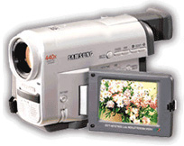




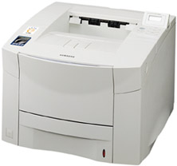




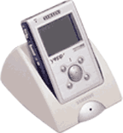


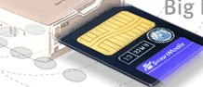




Focus: 4 Core Markets
Home Multimedia
Mobile Multimedia
Personal Multimedia
Core Components

Slide 23
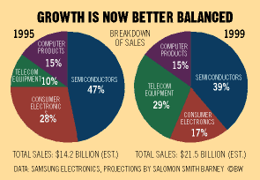
Strategy
1997 Turn around:
Cut a third of workforce, cut debt
New business proposition: profits
Streamlined inventories
Diversification

Slide 24
Strategy
Digital Vision: “A Company that leads the digital convergence revolution”
Brand power, logistics, IP:
  High-margin products
  Create value chain that integrates competencies of all areas
  Customer and market oriented
Global network by function
Performance evaluation and compensation system

Slide 25
SWOT-Analysis
Strengths (internal and positive factors) & Weaknesses (internal, negative factors)
Together Opportunities & Threats identified in the external environmental analysis

Slide 26
Opportunities (external, positive factors)
What opportunities exist in your market or the environment that you can benefit from?
Threats (external, negative factors)
Who are your existing or potential competitors?

Slide 27
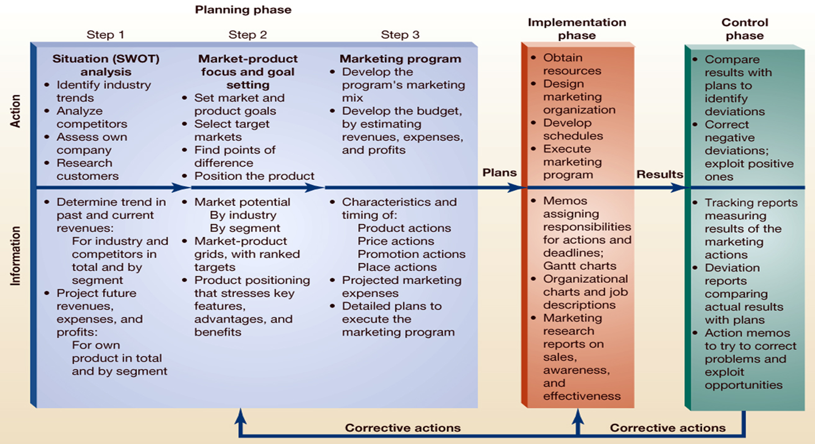
The Strategic Marketing Process
Actions and Information

Slide 28
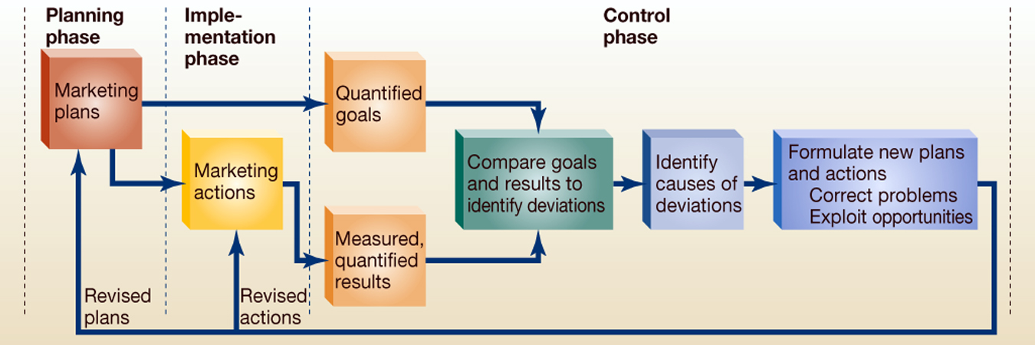
The Control Phase
of
The Strategic Marketing Process

